Slide 1
Assessing the knowledge of Kurdish consumers about the presence and health ‎impacts of arsenic in rice
Bashdar Abuzed Sadee*1,3, Yaseen Galali 1,3, Salih M. S. Zebari 2, 3, Sara Nawzad3, ‎Srwa Khalid3, and Basoz Sardar3‎
1Food Technology Department, College of Agricultural Engineering Sciences, Salahaddin ‎University-Erbil, Erbil, Iraq
‎2Animal Resources Department, College of Agricultural Engineering Sciences, ‎Salahaddin University-Erbil, Erbil, Iraq
‎3Department of Nutrition and Dietetics, Cihan University-Erbil, Erbil, Iraq

Slide 2
Objectives:
Overview of arsenic (As) in rice.
Chemistry of As
Toxicity of As and human health
Methodology
Results and Discussion
Conclusion

Slide 3
Background:
Rice is a staple food in most countries around the world including Kurdistan region of Iraq.
Relationship between As and rice?
Objectives: to assess the knowledge of Kurdish people who consume rice in their daily meal and increase their awareness about As in rice.

Slide 4
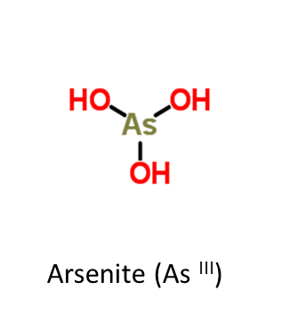
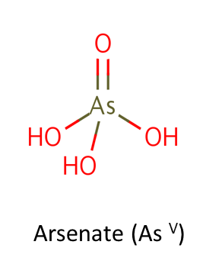
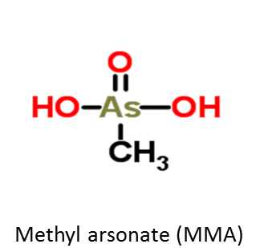
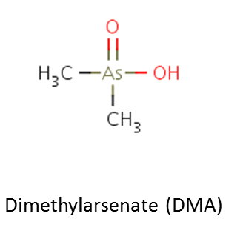
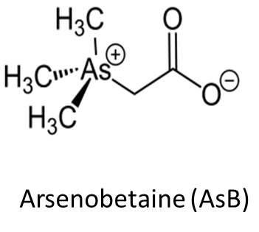
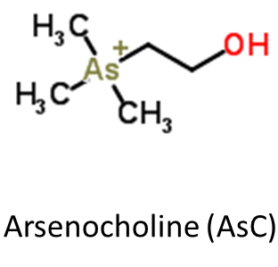
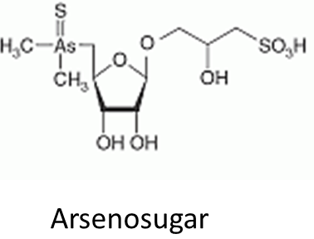
Chemistry of arsenic
Arsenic (As) is a ubiquitous element, which occurs naturally in the earth’s crust (7mg/kg).
Speciation: Different chemical forms of an element.
There are more than 300 As species exist?!

Slide 5
Lethal dose LD₅₀ values of arsenic species in rat
Arsenic species | Dose (mg/ kg body weight)
As ^{III} | 14.0
As ^{V} | 20.0
MMA | 700-1800
DMA | 700-2600
AsC | 6500
AsB | >10,000

Slide 6
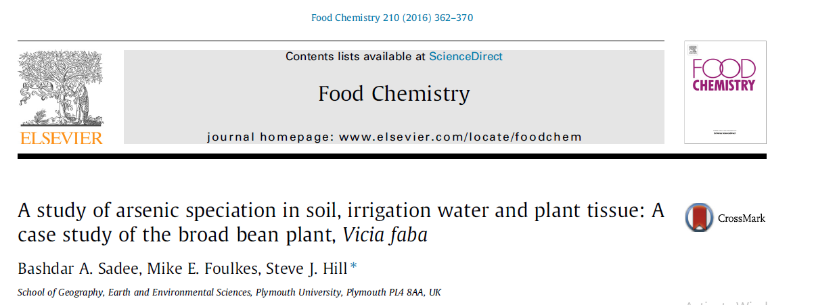
Toxicity of As
As species |  | Toxicity
Inorganic As | As ^{III} and As ^{V} | Extremely toxic , carcinogenic
Organic As | MMA and DMA | Reduced toxicity, possible cancer promoter
 | AsB | Non-toxic

Slide 7
Potential routes for arsenic into food based plants.

Slide 8
Methodology:
Characteristic of Methodology
-The survey was launched on 20/2/2023 until 26/3/2023
-The study was included selecting random people who visited the supermarkets and rice distributes in Erbil city.
-The study population was 282 people.
The Questionnaire design ‎ and data collection
Section 1: includes sociodemographic data such as (age, gender, marital status, number of family members, education level, economic level, and job)
Section 2 contained three items correlated to height, weight and physical activity.
Section 3: includes 19 questions regarding participant’s knowledge on arsenic in rice
Pilot test
Inclusion and Exclusion criteria
Ethical Consideration
Statistical Analysis of Data

Slide 9
Sociodemographic data of participants presented frequency and percentage
Characteristics |  | Frequency | %
Gender | Male | 120 | 43
 | Female | 162 | 57
Age | 18 – 25 years old | 110 | 39
 | 26 – 36 years old | 99 | 35
 | 37 – 46 years old | 56 | 20
 | Older than 46 years old | 17 | 06
Marital Status | Married | 157 | 56
 | Single | 125 | 44
Family member | 2 or less | 52 | 18
 | 3 to 5 | 126 | 45
 | 6 to 8 | 87 | 31
 | More than 9 | 17 | 06
Education level | No schooling completed | 57 | 20
 | High school | 71 | 25
 | Bachelor degree | 145 | 51
 | Doctorate degree | 09 | 03
Income level | High income | 51 | 18
 | Medium income | 215 | 76
 | Low income | 16 | 06
Employment ‎ | Student | 74 | 26
 | Employee | 148 | 52
 | Unemployed | 60 | 21
6th Annual Biogeochemistry Conference

Slide 10
Participants body weight, high and physical activity presented in frequency and (%)
Characteristics |  | Frequency | %
Weight (Kg) | < 50 | 37 | 13
 | 51 – 65 | 120 | 43
 | 66 – 90 | 109 | 39
 | More than 90 | 16 | 06
Height (cm) | Less than 160 | 69 | 24
 | 161 – 170 | 131 | 46
 | 171 – 180 | 59 | 21
 | More than 180 | 23 | 08
Physical Activity | Yes | 160 | 57
 | no | 122 | 43

Slide 11
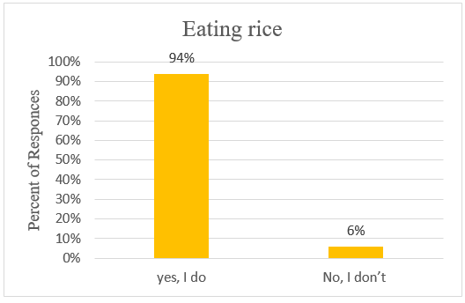
Participants responses regarding eating rice

Slide 12
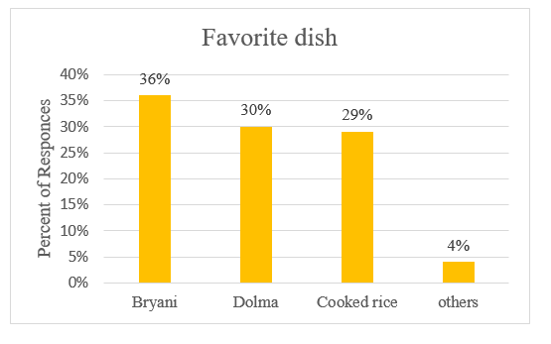
Participants Favorite Dish

Slide 13
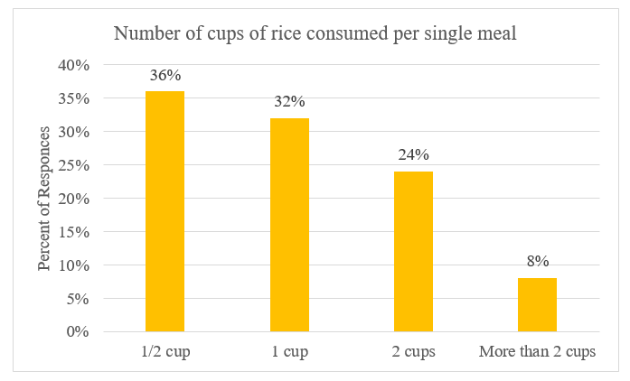
Number of rice cups that participants consumed per single meal

Slide 14
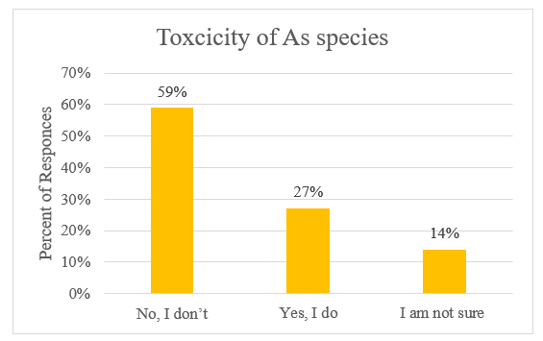
Knowledge of inorganic arsenic species generally indicates that they are more toxic than organic arsenic

Slide 15
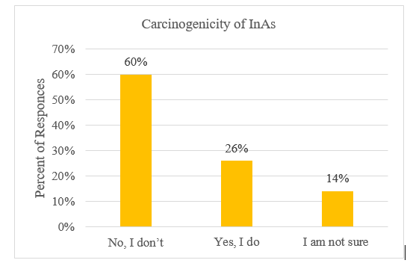
Knowing that inorganic arsenic species are classified as carcinogenic compounds

Slide 16
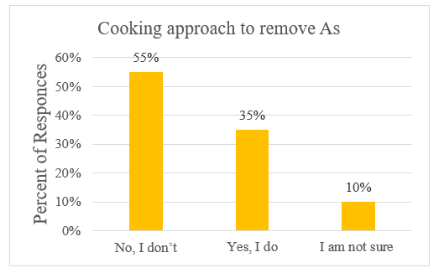
Participants knowledge that washing and cooking rice with the boiling method can help remove a partial amount of arsenic from the rice

Slide 17
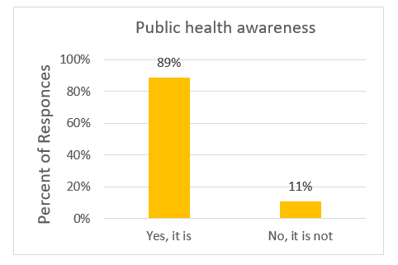
Participants responses about this study indicate that the information is helpful for public health awareness about arsenic

Slide 18
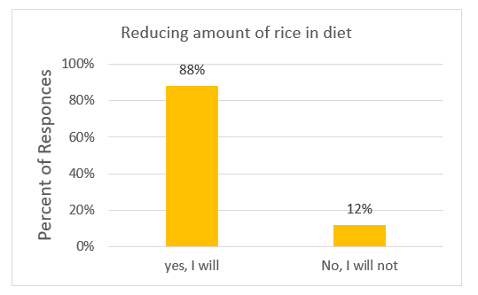
Participants beliefs about whether this information will help them to rethink about the amount of rice they consume

Slide 19
Conclusion
Based on our findings 94% of the participants consume rice ‎as a staple in their daily diet.
60% of the participants didn’t have knowledge whether inorganic arsenic As species are carcinogenic compounds
Majority (89%) of the participants thought that the information this article is helpful for public health awareness about arsenic.
Participants agreed that this newfound information ‎will prompt them to reconsider their rice consumption and have expressed their intention ‎to reduce their rice intake following the conclusion of this study. ‎

Slide 21
Guideline
The permissible level for total arsenic in drinking water is 10 µgL⁻¹ .
For food products a definitive value has not yet been implemented. However, the Food and Agriculture Organisation/World Health Organisation (FAO/WHO) recommended a provisional tolerable daily intake (PTDI) of not more than 2.1 µg inorganic As/kg body weight.

Slide 22
How to measure the amount of ingested arsenic?
Global range of arsenic content in rice is 80 -200 µg As/kg
If you consume 100 g of rice
Then the amount of ingested arsenic=20 µg As/kg
The recommended a provisional tolerable daily intake (PTDI)= 2.1 x 75
=157.5 µg As

Slide 23
Recommendation
Washing before cooking
Cooking method

