Slide 1
Schiff Base Complexes With Transition Metals
SALAHALDIN UNIVERSITY
COLLEGE OF SCINENCE
CHEMESTRY DEPARTEMENT
Prepared by:
Roqaya Qusay
Supervisor:
MSc. Bayan Attalla Faiq

Slide 2
Introduction
Hugo Schiff reported the first synthesis of imines or azomethine in 1864, introducing a new class of organic compounds. Schiff bases is organic compound derived from aromatic amines and aromatic aldehydes are a very important class of organic compounds because of their applications in many fields.

Slide 3
Preparation of ligand
1. Preparation, spectral characterization and biological applications of Schiff base ligand:
Most of the Schiff bases are easily synthesized by using simple synthetic procedures with the reaction of an amine and a carbonyl compound. In coordinate chemistry, a lot of Schiff bases can act as ligands.

Slide 4
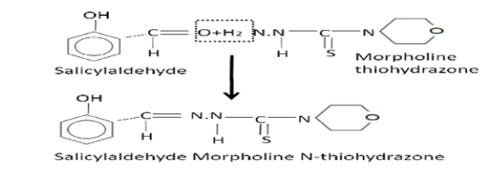
2. Synthesis and characterization of Schiff base from salicylaldehyde and thiohydrazone and its metal complexes:
The ligand salicylaldehyde & thiohydrazone was synthesized & characterized by elemental analyses & IR spectra.

Slide 5
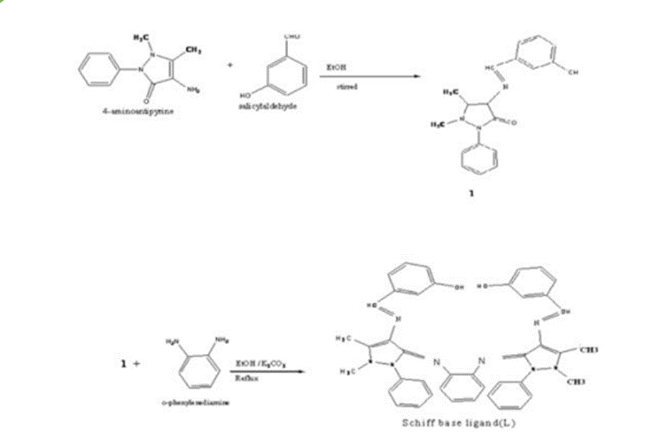
3. Synthesis and characterization of Schiff base transition metal complexes:
Many metal complexes of Cu (II); Ni (II); Co (II); Mn (II); Zn (II); VO(IV) and Cd (II) have been synthesized from the Schiff base (L) derived from 4-amino antipyrine, salicylaldehyde and O-phenylene diamine.

Slide 6
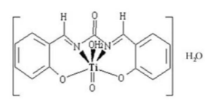
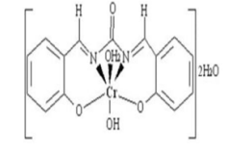
Preparation of complex
Preparation and spectroscopic investigation of a Schiff base metal complexes:
A metal complexes of Cr (III) and TiO (IV) ions with a Schiff base derived from salicylaldehyde and urea have been investigated.

Slide 7
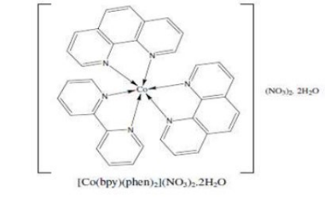
2. Synthesis and characterization of some transition metal complexes:
The complex synthesized from 1,10- phenanthroline and 2,2’-bipyridine mixed-ligand [Co(bpy)(phen)₂] (NO₃)₂.2H₂O

Slide 8
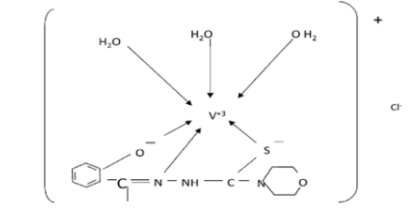
3. Synthesis and characterization of Schiff base salicylaldehyde and thiohydrazone and its metal complexes:
The ligand salicylaldehyde and thiohydrazone was synthesized &characterized by elemental analyses, IR spectra. Its metal complexes with the metals Ti (III), V (III), VO (IV), Co (II) and Mn (III) were synthesized &characterized by the determination of MP, molar conductance and magnetic susceptibilities.

Slide 9
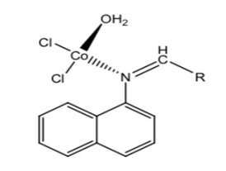
4. Synthesis of metal complexes Fe (II), Co (II), Ni (II) of monodentate Schiff bases derived from aromatic aldehyde:
synthesize the Fe (II), Co (II) and Ni (II) metal complexes of Schiff bases produced from condensation of 1-Naphthyl amine hydrochloride with benzaldehyde or naphthalene-1-carbaldehyde.

Slide 10
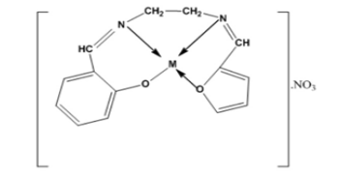
5. Cu (II) and Ni (II) complexes of Schiff base: Synthesis, characterization and antibacterial activity:
Cu (II) and Ni (II) metal ions complexes of Schiff base derived from the condensation reaction of appropriate amount of ethane-1,2-diamine, Salicylaldehyde and 2-furfuraldehyde in alcoholic medium.

Slide 11
Reference
Archana Saxena, Synthesis and characterization of Schiff base salicylaldehyde and thiohydrazone and its metal complexes , “Pelagia Research Library”, 2013, 4(4), pp.152-154.
Dr. A. Xavier and N. Srividhya, Synthesis and Study of Schiff base Ligands , “Journal of Applied Chemistry”, 7(11), (Nov. 2014), PP 06-15.
Eliot, A. C , Schiff base ,"Pyridoxalphosphateenzymes: Mechanistic, Structural, and Evolutionary Considerations". 2004 .73: 383–415.

Slide 12
Reference
F.A. Abdlseed and M.M. El-ajaily, Preparation and spectroscopic investigation of a Schiff base metal complexes “International Journal of PharmTech Research”, Vol.1, pp 1097-1103, Oct-Dec 2009.
Hanan Abd El-Latif Ibraheem, SYNTHESIS AND CHARACTERIZATION OF SCHIFF BASE TRANSITION METAL COMPLEXES “Journal of Al-Nahrain University”, 12 (4), December2009, pp.1-6.
Hayder Hameed AL-Hmedawi , Synthesis and Characterization of some Transition Metal Complexes via Schiff Bases Derived from Dithiooxamide and Selective Aldehydes, “ Scholars International Journal of Chemistry and Material Sciences”, 2013 ; 4(5), pp46-53.

Slide 13
Reference
Lena Radwan, Synthesis of Metal Complexes Fe(II), Co(II), Ni(II) of Monodentate Schiff Bases Derived from Aromatic Aldehyde , “Chemistry and Materials Research”, 8, 2016.
Musarat Farjana Yesmin, Md. Sajjad Hossain, Saiyad Nasira, Nayon Uddin, Md. Ashrafuzzaman, Md. Masuqula and Laila Arjuman Banu, Cu (II) and Ni (II) Complexes of Schiff Base: Synthesis,
Characterization and Antibacterial Activity , “International Journal of Advanced Research in Chemical Science (IJARCS)”, 7(1), 2020, PP 9-15.
Shiva Prasad Koller, M.N. Nagendra Prasad, S. Chandrashekar and Muneera Begum, Preparation, spectral characterization and biological applications of Schiff base ligand and its transition
metal complexes,“Results in Chemistry” ,1, January 2019.

