Slide 1
Salahaddin University – Erbil / College of Science
Department of Computer Science and IT
3rd Year (IT)
E-Business I Instructor: Beeza Asim Email: beeza.asim@su.edu.krd
Lecture 1
Introduction to E-business
2021 - 2022

Slide 2
Course outcomes include
E-business infrastructure.
E-business models models.
Cloud computing in e-business.
E-environment
Mobile commerce

Slide 3
Lecture outline
Definition of e-business
Old vs new economy
Benefits of e-business
Impact of e-business

Slide 4
Defining e-business (1/3)
The simple definition:
“The business of buying and selling goods and services on the internet, or a particular company that does this” – Cambridge Online dictionary.

Slide 5
Defining e-business (2/3)
The longer definition:
“E-business is the term used to describe the information systems and applications that support and drive business processes, most often using web technologies. .
E-business allows companies to link their internal and external processes more efficiently and effectively, and work more closely with suppliers and partners to better satisfy the needs and expectations of their customers, leading to improvements in overall business performance.”
– The National B2B Centre

Slide 6
Defining e-business (3/3)
When you hear the word e-business, you immediately think of a website. But is a website the only tool for a successful online business? If not, what other tools are there which make an e-business?

Slide 7
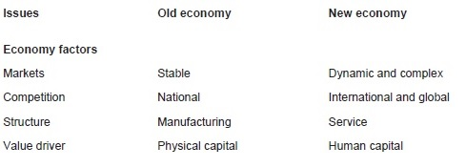
Old vs New Economy (1/3)

Slide 8
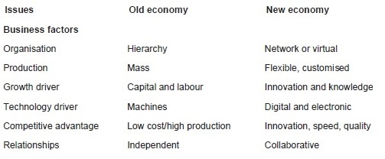
Old vs New Economy (2/3)

Slide 9
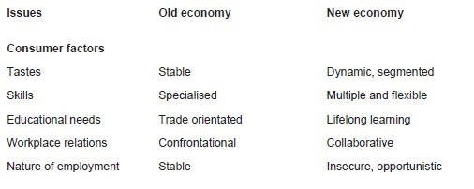
Old vs New Economy (3/3)

Slide 10
Benefits of e-business (1/3)
Cost reduction
Property costs
Personnel costs
Recruitment costs
Training costs
Marketing
Wider online presence
Better advertisement opportunities
Catching up with competition

Slide 11
Benefits of e-business (2/3)
Communication
Business not bound by geographical barriers
Better quality and faster communication with customers and other businesses.
Automatic email response
Frequently Asked Question (FAQ) sections can be very useful.
(e.g. In 2000, IBM eliminated 99 million customer calls and reduced the cost by $2 billion by using online support)
Con?

Slide 12
Benefits of e-business (3/3)
Finding online suppliers
Best prices offered by suppliers can be online. As well as finding discounts
Low start-up cost
Sometimes, small-sized businesses can be started at virtually no cost
Better tracking opportunities
Customers can easily track their orders online

Slide 13
Impact of e-business
Existing businesses adopt e-business.
At the same time, they need to consider the challenges of going digital
Like?
Change in the business-customer relationship
New marketing models
Legal issues

Slide 14
Some technologies for e-business
Social networks (e.g. Facebook, Twitter)
Blogs
Voice assistants
Chatbots
Biometrics
Example?
Rich media
Mobile commerce

Slide 15
References
Chaffey, Dave (2009): E-BUSINESS AND E-COMMERCE. STRATEGY, IMPLEMENTATION AND PRACTICEMANAGEMENT. 4th Edition. Pearson Education Limited: Essex
Combe, C. (2006): Introduction to E-business Management and strategy. Butterworth-Heinemann: Oxford
Systematix (2016): Predicted ecommerce Technology Trends in 2017. [online] available at: https://www.systematixinfotech.com/e-commerce-technology-trends-2017 [Accessed 15 September 2017]

