Slide 1
Salahaddin University – Erbil / College of Science
Department of Computer Science and IT
4th Year (IT)
Human-Computer Interaction Instructor: Beeza Asim
Email: beeza.asim@su.edu.krd
Lecture 1
Introduction to Human-Computer Interaction
2021 -2022

Slide 2
Course outcomes
The most common HCI approaches.
Methods for understanding users and how to apply them in real life.
Designing for usability and user experience.
Software usability testing and analysing data gained from user experiments.

Slide 3
Lecture outline
What is Human-Computer Interaction and why we need to study it?
HCI vs Software engineering
The history of interfaces
Interface metaphors
Human input-output channels

Slide 4
What is Human-Computer Interaction? (1/2)
A field which studies the relationship between people and computers
Emerged in the early 1980s
But the study of the relationship between humans and machines goes back much earlier than that. Examples?

Slide 5
What is Human-Computer Interaction? (2/2)
Started by incorporating areas like cognitive science and human factors into computer science
Aims to build usable software (more about that in future lectures)
A multidisciplinary field
How?

Slide 6
Why do you need to study HCI?
The emergence of “personal computing” since the late 1970s
What do we mean by “ personal computing” and “computers”?
Important to understand the users for whom you’re designing the software
This will help you deliver the right product
Increase user satisfaction and task efficiency

Slide 7
HCI vs Software Engineering
Both HCI and software engineering are concerned about designing good software. So what is the difference between the two fields?

Slide 8
The design process
Who is going to use it?
What is the person doing while using the software?
The environment in which the software is being used
Examples?

Slide 9
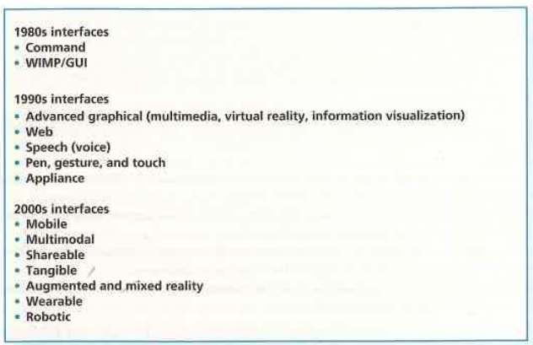
The history of Interfaces

Slide 10
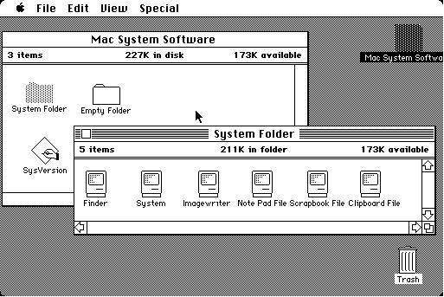
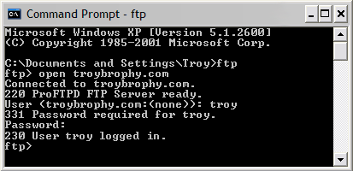
Interfaces of the 1980s
Source: http://toastytech.com/guis/bigmac1.gif
Source: http://www.textheavy.com/tutorials/ComPrompt_open.png

Slide 11
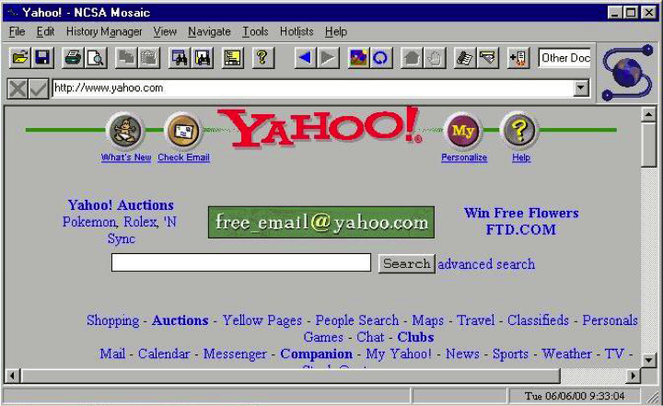
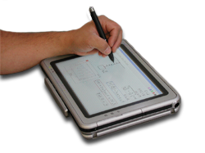
Interfaces of the 1990s
Source: http://www.computerhistory.org/timeline/images/1993_mosaic_browser_large.jpg
Source: http://www.cs.ucf.edu/courses/cap6105/fall2012/mathpad.png

Slide 12
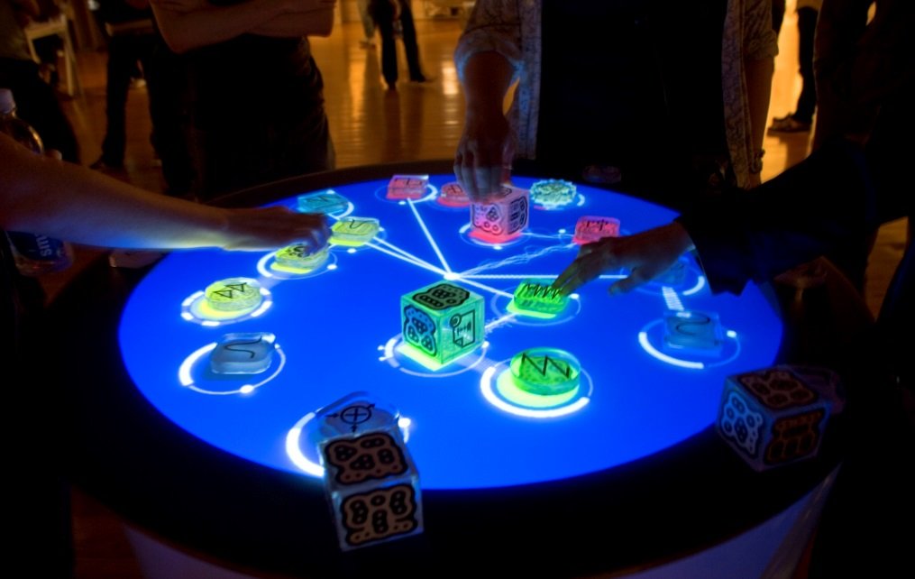
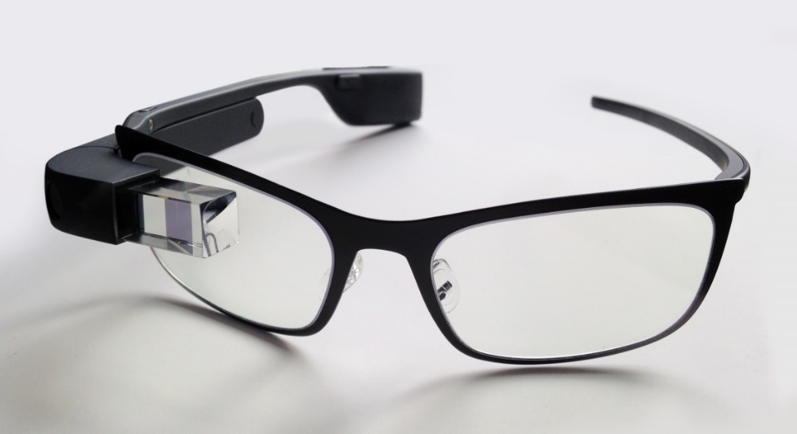
Post-2000 Interfaces
Source: http://upload.wikimedia.org/wikipedia/commons/e/e3/Reactable_Multitouch.jpg
Source: http://upload.wikimedia.org/wikipedia/commons/b/be/Google_Glass_with_frame.jpg

Slide 13
Interface Metaphors
Connecting the user interface with objects of everyday life
Examples?
Arguments against using interface metaphors
Breaking cultural rules
Too constraining
Leading to bad design choices

Slide 14
Human input-output channels
Humans interact with computers via their sensory channels
The five major senses
Sight
Hearing
Touch
Taste
Smell
The first three are the most important to the field of interaction design

Slide 15
Vision
You need to understand human vision to design an interface
E.g. the density of the text, where to place error messages, brightness and colour contrast, etc.
Humans have limited visual processing
Sizes and colours can be perceived wrongly
Visual illusions

Slide 16
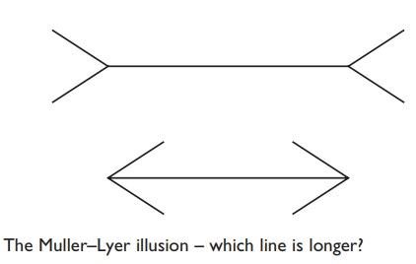
Visual Illusions

Slide 17
Hearing
Very important in interface design
Not always used to its fullest potential
Give examples of the way sound can be used in an interface

Slide 18
Touch
Becoming more and more important in interface design lately
Examples of using touch in interface design?

Slide 19
Resources
Dix, A., Finlay, J., Abowd, G. D., Beale, R. (2004): Human Computer Interaction. 3rd Edition. Pearson Education Limited: Essex.
Sharp, H., Rogers, Y., Preece, J. (2007): Interaction Design: Beyond Human-Computer Interaction. 2nd Edition. Wiley: Hoboken

