Slide 1
Salahaddin University – Erbil / College of Science
Department of Computer Science and IT
3rd Year (IT)
E-Business II Instructor: Beeza Asim Email: beeza.asim@su.edu.krd
Theoretical Lecture 1
E-business Environment
2021 - 2022

Slide 2
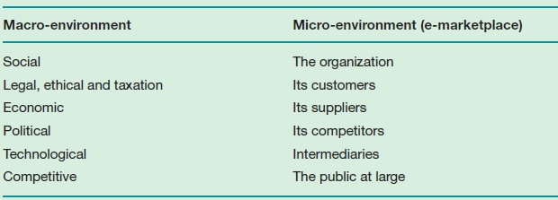
Factors of macro- and micro-environment of an organisation

Slide 3
SLEPT Factors
Macro-environment factors (SLEPT framework)
Social factors
Legal and ethical factors
Economic factors
Political factors
Technological factors
Environmental Scanning:
“The process of continuously monitoring the environment and events and responding accordingly”

Slide 4
Social Factors
Using the internet for business on the consumer’s end is determined by:
Cost of access
Value proposition
Ease of use
Security
Fear of the unknown

Slide 5
Social Factors
We need to understand consumers’ online behaviour
Web Motivation Inventory (WMI)
Research
Communication
Surfing
Shopping

Slide 6
Legal and Ethical Factors
Ethical standards: “Practice or behaviour which is morally acceptable to society”
Ethical issues include:
Privacy: “The right of individuals to avoid intrusion into their personal affairs”
Financial privacy and personal privacy
Consumer’s personal information is important to businesses. Why?

Slide 7
Legal and Ethical Factors
Personal information include:
Contact information
Profile information
Access platform usage
Behavioural information on a single site
Behavioural information on multiple sites

Slide 8
Legal and Ethical Factors
Domain name registration
Using competitor’s name in meta-data
Accessibility law
Protecting Intellectual Property (IP)
Trademark protection
Patent protection

Slide 9
Economic Factors
E-economy: “The dynamic system of interactions between a nation’s citizens, the businesses and government that capitalize upon online technology to achieve a social or economic good”
Globalisation: “The increase of international trading and shared social and cultural values.”
Localisation

Slide 10
Political Factors
Internet governance: “describes the control put in place to manage the growth of the Internet and its usage.”
Who can govern the internet?
Question: What can governments do to encourage e-business?

Slide 11
Technological Factors
Methods of adopting new technologies
Cautious approach
Risk-taking approach
Intermediate approach

Slide 12
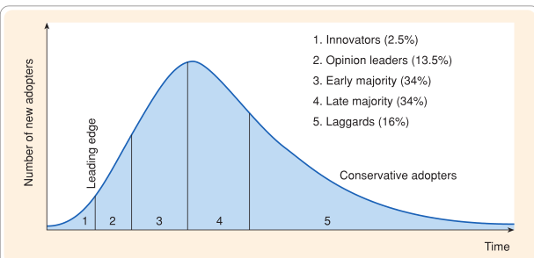
Figure: Diffusion-adoption Curve

