Slide 1
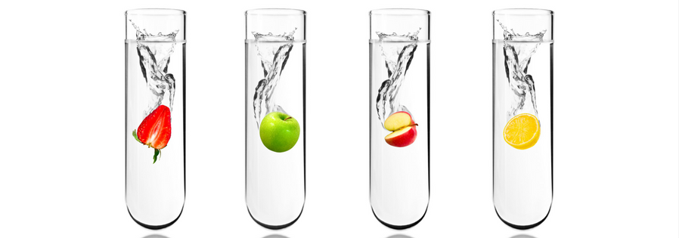
Salahaddin University-Erbil College of Agriculture Engineering Sciences Food Technology dept. Food analysis–practical

Slide 2
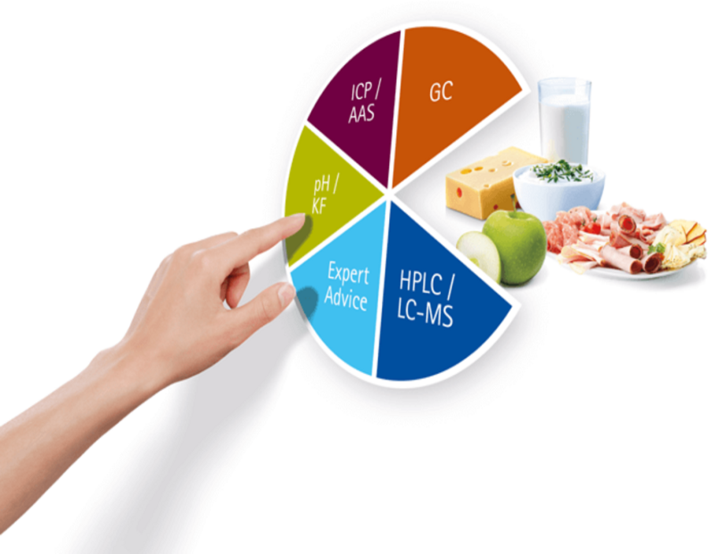
Introduction to food analysis :
Food analysis refers to the assessment of food composition using chemical biological or physical methods . It is a tool used to ascertain the quality of food. Its aim is to solve the qualitative and quantitative problems of food stuffs.

Slide 3
The analysis of food mean :
Identification ,specification and determination of components , additives and contaminates in different raw material and products .
This analytical procedures are used to provide information about a wide variety of different characteristic of food and their composition ,structure , physicochemical properties and sensory attributes.

Slide 4
There are two major types of analysis conducted on food. These include:
Qualitative food analysis
1- Sample losses can be tolerated.2-The extent by which the reaction is allowed to continue is not important
Quantitative food analysis
1-Sample losses are not acceptable. 2-The reaction must be allowed to continue until completion

Slide 5
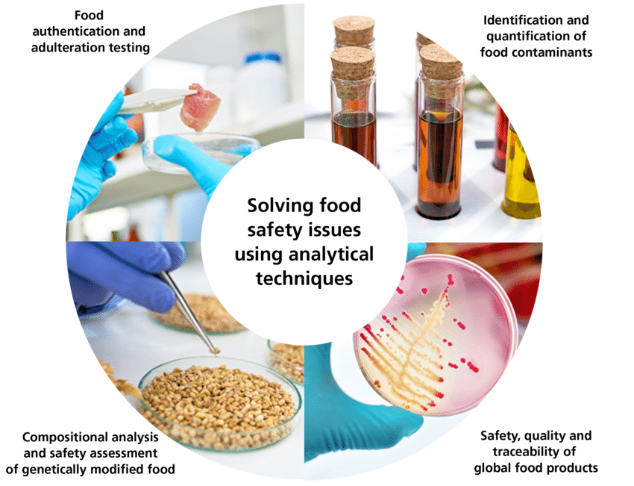
Importance of Food Analysis
Nutrition
Spoilage
Quantity
Quality
Health
Standardizations

Slide 6
Factors Considered Before Food Analysis
You must ensure that all the materials and equipment you are going to use are available
You must consider the nature of the food sample you will be dealing with (Is it organic or inorganic?)
The accuracy and precision expected. This dictates the equipment and procedure to be followed.
Whether the component of interest is major or minor.
You must always check for interferences during analysis.
Always consider the number of samples to be analyzed.
Whether separation is needed before analysis.

Slide 7
Accuracy
Accuracy refers to how close a particular measure is to the true or correct value. In the moisture analysis for hamburger, recall that we obtained a mean of 64.72%. Let us say the true moisture value was actually65.05%. By comparing these two numbers, you could probably make a guess that your results were fairly accurate because they were close to the correct value. (The calculations of accuracy will be discussed later.)

Slide 8
Precision
Precision is a measure of how reproducible or how close replicate measurements become. If repetitive testing yields similar results, then we would say that the precision of that test was good. From a true statistical view, the precision often is called error, when we are actually looking at experimental variation. So, the concepts of precision, error, and variation are closely related.

Slide 9
Accuracy and precision

Slide 10
Measures of Central Tendency
Because we are not sure which value is closest to the true value, we determine the mean (or average) using all the values obtained and report the results of the mean. The mean is designated by the symbol ¯x and calculated according to the equation below.

Slide 11
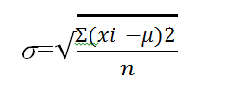
Probably the best and most commonly used statistical evaluation of the precision of analytical data is the standard deviation. The standard deviation measures the spread of the experimental values and gives a good indication of how close the values are to each other.

Slide 12
Because we do not know the value for the true mean, the equation becomes somewhat simplified so that we can use it with real data. In this case, we now call the σ term the standard deviation of the sample and designate it by SD or σ. It is determined according to the calculation in Equation [4], where ¯x replaces the true mean term μ and n represents the number of samples.

Slide 13
Determination of the Standard Deviation of Percent Moisture in Uncooked Hamburger.

Slide 14
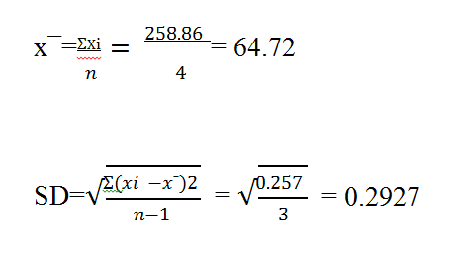

Slide 15
Determination of total solids
Remnants of protein & other solids are easily determined gravimetrically, after evaporation of water from a known weight of sample.
The solid present in egg white.

Slide 16
Method:
Weight a dry dish.
Add 2 gm of egg white.
Place the dish in an oven for 0.75 hrs.
at 100 C° .
Put the dish in desiccators to cool % weight.

Slide 17
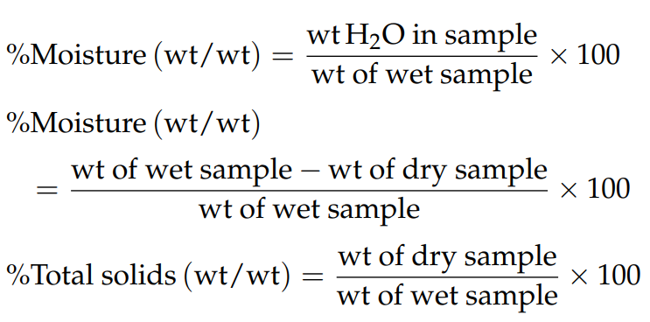
Calculation:

