Slide 1
Kurdistan Region Government
Ministry of Higher Education and Scientific Research
Salahaddin University - Erbil
Green hydrothermal synthesis of high quality ZnO-NPs utilizing milk thistle seed for biomedical applications
A Project Submitted To the Council of Physics of College of Education – Shaqlawa University of Salahaddin – Erbil in Partial Fulfilment of the Requirements of the Degree of Bachelor in Physics
BY:
Alanad Shakr Hassan- Allan Taha Hamad
Hevin Ibrahim Sabir
Supervised By:
Dr. Bestoon Anwer Hamadameen
2023

Slide 2
Introduction:
Zinc is also required for production, secretion, and signaling of insulin, which in turn affects its action on metabolism. Even though, prior to discovering the relationship between the existence of insulin and zinc, it was identified that zinc addition helps for extended action duration of insulin. Moreover, ZnO is known as effective antibacterial agent at visible light region, mainly attributed to its photochemical properties (Dutta et al.,2013). It should be noted that the recent studies have found that the antibacterial performance of ZnO could be remarkably improved when its size is reduced to nanometers. Various methods are employed for production of ZnO NPs. Globally, one of the five main reasons of death is diabetes mellitus, which is a common chronic metabolic disorder, accompanying glucose intolerance and hyperglycemia (Arvanag et al., 2019). Deficient insulin secretion is called Type 1 diabetes and the inefficient utilization of insulin by body is known as Type 2 diabetes. The uncharacteristic secretion of insulin or unusual insulin receptor or post-receptor actions in diabetes mellitus influences the metabolism concerning the kidney, liver, and the β-cells of the pancreas (Daisy et al., 2010).

Slide 3
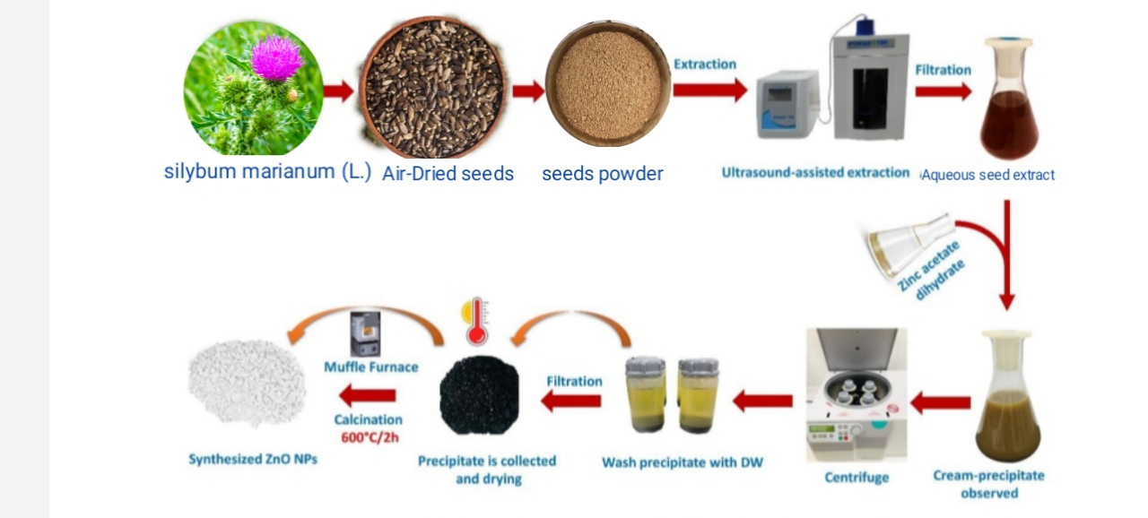
Preparation of plant extract
First, we mixed 12.5gm was added to 250ml distilled water (DW) and boiled for 1hr/at a temperature of 60°C and then we filtered it for us to have a clean structure we stayed for it and then centrifuged at 3000 rpm for 15 min end of the centrifuge, after the end of the centrifuge, we got it a purity structure.

Slide 4
Preparation ZnO NPs by hydrothermal technique
The ZnO were synthesized from milk thistle by a simple hydrothermal treatment at relatively low temperatures and through a less time-consuming process. Eighty milliliters of pulp-free milk thistle was transferred into a polytetrafluoroethylene-equipped stainless steel autoclave and is heated at a constant temperature at about 200 °C for 6 h. After the reaction, the dark brown product was obtained after natural cooling to room temperature. The deionized water was added until the volume of the brown solution increased up to one third of the solution and centrifuged at 3000 rpm for 15 min to separate the large particles. Thus, the ZnO samples can be obtained by carbonization of Curcumin, Ginger and Black pepper, which contains carbohydrates and organic acids like glucose, fructose, sucrose, ascorbic acid, citric acid, etc. as carbon precursors. Our facile hydrothermal reaction is at a lower temperature (200 °C) and takes less time (6h), compared to the reported method.

Slide 5
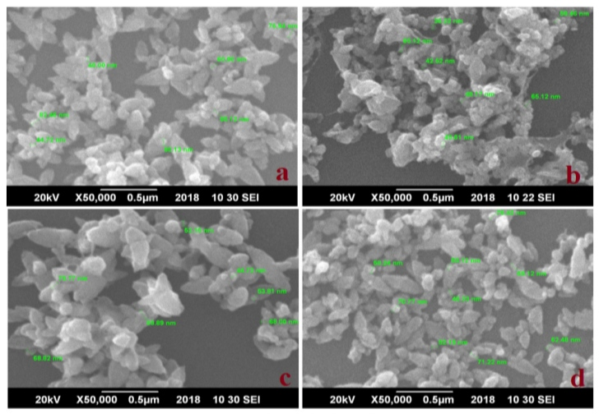
Characterization of CQDs decorated by Au NPs
SEM-EDS
Show the SEM image of the synthesized ZnO NPs, demonstrating that most of the NPs are spherical, with dispersed irregular forms and some aggregation in. Fig.3.1. Scanning Electron Microscopy Size and surface morphology of the prepared ZnO NPs were imaged through SEM analysis. Figure 3.1 displays SEM images of W-ZNPs (Figure 3.1a), P-ZNPs (Figure 3.2b), C-ZNPs (Figure 3.3c) and S-ZNPs (Figure 3.4d). Seed-like morphology was observed for W-ZNPs, C-ZNPs and S-ZNPs. In the case of P-ZNPs, small petal-like structures attached to form a Seed-shaped morphology with irregular shapes.

Slide 6
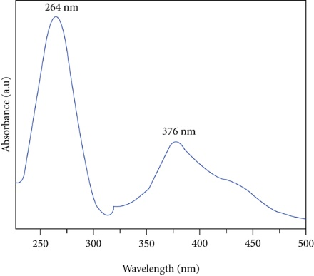
UV-VIS Analysis
The UV-Vi absorption spectrum of the aqueous The UV-vis absorbance spectrum of produced ZnO NPs at a ﬁxed heating rate of 300°C is depicted in Figure 3.2. These uptake peaks were found at 264nm and 376nm. The strong absorption peak was observed at 264nm. This indicates that a high ability to absorb ultraviolet radiation. Furthermore, synthesized nanoparticles have high absorption abilities in the region of 200-300nm and 350-450nm.

Slide 7
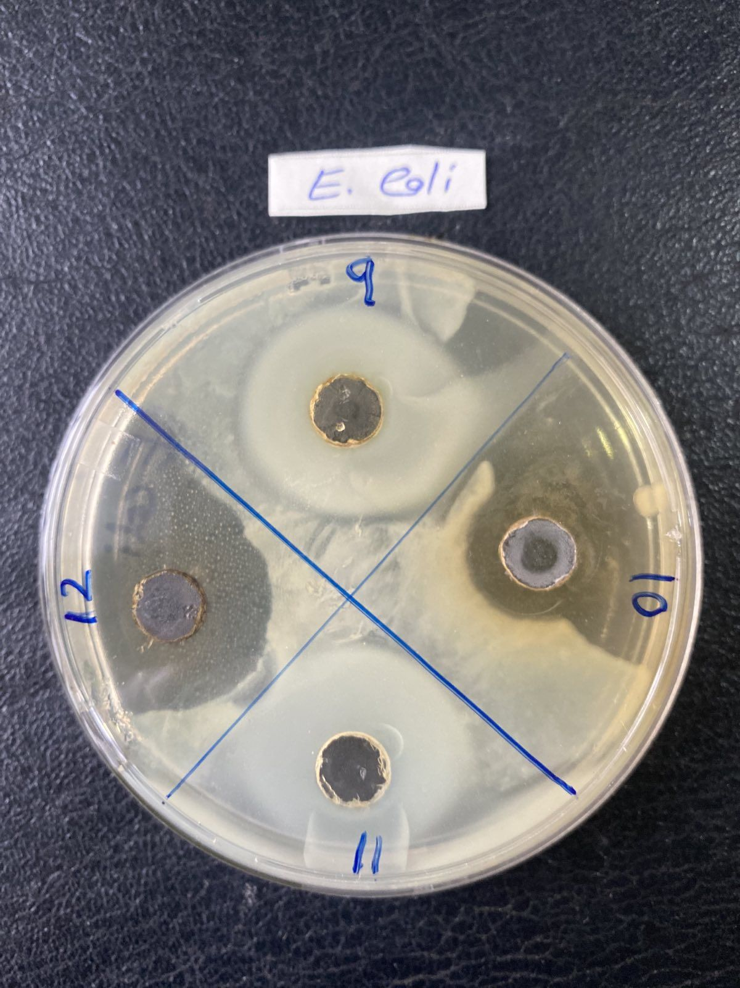
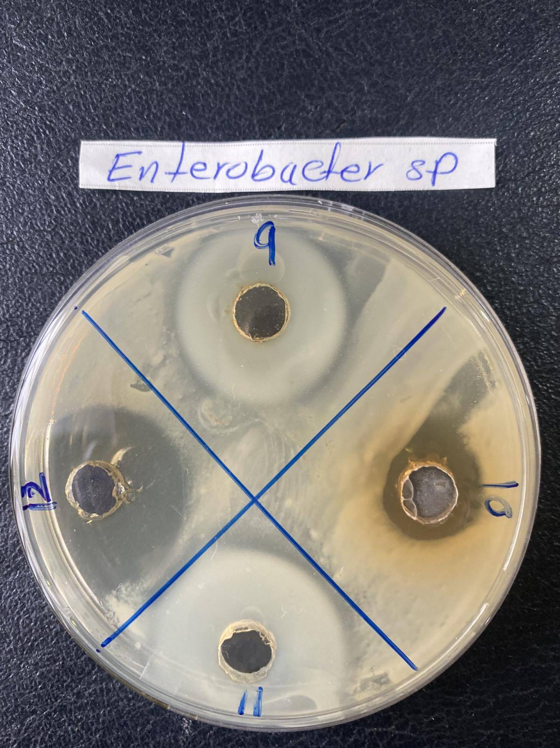
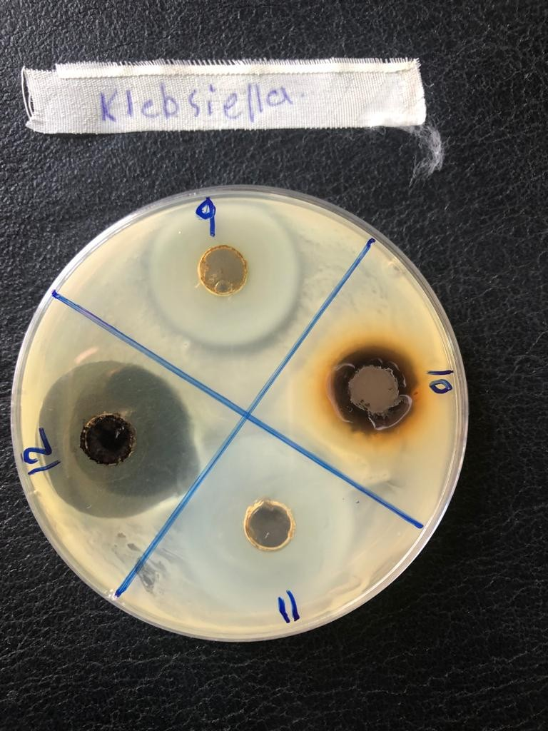
Antibacterial
The suspension of green-synthesized ZnO NPs and Milk thistle extract were investigated with respect to their activities against various Gram-positive (S. aureus and P .aeruginosa) and Gram-negative (E.coli, Klebsiella pneumonia, and P. aeruginosa) bacteria. Au NPs demonstrated moderate activity against most of the tested microorganisms, with the highest activity against the Gram-negative bacteria E. coli, K. pneumonia, and Pseudomonas spp.

Slide 8
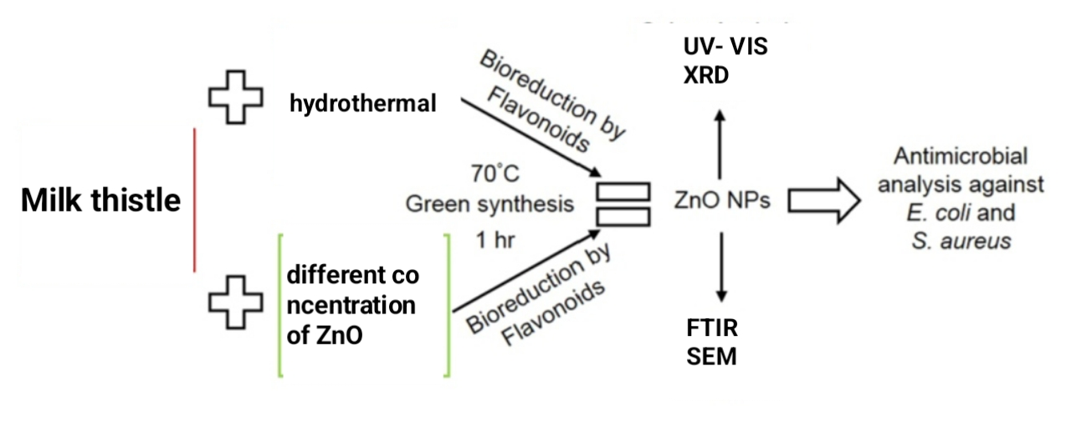
Figure 3.6 Schematic model of ZnO NPs synthesis from the seed extracts of Milk thistle and their antibacterial activity analysis.

Slide 9
Conclusions:
Overall, Diabetes is one of the most alarmed diseases worldwide, which requires great efforts to be controlled and effectively treated. Since zinc plays a pivotal role in various bio-processes including the glucose metabolism, the present study investigated the effects of the Silybum marianum L seed extract for biosynthesis of ZnO NPs on its antidiabetic and antimicrobial activities. The study on the physicochemical properties of the as-prepared samples revealed that both ZnO samples had average sizes in nano-range, being smaller for ZnO/extract sample owing to the capping action of extract. The occurrence of phytochemicals of the studied extract was verified by SEM, FT-IR and UV–vis analyses. The ZnO/extract, along with ZnO, insulin, and only extract showed antidiabetic activities when were used for treating al-loxan-induced diabetic rats. However, the effects were much influential for ZnO/extract sample in reducing the levels of FBS, TG, and TC when compared to other treatments.

Slide 10
References:
ARVANAG, F. M., BAYRAMI, A., HABIBI-YANGJEH, A., POURAN, S. R. J. M. S. & C, E. 2019. A comprehensive study on antidiabetic and antibacterial activities of ZnO nanoparticles biosynthesized using Silybum marianum L seed extract. 97, 397-405.
ASANI, S. C., UMRANI, R. D. & PAKNIKAR, K. M. J. N. 2016. In vitro studies on the pleotropic antidiabetic effects of zinc oxide nanoparticles. 11, 1671-1687.
HSU, C.-L. & CHEN, K.-C. J. T. J. O. P. C. C. 2012. Improving piezoelectric nanogenerator comprises ZnO nanowires by bending the flexible PET substrate at low vibration frequency. 116, 9351-9355.
SAJADI, S. M., NASROLLAHZADEH, M., MAHAM, M. J. J. O. C. & SCIENCE, I. 2016. Aqueous extract from seeds of Silybum marianum L. as a green material for preparation of the Cu/Fe3O4 nanoparticles: a magnetically recoverable and reusable catalyst for the reduction of nitroarenes. 469, 93-98.

