Slide 1
Salahaddin university college of education of physics
Green synthesis of cellulose nano crystal(CNC)from banana rachis for membrane filter
By:
Nasuh Asaad
Aysha Mustafa
Taran Fazl
Supervised by:Dr.Bestun Anwar Hamadamen
2023-2024

Slide 2
2
CONTENT CHAPTER I
.11. Introduction ................................................... 3
1.2. Molecular features of cellulose .......................................................................... 6
Chapter 2
.3 SEMICRYSTALLINE NATURE OF CELLULOSE ........................................... 20
2.1. Cellulose crystal structure and cellulose Polymorphs ...................................... 25
2.2. Isolation of CNC from cellulose source material ............................................. 43
2.3. Toxicology assessment and biodegradability ................................................. 52
. REFERENCES ......................................................................................................... 61
Chapter I

Slide 3
3
1.1. Introduction
Cellulose is the major component of the plant biomass. Since it is made by all true plants (Kingdom Plantae), from the current point of view, cellulose is considered the
most abundant naturally occurring organic compound on Earth. Cellulose metabolism is
an important part of the biosphere’s carbon cycle. This carbohydrate is found primarily
in plant cell walls, where its main function is to provide structural support and protection to the cells. It can be also found in several other types of organisms such as bacteria, fungi, animal tunicates and even amoeba, although the content of cellulose in these species is negligible when compared with plants (Chen, 2014; Dufresne, 2012). Cellulose is continually produced by different living species every day in the biosphere, providing a total annual production around 1.5·10¹² tons (Klemm et al., 2005). Thereby, cellulose is a renewable (naturally replenished) resource widely available all over the world. Further, it is biodegradable, returning to the natural carbon cycle by simple rotting, and non-toxic to living organisms, including humans.
Cellulose has always played an important role in the life of man, from prehistoric
to present time, and its applications could even represent a landmark in the understanding of human evolution. Natural cellulose-based materials, such as wood, have been utilized to many purposes for thousands of years, e.g., as source of heat for warming, cooking and industrial production; as engineering materials for buildings, bridges, ships, furniture, utensils etc. In its almost pure form, such as cotton and flax fibers, cellulose has also been used since a long time ago, as clothing and writing material going back to the time of Egyptian pharaohs (Kamide, 2005; Pérez & Mazeau, 2004). The first industrial scale product based on cellulose was created from nitrocellulose and camphor by the Hyatt Manufacturing Company in 1870, corresponding to the first thermoplastic polymer material under the trade name of celluloid (Klemm et al., 2005).
Currently, cellulose has a great economic importance, because it is used as feedstock in numerous industries and gives rise to a broad spectrum of products and materials, ranging from packaging to biomedical field. The paper and cardboard industries are the largest consumers of cellulose. Only a small amount of cellulose used is used to produce textile fibers, films and a larger number of cellulose derivatives, such as cellulose ethers and esters (Dufresne, 2012; Klemm et al., 2005; Moon et al., 2011; Varshney & Naithani, 2011). For instance, carboxymethylcellulose is a cellulose derivative utilized in foodstuffs, pharmaceuticals, cosmetics, detergents, paints, coatings, adhesives and plastics etc.
Chapter I

Slide 4
4
Although cellulose can be derived from a broad variety of sources (such as: cotton, jute, flax, ramie, sisal, bagasse, bamboo etc), wood is presently the most important raw material for commercial production of cellulose (Siró & Plackett, 2010).
When it comes to sustainable raw materials for future demands on energy, chemicals and materials, cellulose definitely has great importance on account of its abundance and renewability, but still today is underutilized. For this reason, intensive research efforts have been devoted to seeking efficient processing technologies for conversion of this biomass into multiple value-added bioproducts. Therefore, cellulose is a promising versatile resource with potential to decrease the dependence on pretroleum- based products and at the same time attends the increasing need for environmentally friendly, biocompatible products and carbon-neutral (Cherubini, 2010; Olsson & Westman, 2013). Nevertheless, numerous technical challenges must be overcome to enable the efficient and profitable utilization of cellulose for the production of energy, chemicals and materials.
Cellulose has been used for centuries in highly diverse applications, however its
chemical composition, structure and morphology remained very long ignored. Though the early work of Braconnot concerning the acid hydrolysis of the substance constituting plant cell walls goes back to the beginning of the 19th century (Braconnot, 1819), it was the French chemist Anselme Payen (1795–1871) who established that the main constituent of all plant cells has a unique chemical structure (Payen, 1838) and coined the word “cellulose” (Latin: rich in small cells) for the first time in 1838. In his studies, Payen described that when various plant tissues were treated with acid-ammonia treatment, followed by subsequent extraction in water, alcohol and ether a constant fibrous material
was formed. He deduced the molecular formula to be C6H10O5 by elemental analysis, and observed the isomerism with starch (Klemm et al., 2005; Pérez & Mazeau 2004).
It is only later, due to the pioneering works of the German chemist Hermann Staudinger (1881-1965) at the beginning of the 20th century that the macromolecular nature of cellulose was recognized. Through acetylation and deacetylation of cellulose, he suggested that its structure does not merely consist of an aggregation of D-glucose units. Rather, the glucose units were found to be linked to each other covalently to form long molecular chains. This, along with Staudinger’s research with other chain molecules (e.g. natural rubber), marked the discovery of the polymeric state of molecules and
Chapter I

Slide 5
5
represents the origin of polymer science. Staudinger's research on macromolecules was acknowledged by the award of the Nobel Prize in Chemistry in 1953 (Klemm et al., 2005; Mülhaupt, 2004; Pérez & Mazeau 2004; Staudinger, 1920, 1926).
Despite the degree to which cellulose has been investigated, its molecular structural features have not been identified with absolute clarity and new information appeared in the literature constantly by employing technological advances alongside conventional analytical tools. Thus, the progress of knowledge on cellulose is closely linked to the evolution of characterization techniques, such as X-ray diffraction, neutron scattering, electron microscopy, ¹³C solid state nuclear magnetic resonance etc (Dufresne, 2012; O’Sullivan, 1997). Several reviews and books have already been published reporting the state of knowledge of this fascinating polymer (Fengel & Wegener 1989; Gardner & Blackwell, 1974; Habibi et al., 2010; Hon, 1994; Kamide, 2005; Klemm et al., 2005; Kovalenko, 2010; O’Sullivan, 1997).
Cellulose displays unusual physical and chemical properties arising from its structural architecture, such as:
Highly hydrophilic nature. However, it is insoluble in water and in most conventional organic solvents. Even such a short oligosaccharide as celloheptose is virtually insoluble. This does not mean that cellulose interacts poorly with water - a cellulose surface is very hydrophilic, e.g. cotton fibers can absorb 10 times its own weight of water (Monica et al., 2009).
Good thermal stability. But it decomposes prior to the onset of melting, i.e. it is a non-thermoplastic material.
Resistant to chemicals attack. Cellulose is relatively resistant to chemical derivatization, and added groups are seldom evenly distributed. Nevertheless, there is a large industry based on derivatization of cellulose, as previously mentioned.
Good mechanical properties. Cellulose form fibers with high tensile strength and stiffness, which makes the cellulose fibers useful e.g. as reinforcing element in polymeric composites.
Low density and thermal conductivity. Etc.
Therefore, in order to understand properly the macroscopic properties of cellulose it is essential to acquire knowledge of its structural architecture from the atomic scale, all the way up to the macro scale. In that case, the cellulose biosynthesis, its supramolecular
Chapter I

Slide 6
6
structures and hierarchical organization inside the cell wall must be considered. Besides this, it is important to examine how interactions at and between the various levels of structure have important and often quite specific influences.
1.2. Molecular features of cellulose
Cellulose is a semicrystalline long chain linear homopolymer, consisting of β-D- glucopyranose (glucose) molecules covalently linked through acetal functions formed by
β-(1,4)-glycosidic bonds (Figure 1), i.e. β-type glycosidic bond between the hemiacetal group of anomeric carbon atom C1 of one D-glucose and the hydroxyl group at C4 of the
adjacent molecule. This glycosidic bond has a strength on the order of ~360 kJ/mol. Since a molecule of water is lost when an alcohol and a hemiacetal react to form an acetal
linkage, each glucose molecule in cellulose is referred to as anhydroglucose unit (AGU). The AGUs are joined to one another in head-to-tail orientation and the C–O–C angle
between two AGU rings is ~116°. To accommodate the preferred bond angles of this acetal oxygen bridges formed by β 1→4 links, each AGU ring is rotated 180° in the plane
with respect to its neighbor. In this manner, two adjacent AGU rings define the repeating structural unit of cellulose polymer, known as cellobiose. However, the chain length of
cellulose is expressed in the number of constituent AGUs (degree of polymerization, DP),
and hence, the chemical formula of cellulose is (C6H10O5)n.
Figure 1 – Structure of cellulose molecule, representing the cellubiose unit as the repeating structural unit having a periodicity of ~1.03 nm and showing the quite different terminal groups non-reducing end (left) and reducing end (right). The numbering system for carbon atoms in anhydroglucose unit is also indicated in red; and the directionality of the 1→4 linkage is indicated by the blue arrow.
Taking the cellobiose as the basic unit, cellulose can be considered as an isotactic polymer of cellobiose. Each of the AGU ring contains three hydroxyl groups. The hydroxyl group at the C6 position is a primary alcohol, while the hydroxyl groups at the C2 and C3 positions are secondary alcohols. These hydroxyl groups are all accessible
Chapter I

Slide 7
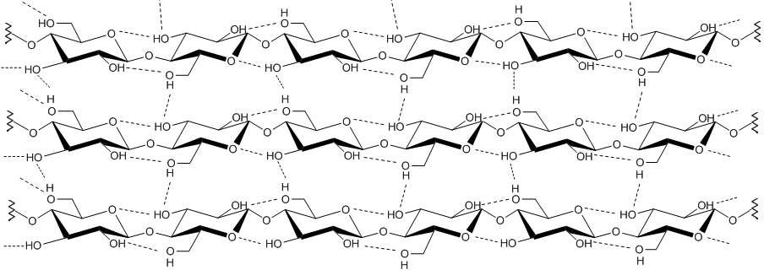
7
sites for chemical reactions. Unlike simple alcohols, however, the reactivity of these hydroxyl groups are usually controlled more by steric factors and molecular interactions than would be expected on the basis of the inherent reactivity of the different hydroxyl groups. The cellulose molecule has a directional chemical asymmetry with respect to the termini of its chain axis: one end is a hemiacetal which is in equilibrium with the aldehyde structure (i.e. the reducing end); and the other end has a pendant hydroxyl group, the nominal non-reducing end (Dufresne, 2012; Habibi et al., 2010; Klemm et al., 2005; Pérez & Mazeau 2004).
The β configuration allows cellulose to form long, straight, “fully extended”
chains, i.e. molecular chains are stretched out in a straight line, in the opposite to the 1→4 glucan of α -anomers, amylose, which is hexicalled shaped. All β-D-glucopyranose rings
adopt a ⁴C1 chair conformation, the lowest free energy conformation of the molecule, in which, the glycosidic bonds and the ring substituents are all positioned in the ring plane (equatorial), while the hydrogen atoms are in the vertical position (axial) (Kovalenko, 2010; Pérez & Mazeau 2004; Varshney & Naithani, 2011). This way, as represented in Figure 2, the cellulose molecule takes the form of a flat ribbon with hydroxyl groups protruding laterally along the extended chain and, as a consequence, these hydroxyl groups are readily available for hydrogen bonding, either within the same cellulose chain (intramolecular) or between different chains (intermolecular).
Figure 2 – Schematic drawing of the intra- and intermolecular hydrogen bonding network in cellulose. It is important pointing out that the detailed features of hydrogen-bond pattern is still an ongoing subject for discussion.
The presence of intramolecular hydrogen bonds is of high relevance with regard to single-chain conformation of cellulose, since they hinder the free rotation of the rings along their linking glycoside bonds resulting in the stiffening of the cellulose chain. These
Chapter I

Slide 8
8
intramolecular hydrogen bonds between adjacent AGU rings stabilize the glycosidic linkage insomuch that the rigidity and the linear integrity of the polymer chain are enhanced. The intermolecular hydrogen bonds, in turn, are thought to be mostly responsible to interchain cohesion, and thus, also to the aggregation state of cellulose (from sheet-like to fibrillar aggregates), also known as supramolecular structure (Djahedi et al., 2016; Dufresne, 2012; Habibi et al., 2010; Varshney & Naithani, 2011).
Therefore, this very complex and strong hydrogen bonding network present in
cellulose is extremely important for the particular characteristics of cellulose, such as reactivity, solubility, thermal stability and mechanical properties. For instance, it affects:
(i) the reactivity of the hydroxyl groups, particularly of the C3 hydroxyl group, which hydrogen binds strongly to the endocyclic oxygen of the adjoining AGU unit in the same chain; (ii) the solubility, a priori, the high number of hydroxyl groups in a molecule should lead to a large solubility in water, but cellulose is insoluble in water and in most conventional solvents, since to solubilize it the solvent-solute attraction must be stronger than the high intermolecular attractive forces which hold the cellulose molecules together;
(iii) the thermal stability, since high energy in the form of heat is required to overcome the high cohesive energy between the cellulose molecules, it explains why cellulose does not possess a liquid state (it decomposes prior to the onset of melting), this means that the total bonding force between the cellulose molecules is stronger than their covalent intramolecular bonds; (iv) mechanical properties, the intra and inter-chain hydrogen bonding system imparts to cellulose fibrils a relatively high axial stiffness and good strength.
Another important feature arising from the flat ribbon-like shape of cellulose
molecule and the positioning of its hydroxyl groups and hydrogen atoms in the pyranose ring (OH groups are equatorial, while the H atoms are oriented axially to the ring plane) is the formation of sites with markedly distinct polarities: the hydrophilic sites parallel to the ring plane and the hydrophobic sites perpendicular to the ring (Jarvis, 2003; Li & Renneckar 2011; Medronho & Lindman, 2014; Yamane et al., 2006). This feature is depicted in Figure 3, and is expected to considerably influence both the microscopic (e.g. interactions) and macroscopic properties (e.g. solubility) of cellulose.
Chapter I

Slide 9
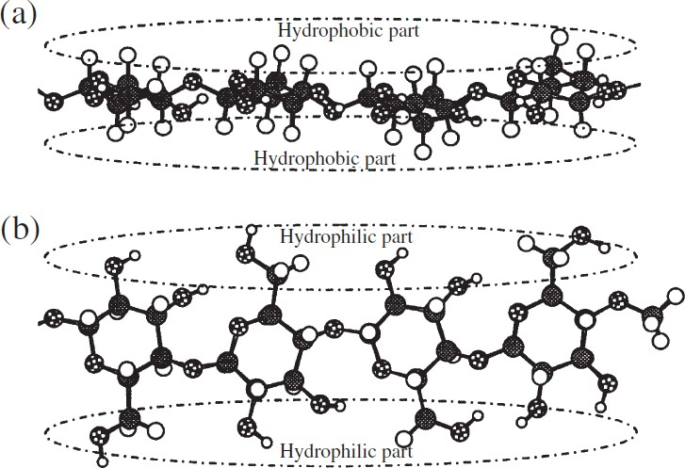
9
Figure 3 – Hydrophilic and hydrophobic parts of cellulose molecule. (a) Hydrophobic sites of cellulose molecule in side view of glucopyranose ring plane showing the hydrogen atoms of C–H bonds on the axial positions of the rings, (b) hydrophilic sites of cellulose molecule in top view of glucopyranose ring plane showing the hydroxyl groups located on the equatorial positions of the rings (Yamane et al., 2006).
The rotational conformation of the hydroxymethyl group can be altered, as shown in Figure 4, and this will have a profound impact on the hydrogen bonding pattern (Nishiyama et al., 2002). There are three possible low energy orientations for this substituent to the pyranose ring, defined by two letters (gt, gg and tg) referring to the trans and gauche states of the dihedral angles O6–C6–C5–O5 and O6–C6–C5–C4, respectively. For example, if O6–C6 is gauche to C5–O5 and trans to C5–C4, then the conformation is called gt. The reason for the difference in stability between these three staggered conformers is the relative proximity of the oxygen and carbon substituents (Habibi et al., 2010; O’Sullivan, 1997).
Figure 4 – The three most probable rotational positions of the hydroxymethyl group defined by ascertaining the placement of the O6-C6 bond with respect to the C5-O5 and C5-C4 bonds. In this figure g and t are abbreviations of gauche (60°) and trans (180°), respectively, indicating qualitatively the value of a dihedral angle (Habibi et al., 2010).
Chapter I

Slide 10
10
Degree of polymerization of cellulose
The size of the cellulose molecule, indicated by the degree of polymerization (DP) or molecular weight (MW), has a great influence on the mechanical, solution, biological,
and physiological properties of cellulose. It is believed that a β (1→4) linked glucan with DP around 20–30 can offer all properties of cellulose (Dufresne, 2012; Klemm et al.,
2005; Kobayashi et al., 2001). Values of DP ranging from hundreds and several tens of thousands have been reported. The DP is heavily dependent on the source of the original
cellulose (e.g., 10 000 in native wood, 15 000 in cotton, 44 000 in Valonia), and in less degree on the isolation and purification methods (e.g., 250 – 500 in regenerated cellulose
and 1000 in bleached kraft pulp). The combination of procedures required to isolate and purify cellulose inevitably causes some degradation during analysis resulting in chains
scission. The values of DP obtained are therefore minimal and depend on the method used to determine it. For the same reasons, the distribution of chain lengths of cellulose is not
well established. Nonetheless, some authors suggest that the molecular mass distribution must be homogeneous for cellulose of a given source (Dufresne, 2012; Fengel & Wegener
1989; Habibi et al., 2010; Klemm et al., 2005; Varshney & Naithani, 2011).
In its commonly used form, isolated cellulose is always a polydisperse polymer,
viz., like nearly all polymers it is a mixture of molecules that have the same basic composition but differ in the chain length. Thereby, the molecular mass and the DP of cellulose can only be considered as average values. Since celulose often has a high DP, the fibrils are quite long. For example, given a glucose unit as 0.515 nm long, for DP value of 10 000, the cellulose molecules may have average length around 5 μm by considering stretched chains.
Cellulose biosynthesis and cellulose microfibril formation
In nature, cellulose does not occur as an isolated molecule, but it is found as assemblies of individual chains forming a fiber-like structure. This is because cellulose is
polymerized as individual molecules, which undergo spinning and crystallization in a hierarchical order at the site of biosynthesis resulting in fibrillar supramolecular structures (Habibi et al., 2010). That way, the biosynthesis of cellulose can be described as a
complex sequential multistep phenomenon, involving coupled processes (i) the enzymatic polymerization of individual β-(1,4)-D-glucopyranose chains from glucose monomers,
and (ii) the assemble of these glucan chains, through spinning and crystallization, to form fibrillar supramolecular structures (Dufresne, 2012).
Chapter I

Slide 11
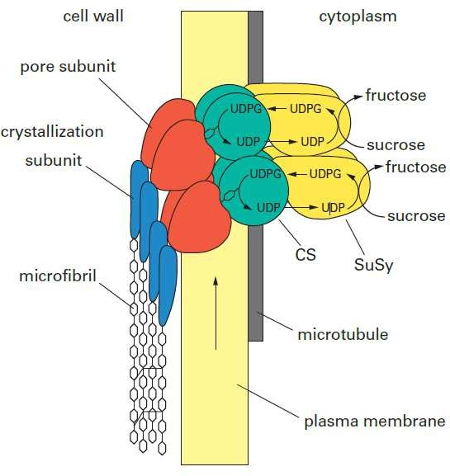
11
Cellulose biosynthesis process takes place at plasma membrane-bound enzyme system in the cell wall, known as cellulose synthase complexes (CSCs). The CSCs have functional specialization roles in gene expression, regulation and catalytic functions (Festucci-buselli et al., 2007). The model proposed by Delmer and Amor (Delmer & Amor, 1995) represents the CSC through the cytoplasmic membrane within the plant cell (Figure 5). This hypothetical model describes the growth of glycosidic chains and the catalytic role of the main enzymes. According to this model, the polymerization of glucose is provided by an enzyme system whose main family is named cellulose synthase (CS), which cannot function without the presence of another class of enzymes called sucrose synthase (SUSY). SUSY hydrolyzes sucrose to fructose by creating a UDP- glucose (uridine diphosphate-glucose) unit and it is within the CS that the UDP-glucose unit initiates the polymerization process by loss of the UDP (uridine diphosphate) unit and dimerization of glucose. Afther that, the growing chains are secreted via a pore (CSC subunit) and the crystallization event is brought about by a protein, the top subunit, which should facilitate alignment of the chains to promote precise crystallization into metastable cellulose I.
Figure 5 – The Hypothetical Model of a Cellulose Synthase Complex in the Plasma Membrane (Delmer & Amor, 1995). A microfibril is synthesized via a multisubunit complex, with one unit of the complex responsible for the polymerization, secretion, and alignment of each glucan chain. For simplicity, the number of such units shown here in the complex and the number of chains formed are less than that expected in nature. This model should be considered purely speculative and is a composite derived from studies done with a variety of organisms, including bacteria, algae, and higher plants.
Chapter I

Slide 12
12
CSCs are often called the terminal complexes (TCs), due to their association with one end of microfibrils (collections of celulose chains) (Li et al., 2014; O’Sullivan, 1997). By microdiffraction investigation of nascent bacterial cellulose microfibrils Koyama et al. (1997) showed that the reducing end of the growing cellulose chains points away from the bacterium, providing evidence that polymerization takes place at the non-reducing end of the growing cellulose chains. Thus the non-reducing end is tightly associated with the catalytic region of TCs. TCs are made up of many identical subunits organized into specific geometrical arrangement, in which each subunit contains multiple catalytic sites for glucan chain polymerization (Moon et al., 2011). Although significant progress has been made in understanding the structure and regulation of CSCs, many fundamental aspects remain to be addressed (Li et al., 2014).
Multiple glucan chains are processively polymerized by the TCs and immediately assemble to form the supramolecular structures with parallel arrangement of glucan chains. This requires that the newly synthesized glucan chains (i.e. the growing chains within the TCs) align in a parallel way to each other and pack into a specific crystalline arrangement (cellulose I), otherwise they would fold into the more thermodynamically stable cellulose II or simply exist as non-crystalline cellulose. Hence, although polymerization and crystallization are separate events, it is believed that crystallization follows very closely the polymerization in a way that allows the enzyme complex to govern the crystalline form of the microfibril (Li et al., 2014; O’Sullivan, 1997; Saxena & Brown, 2005).
Cousins & Brown (1995) have proposed a general four-stage model to describe the microfibril formation from glucose monomers (Figure 6). The first stage is the enzymatic polymerization of glucan chains from glucose monomers (Figure 6, step 1). Just after the extrusion of the glucan chains from the enzyme’s catalytic site in TCs subunit, the second stage consists in the self-assembly of the chains via van der Waals forces which act perperdicularly to the main planes of the glucopyranose rings to produce a ‘‘minisheet’’ of cellulose chains parallely stacked (Figure 6, step 2). In the next step, as the “minisheets” pass from the interior of the enzyme complex subunit to the true exterior of the cell, these cellulose “minisheets” are held together side-by-side through hydrogen bonds to form elementary fibrils, also known as nanofibrils, where highly ordered regions (the crystallites) alternate with less organized ones (amorphous regions) (Figure 6, step 3). In the last stage the elementary fibrils from different TC subunits join together into
Chapter I

Slide 13
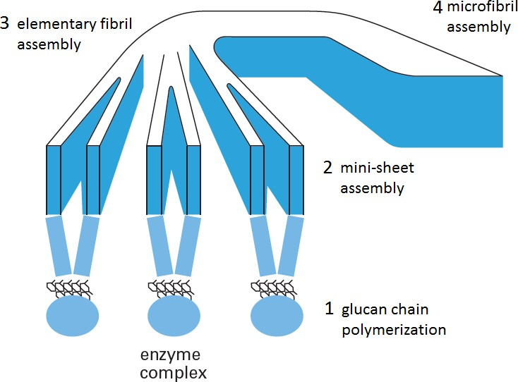
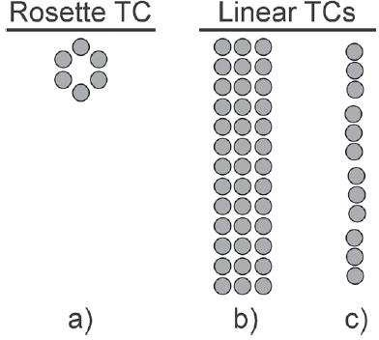
13
either micro or macrofibrils (Figure 6, step 4), depending on the organism (Dufresne, 2012; Moon et al. 2011; Cousins & Brown, 1995; Saxena & Brown, 2005).
Figure 6 – A general proposed model for the stages of microfibril formation during celulose biosynthesis:
(1) glucose monomers are polymerized enzymatically from catalytic sites in the enzyme complex subunits to form glucan chains; (2) the glucan chains associate via van der Waals forces to form mini-sheets; (3) minisheets associate and hydrogen bond to form elementary fibrils; (4) several minicrystals then associate
to form a microfibril. Figure adapted from Cousins & Brown (1995).
The geometrical configuration and the number of catalytic sites of the subunits within the TC, both of which vary between organisms (Figure 7), dictate the aggregation process, and thus the resulting supramolecular cellulose structure.
Figure 7 – Schematics of rosette and linear TCs, for (a) wood (6 chains/subunit), (b) green algae (Valonia) (10–12 chains/subunit), and (c) bacterial (Acetobacter) (16 chains/subunit). Each dark circle represents a single subunit. Adapted from Moon et al. (2011).
Chapter I

Slide 14
14
So, the cellulose biosynthesis is highly specific to the organism producing the cellulose. For example, in trees and plants the TC is proposed to be organized of 6 identical subunits in hexagonal symmetry, known as rosette structure, with each subunit composed of 6 catalytic sites for cellulose chain polymerization, so each TC subunit produces a linear “minisheet” of 6 cellulose chains. From a single TC, the assembly of 6 “minisheets” results in cellulose elementary fibril with 36 cellulose chains, a square cross- section ~3–5 nm in size and contains both crystalline and amorphous regions (Moon et al. 2011). These elementary fibrils or nanofibrils are guessed to be the basic building block of cellulose. Then multiple elementary fibrils are brought together into larger units called microfibrils with a diameter of ~20-30 nm and length of several micrometers (many times larger than the cross-section).
Figure 8 shows schematically these different stages of the formation of a wood microfibril. In wood, there are non-cellulosic constituents that are in close contact with cellulose in cell wall and they are thought to be involved in the bundling of cellulose microfibrils (Figure 8). Unlike cellulose, neither of these non-cellulosic constituents is manufactured directly in the cell wall, but both follow the more traditional intracellular synthesis followed by secretion. So, the inter-fibril space within a microfibril (viz. the space between the elementary fibrils or bundles of elementary fibrils within a microfibril) is filled with different proportions and kind of hemicelluloses, while the microfibril is wrapped with lignin. Thus, microfibril is essentially a natural composite material consisting of elementary fibrils embedded in a matrix of other cell wall compounds, mostly hemicelluloses and lignin (Chen, 2014; Ding et al., 2014; Nishiyama, 2009).
It is worth mentioning that each microfibril in wood may contain multiple
elementary fibrils, plus variable amounts and kinds of non-cellulosic matrix; hence the microfibrils can appear dramatically different in size and composition according to: cell wall, cell type, celulose-producing specie, state of cell differentiation of the plant etc.
Owing to this inhomogeneous nature, the small size (which represent a real
challenge to the limited resolution of the characterization techniques used), the close relationship with other cell wall constituents and the tendency to tightly associate with each other in the cell wall the exact features of wood microfibril are still poorly understood (or has not been up to now fully elucidated), though wood represents the largest source of celulose (Ding et al., 2014; Nishiyama 2009).
Chapter I

Slide 15
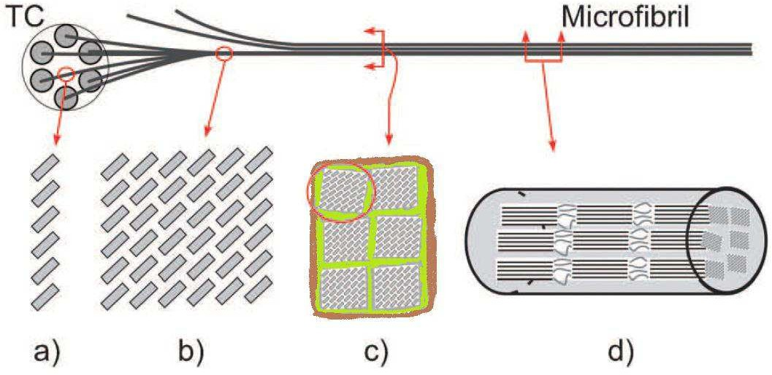
15
Figure 8 – Schematic of the different levels of the formation of a wood microfibril (adapted from Moon et al. 2011). (a) minisheet cross-section believed to form from a single subunit, in which van der Waals forces hold the cellulose chains together. Each grey box represents a cellulose chain looking down the chain-axis.
(b) elementary fibril cross-section, the assembly of 6 minisheets into a cellulose crystal I lattice of ~3–5 nm dimensions. The consolidation of multiple elementary fibrils (the basic building block of cellulose) forms a microfibril, (c) microfibril cross-section composed of 6 elementary fibrils (according to the modified Frey-Wysling model) embedded in a matrix of other cell wall compounds, mostly hemicellulose and lignin (representend in green and brown, respectively), (d) microfibril lateral section showing the series configuration of crystalline and amorphous regions of elementary fibrils.
In view of the inequality in size, many terminologies including elementary fibril, protofibril, nanofibril, fibril, microfibril, mini-crystal, microfibril bundle, macrofibril, have been used to describe the fibrillar celulose entities. Sometimes it generates confusion, because different authors use the term in different ways. There are diverse models and structural concepts for fibrillar structure of cellulose based on different observation and scientific environments, some of them facing counter evidence but still persisting in the literature. Thus, there appears to be no agreement as to the size and nature of microfibrils, perhaps due to a dependence of cellulose structure on the sample source (Nishiyama 2009; O’Sullivan, 1997). These models differ mainly in the description of the organization and the distribution of the amorphous or less ordered regions within the microfibril. After many years of controversy, it is common practice to acknowledge that the amorphous regions are distributed as chain dislocations on segments along the elementary fibril where the microfibrils are distorted by internal strain in the fiber and proceed to tilt and twist (Habibi et al., 2010).
Chapter I

Slide 16
16
Although the catalytic domains of celulose synthases are conserved for all cellulose-synthesizing organisms, the drastic differences in both the lifestyle of the organisms and the structure of the cellulose that they produce suggest that the regulatory proteins and the underlying mechanisms for celulose synthesis may have evolved independently (Li et al., 2014).
The simplicity in the chemical structure of cellulose belies the complexities that are associated with the synthesis and assembly of this polysaccharide. Detailed descriptions of cellulose biosynthesis can be found in Festucci-buselli et al. (2007), Li et al. (2014) and Saxena & Brown (2005). Despite the recent advances using a combination of molecular genetics, live cell imaging, and spectroscopic tools, many aspects of the celulose biosynthesis are still not well understood (conjectural). Thus, there is problaby no biochemical pathway in plants that is both so important and so poorly understood at the molecular level as cellulose biosynthesis.
Chapter I

Slide 17
20
Chapter 2
SEMICRYSTALLINE NATURE OF CELLULOSE
As might be expected, the many hydroxyl groups readily available for hydrogen
bonding associated to “extended” chain structure of cellulose macromolecule causes the
chains, or part of them, to become sufficiently aligned parallel to each other forming a compact packing that gives rise to three-dimensional highly ordered structures (crytal- like) of long-range, viz. order extending to distances of hundreds or thousands of times the molecular size of the repeating unit. However, seeing that the chains are usually longer than these crystalline regions, they are thought to pass through several different crystalline regions which have less-ordered areas in between them. These less-ordered regions are also frequently referred to as amorphous or non-crystalline regions. Unlike the crystalline region, the cellulose chains in the amorphous region are arranged irregularly and loosely, so the distance between molecules is larger. The amorphous state is thus characterized by an absence of long-range ordering and greater orientation disorder of cellulose chains. Accordingly, cellulose microfibrils are said to be semicrystalline materials, because ordered regions characterized by a long-range regular spatial arrangement coexist with disordered regions typical of the amorphous state.
It must be emphasized that polymers are often referred to as crystalline, but, unlike
ionic crystals and metals, in crystals of polymers, the arrangement of atoms is not perfectly regular as in ideal crystals and considerable disorder can be included. On one hand, this may be due to the presence of microstructural defects of constitution, configuration and conformation in the single macromolecules, which may be included in the crystals. On the other hand, it may be also a consequence of the inability of the polymer chains to completely disentangle and line up properly owing to the long-chain nature and subsequent entanglements. Since these requirements are not completely satisfied, crystals of polymers are very far from the ideality, and thus structural disorder inside polymer crystals is a rule rather than an exception. So, the main characteristic of polymeric materials is that, unlike other crystalline materials, they are never totally crystalline but are semicrystalline (de Rosa & Auriemma, 2013; Sperling, 2005). By the way, the term “configuration” refers to the geometrical organization of the atoms along the chain that is determined by chemical bonds; while the term “conformation” denotes the spatial arrangement of the atoms and substituents of a polymer chain that arises from the simple rotation about single bonds. Different conformations are obtained simply by rotation around the single primary bonds. Unlike the conformation, the configuration of a polymer chain cannot be altered without breaking chemical bonds.
Chapter I

Slide 18
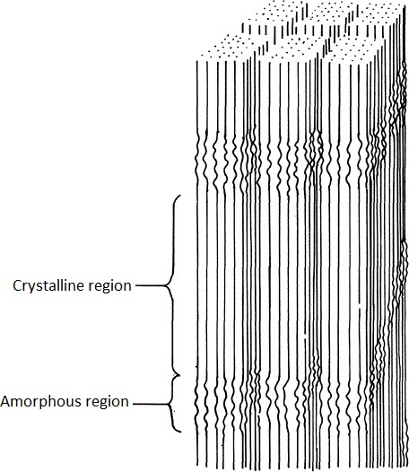
21
Several others studies carried out at the sub-microscopic scale emphasized the discontinuous character of microfibrils (i.e. the biphasic nature of its structure). Experimental evidence was provided by wide angle (Fink et al., 1987) and small angle X-ray diffraction (Grigoriew & Chmielewski, 1998), solid state ¹³C NMR (nuclear magnetic resonance) experiments (Earl and VanderHart, 1981), and tensile tests performed on cellulose fibers (Ishikawa et al., 1997). As mentioned in the previous section on cellulose biosynthesis, the crystallization follows very closely the polymerization of glucopyranose residues in a way that allows the present proteins of the TCs to govern the microfibril crystalline form. Analogously to Figure 8d, a simplified view of the organization of crystalline and amorphous domains in cellulose microfiber is shown in Figure 11. Thus, as a basic rule, microfibrils can be considered as a slender rod- like element composed of highly ordered regions (the cellulose crystals) linked along the fiber axis by less organized ones.
Figure 11 – Possible microstructure of cellulose microfibrils showing the highly ordered regions (the crystallites) that alternate with less organized ones according to the traditional two-phase model system.
The secondary interactions (i.e. non-covalent interactions) such as van der Waals and hydrogen bonds are intrinsically related to the cohesion between cellulose chains and
Chapter I

Slide 19
22
their strong tendency to crystallize. But, considering that these hydrogen bonds in cellulose have strength on the order of ~20-40 kJ/mol and are significantly stronger than van der Waals forces which have strength of ~2-25 kJ/mol, these hydrogen bonds are thought to be the main responsible to the interchain cohesion, and therefore, to the formation of the crystalline domains in cellulose (Belgacem & Pizzi, 2016; Krassig, 1993).
Thermodynamically, the crystal formation can be explained by the balance
between entropy and enthalpy effects during the packing of cellulose chains. According to Qian et al. (2005) the hydrogen bonds are stronger in the cellulose crystal in comparison to the single chains or sheets. This indicates that during the packing of the chains, the –OH groups are closer. In that situation there is a loss in the conformational degree of freedom of the molecules, causing the formation of hydrogen bonds as compensation. The formation of bonds is an exothermic process (ΔH < 0) that causes a decrease in enthalpy and this can compensate the rigidity and decrease of the entropy. It can keep the system stable with a negative overall energy (ΔG < 0). As expected by the Gibbs equation (Equation 1) (Qian et al., 2005; Mariano, 2016).
∆𝐺 = ∆𝐻 − 𝑇∆𝑆
Eq. (1)
Conversely, also according to Qian et al. (2005) the crystal size is able to increase by the deposition of new monomers, but after some point the hydrogen bonds can no longer compensate these effects. At this time, the system will be dominated by the entropy effects, causing disorder. This can explain the periodic nature of the distribution of the amorphous zones in the cellulose supramolecular structure that can be observed in Figure 11. This periodic nature of the distribution of disordered regions along ramie microfibrils was demonstrated by Nishiyama et al., (2003) using small angle neutron diffraction. A periodicity of about 150 nm was found, corresponding to the sizes estimated by diffraction of hydrolyzed microfibrils. Earlier, it has been believed that disordered chains are located primarily on the surface of microfibrils (Kovalenko, 2010).
In view of the fact that in the crystalline site the hydrogen bonds are stronger and
more numerous in comparison to non-crystalline one, the physical and mechanical properties of the crystalline and non-crystalline phase can be different. For instance, properties such as elastic modulus and density and are higher for crystalline zones than for non-crystalline ones (Sinko et al., 2013; Kulasinski et al. 2014). In particular, the mechanical properties have been found to be substantially distinct. While the chain
Chapter I

Slide 20
23
molecules in the disordered regions contribute to the flexibility and the plasticity of the bulk material, those in the ordered regions contribute to the stiffness and elasticity of the material (Dufresne, 2012).
Concerning these mechanical properties, there are several modeling studies that are concerned with the contribution of hydrogen bonding to the stiffness of the cellulose chain (Wohlert et al., 2012). By removing the hydrogen bonds from the computational model Eichhorn & Davies (2006) noted a decrease in elastic modulus in the chain direction by 15%, while Tashiro & Kobayashi (1991) calculated the contribution to 40%. Kroon-Batenburg et al. (1986) and, more recently, Cintrón et al. (2011) obtained values as high as 55–60%. These studies were carried out considering the crystalline structure of cellulose Iβ and are able to highlight the importance of the hydrogen bonds on mechanical properties.
The degree of crystallinity of polymers can be defined as the fraction of a polymer
that is occupied in the crystalline region, being often expressed in percentage. The degree of crystallinity of cellulose microfibrils depends on their origin and also on the processing method used to obtain the microfibril, e.g. the percentage of crystalline domains in cellulose isolated from softwood ranges from 40 to 60%, whereas the percentage of ordered chains in cellulose from bacteria and algae are typically higher, reaching values greater than 80%. Thus, the degree of crystallinity definitely has a great practical importance, since the physical and mechanical properties of the fiber-like cellulose structure are directly related to its value.
Except physical and mechanical properties, also the physico-chemical behavior of the crystalline and non-crystalline domains is distinct, hence the physico-chemical behavior of cellulose is strongly related to its degree of crystallinity influencing directly the accessibility for chemical derivatization, swelling, water-binding etc. Therefore, the degree of crystallinity is a very important property which needs to be taken into account when considering the manufacturing and applications of cellulose and cellulosic materials (Schenzel et al., 2005).
The degree of crystallinity of cellulose can be measured by several different
13_{C}
techniques including wide-angle X-ray scattering, solid-state NMR, Fourier
transform infrared spectroscopy and Raman spectroscopy. Even though results from different techniques show a good correlation, the values obtained for the degree of crystallinity can vary significantly depending on the technique used and also the data analysis method applied (Park et al., 2009; 2010).
Chapter I

Slide 21
24
Other important distinct feature between the crystalline and non-crystalline phase is the rotational conformation of the hydroxymethyl group (see Figure 4). The tg conformation is characteristic for the crystal structure of native cellulose, called cellulose
I. gt is characteristic for regenerated or mercerized cellulose crystals, cellulose II. gg is found, together with gt and tg, in non-ordered regions (Habibi et al., 2010; Nishiyama et al., 2002; O’Sullivan, 1997).
The two-phase model is very sucessful to describe the property of semicrystalline
polymers in general, however, this two-phase model considering only the crystalline and amorphous phase is a simplified view. Polymers consist, indeed, of various regions, each with a characteristic degree of internal order, ranging continuously from something close to the ideal crystalline state to the completely amorphous state. In the highly crystalline regions, the arrangement of atoms or molecules is not always perfectly regular, and even in amorphous regions, there are often areas in which the molecules are roughly parallel with an arrangement close to that of crystals (De Rosa & Auriemma, 2013; Sperling, 2005).
Whereas the crystalline cellulose is relatively well understood, there are numerous aspects pertaining to the structure and properties of amorphous cellulose that are less understood (Kulasinski et al., 2014). It is probably associated to the current knowledge on the amorphous state of polymers in general, which remains very incomplete at this time (Sperling, 2005). For instance one interesting question from the point of view of fundamental understanding of the properties of cellulose, is whether the amorphous regions of cellulose microfibril are paracrystalline or fully amorphous. Indeed the amorphous portions within a cellulose microfibril may not be fully disordered but may rather behave like bundles of nearly parallel chain which are not well enough oriented to give a long-range highly ordered three-dimensional structure, but these amorphous regions of cellulose may contains some residual order chacaterized by short-range interactions. These amorphous regions with some residual order are known as paracrystalline domains. Kulasinski et al. (2014) in a recent study provided evidence in support of, and consistent with, the hypothesis of the existence of this paracystalline interphase which has intermediate mechanical properties between the crystalline and fully amorphous phases in wood microfibrils.
Apart from the dependency on the degree of crystallinity, the physical and mechanical properties of polymer materials also are strongly influenced by the crystalline
structure and morphology. “Crystalline structure” refers to the way in which the chains,
Chapter I

Slide 22
25
in a particular conformation, are packed, giving rise to the regular three-dimensional structure, while “crystalline morphology” refers to the size and shape of the crystallites, their arrangement, and their interconnection with the amorphous phase.
2.1. Cellulose crystal structure and cellulose Polymorphs
Broadly speaking, in the context of chemistry, polymorphism is an inherent property of the solid state in which the solid phase of a given chemical compound can
exhibit different crystal structures which, although possessing the same chemical composition, may manifest different properties. Each distinct form of the crystal structure
for a given compound is called a polymorph or allomorph and they have a different arrangement and/or conformation of the molecules in the crystal lattice. The word
polymorphism comes from a Greek word. The term “poly” means “many” and “morph” means “form or shape”, so the word polymorphism can be translated to many forms. The
investigation of crystal forms impacts on fundamental science as well as on utilitarian objectives because different polymorphs may display a range of different properties (e.g.
density, solubility, melting point, free energy, rate of dissolution, tensile strength and tabeling etc), which may affect application and utilization of the solid materials
(Bernstein, 2002).
Polymorphism is quite common for crystals of organic compounds whose
molecules contain groups capable of hydrogen bonding (Bernstein, 2002). The repeating unit of cellulose, or cellobiose, includes six hydroxyl groups and three oxygen atoms. Therefore, the presence of six hydrogen bond donors and nine hydrogen bond acceptors provides several possibilities for forming various hydrogen bond systems. Due to different mutual arrangements of the glucopyranose rings and possibility of conformational changes of the hydroxymethyl groups, cellulose chains can exhibit different crystal packings (Kovalenko, 2010). As a result, cellulose has several
polymorphs, namely cellulose I, II, III and IV and their varieties Iα, Iβ, IIII, IVI, IIIII and IVII. Most of these polymorphs result from chemical treatments of polymorph I. These polymorphs differ by packing (i.e. unit cell parameters) and polarity of the constituting chains, as well as the hydrogen bond patterns established between them (Wada et al., 2008). The first structural model was suggested in 1937 by Meyer and Misch (Meyer & Misch, 1937). Since then considerable progress has been made in elucidating the crystal structures of cellulose. However, on account of the structural variety of cellulose, the structural properties continue to be under intensive characterisation and there are still
Chapter I

Slide 23
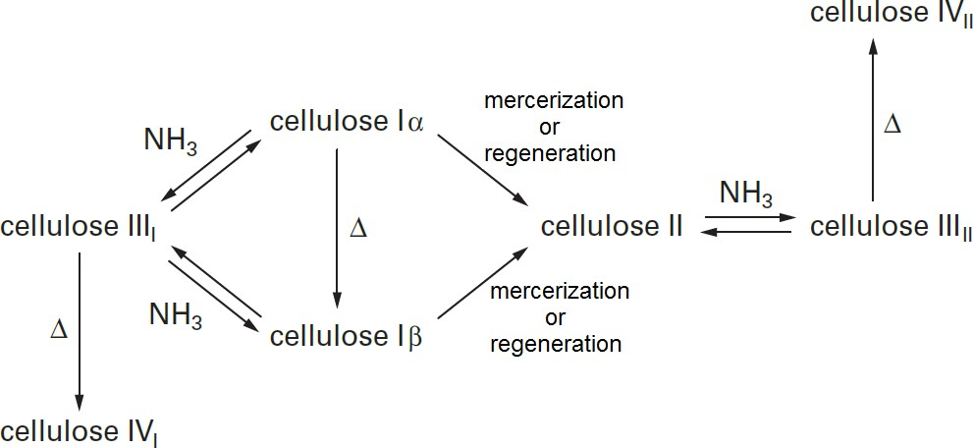
26
many open questions. The possible transitions between the different cellulose polymorphs are presented schematically in Figure 12 (Dufresne, 2012). This review focuses on the Cellulose I and II structures.
Figure 12 – Possible interconversions of cellulose polymorphs. Adapted from Dufresne (2012).
Cellulose I is the most abundant polymorph in nature. That is why it is known as native cellulose and it is the focus of major studies in the area. In 1984, Atalla and Vanderhart by high-resolution solid-state ¹³C NMR spectroscopical studies demonstrated that native cellulose actually consists of two distinct polymorphic forms, namely cellulose Iα and Iβ (Atalla & VanderHart, 1984). These two different crystalline forms of cellulose I can be found alongside each other and the Iα/Iβ ratio depends on the source, i.e. origin of the cellulose. The Iα structure is dominant in most algae and bacteria (which are considered as primitive organisms), whereas Iβ is the dominant polymorph in higher plants and in tunicates (Dufresne, 2012; Wada et al., 2008). Nishiyama and co-workers by means of synchrotron X-ray and neutron fiber diffraction have provided the most accurate characterization of the Iα and Iβ lattice structures to date. Cellulose Iα corresponds to a triclinic unit cell, space group P1, containing only one chain per unit cell and the unit-cell parameters are a = 0.672 nm, b = 0.596 nm, c = 1.040 nm, α = 118.08°, β = 114.80°, y = 80.37°. The polymorph Iβ has a monoclinic unit cell, space group P21, with two chains per unit cell and the unit-cell parameters are a = 0.778 nm, b = 0.820 nm, c = 1.038 nm, α = β = 90°, y = 96.51° (Nishiyama et al., 2002; 2003b). The Iα and Iβ unit cells are shown in Figure 13b. The characteristic features of the complex hydrogen bond pattern established in each of these polymorphs (Iα and Iβ) and their differences are well discussed by Kovalenko (2010). The Iα phase is considered to be less thermodynamically
Chapter I

Slide 24
27
stable than the Iβ phase, because it can be irreversibly converted into Iβ by high- temperature annealing at 260 to 280°C in various media, such as organic solvents or helium. However, complete conversion to Iβ is typically not achieved (Dufresne, 2012; Wada et al., 2008; Yamamoto & Horii, 1993).
Despite the differences between Iα and Iβ unit-cell parameters, the shifts in the
cellulose chain arrangement are small when viewed along the chain axis (Figure 13a). Three lattice planes with approximate d-spacings of 0.39 nm, 0.53 nm, and 0.61 nm are
shared and correspond to Iα lattice planes (110)Iα, (010)Iα, and (100)Iα, and Iβ lattice planes (200)Iβ, (110)Iβ, and (1-10)Iβ, respectively. As the projection perpendicular to the chain axis in the plane of the hydrogen-bonded sheets shows, the main difference between cellulose Iα and Iβ is the relative displacement of sheets (parallel stacking of cellulose chains in one plane) along the (110)Iα and (200)Iβ planes (called ‘‘hydrogen-bonded’’ planes) in the chain axis direction (Figure 13c and d). For Iα there is a relative displacement of c/4 between each subsequent hydrogen-bonded plane (i.e. neighboring sheets), while for Iβ the displacement alternates between c/4 and -c/4 (Moon et al., 2011). An important common feature for both polymorph Iα and Iβ is that there are no intersheet O–H∙∙∙O hydrogen bonds and, therefore, the cellulose sheets are held together by only hydrophobic interactions (van der Waals forces) and weak C–H∙∙∙O hydrogen bonds. So, the most likely route for solid-state conversion of cellulose Iα → Iβ is the relative slippage of the cellulose chains past one another. Such a movement does not require the disruption of the hydrogen-bonded sheets but slippage by c/2 at the interface of the sheets (Nishiyama et al., 2003b; Pérez & Mazeau, 2004).
In both phases (Iα and Iβ) the hydroxymethyl groups are oriented in the tg
conformation and the cellulose chains are arranged in what is called the ‘‘parallel-up’’ configuration (Koyama et al., 1997; Nishiyama et al., 2002; 2003b). This parallel-up packing in cellulose Iα and Iβ unit cells was experimentally demonstrated by Koyama et al. (1997) through a combination of direct-staining the reducing ends of cellulose chains and microdiffraction-tilting electron crystallographic analysis. Since the cellobiose repeat unit has a different structure on either side of the 1–4 linkage, the directionality of the 1- to-4 linkage (1→4 linkage) along the length of the cellulose chain affects how neighboring chains interact with each other. The term ‘‘parallel’’ is used when all the cellulose chains are arranged such that the 1→4 link points in the same direction. In contrast “antiparallel” describes alternating stacking of the cellulose chains in the 1→4 link directionality between different hydrogen bonding planes. The direction of the
Chapter I

Slide 25
28
cellulose chain 1→4 link with respect to the c-axis of the unit cell is also defined because this alters the interaction between neighboring hydrogen bonding planes (Figure 13a). The ‘‘up’’ configuration corresponds to the 1→4 link direction pointing in the positive c- axis direction of the unit cell, while the ‘‘down’’ configuration the 1→4 link direction pointing in the negative c-axis direction (Moon et al., 2011). Note that most of the literature uses a different convention, in which ‘‘up’’ versus ‘‘down’’ are defined in terms of the relative location of the O5 and C5 atoms along the positive c-axis of the unit cell. In the ‘‘up’’ configuration, the position of O5 is greater than that of C5, while in the ‘‘down’’ configuration the position of O5 is less than that of C5 (Koyama et al., 1997). Both Iα and Iβ have the ‘‘parallel-up’’ configuration, thus all cellulose chain segments run parallel along the chain axis and are arranged such that the 1→4 link points in the same direction (Figure 13c, d) and that direction is in the positive c-axis direction of their respective crystalline unit cell (Moon et al., 2011).
Figure 13 – Schematic of the unit cells for cellulose Iα (triclinic, dashed line) and Iβ (monoclinic, solid line): (a) projection along the chain direction with the Iα and Iβ unit cells superimposed on the cellulose I crystal lattice, showing the parallelogram shape of both unit cells when looking down the c-axis. In this orientation both unit cells have nearly identical molecular arrangements, sharing the three major lattice planes, labeled 1, 2, and 3, with the corresponding d-spacings of 0.39, 0.53, and 0.61 nm. The corresponding lattice planes for 1, 2, and 3, are (110)Iα, (010)Iα, and (100)Iα, for Iα and (200)Iβ, (110)Iβ, and (1-10)Iβ for Iβ. (b–d) View along the direction labeled 4, (b) relative configuration of Iα with respect to Iβ unit cell and the displacement of the hydrogen bonding sheets for (c) Iα of +c/4, and for (d) Iβ alternating +c/4 and -c/4 (from Moon et al., 2011).
Cellulose II is the second most extensively studied allomorph due to its technical relevance. Cellulose II, like cellulose Iβ, has the monoclinic unit cell, space group P21, containing two chains, but differ in the unit-cell parameters, which are a = 0.801 nm, b = 0.902 nm, c = 1.034 nm, α = β = 90°, y = 117.11°. Unlike cellulose I which has a parallel- up orientation and the hydroxymethyl groups oriented in the tg conformation, the chains
Chapter I

Slide 26
29
in cellulose II are aligned in an antiparallel manner (up and down directions) with the hydroxymethyl groups near the gt conformation (Langan et al., 1999, 2001, 2005). These diferences are regarded as the most significant differences between the cellulose polymorphs I and II. As previously mentioned, the term antiparallel refers to alternating stacking of the cellulose chains in the 1→4 link directionality between different hydrogen bonding planes (Pérez & Mazeau, 2004; Kovalenko, 2010). Recently, Kim et al. (2006) using a method of reductive amination, followed by gold labeling, visualized the reducing ends of cellulose I and cellulose II “crystals” by transmission electron microscopy (TEM) showing that the reducing groups are all located at the same end of the chain assembly (parallel arrangement) for cellulose I, while for the mercerized specimen (cellulose II) the reducing groups are alternatively on either side within the assembly (antiparallel arrangement). Owing to this antiparallel directionality of the chains, the polymorph II is often said to be less polar when compared to polymorph I. In effect, though there is a general consensus that the chains are packed in antiparallel mode in cellulose II, this is not unanimously accepted and such question is still raising many debates.
Other notable feature of cellulose II is that during the conversion from polymorph I to II, the exocyclic C6H2OH groups rotate from the tg to the gt conformation so that an inter-residue hydrogen bond is lost. However, new intersheet hydrogen bonds are established. This redistribution of hydrogen bonds is particularly interesting, because it provides a more uniform distribution of the H-bonds connecting all neighboring cellulose molecules and at the same time improves the interlayer attraction forces (i.e. the forces involved in the attraction of cellulose sheets to each other). In other words, in cellulose II the absence of the second hydrogen bond along the chain is compensated by the presence of four weak hydrogen bonds between the sheets, and although these new bonds are weaker, their number (four hydrogen bonds per glucopyranose residue) is sufficiently large to have an effect on the properties of this polymorph (Figure 14). Therefore, cellulose I and II possess different properties and advantages over the other, what make the polymorph II preferable for some applications (Langan et al., 1999, 2001, 2005; Pérez & Mazeau, 2004; Kovalenko, 2010, Wada et al., 2008; Yue et al., 2012; Jin et al., 2016).
Chapter I

Slide 27
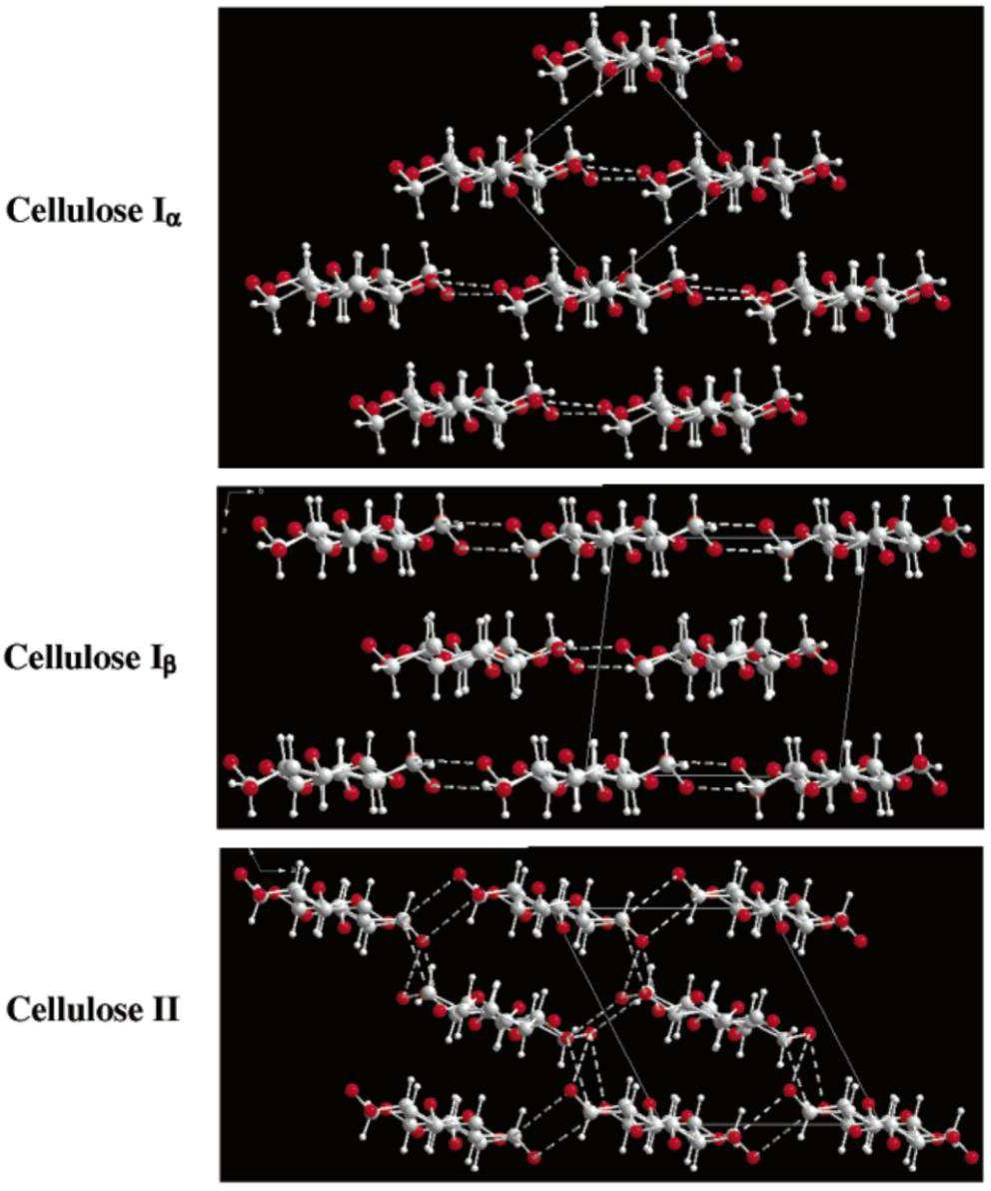
30
Figure 14 – Schematic projections of the crystal structures of cellulose Iα, Iβ and II down the chain axes directions. C, O, and H atoms are represented as gray, red, and white balls, respectively. Covalent and hydrogen bonds are represented as full and dashed sticks, respectively. Only the major components of hydrogen bonds are represented. Adapted from Wada et al. (2004).
The changes in hydrogen bonding network (mentioned above) imparts to cellulose II an additional stability compared to cellulose I, which could explain why it is possible to convert cellulose I to cellulose II, but not in the reverse direction. Thus, the transition from cellulose I to cellulose II is widely considered as irreversible, suggesting that polymorph II is thermodynamically more favorable than polymorph I. A detailed description of the complex hydrogen-bonding system in cellulose II, as well as the comparison with the hydrogen bond network present in cellulose I, is provided by Kovalenko (2010).
Chapter I

Slide 28
31
Cellulose II can be prepared from native cellulose (cellulose I) by two distinct processes: i) mercerization (alkaline treatment) or ii) regeneration (solubilization followed by recrystallization).
i)
Mercerization, a universally recognized process the name of which is derived from its inventor John Mercer, is an essentially solid-state process during which cellulose fibers are swollen in concentrated alkali media and recrystallized into cellulose II upon washing and drying (removal of the swelling agent). The mercerization of cellulose leads only to its swelling, but not to solubilization.
In the process known as regeneration, the native cellulose (polymorph I) is dissolved in a solvent and subsequent reprecipitated by adding a non-solvent, leading the chains to recrystallize into cellulose polymorph II.
Even though the unit cells of cellulose II obtained by these two distinct routes
ii)
resemble each other closely, small differences have been reported. For example, the values of the b parameter in mercerized cellulose from ramie has been quoted as 0.810(3) nm and 0.801(5) nm in the case of regenerated specimen. In addition, the torsion angle χ of the center chain, representing the conformation of the hydroxymethyl group, is
+148(6)° and -175(8)° for regenerated and mercerized samples, respectively (Langan et al., 1999, 2001). So, it could be argued whether these different methods of preparation of cellulose II might account for some of the small differences. Facing these small differences reported between the mercerized and regenerated celluloses, which could be negligible on account of the different resolutions of X-ray data utilized, Langan et al. (2005) provided experimental data from which it is possible to conclude that these two singular ways for preparing cellulose II lead to essentially identical crystal and molecular structures.
It must be mentioned that cellulose II can, in rare cases, be formed naturally; two examples are that of the marine alga Halicystis (Sisson, 1938) and the gram-positive bacterium Sarcina (Canale-Parola, 1970). Other cases relate to conditions where the normal process of synthesis is perturbed, either by mutation (Kuga et al, 1993) or by addition of the dye Tinopal (Cousins & Brown, 1997), which alters crystal structure and leads to an antiparallel structure. Both are very useful to insights into the crystalline structure and morphology of cellulose II as will be discussed along the next sections.
Chapter I

Slide 29
43
2.2. Isolation of CNC from cellulose source material
The isolation of CNC from cellulose source materials occurs in two stages. The
first one is the pretreatment of the source material to remove the non-cellulosic constituents, so that the cellulose molecules becomes accessible to react more consistently in the subsequent stage. The second one is a well-controlled and chemically induced treatment (generally chemical hydrolysis) where a “complete” regioselective degradation
Chapter I

Slide 30
44
of the less organized and more accessible fraction of the cellulosic material takes place, so releasing the crystalline domains from the “purified” material obtained after the first stage.
The goal of the pretreatment stage is the complete or partial removal of the non- cellulosic components (such as lignin, hemicelluloses, protein, etc) to obtain high purity cellulosic fibers and get acess to them. The particular pretreatment is dependent on the cellulose source material. Classicaly, for lignocellulosic biomass source this pretreatment consist in similar techniques that are employed in pulp and paper industry. It is usually done as a two-step chemical processing, the alkali delignification followed by bleaching. The alkali step purpose is to degradate and solubilize the lignin, pectins, hemicelluloses and proteins, being commonly performed with aqueous solution of NaOH 2% at 80 or 100°C. The subsequent bleaching step aims in removing the residual phenolic molecules
like lignin by oxidizing agents such as hydrogen peroxide (H2O2), ozone (O3) or sodium hypochorite (NaClO2). Both steps must be carefully done to eliminate the non-cellulosic constituents, while leaving cellulose moieties intact, i.e. avoiding the breakdown of cellulose chains (Brinchi et al., 2013, Mariano, 2016; Moon et al 2011). Deeper descriptions of the deconstruction of non-cellulosic contents in lignocellulosic biomass are available, for instance in the paper by Ng et al. (2015).
The second stage can be performed by many different top-down chemically
induced deconstructing strategies, among them the controlled strong acid hydrolysis is the most well-known and widely used (Peng et al., 2011). During acid hydrolysis the amorphous domains surrounding and embedded within cellulose microfibrils are preferentially hydrolyzed, then releasing well-defined crystals from microfibrils (Figure 18). This procedure is based in the quicker hydrolysis kinetics presented by the amorphous domains, as compared to the crystalline ones (Habibi et al., 2010). Owing to some drawbacks related to acid hydrolysis (which will be discussed later), several alternatives methods have also been studied, e.g. enzyme-assisted hydrolysis (George et al., 2011; Hayashi et al., 2005; Satyamurthy et al., 2011), sono-chemical-assisted hydrolysis using weak organic acid (Filson & Dawson-Andoh, 2009; Li et al., 2011), hydrolysis with oxidative reagents such as ammonium persulfate (Cheng et al., 2014; Leung et al., 2011) or sodium metaperiodate (Visanko et al., 2014) or 2,2,6,6- Tetramethylpiperidine-1-oxyl (TEMPO)–NaBr–NaClO system (Qin et al., 2011; Brinchi et al., 2013), subcritical water hydrolysis (Novo et al., 2015), hydrolysis mediated by ionic liquids (Han et al., 2013; Lazko et al., 2016; Mao et al., 2015; Yang et al., 2013).
Chapter I

Slide 31
45
Concerning the second stage, it should be noted that the vast majority of the technologies used are top-donw deconstructing strategies, and only few recent works have reported a bottom-up approach for the production of CNC, such as the works of Yang et al. 2013 and Han et al., 2013. This “new” approach to CNC production involves the regeneration process of cellulose, and could be very interesting toward a better control of nanomaterial formed and its properties (e.g., control of size, shape, aspect ratio, crystallinity, etc).
Chapter I

Slide 32
52
2.3. Toxicology assessment and biodegradability
Manufactured nanomaterials have recently caused societal concerns about their possible adverse effects on human health and environment. Properties of nanomaterials
typically differ from those of their parent bulk materials because of their larger surface area to volume ratio, leading to a greater activity, their smaller size, resulting in their
ability to cross cellular membranes (i.e. penetrate into cells), and intrinsic effects caused by nanometric size, including electronic and plasmonic effects. Since such particles may
have a negative effect on biological systems and ecosystems, their toxicological risks must be evaluated and an accurate description of the product in terms of dimensions,
chemistry, and toxicity is required by the authorities.
While the production and application of CNC are growing exponentially, research into the toxicological impact and possible hazard of these nanoparticles is still restricted
at a very preliminary stage (mainly on the level of cytotoxicity) (Lin & Dufresne, 2014b; Roman, 2015). CNCs have been evaluated using several standard ecotoxicological and mammalian test protocols and, so far, the results seem to point towards the same direction suggesting that CNCs have no or low toxicity (i.e. are practically non-toxic). Moreover,
Chapter I

Slide 33
53
CNCs have recently obtained regulatory approval under Canada’s New Substances Notification Regulations for unrestricted use in Canada and it is the first organic nanomaterial to be added to Canada’s domestic substance list (Kaushik et al., 2015; Kovacs et al., 2010). Anyway, further testing is necessary especially regarding evaluation on the environmental fate, potential CNC uptake and exposure studies, so that a detailed risk assessment can be determined. In doing so, are taken steps protect workers, consumers and the environment from suspect CNC materials and guide the development of safer materials in the future (Brinchi et al., 2013; Roman, 2015).
Knowledge on the biodegradability is also of utmost importance for risk
assessment of this nanomaterial. The biodegradability of CNC in aqueous environment has been investigated according to OECD (Organisation of Economic Cooperation and Development) standards. CNCs were found to degrade faster than its macroscopic counterpart, whereas other important and widely used nanoparticles such as fullerenes and carbon nanotubes did not biodegrade at all (Kümmerer et al., 2011). Here, it is important to note that these findings are crucial issues directly associated to practical applications of CNC, e.g. biomedical applications requiring biocompatibility such as drug delivery and cellular growth systems.
Chapter I

Slide 34
61
5. REFERENCES
Atalla, R. H., & Vanderhart, D. L. (1984). Native Cellulose: A Composite of Two Distinct Crystalline Forms. Science, 223, 283-285.
Atkins, E. D. T., Blackwell, J., & Litt, M. H. (1979). Texture of cellulose crystallized from hydrazine. Polymer, 20, 145-147.
Battista, O.A. (1950). Hydrolysis and crystallization of cellulose. Industrial & Engineering Chemistry, 42, 502-507.
Battista, O. A., Coppick, S., Howsmon, J. A., Morehead, F. F. & Sisson, W.A. (1956). Level-off degree of polymerization -relation to polyphase structure of cellulose
fibres. Industrial & Engineering Chemistry, 48, 333-335.
Beaumont, M., Nypelö , T., Kö nig, J., Zirbs, R., Opietnik, M., Potthast, A., & Rosenau,
T. (2016). Synthesis of redispersible spherical cellulose II nanoparticles decorated with carboxylate groups. Green Chemistry, 18, 1465-1468.
Beck-Candanedo, S., Roman, M., & Gray, D. G. (2005). Effect of reaction conditions on the properties and behavior of wood cellulose nanocrystal suspensions Biomacromolecules, 6, 1048-1054.
Belgacem, M. N., Pizi, A. (2016). Lignocellulosic Fibers and Wood Handbook:
Renewable Materials for Today's Environment. John Wiley & Sons/Scrivener Publishin, Hoboken/ Salem, Massachusetts.
Bernstein, J. (2002). Polymorphism in molecular crystals. Clarendon Press Oxford, New York.
Bettaieb, F., Khiari, R., Dufresne, A., Mhenni, M.F., & Belgacem, M. N. (2015). Mechanical and thermal properties of Posidonia oceanica cellulose nanocrystal reinforced polymer. Carbohydrate Polymers, 123, 99-104.
Boerjan, W., Ralph, J. & Baucher, M. (2003). Lignin biosynthesis. Annual Review of Plant Biology, 54, 519 -546.
Braconnot, H. (1819). Sur la conversion du corps ligneux en gomme, en sucre, et en un
acide d’une nature particulière, par le moyen de l’acide sulfurique; conversion de la même substance ligneuse en ulmine par la potasse. Annuaire de Chimie, 12, 172-195. Bras, J., Viet, D., Bruzzese, C., & Dufresne, A. (2011). Correlation between stiffness of sheets prepared from cellulose whiskers and nanoparticles dimensions.
Carbohydrate Polymers, 84, 211-215.
Brejnholt, S. M. (2010). Pectin. In: Imerso, A. (eds). Food stabilizers, thickeners and gelling agents. John Wiley and Sons, pp. 237-264.
Chapter I

Slide 35
62
Brinchi, L., Cotana, F., Fourtunati, E., & Kenny, J. M. (2013). Production of nanocrystalline cellulose from lignocellulosic biomass: Technology and applications. Carbohydrate Polymers, 94, 154-169.
Buléon, A., & Chanzy, H. (1978). Single crystals of cellulose II. Journal of Polymer Science, 16, 833-839.
Campbell, F. C. (2010). Structural Composite Materials. ASM International.
Canale-Parola, E. (1970). Biology of the sugar-fermenting Sarcinae. Bacteriological Reviews, 34, 82-97.
Célino, A., Fréour, S., Jacquemin, F., & Casari, P. (2013). The hygroscopic behavior of
plant fibers: a review. Frontiers in Chemistry, 1, 43.
Chanzy, H. D., & Roche, E. J. (1976). Fibrous transformation of Valonia cellulose I into cellulose II. Applied Polymer Symposium, 28, 701-711.
Chen, H. (2014). Biotechnology of lignocellulose: theory and practice. Chemical Industry
Press, Beijing.
Cheng, M., Qin, Z., Liu, Y., Qin, Y., Li, T., Chen, L., & Zhu, M. (2014). Efficient
extraction of carboxylated spherical cellulose nanocrystals with narrow distribution through hydrolysis of lyocell fibers by using ammonium persulfate as an oxidant. Journal of Materials Chemistry A, 2, 251-258.
Cherubini, F. (2010). The biorefinery concept: using biomass instead of oil for producing energy and chemicals. Energy Conversion and Management, 51, 1412-1421.
Cintrón, M.S., Johnson, G.P., French, A. (2011). Young’s modulus calculations for
cellulose I b by mm3 and quantum mechanics. Cellulose, 18, 505-516.
Cousins, S. K. & Brown, R. M. Jr. (1995). Cellulose I microfibril assembly:
computational molecular mechanics energy analysis favours bonding by van der Waals forces as the initial step in crystallization. Polymer, 36, 3885-3888.
Cousins, S. K., & Brown, R. M. (1997). X-ray diffraction and ultrastructural analyses of dye-altered celluloses support van der Waals forces as the initial step in cellulose crystallization. Polymer, 38, 897-902.
da Silva, I. S.V., Flauzino Neto, W. P., Silvério, H. A., Pasquini, D., Andrade, M. Z., & Otaguro, H. (2015). Mechanical, thermal and barrier properties of pectin/cellulose
nanocrystal nanocomposite films and their effect on the storability of strawberries (Fragaria ananassa). Polymer Advanced Technologies. doi: 10.1002/pat.3734.
de Gennes, P.G. (1976). On a relation between percolation theory and the elasticity of gels. Journal of Physical Chemistry Letters, 37, l-2.
Chapter I

Slide 36
63
de Rosa, C., & Auriemma, F. (2013). Crystals and Crystallinity in Polymers: Diffraction Analysis of Ordered and Disordered Crystals. John Wiley & Sons, Hoboken.
Delmer, D.P. & Amor, Y. (1995). Cellulose biosynthesis. Plant Cell, 7, 987-1000.
Ding, S., Zhao, S., & Zeng, Y. (2014). Size, shape, and arrangement of native cellulose fibrils in maize cell walls. Cellulose, 21, 863-871.
Dinwoodie, J. M. (1975). Timber- a review of the structure-mechanical property relationship. Journal of Microscopy, 104, 3-32.
Djahedi, C., Bergenstrahle-Wohlert, M., Berglund, L. A., & Wohlert, J., (2016). Role of hydrogen bonding in cellulose deformation: the leverage effect analyzed by molecular modeling. Cellulose, 23, 2315-2323.
dos Santos, R. M., Flauzino Neto, W. P., Silvério, H. A., Martins, D. F., Dantas, N. O.,
& Pasquini, D. (2013). Cellulose nanocrystals from pineapple leaf, a new approach for the reuse of this agro-waste. Industrial Crops and Products, 50, 707-714.
Dufresne, A. (2000). Dynamic mechanical analysis of the interphase in bacterial polyester/ cellulose whiskers natural composites. Composite Interfaces, 7, 53-67.
Dufresne, A. (2012). Nanocellulose: From nature to high-performance tailored materials. de Gruyter, Berlin/Boston.
Dufresne, A. (2013). Nanocellulose: a new ageless bionanomaterial. Materials Today, 16, 220-227.
Durán, N., Lemes, A. P., & Seabra, A. B. (2012). Review of cellulose nanocrystals patents: Preparation, composites and general applications. Recent Patents on Nanotechnology, 6, 16-28.
Earl, W. L., & VanderHart, D. L. (1981). Observations by high-resolution C-13 NMR of
cellulose-I related to morphology and crystal-structure. Macromolecules, 14, 570- 574.
Ebeling, T., Paillet, M., Borsali, R., Diat, O., Dufresne, A., Cavaille, J. Y. Chanzy, H. (1999). Shear-Induced Orientation Phenomena in Suspensions of Cellulose Microcrystals, Revealed by Small Angle X-ray Scattering. Langmuir, 15, 6123-6126. Ebringerova, A., Hromadkova, Z. & Heinze, T. (2005). Hemicellulose. Advances in
Polymer Science, 186, 1-67.
Eichhorn, S. J., Davies, G. R. (2006). Modelling the crystalline deformation of native and regenerated cellulose. Cellulose, 13, 291-307.
Chapter I

Slide 37
64
Elazzouzi-Hafraoui, S., Nishiyama, Y., Putaux, J-L., Heux, L., Dubreuil, F., & Rochas,
C. (2008). The shape and size distribution of crystalline nanoparticles prepared by acid hydrolysis of native cellulose. Biomacromolecules, 9, 57-65.
Favier, V., Canova, G.R., Cavaillé, J.Y., Chanzy, H., Dufresne, A. & Gauthier, C. (1995a). Nanocomposites materials from latex and cellulose whiskers. Polymers for Advanced Technologies, 6, 351-355.
Favier, V., Chanzy, H. & Cavaillé, J.Y. (1995b). Polymer nanocomposites reinforced by cellulose whiskers. Macromolecules, 28, 6365-6367.
Fengel, D., Wegener, G. (1989). Wood: Chemistry, Ultrastructure, Reactions. de Gruyter,
Berlin/New York.
Festucci-Buselli, R. A., Otoni, W. C., & Joshi, C. P. (2007). Structure, organization, and
functions of cellulose synthase complexes in higher plants. Brazilian Journal of Plant Physiology, 19, 1-13.
Filpponen, I. & Argyropoulos, D. S. (2010). Regular Linking of Cellulose Nanocrystals via Click Chemistry: Synthesis and Formation of Cellulose Nanoplatelet Gels. Biomacromolecules, 11, 1060-1066.
Filson, P. B., & Dawson-Andoh, B. E. (2009). Sono-chemical preparation of cellulose
nanocrystals from lignocellulose derived materials. Bioresource Technology, 100, 2259-2264.
Fink, H. P., Philipp, B., Paul, D., Serimaa, R. & Paakkari, T. (1987). The structure of amorphous cellulose as revealed by wide-angle X-ray scattering. Polymer, 28, 1265- 1270.
Flauzino Neto, W. P., Silvério, H. A., Dantas, N. O., & Pasquini, D. (2013). Extraction and characterization of cellulose nanocrystals from agro-industrial residue-soy hulls.
Industrial Crops and Products, 42, 480-488.
Flauzino Neto, W.P., Mariano, M., da Silva, I.S.V., Putaux, J-L., Otaguro, H., Pasquini, D., & Dufresne, A., (2016a). Mechanical properties of natural rubber nanocomposites reinforced with high aspect ratio cellulose nanocrystals isolated from soy hulls. Carbohydrate Polymers, 153, 143-152.
Flauzino Neto, W.P., Putaux, J-L., Mariano, M., Ogawa, Y., Otaguro, H., Pasquini, D.,
& Dufresne, A., (2016b). Comprehensive morphological and structural investigation of cellulose I and II nanocrystals prepared by sulfuric acid hydrolysis. Royal Society of Chemistry Advances, 6, 76017-76027.
Chapter I

Slide 38
65
Gardner, K. H., & Blackwell, J. (1974). The structure of native cellulose. Biopolymers, 13, 1975-2001.
George, J., Ramana, K.V., Bawa, A.S., & Siddaramaiah. (2011). Bacterial cellulose nanocrystals exhibiting high thermal stability and their polymer nanocomposites.
International Journal of Biological Macromolecules, 48, 50-57.
Grigoriew, H. & Chmielewski, A., G. (1998). Capabilities of X-ray methods in studies of processes of permeation through dense membranes. Journal of Membrane Science, 142, 87-95.
Gupta, P. K., Uniyal, V., & Naithani, S. (2013). Polymorphic transformation of cellulose
I to cellulose II by alkali pretreatment and urea as an additive. Carbohydrate Polymers, 94, 843-849.
Habibi, Y., Lucia, L. A., & Rojas, O. J. (2010). Cellulose nanocrystals: chemistry, self- assembly, and applications. Chemical Reviews, 110, 3479-3500.
Håkansson, H. & Ahlgren, P. (2005). Acid hydrolysis of some industrial pulps: Effect of hydrolysis conditions and raw material. Cellulose, 12, 177-183.
Hamad, W. Y. (2017). Cellulose Nanocrystals: Properties, Production and applications.
John Wiley & Sons, Hoboken.
Han, J. Q., Zhou, C. J., French, A. D., Han, G.P., & Wu, Q. L. (2013). Characterization of cellulose II nanoparticles regenerated from 1-butyl-3-methylimidazolium chloride. Carbohydrate Polymers, 94, 773-781.
Hayashi, J., Masuda, S., & Watanabe, S. (1974). Plane Lattice Structure in Amorphous Region of Cellulose Fibers. Nippon Kagaku Kaishi, 1974, 948-954.
Heinze, T., & Koschella, A. (2005). Solvents applied in the field of cellulose chemistry-
a mini review. Polímeros: Ciência e Tecnologia, 15, 84-90.
Hermans, P. H. (1949). Degree of Lateral Order in Various Rayons as Deduced from X- Ray Measurements. Journal of Polymer Science, 4, 145-151.
Hon, D. N. S. (1994). Cellulose: a random walk along its historical path. Cellulose, 1, 1-
25.
Hubbe, M. A., Rojas, O. J., Lucia, L. A., & Sain, M. (2008). Cellulosic nanocomposites: A review. Bioresources, 3, 929-980.
Ishikawa, A., Okano, T., & Sugiyama, J. (1997). Fine structure and tensile properties of ramie crystalline form of cellulose I, II, IIII and IVI, Polymer, 38, 463-468.
Isobe, N., Kimura, S., Wada, M., & Kuga, S. (2012). Mechanism of cellulose gelation from aqueous alkali-urea solution, Carbohydrate Polymers, 89, 1298-1300.
Chapter I

