Slide 1
Layer incorporation TiO2 dye solar cells by blade coating method
Prepered by:
Evan Zrar, Helen Himdad, Galawezh Jamal
Supervised by:
Assist prof. Dr. Bestoon A. Gozeh
2023-2024

Slide 2
Content
Introduction
Objective
Experiment benefit
Methods
Result
Conclusion

Slide 3
Introduction
Power generation is heading towards a revolutionary platform with the introduction of clean and greener modes such as Dye-sensitized solar cells(DSSCs)which is a generating device finding its utility in all fields due to its easy availability and economic nature.
Dye-sensitized solar cells(DSSCs) belong to the group of thin-film solar cell which have been under extensive research for more than two decades due to their low cost, simple preparation methodology, low toxicity, and ease of production.

Slide 4
Objective
The main objective behind this research work is to fabricate a dye sensitized solar cell with enhanced efficiency and with a minimum cost of fabrication along with least environmental hazards.
DSSCs are mainly composed of a glass substrates-based semiconductor which is organic dye synthesized, with an electrolyte, and an electrode. Its performance is majorly affected by the dye used as a sensitizer.

Slide 5
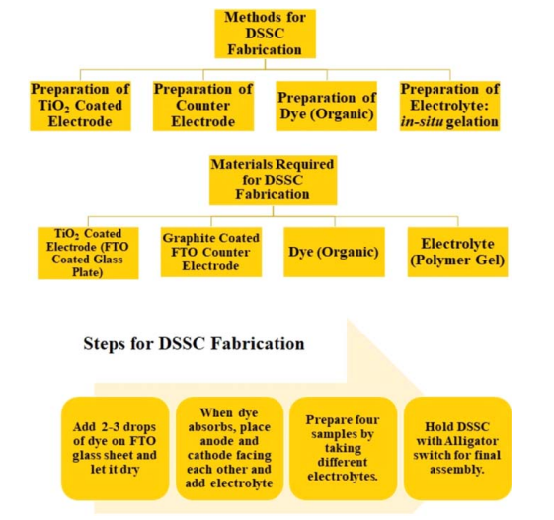
Method
For fabrication of DSSC, different components were prepared namely electrodes with coating of TiO2 and graphite on them, dye, electrolyte and finally the whole assembly was brought together using Doctor Blades method. Figure 1
Figure 1. Materials and methods required for fabrication of DSSC.

Slide 6
experiment details
Electrodes play a major role in DSSC assembly. The performance of a DSSC depends on the molecules liberated from the dye and semiconductor electrodes, as a sensitizer.
The major components used for assembling the cell and methods of their fabrication have been discussed separately in the consecutive figures.
1-Preparation of TiO2
2-Preparation of organic dye
3-Preparation of electrolyte
Preparation of counter electrode

Slide 7
1. Preparation of TiO2
Dye gets absorbed at the TiO2 layer of the electrode, which further interacts with the sunlight and liberates an electron from the lower orbit of the atomic structure to the excited state. During this process, light source photons from sun breach into the DSSC and process of photoexcitation takes place.
The diffusion of electrons into the titanium dioxide takes place.
The DSSC is called a sandwiched cell because a pair of TCO glass sheets overlap the layers of dye and electrolytes.
Hence, the anode electrode is layered by TiO2 coating using Doctor Blades method as mentioned in figure 2

Slide 8
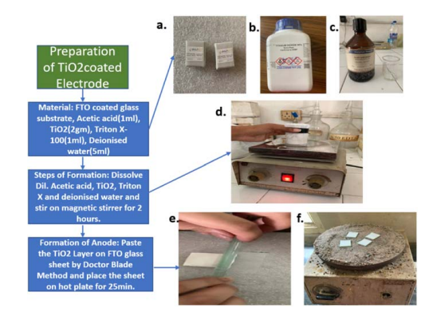
Figure 2. Preparation of TiO2. Materials: (a). FTO coated glass substrate, (b). TiO2 powder, (c). Magnetic stirring of all components(d). Pasting of TiO2 layer on anode using doctor blades method (e). Drying uniformly of the anode on a hotplate.

Slide 9
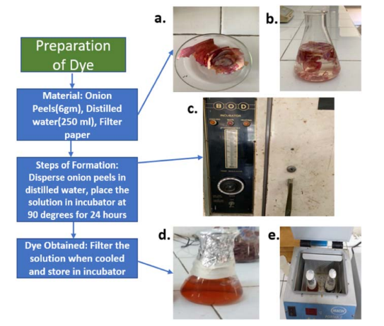
2-preparation of organic dye
the preparation of the Dye the sensitized anthocyanin is extracted from preparation of dye using organic substrates like onion peels as shown in figure 3.
Figure 3. Preparation of organic dye

Slide 10
3. Preparation of electrolyte
Preparation of Electrolyte. Materials: (a). Potassium Iodide. (b). Iodide (c). Acetic acid (d). Preparation of liquid electrolyte by magnetic spinning figure 4.
Figure 4. Preparation of Electrolyte

Slide 11
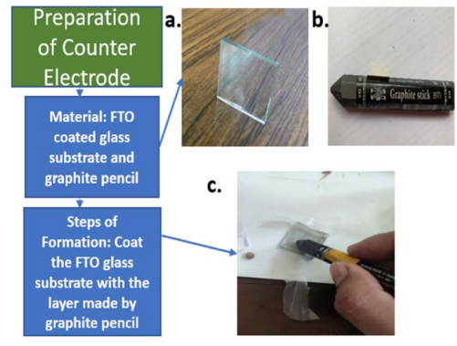
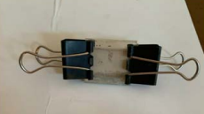
4. Preparation of counter electrode
The final component for assembling the DSSC is the preparation of the counter electrode by graphite coating as shown in figure 5, and Cell assembly in figure 6.
Figure 6. The anode, also known as sensitized electrode and cathode that is the counter electrode coated with graphite were clamped together with clips.
Figure 5. Preparation of Counter Electrode. Materials: a. FTO coated glass substrate b. Graphite stick Method: c. Coating of graphite on glass substrate for formation of anode

Slide 12
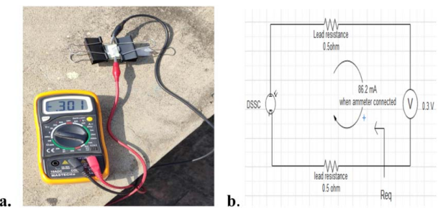
Result
The DSSC was tested under day light and diffused sunlight using multi meter. Luxmeter was used to observe the intensity of sunlight, a shown in figure 7. and Mathematical Measurement of various parameters for performance of DSSC.
Figure 7. Luxmeter used to observe intensity of sunlight.
Figure 8. (a). Measurement of various parameters for performance check of DSSC, (b).Mathematical model for DSSC assembly.

Slide 13
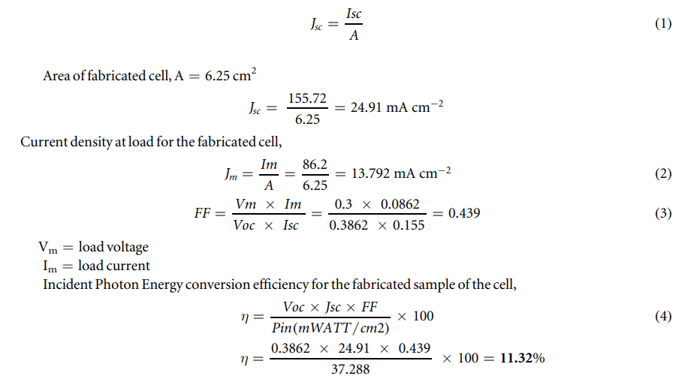
The performance parameters obtained from the above analysis yielded an efficiency of the sample cell fabricated to be 11.323% and a fill factor was found out to be 0.439.
Conclusion
The process used for the preparation of the DSSC. Have a maximum efficiency obtained for the DSSC fabricated by using gel-based polymer electrolytes was 11.32% with a fill factor of 0.439.
The results were found out to be encouraging and can be referred for the fabrication of a
revolutionary economic and eco-friendly dye sensitized solar cells.

Slide 14
References
[1]Buraidah M, Shah S, Teo L, Chowdhury F I, Careem M, Albinsson I, Mellander B-E and Arof A 2017 High efficient dye sensitized solar cells using phthaloylchitosan based gel polymer electrolytes Electrochimica Acta, 245 846–53
[2] Calogero G, Barichello J, Citro I, mariani P, Vesce L, Bartolotta A, DI Carlo A and Di Marco G 2018 Photoelectrochemical and spectrophotometric studies on dye-sensitized solar cells(DSCs) and stable modules(DSCMs) based on natural apocarotenoidspigments Dyes Pigm. 155 75–83
سوپاس
بۆ ئامادەبوون و گوێگرتنتان

