Slide 1
Chapter 5
QUANTUM MECHANICS
The fundamental difference between classical (or Newtonian) and quantum mechanics lies in what they describe. In classical mechanics, the future history of a particle is completely determined by its initial position and momentum together with the forces that act on it. In the every day world, i.e. the world of macroscopic bodies, all these quantities can be determined well enough for the predictions of classical mechanics to agree with observations.
The uncertainty principle suggests that the nature of an observable quantity is different in the world of microscopic particles. It is impossible to determine exactly the future history of a particle because its initial state cannot be established with sufficient accuracy. This world requires quantum mechanics.

Slide 2
The quantities whose relationships quantum mechanics explores are probabilities. For example, instead of asserting that the radius of the electron's orbit in the ground-state hydrogen atom is 5.3 × 10⁻¹¹ m, as the Bohr Theory does, quantum mechanics states that this is the most probable radius. In a suitable experiment most trials will yield different values, either larger or smaller, the value most likely to be found will be 5.3 ×10⁻¹¹m.
Classical mechanics is an approximate version of quantum mechanics. The certainties in classical mechanics are illusory, and their apparent agreement with experiment occurs because ordinary objects consist of so many individual atoms that departures from average behavior are unnoticeable.

Slide 3
Wave function
The quantity with which quantum mechanics is concerned is the wave function Ψ of a body. The wave function Ψ itself has no physical interpretation. However, the square of its absolute value, |Ψ(x,t)|² , evaluated at a particular place x at a given time t, is proportional to the probability of finding the body there at that time. The probabilities of all other characteristics of the body, such as linear momentum, angular momentum, and energy, can also be established from Ψ.
The problem of quantum mechanics is to determine Ψ for a body when its freedom of motion is limited by the action of external forces. Wave functions are usually complex, with both real and imaginary parts. Every complex wave function can be written as
$$wave function Ψ=A+iB where A and B are real functions.$$
The complex conjugate is
$$Ψ^{∗}=A−iB$$

Slide 4
The probability density is
$${|Ψ|}^{2}=ΨΨ^{∗}=A^{2}+B^{2}$$
Thus the probability density P α |Ψ|² is always a positive real number, as required.
We now establish certain requirements for Ψ.
Since |Ψ|² is proportional to the probability of finding the body at a point, the integral of |Ψ|² over all space,
$$\int_{−∞}^{∞}{{|Ψ|}^{2}}dV$$
Is proportional to the probability of finding the body somewhere in space. Therefore, this integral must be finite. It cannot be 0 or 1. If this integral is zero, the particle does not exist. If this integral is 1, it cannot have the meaning of a probability.

Slide 5
It is convenient to have|Ψ|² be equal to the probability density P of finding the particle. If so, then it must be true that
$$\int_{−∞}^{∞}{{|Ψ|}^{2}}dV=1 (5−1)$$
Because
$$\int_{−∞}^{∞}{P}dV=1$$
A wave function that satisfies Eq.(5-1) is said to be normalized. Every acceptable wave function can be normalized by multiplying it by an appropriate constant.

Slide 6
Besides being normalizable, Ψ must be single- valued since P can have only one value at a particular place and time. Ψ must also be continuous. On the other hand, the momentum components are proportional to the partial derivatives $\frac{∂Ψ}{∂x},\frac{∂Ψ}{∂y},\frac{∂Ψ}{∂z}$ Therefore, these derivatives must be finite, continuous, and single-valued. Only wave functions with all these properties can yield physically meaningful results when used in calculations, so only such well-behaved wave functions are admissible as mathematical representations of real bodies.
To summarize:
1.Ψ must be single-valued and continuous everywhere.
2.$\frac{∂Ψ}{∂x},\frac{∂Ψ}{∂y},\frac{∂Ψ}{∂z}$ must be single-valued and continuous everywhere.
3.Ψ must be normalizable, which means that Ψ must go to 0 as x, y, or z tends to ±∞ in order that $\int{{|Ψ|}^{2}dV}$ Over all space be a finite constant.

Slide 7
Given a normalized and otherwise acceptable wave function Ψ, the probability that the particle it describes will be found in a certain region is simply the integral of the probability density |Ψ|² over that region. Thus for a particle restricted to motion in the x direction, the probability of finding it between x₁ and x₂ is given by
$$probability P_{x1x2}=\int_{x1}^{x2}{{|Ψ|}^{2}dV (5−2)}$$

Slide 8
SCHRODINGER EQUATION
Schrödinger’s equation, which is the fundamental equation of quantum mechanics in the same sense that the second law of motion is the fundamental equation of Newtonian mechanics, is a wave equation in the variable Ψ.
Wave equation
Consider a wave whose variable quantity is y. Assume that this wave propagates in the x direction with the speed ʋ. Then, the propagation of the wave is described by the wave equation
$$\frac{∂^{2}y}{{∂x}^{2}}=\frac{1}{v^{2}}\frac{∂^{2}y}{{∂t}^{2}} (5−3)$$
All the solutions of the above equation must be of the form
$$y=F\left(t±\frac{x}{v}\right) (5−4)$$

Slide 9
where F is any function that can be differentiated. The solutions F(t- x/v) represent waves traveling in the +x direction, and the solutions F(t + x/v) represent waves traveling in the -x direction.
Consider the wave equivalent of a free particle moving in the +x direction. This wave is described as an undammed, monochromatic harmonic wave
$$y=Ae^{−iw(t−\frac{x}{v})} (5−5)$$

Slide 10
Time-dependent Schrodinger equation
In quantum mechanics, a particle is described by a wave function Ψ. We assume that the wave function of a free particle moving along the +x direction is specified by
$$Ψ=Ae^{−iw(t−\frac{x}{v})} (5−6)$$
When we use the relations W =2𝝿𝜈 and ʋ=λ𝜈, we have
$$Ψ=Ae^{−2πi(νt−\frac{x}{λ})} (5−7)$$
In terms of the total energy E = h𝜈 =2𝝿ħ𝜈 and the momentum p = h/λ =2𝝿ħ/λ, the wave function of the free particle is
$$Ψ=Ae^{−(\frac{i}{ħ})(Et−px)} (5−8)$$

Slide 11
We differentiate Eq.(5-8) twice with respect to x. Then we obtain
$$\frac{∂^{2}Ψ}{{∂x}^{2}}=−\frac{p^{2}}{ħ^{2}} Ψ$$
$$p^{2}Ψ=−ħ^{2} \frac{∂^{2}Ψ}{{∂x}^{2}} (5−9)$$
Differentiating Eq. (5.8) once with respect to t gives
$$\frac{∂Ψ}{∂t}=−\frac{iE}{ħ}Ψ$$
$$EΨ=\frac{−ħ}{i}\frac{∂Ψ}{∂t} (5−10)$$

Slide 12
Assume that Eqs. (5-9) and (5-10) are valid for an arbitrary particle. Assume that the velocity ʋ of the particle is small compared to the light velocity c. Then, the total energy E of the particle is the sum of its kinetic energy p² /2m and its potential energy U(x;t):
$$E=\frac{p^{2}}{2m}+U\left(x,t\right) (5−11)$$
Multiplying both sides of Eq. (5.11) by the wave function Ψ gives
$$EΨ=\frac{p^{2}Ψ}{2m}+UΨ (5−12)$$
Now we substitute for EΨ and p²Ψ from Eqs. (5.9) and (5.10) to obtain the time- dependent form of Schrödinger’s equation:
$$iħ\frac{∂Ψ}{∂t}=−\frac{ħ^{2}}{2m}\frac{∂^{2}Ψ}{{∂x}^{2}}+UΨ (5−13)$$
This is the time-dependent Schrödinger equation in one dimension.

Slide 13
In three dimensions, the time-dependent Schrödinger equation is
$$iħ\frac{∂Ψ}{∂t}=−\frac{ħ^{2}}{2m}(\frac{∂^{2}Ψ}{{∂x}^{2}}+\frac{∂^{2}Ψ}{{∂y}^{2}}+\frac{∂^{2}Ψ}{{∂z}^{2}})+UΨ (5−14)$$
Here, the potential energy U is a function of x, y, z, and t.
The Schrödinger equation is a basic principle. It must be postulated. It cannot be derived from other principles of physics.

Slide 14
EXPECTATION VALUES
How to extract information from a wave function
The wave function of a particle contains all the information about the particle. How to extract information from the wave function? As an example, let us calculate the expectation value ˂x˃ of the position of a particle that is described by the wave function Ψ(x,t) in one dimension.
To make the procedure clear, we first consider a number of identical particles. Assume that there are N₁ particles at x₁, N₂ particles at x₂, and soon. The average position is then given by
$$\overline{x}=\frac{N_{1}x_{1}+N_{2}x_{2}+N_{3}x_{3}+…}{N_{1}+N_{2}+N_{3}+…}=\frac{\sum{N_{i}x_{i}}}{{\sum{N}}_{i}} (5−15)$$

Slide 15
When we are dealing with a single particle, we must replace the number N_{i} of particles at x_{i} by the probability P_{i} that the particle be found in an interval dx at x_{i}. This probability is
$$p_{i}={|Ψ|}^{2}dx (5−16)$$
Where Ψ_{i} is the wave function evaluated at x = xi. Making the substitution N_{i} = P_{i} = |Ψ|²dx and changing the summations to integrals, we find that the expectation value of the position of the single particle is
$$<x> =\frac{\int_{−∞}^{∞}{x {|Ψ|}^{2}dx}}{\int_{−∞}^{∞}{ {|Ψ|}^{2}dx}} (5−17)$$
We say that Ψ is a normalized wave function if $\int_{−∞}^{∞}{ {|Ψ|}^{2}dx}=1$ .When Ψ is normalized, the expectation value for position is

Slide 16
$$<x> = \int_{−∞}^{∞}{x {|Ψ|}^{2}dx} (5−18)$$
In more general, consider an arbitrary quantity G(x) that depends on the position x but not on the momentum p. The expectation value of this quantity is calculated as
$$<G(x)> = \int_{−∞}^{∞}{G\left(x\right){\left|Ψ\right|}^{2}dx (5−19)}$$
The expectation value <p> for momentum cannot be calculated this way because, according to the uncertainty principle, no such function as p(x) can exist. Indeed, if we specify x, so that Δx =0, we cannot specify a corresponding p since ΔxΔp ≥ ħ/2.The same problem occurs for the expectation value <E> for energy.

Slide 17
Example
A particle limited to the x axis has the wave function Ψ= ax between x =0 and x =1; Ψ=0 elsewhere.
(a) Find a for which Ψ is normalized wave function.
(b) Find the probability that the particle can be found between x = 0.45 and x = 0.55.
(c) Find the expectation value <x> of the particle’s position.
Solution
(a)The constant a satisfies the normalization condition
$$\int_{0}^{1}{{\left|Ψ\right|}^{2}}dx=1 =a^{2}\int_{0}^{1}{x^{2}}dx=a^{2}\frac{x^{3}}{3}=\frac{a^{2}}{3}$$
Hence we find $a=\sqrt{3}$

Slide 18
(b) The probability is
$$\int_{x1}^{x2}{{\left|Ψ\right|}^{2}}dx= a^{2}\int_{0.45}^{0.55}{x^{2}}dx=a^{2}\frac{x^{3}}{3}=0.0251 a^{2}=0.0753$$
(c) The expectation value for position is
$$<x> =\int_{0}^{1}{{x\left|Ψ\right|}^{2}}dx=a^{2}\int_{0}^{1}{x^{3}}dx=a^{2}\frac{x^{4}}{4}=\frac{a^{2}}{4}=\frac{3}{4}.$$

Slide 19
5.6 OPERATORS
Another way to find expectation values
An operator is a rule or an instruction which transforms a function into another function.
A hint as to the proper way to evaluate ˂p˃ and˂ E ˃ comes from differentiating the free-particle wave function $Ѱ=Ae^{−(\frac{i}{ħ})(\left(Et−Px\right)}$ with respect to x and to t. We find that
$$\frac{∂Ѱ}{∂x}=\frac{i}{ħ}PѰ$$
$$\frac{∂Ѱ}{∂t}=−\frac{i}{ħ}EѰ$$
which can be written in the suggestive forms

Slide 20
$$PѰ=\frac{ħ}{i}\frac{∂}{∂x}Ѱ (5−20)$$
$$EѰ=iħ\frac{∂}{∂t}Ѱ (5−21)$$
It is customary to denote operators by using a caret, so that $\hat{p}$ is the operator that corresponds to momentum p and Ê is the operator that corresponds to total energy E. From Eqs. (5.20) and (5.21) these operators are
$$momentum opertor \hat{p}=\frac{ħ}{i}\frac{∂}{∂x} (5−22)$$
$$total−energy operator Ê=iħ\frac{∂}{∂t} (5−23)$$

Slide 21
Though we have only shown that the correspondences expressed in Eqs. (5.22) and (5.23) hold for free particles; they are entirely general results whose validity is the same as that of Schrödinger’s equation. To support this statement, we can re-place the equation E = KE + U for the total energy of a particle with the operator equation
$$Ê={KE}^{ˆ}+U^{ˆ} (5−24)$$
The operator Uˆ is just U(Ѱ). The kinetic energy KE is given in terms of momentum p by
$$KE=\frac{P^{2}}{2m}$$
And so we have
$$kinetic−energy operator { KE}^{ˆ}=\frac{{\hat{p}}^{2}}{2m}=\frac{1}{2m}{(\frac{ħ}{i}\frac{∂}{∂x})}^{2}=−\frac{ħ^{2}}{2m} \frac{∂^{2}}{{∂x}^{2}} (5−25)$$

Slide 22
Equation (5-24) therefore reads
$$iħ\frac{∂}{∂t}=−\frac{ħ^{2}}{2m} \frac{∂^{2}}{{∂x}^{2}}+U (5−26)$$
Now we multiply the identity Ѱ=Ѱ by Eq. (5.26) and obtain
$$iħ\frac{∂Ѱ}{∂t}=−\frac{ħ^{2}}{2m} \frac{∂^{2}Ѱ}{{∂x}^{2}}+UѰ$$
which is Schrödinger’s equation. Postulating Eqs. (5.22) and (5.23) is equivalent to postulating Schrödinger’s equation.

Slide 23
Operators and Expectation Values
Because p and E can be replaced by their corresponding operators in an equation, we can use these operators to obtain expectation values for p and E. Thus the expectation value for p is
$$<p> =\int_{−∞}^{∞}{Ѱ^{∗}}\hat{p}Ѱdx=\int_{−∞}^{∞}{Ѱ^{∗}}\left(−iħ\frac{∂}{∂x}\right)Ѱdx=−iħ\int_{−∞}^{∞}{Ѱ^{∗}}\frac{∂Ѱ}{∂x}dx (5−27)$$
And the expectation value for E is
$$<E> =\int_{−∞}^{∞}{Ѱ^{∗}}E^{ˆ}Ѱdx=\int_{−∞}^{∞}{Ѱ^{∗}}\left(iħ\frac{∂}{∂t}\right)Ѱdx=iħ\int_{−∞}^{∞}{Ѱ^{∗}}\frac{∂Ѱ}{∂t}dx (5−28)$$
Both Eqs. (5.27) and (5.28) can be evaluated for any acceptable wave function Ѱ(x, t).

Slide 24
Let us see why expectation values involving operators have to be expressed in the form
$$<p> =\int_{−∞}^{∞}{Ѱ^{∗}}p^{ˆ}Ѱdx$$
The other alternative are
$$\int_{−∞}^{∞}{{ \hat{p}Ѱ}^{∗}}Ѱdx=\frac{ħ}{i}\int_{−∞}^{∞}{{\frac{∂}{∂x}(Ѱ}^{∗}Ѱ)}dx=\frac{ħ}{i} \left[Ѱ^{∗}Ѱ\right]{∞ \atop −∞}=0$$
Since $Ѱ^{∗} and Ѱ$ must be 0 at x=±∞, and
$$\int_{−∞}^{∞}{Ѱ^{∗}}Ѱp^{ˆ}dx=\frac{ħ}{i}\int_{−∞}^{∞}{Ѱ^{∗}Ѱ}\frac{∂}{∂x}dx$$

Slide 25
which makes no sense. In the case of algebraic quantities such as x and V(x), the order of factors in the integrand is unimportant, but when differential operators are involved, the correct order of factors must be observed.
Every observable quantity G characteristic of a physical system may be represented by a suitable quantum-mechanical operator G^{ˆ}. To obtain this operator, we express G in terms of x and p and then replace p by $\left(\frac{ħ}{i}\right)\frac{∂}{∂x}.$ If the wave function Ѱ of the system is known, the expectation value of G(x, p) is
$$Expectaion value of an operator <G\left(x,p\right)>=\int_{−∞}^{∞}{Ѱ^{∗} \hat{G}}Ѱdx (5.29)$$
In this way all the information about a system that is permitted by the uncertainty principle can be obtained from its wave function Ѱ.

Slide 26
Steady-state Schrodinger equation
Note that the wave function of a free particle (U = 0) can be written as
$$Ψ=Ae^{−(\frac{i}{ħ})(Et−px)} =A{ e}^{−\frac{i}{ħ}Et } e^{ipx/ħ} =ψ{ e}^{−\frac{i}{ħ}Et } (5−30)$$
where 𝜓 depends on position but not on time.
Consider the case where the particle is not free. Assume that the potential U is a function of x but is independent of time. Consider the situation where the wave function Ψ can be written in the form
$$Ψ=ψ{ e}^{−\frac{i}{ħ}Et }$$
where 𝜓 is independent of time. This situation is called the steady state. Substituting Eq. (5-30) in to Eq. (5-13), we find

Slide 27
$$Eψ{ e}^{−\frac{i}{ħ}Et }=−\frac{ħ^{2}}{2m}{ e}^{−\frac{i}{ħ}Et }\frac{∂^{2}ψ}{{∂x}^{2}}+Uψ{ e}^{−\frac{i}{ħ}Et }$$
Dividing the above equation by the common exponential factor gives
$$\frac{∂^{2}ψ}{{∂x}^{2}}+\frac{2m}{ħ^{2}}\left(E−U\right)ψ=0 (5−31)$$
The above equation is called the steady-state Schrodinger equation in one dimension. In three dimensions, the steady-state Schrodinger equation is
$$\frac{∂^{2}ψ}{{∂x}^{2}}+\frac{∂^{2}ψ}{{∂y}^{2}}+\frac{∂^{2}ψ}{{∂z}^{2}}+\frac{2m}{ħ^{2}}\left(E−U\right)ψ=0 (5−32)$$
An important property of the steady-state Schrodinger equation is that, if it has one or more solutions for a given system, each of these solutions corresponds to a specific value of the energy E. That is how energy quantization appears in quantum mechanics.

Slide 28
Eigen values and Eigen functions
The values of energy E_{n} for which the steady-state Schrodinger equation can be solved are called Eigen values or Eigen energies. The corresponding wave functions 𝜓_{n} are called Eigen functions or Eigen states. An example of a set of Eigen energies is the discrete energy levels of the hydrogen atom:
$$E_{n}=−\frac{me^{4}}{32π^{2}{∈_{0}}^{2}ħ^{2}}\frac{1}{n^{2}} , with n=1,2,3,…$$

Slide 29
Operators and Eigenvalues
The condition that a certain dynamical variable G be restricted to the discrete values Gn—in other words, that G be quantized—is that the wave functions ѱ_{n} of the system be such that
$$Eigenvalue equation \hat{G}ѱ_{n}=G_{n}ѱ_{n} (5−33)$$
where Gˆ is the operator that corresponds to G and each G_{n} is a real number. When Eq. (5.33) holds for the wave functions of a system, it is a fundamental postulate of quantum mechanics that any measurement of G can only yield one of the values G_{n}. If measurements of G are made on a number of identical systems all in states described by the particular Eigen function ѱ_{k}, each measurement will yield the single value G_{k}.

Slide 30
Example
An Eigen function of the operator $\frac{d^{2}}{{dx}^{2}} is ѱ=e^{2x}. find the corresponding eigenvalue.$
Solution
Here $\hat{G}=\frac{d^{2}}{{dx}^{2}} , so$
$$\hat{G}ѱ=\frac{d^{2}}{{dx}^{2}}\left(e^{2x}\right)=\frac{d}{dx}\left[\frac{d}{dx}\left(e^{2x}\right)\right]=\frac{d}{dx}\left({2e}^{2x}\right)=4e^{2x}$$
But $e^{2x}=ѱ, so$
$$\hat{G}ѱ=4ѱ$$
From Eq. (5.34) we see that the eigenvalue G here is just G = 4.

Slide 31
In view of Eqs. (5.24) and (5.25) the total-energy operator Eˆof Eq. (5.23) can also be written as
$$Hamiltonian operator \hat{H}=−\frac{ħ^{2}}{2m}\frac{∂^{2}}{{∂x}^{2}}+U (5.34)$$
and is called the Hamiltonian operator because it is reminiscent of the Hamiltonian function in advanced classical mechanics, which is an expression for the total energy of a system in terms of coordinates and momenta only. Evidently the steady-state Schrödinger equation can be written simply as
$$Schrodingers equation \hat{H}ѱ_{n}=E_{n}ѱ_{n} (5.35)$$

Slide 32
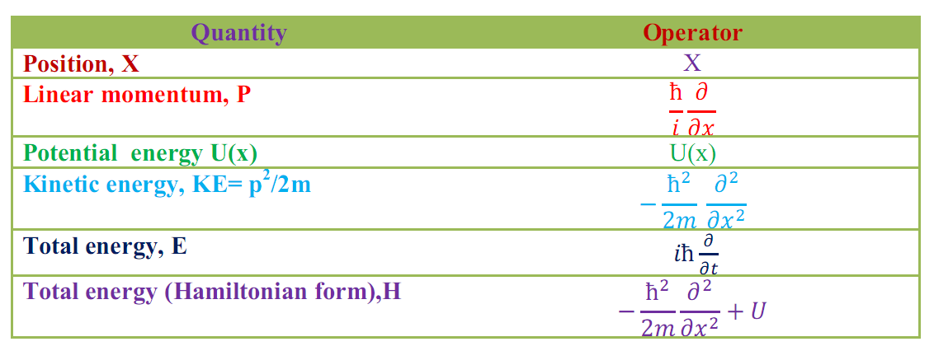
so we can say that the various E_{n} are the eigenvalues of the Hamiltonian operator Hˆ. This kind of association between eigenvalues and quantum-mechanical operators is quite general. Table 5.1 lists the operators that correspond to various observable quantities.
Table 5.1 Operators Associated with Various Observable Quantities

Slide 33
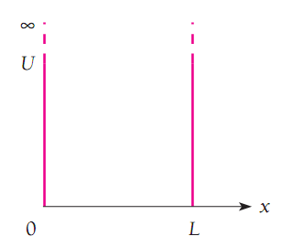
PARTICLE IN A BOX
The simplest quantum- mechanical problem is that of a particle trapped in a box with infinitely hard walls. Consider a particle that is restricted to traveling along the x axis between x = 0and x = L by infinitely hard walls. This situation can be described by the potential energy U that is infinite on both sides of the box and is a finite constant on the inside. Because the particle cannot have an infinite amount of energy, it cannot exist outside the box. Hence, the wave function 𝜓 is zero for x≤0 and x ¸ ≥ L. We will calculate the steady-state wave function 𝜓 for the inside of the box.
FIG.5.1: An infinite potential.

Slide 34
Inside the box, U is a constant. For convenience, we take U = 0 for the inside of the box. Then, the steady- state Schrodinger equation (5-21) becomes
$$\frac{∂^{2}ψ}{{∂x}^{2}}+\frac{2m}{ħ^{2}}Eψ=0 (5−36)$$
Since U = 0 there. (The total derivative d²ѱ/dx² is the same as the partial derivative $\frac{∂^{2}ѱ}{{∂x}^{2}}$ because ѱ is a function only of x in this problem. The general solution of the above equation is
$$ψ=A\sin{\frac{\sqrt{2mE}}{ħ}}x+Bcos\frac{\sqrt{2mE}}{ħ}x (5−37)$$
Here, A and B are coefficients to be evaluated.

Slide 35
The boundary conditions are 𝜓 (0)=0 and 𝜓(L) = 0. From 𝜓 (0) = 0, sin 0 = 0 and cos 0 =1,we find B = 0. The condition 𝜓 (L)= 0 will be satisfied if sin $\frac{\sqrt{2mE}}{ħ}=0$, that is, if
$$\frac{\sqrt{2mE}}{ħ}l=nπ, with n=1,2,3… (5−38)$$
Hence, the energy of the particle can have only certain values
$$particle in a box E_{n}=\frac{n^{2}π^{2}ħ^{2}}{2ml^{2}} n=1,2,3,…….. (5−39)$$
The above values are the Eigen energies of the particle. They constitute the energy levels of the particle.

Slide 36
Wave function of a particle in a box
Since B = 0, the wave function of the particle inside a box is
$$ψ_{n}=A\sin{\frac{\sqrt{2mE_{n}}}{ħ}}x (5−40)$$
Using Eq.(5-39) for E_{n}, we find
$$ψ_{n}=A\sin{\frac{nπx}{L}} (5−41)$$
It is easy to verify that the above wave function satisfies the steady- state Schrodinger equation and the boundary conditions 𝜓(0)= 𝜓(L)= 0. Note that Eq.(5-41) is valid only for 0 ≤ x ≥ L. Outside the box, we have 𝜓_{n} = 0. We also note that the spatial derivative 𝜓_{n}´ of the wave function (5-41) is not continuous at x =0 as well as at x = L. The reason is that the box with infinitely hard walls is just an approximate model, not a realistic situation.

Slide 37
To find the constant A, we calculate the integral of |Ψ_{n}|² from x = -∞ to x =+∞. We find
$$\int_{−∞}^{∞}{{\left|Ψ\right|}^{2}}dx=\int_{0}^{L}{{\left|Ψ\right|}^{2}dx}=A^{2}\int_{0}^{L}{\sin^{2}{\frac{nπx}{L}}} dx = \frac{A^{2}}{2}\int_{0}^{L}{\left(1−cos\frac{2nπx}{L}\right)dx=} \frac{A^{2}L}{2} (5−42)$$
To satisfy the normalization condition
$$\int_{−∞}^{∞}{{|Ψ|}^{2}}dx=1 (5−43)$$
We choose
$$A=\sqrt{\frac{2}{L}} (5−44)$$

Slide 38
Thus the normalized wave functions of the particle are
$$particle in a box ψ_{n}=\sqrt{\frac{2}{L}}\sin{\frac{nπx}{L}} with n=1,2,3,… (5−45)$$
The normalized wave functions 𝜓1, 𝜓 2 and 𝜓 3 together with the probability densities |Ψ₁|^{2,} |Ψ₂|² and |Ψ₃|² are plotted in Fig. 5.2.
As seen, 𝜓_{n} = 0 at x = 0 and x = L. At a particular place in the box, the probability of finding the particle may be very different for different quantum numbers. For example,

Slide 39
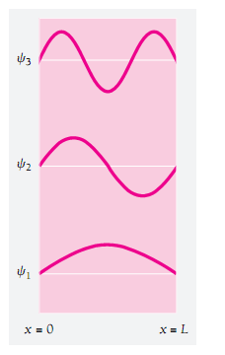
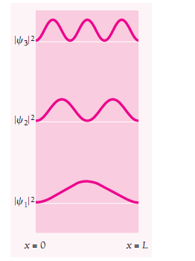
Fig.5.2: Wave functions and probability densities of a particle in a box with rigid walls.
|Ψ₁|² has its maximum value in the middle of the box, while |Ψ₂|² = 0 there. In other words, a particle in the lowest energy level of n =1 is most likely to be in the middle of the box, while a particle in the next higher state of n =2 is never there. Classical physics, of course, suggests the same probability for the particle being anywhere in the box.

Slide 40
Example
Find the probability that a particle trapped in a box L wide can be found between 0.45L and 0.55L for the ground and first excited states.
Solution
This part of the box is one-tenth of the box’s width and is centered on the middle of the box. Classically we would expect the particle to be in this region 10 percent of the time. Quantum mechanics gives quite different predictions that depend on the quantum number of the particle’s state. The probability of finding the particle between x₁ and x₂ when it is in the nth state is
$$P_{x1x2}=\int_{x1}^{x2}{{|ѱ_{n}|}^{2}dx =\frac{2}{L} \int_{x1}^{x2}{\sin^{2}{\frac{nπx}{L}}} dx=(\frac{x}{L}−\frac{1}{2πn}\sin{\frac{2nπx}{L}})\begin{matrix}x_{2} \\ ⃒ \\ x_{1}\end{matrix} }$$
$$=\frac{x_{2}−x_{1}}{L}−\frac{1}{nπ}cos\frac{nπ(x_{2}+x_{1})}{L}sin\frac{nπ(x_{2}−x_{1})}{L}$$

Slide 41
For x₁=0.45 L and x₂ = 0.55 L, we obtain
$$P_{x1x2}=\frac{1}{10}−\frac{1}{nπ}cosnπ sin\frac{nπ}{10}= \frac{1}{10}+{(−1)}^{n+1 }\frac{sin\frac{nπ}{10}}{nπ}$$
For the ground state, which corresponds to n =1, we have
$$P_{x1x2}=0.198=19.8\%$$
This is about twice the classical probability.
For the first excited state, which corresponds to n =2, we have
$$P_{x1x2}=0.0065=0.65\%$$
This low probability is consistent with the fact that |ѱ₂|² = 0 at x = 0.5 L.
Note that, when n is very large, we have Px₁x₂ → (x₂-x₁) = L. This result is in agreement with classical physics, as required by the correspondence principle.

Slide 42
Example
Consider a particle trapped in a box of with L. Find the expectation value <x˃ of the position of the particle.
Solution
$$<x˃=\int_{0}^{L}{x{\left|ѱ\right|}^{2}dx}=\frac{2}{L}\int_{0}^{L}{x\sin^{2}\frac{nπx}{L}dx}=\frac{2}{L}\left[\frac{x^{2}}{4}−\frac{xsin\left(\frac{2nπx}{L}\right)}{\frac{4nπ}{L}}−\frac{cos\left(\frac{2nπx}{L}\right)}{8{\left(\frac{nπ}{L}\right)}^{2}}\right]=\frac{L}{2}$$
This result means that the average position of the particle is the middle of the box. It reflects the symmetry of the system. There is no conflict with the fact that |𝜓_{n}|²=0 at L/2 for the states of n =2, 4, 6,…because <x˃ is an average, not a probability.

Slide 43
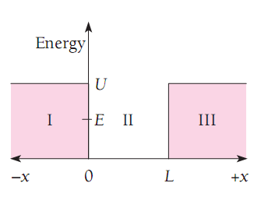
Finite potential well
Potential energies are never infinite in the real world. Therefore, the box with infinitely hard walls has no physical counterpart. However, potential wells with barriers of finite heights certainly do exist.
Consider a potential well with square corners that is U high and L wide and contains a particle whose energy E is less than U. According to classical mechanics, when the particle strikes the sides of the well, it bounces off without entering regions I and III. In quantum mechanics, the particle also bounces back and forth, but now it has a probability of penetrating in to regions I and III even though E<U.
Fig. 5.3 A finite potential well.

Slide 44
In regions I and III, the steady-state Schrodinger equation is
$$\frac{∂^{2}ψ}{{∂x}^{2}}+\frac{2m}{ħ^{2}}\left(E−U\right)ψ=0$$
We rewrite the above equation as
$$\frac{∂^{2}ψ}{{∂x}^{2}}−a^{2}ψ=0 , x<0 and x>L (5−46)$$
Where $a=\frac{\sqrt{2m(U−E)}}{ħ}˃0.$
The solution to eq.(5-46) are
$$ψ_{I}=Ae^{ax}+Be^{−ax} (5−47)$$
$$ψ_{III}=Ce^{ax}+De^{−ax} (5−48)$$

Slide 45
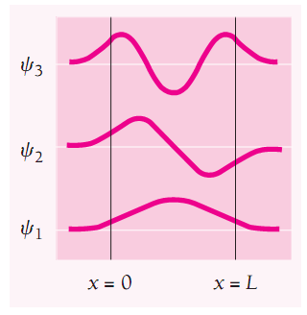
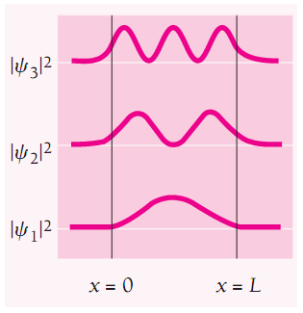
Fig.5.4 Wave functions and probability densities of a particle in a finite potential well.
Both 𝜓_{I} and 𝜓_{III} must be finite everywhere. Since $e^{−ax}→∞ as x→−∞ and e^{ax}→∞ as x→∞, the coefficients B and C must be zero. hence we have$
$$ψ_{I}=Ae^{ax} (5−49)$$
$$ψ_{III}=De^{−ax} (5−50)$$

Slide 46
These wave functions decrease exponentially inside the barrier at the sides of the well.
Inside the well, the steady-state Schrodinger equation is the same as Eq.(5-36), that is,
$$\frac{∂^{2}ψ}{{∂x}^{2}}+\frac{2m}{ħ^{2}}Eψ=0$$
The solution is again
$$ψ_{II}=G\sin{\frac{\sqrt{2mE}}{ħ}x+}F\cos{\frac{\sqrt{2mE}}{ħ}x } (5−51)$$
In the case of a well with infinitely high barriers, we found that F = 0 in order that 𝜓 =0 at x =0 and x = L. Here, because 𝜓_{II} = A at x = 0 and 𝜓_{II} = D at x = L, both the sine and cosine components in the solution (5-51) are possible.

Slide 47
For either solution, both 𝜓 and d𝜓 /dx must be continuous at x = 0 and x = L. The wave functions inside and outside each side of the well must have the same values and the same slopes where they join. When these boundary conditions are taken into account, we find that exact matching occurs only for certain specific values E_{n} of the particle energy.

Slide 48
HARMONIC OSCILLATOR
Its energy levels are evenly spaced
In the special case of simple harmonic motion, the restoring force F on a particle of mass m is linear; that is, F is proportional to the particle’s displacement x from its equilibrium position and in the opposite direction. Thus
$$Hookes law F=−kx$$
From the second law of motion, F=ma, we have
$$−kx=m\frac{d^{2}x}{{dt}^{2}}$$
$$harmonic oscilator \frac{d^{2}x}{{dt}^{2}}+\frac{k}{m}x=0 (5−52)$$
a common solution of equation (5-52) is

Slide 49
$$x=Acos\left(2πνt+∅\right) (5−53)$$
Where
$$frequancy of harmonic oscilator ν=\frac{1}{2π}\sqrt{\frac{k}{m}} (5−54)$$
is the frequency of the oscillations and A is their amplitude. The value of ø , the phase angle, depends upon what x is at the time t = 0 and on the direction of motion then.
any system in which something executes small vibrations about an equilibrium position behaves very much like a simple harmonic oscillator.
To verify this important point, we note that any restoring force which is a function of x can be expressed in a Maclaurin’s series about the equilibrium position x=0 as

Slide 50
$$F\left(x\right)=F_{x=0}+{(\frac{dF}{dx})}_{x=0} x+\frac{1}{2} {(\frac{d^{2}F}{{dx}^{2}})}_{x=0} x^{2}+\frac{1}{6} {(\frac{d^{3}F}{{dx}^{3}})}_{x=0} x^{3}+…$$
Since x = 0 is the equilibrium position, F_{x=0} = 0. For small x the values of x², x³, . . . are very small compared with x, so the third and higher terms of the series can be neglected. The only term of significance when x is small is therefore the second one. Hence
$$F\left(x\right)={(\frac{dF}{dx})}_{x=0} x$$
which is Hooke’s law when (dF/dx)_{x=0} is negative, as of course it is for any restoring force. The conclusion, then, is that all oscillations are simple harmonic in character when their amplitudes are sufficiently small.

Slide 51
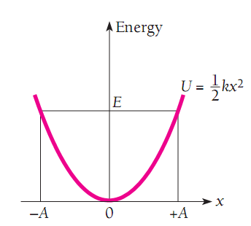
The potential-energy function U(x) that corresponds to a Hooke’s law force may be found by calculating the work needed to bring a particle from x = 0 to x = x against such a force. The result is
$$U\left(x\right)=−\int_{0}^{x}{F\left(x\right)dx=k\int_{0}^{x}{xdx=\frac{1}{2}kx^{2}}} (5−55)$$
Which is plotted in Fig(5.5.) The curve of U(x) versus x is a parabola. If the energy of the oscillator is E, the particle vibrates back and forth between x = - A and x =+A, where E and A are related by $E=\frac{1}{2}kA^{2}.$
Fig.5.5 The potential energy of a harmonic. is proportional to x², where x is the displacement from the equilibrium position. The amplitude A of the motion is determined by the total energy E of the oscillator, which classically can have any value.

Slide 52
Even before we make a detailed calculation we can anticipate three quantum mechanical modifications to this classical picture:
1- The allowed energies will not form a continuous spectrum but instead a discrete spectrum of certain specific values only.
2-The lowest allowed energy will not be E = 0 but will be some definite minimum E = E₀.
3- There will be a certain probability that the particle can penetrate the potential well it is in and go beyond the limits of -A and +A.

Slide 53
Energy Levels
Schrödinger’s equation for the harmonic oscillator is, with $U= \frac{1}{2}kx^{2}$
$$\frac{d^{2} ѱ}{{dx}^{2}}+\frac{2m}{ħ^{2}}\left(E−\frac{1}{2}kx^{2}\right)ѱ=0 (5−56)$$
$$y={( \frac{1}{ħ}\sqrt{km })}^{1/2} x=\sqrt{\frac{2πmν}{ħ}} x (5−57)$$
$$α=\frac{2E}{ħ}\sqrt{\frac{m}{k}}=\frac{2E}{hν} (5−58)$$
where ν is the classical frequency of the oscillation given by Eq. (5.54). In making these substitutions, what we have done is change the units in which x and E are expressed from meters and joules, respectively, to dimensionless units.

Slide 54
In terms of y and α Schrödinger’s equation becomes
$$\frac{d^{2} ѱ}{{dy}^{2}}+\left(α−y^{2}\right)ѱ=0 (5−59)$$
The solutions to this equation that are acceptable here are limited by the condition that
ѱ→0 as y→∞ in order that
$$\int_{−∞}^{∞}{{\left|ѱ\right|}^{2}dy=1}$$
Otherwise the wave function cannot represent an actual particle. The mathematical properties of Eq. (5.59) are such that this condition will be fulfilled only when
α=2n+1 n= 0,1,2,3,….

Slide 55
Since α= 2E/hν according to Eq. (5.58), the energy levels of a harmonic oscillator whose classical frequency of oscillation is ν are given by the formula
$$Energy level of harmonic oscilator E_{n}=\left(n+\frac{1}{2}\right)hν , n=0,1,2,3,… (5−60)$$
The energy of a harmonic oscillator is thus quantized in steps of hν. We note that when n =0,
$$Zero point energy E_{0}=\frac{1}{2}hν (5−61)$$
which is the lowest value the energy of the oscillator can have. This value is called the zero-point energy because a harmonic oscillator in equilibrium with its surroundings would approach an energy of E = E₀ and not E = 0 as the temperature approaches 0 K.

Slide 56
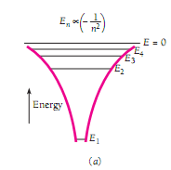
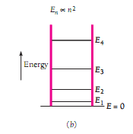
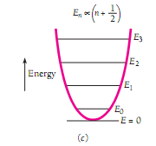
Fig. 5.6 is a comparison of the energy levels of a harmonic oscillator with those of a hydrogen atom and of a particle in a box with infinitely hard walls. The shapes of the respective potential-energy curves are also shown. The spacing of the energy levels is constant only for the harmonic oscillator.
Fig. 5.6 Potential wells and energy levels of (a) a hydrogen atom, (b) a particle in a box, and (c) a harmonic oscillator. In each case the energy levels depend in a different way on the quantum number n. Only for the harmonic oscillator are the levels equally spaced.

Slide 57
Wave Functions
For each choice of the parameter n there is a different wave function ѱ_{n}. Each function consists of a polynomial H_{n}(y) (called a Hermite polynomial) in either odd or even powers of y, the exponential factor $e^{−y^{2}/2}$, and a numerical coefficient which is needed for ѱn to meet the normalization condition
$$\int_{−∞}^{∞}{{\left|ѱ\right|}^{2}dy=1 } n=0,1,2,3,….$$
The general formula for the nth wave function is
$$Harmonic oscilator ѱ_{n}={\left(\frac{2mν}{ħ}\right)}^{\frac{1}{4}}{(2^{n}n!)}^{−1/2} H_{n}\left(y\right)e^{−\frac{y^{2}}{2}} (5.62)$$

Slide 58
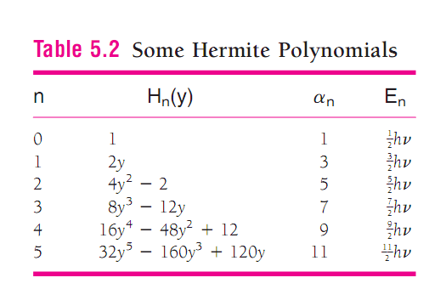
The first six Hermite polynomials H (y) are listed in Table 5.2. The wave functions that correspond to the first six energy levels of a harmonic oscillator are shown in Fig. 5.7.

Slide 59
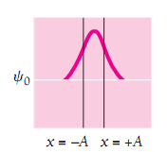
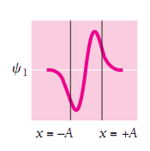
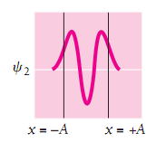
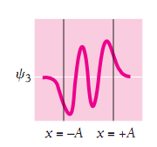
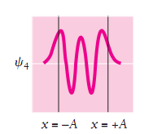
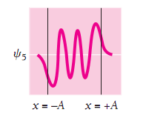
Fig.5.7 The first six harmonic oscillator wave functions. The vertical lines show the limits -A and +A between which a classical oscillator with the same energy would vibrate.

Slide 60
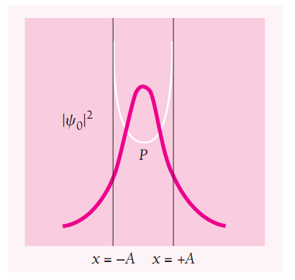
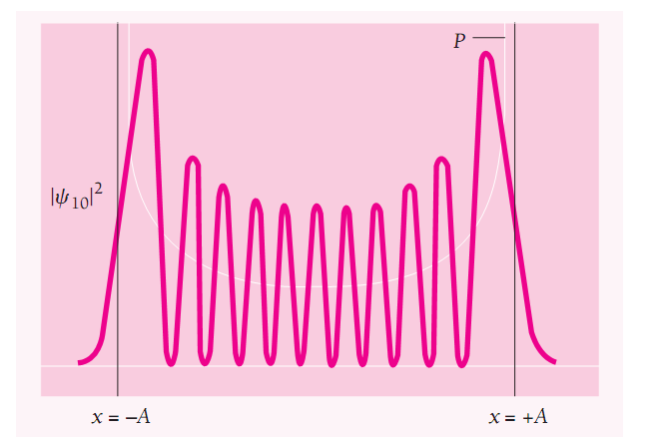
The probability density ${\left|ѱ_{0}\right|}^{2}$ has its maximum value at x = 0 and drops off on either side of this position. However, this disagreement becomes less and less marked with increasing n. The lower graph of Fig.5.8 corresponds to n = 10, and it is clear that ${\left|ѱ_{10}\right|}^{2}$ when averaged over x has approximately the general character of the classical probability P.
Fig. 5.8 Probability densities for the n = 0 and n = 10 states of a quantum-mechanical harmonic oscillator. The probability densities for classical harmonic oscillators with the same energies are shown in white. In the n = 10 state, the wavelength is shortest at x = 0 and longest at x =-A.

Slide 61
Example
Find the expectation value ˂x ˃for the first two states of a harmonic oscillator.
Solution
The general formula for ˂ x˃ is
$$<x> =\int_{−∞}^{∞}{x{\left|ѱ\right|}^{2}dx}$$
In calculations such as this it is easier to begin with y in place of x and afterward use Eq. (5.57) to change to x. From Eq. (5.62) and Table 5.2,
$$ѱ_{0}={\left(\frac{2mν}{ħ}\right)}^{\frac{1}{4}}e^{−\frac{y^{2}}{2}} and ѱ_{1}={\left(\frac{2mν}{ħ}\right)}^{\frac{1}{4}} {(\frac{1}{2})}^{1/2}(2y){ e}^{−\frac{y^{2}}{2}}$$
The values of ˂x˃ for n = 0 and n = 1 will respectively be proportional to the integrals

Slide 62
$$n=0: \int_{−∞}^{∞}{y{\left|ѱ_{0}\right|}^{2}dy=\int_{−∞}^{∞}{ye^{−y^{2}}dy=−\left[\frac{1}{2}e^{−y^{2}}\right]\begin{matrix}+∞ \\ ⃒ \\ −∞\end{matrix}=0}}$$
$$n=1: \int_{−∞}^{∞}{y{\left|ѱ_{1}\right|}^{2}dy=\int_{−∞}^{∞}{y^{3}e^{−y^{2}}dy=−\left[(\frac{1}{4}+\frac{y^{2}}{2})e^{−y^{2}}\right]\begin{matrix}+∞ \\ ⃒ \\ −∞\end{matrix}=0}}$$
The expectation value ˂x˃ is therefore 0 in both cases. In fact, ˂x˃ = 0 for all states of a harmonic oscillator, which could be predicted since x =0 is the equilibrium position of the oscillator where its potential energy is a minimum.

Slide 63
EXERCISE 5
1. Which of the following wave functions cannot be solutions of Schrödinger's equation for all values of x? why not? (a) Ѱ=A sec x; (b) Ѱ=A tanx; (c) Ѱ=A exp (x²).
Solution
The functions (a) and (b) are both infinite when cosx=0, at x=±𝞹/2, ±3𝞹/2,……±(2n+1)𝞹/2 for any integer n, neither Ѱ=A sec x; or Ѱ=A tanx could be a solution of Schrodinger’s equation for all values of x. the function (c) diverges as x=±∞, and cannot be a solution of Schrodinger’s equation for all values of x.

Slide 64
2. Find the value of the normalization constant A for the wave function
$$ѱ=Axe^{−x^{2}/2}$$
Solution
$$\int_{−∞}^{∞}{A^{2}x^{2}{(e^{−x^{2}/2})}^{2}dx=1}→A^{2}\int_{−∞}^{∞}{x^{2}{(e^{−x^{2}/2})}^{2}dx=1}$$
$$A^{2}\int_{−∞}^{∞}{x^{2}e^{−x^{2}}dx=1}→{2 A}^{2}\int_{0}^{∞}{x^{2}e^{−x^{2}}dx=1}$$
$${2 A}^{2}\left[\frac{\sqrt{π}}{4}\right]=1$$
$$A={(\frac{4}{π})}^{1/4}$$

Slide 65
3. The wave function of a certain particle is$ѱ=A\cos^{2}{x }for−π/2<x<=π/2$. (a) Find the value of A. (b) Find the probability that the particle be found between x = 0 and x = 𝞹/4.
Solution
$$\int_{−π/2}^{π/2}{ѱ^{∗}ѱ}dx=A^{2}\int_{−π/2}^{π/2}{\cos^{4}xdx}$$
$$A^{2}[\frac{3}{8}\int_{−π/2}^{π/2}{dx+\frac{1}{2}}\int_{−π/2}^{π/2}{\cos{2}xdx+\frac{1}{8}}\int_{−π/2}^{π/2}{\cos{4}xdx]=1}$$
The integrals
$$\int_{−π/2}^{π/2}{\cos{2}xdx=\frac{1}{2}\sin{2x}}\begin{matrix}π/2 \\ ⃒ \\ −π/2\end{matrix}and\int_{−π/2}^{π/2}{\cos{4}xdx=\frac{1}{4}\sin{4x}}\begin{matrix}π/2 \\ ⃒ \\ −π/2\end{matrix}$$
are seen to be vanish, and the normalization condition reduces to
$$1=A^{2}\left(\frac{3}{8}\right)π, or A=\sqrt{\frac{8}{3π}}.$$

Slide 66
(b)Evaluating the same integral between the different limits,
$$\int_{0}^{π/4}{\cos^{4}{x}dx=[\frac{3}{8}x+\frac{1}{4}\sin{2x}+\frac{1}{32}\sin{4x]}}\begin{matrix}π/4 \\ ⃒ \\ 0\end{matrix}=\frac{3π}{32}+\frac{1}{4},$$
The probability of the particle being found between x = 0 and x = 𝞹/4 is the product of this integral and A², or
$$A^{2}\left(\frac{3π}{32}+\frac{1}{4}\right)=\frac{8}{3π}\left(\frac{3π}{32}+\frac{1}{4}\right)=0.46$$

Slide 67
$$<px> −<xp> = \frac{ħ}{i}$$
4. Show that the expectation values <px> and <xp> are related by
solution
$$\left(pˆxˆ\right)Ѱ=pˆ\left(xˆѰ\right)=\frac{ħ}{i}\frac{∂}{∂x}\left(xѰ\right)=\frac{ħ}{i}\left[Ѱ+x\frac{∂}{∂x}Ѱ\right],$$
where the product rule for partial differentiation has been used. Also,
$$\left(xˆpˆ\right)Ѱ=xˆ\left(pˆѰ\right)=x\left(\frac{ħ}{i}\frac{∂}{∂x}Ѱ\right)=\frac{ħ}{i}\left[x\frac{∂}{∂x}Ѱ\right].$$
Thus $\left(pˆxˆ−xˆpˆ\right)Ѱ=\frac{ħ}{i}Ѱ$
And $<px−xp> =\int_{−∞}^{∞}{Ѱ^{∗}\frac{ħ}{i}Ѱdx=\frac{ħ}{i}\int_{−∞}^{∞}{Ѱ^{∗}Ѱdx=}} \frac{ħ}{i}$

Slide 68
5. Consider a particle in a box. Show that as n →∞, the probability of finding the particle between x and x+∆x is ∆x/L and so is independent of x, which is the classical expectation.
Solution
The probability of finding the particle between x and ∆x is
$$P_{x, x+∆x}=\int_{x}^{x+∆x}{{|ѱ_{n}|}^{2}dx =\frac{2}{L} \int_{x}^{x+∆x}{\sin^{2}{\frac{nπx}{L}}} dx=(\frac{x}{L}−\frac{1}{2πn}\sin{\frac{2nπx}{L}})\begin{matrix}x+∆x \\ ⃒ \\ x\end{matrix} }$$
$$=\frac{∆x}{L}−\frac{1}{2nπ}sin\frac{2nπ\left(x+∆x\right)}{L}+\frac{1}{2nπ}sin\frac{nπx)}{L}$$
As n→∞ the last two terms vanish. Hence, we obtain in this limit the classical result
$$P_{x, x+∆x}=\frac{∆x}{L}$$

Slide 69
6. Find the probability that a particle in a box L wide can be found between x = 0 and x = L/n, when it is in the nth state.
Solution
This is a special case of the probability that such a particle is between x₁ and x₂, as found in Example 5.4. With x = 0 and x = L/n,
$$P_{0L}=[\frac{x}{L}−\frac{1}{2nπ}sin\frac{2nπx}{L}\begin{matrix}L/n \\ ]= \\ 0\end{matrix} \frac{1}{n}.$$

Slide 70
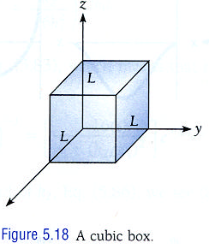
7. A particle is in a cubic box with infinitely hard walls whose edges are L long (Fig. 5. 18). The wave functions of the particle are given by
$$ψ=A\sin{\frac{n_{x}πx}{L}} \sin{\frac{n_{y}πy}{L}} \sin{\frac{n_{z}πz}{L}}$$
$$n_{x}=1,2,3,…$$
$$n_{y}=1,2,3,…$$
$$nz=1,2,3,…$$
Find the value of the normalization constant A.
Solution
The normalization constant, assuming A to be real, is given by
$$\int{ѱ^{∗}ѱdV}=1=\int{ѱ^{∗}ѱdxdydz}$$

Slide 71
$$=A^{2}(\int_{0}^{L}{\sin^{2}\frac{n_{x}πx}{L}dx})(\int_{0}^{L}{\sin^{2}\frac{n_{y}πy}{L}dy})(\int_{0}^{L}{\sin^{2}\frac{n_{z}πz}{L}dz})$$
Each integral above is equal to L/2 (from calculations identical to Equation (5.42)). The result is
$$A^{2}{(\frac{L}{2})}^{3}=1 or A=({\frac{2}{L})}^{3/2}$$

Slide 72
8. (a) Find the possible energies of the particle in the box of Exercise 21 by substituting its wave function ѱ in Schrödinger's equation and solving for E. (Hint: inside the box U = 0.) (b) Compare the ground-state energy of a particle in a one-dimensional box of length L with that of a particle in the three-dimensional box.
Solution
(a)For the wave function of Problem 5-21, Equation (5.32) must be used to find the energy. Before substitution into Equation (5.32), it is convenient and useful to note that for this wave function
$$\frac{∂^{2}ѱ}{{∂x}^{2}}=−\frac{{n_{x}}^{2}π^{2}}{L^{2}}ѱ ,\frac{∂^{2}ѱ}{{∂y}^{2}}=−\frac{{n_{y}}^{2}π^{2}}{L^{2}}ѱ, \frac{∂^{2}ѱ}{{∂z}^{2}}=−\frac{{n_{z}}^{2}π^{2}}{L^{2}}ѱ$$
Then, substitution in to equation (5.32) gives
$$−\frac{π^{2}}{L^{2}}\left({n_{x}}^{2}+{n_{y}}^{2}+{n_{z}}^{2}\right)ѱ+\frac{2m}{ħ^{2}}Eѱ=0,$$
And so the energies are
$$E_{n_{x},n_{y},n_{z}}=\frac{π^{2}ħ^{2}}{2mL^{2}}\left({n_{x}}^{2}+{n_{y}}^{2}+{n_{z}}^{2}\right).$$

Slide 73
(b) The lowest energy occurs when n_{x} = n_{y} = n_{z} = 1. None of the integers n_{x}, n_{y}, or n_{z} can be zero, as that would mean ѱ= 0 identically. The minimum energy is then
$$E_{min}=\frac{3π^{2}ħ^{2}}{2mL},$$
which is three times the ground-state energy of a particle in a one-dimensional box of length L.

Slide 74
9. Find the expectation values <x> and <x2> for the first two states of a harmonic oscillator.
Solution
The expectation values will be of the forms
$$\int_{−∞}^{∞}{xѱ^{∗}ѱdx and }\int_{−∞}^{∞}{x^{2}ѱ^{∗}ѱdx }$$
It is far more convenient to use the dimensionless variable y as defined in Equation (5.57). The necessary integrals will be proportional to
$$\int_{−∞}^{∞}{ye^{−y^{2}}dy} ,\int_{−∞}^{∞}{y^{2}e^{−y^{2}}dy,} \int_{−∞}^{∞}{y^{3}e^{−y^{2}}dy,}\int_{−∞}^{∞}{y^{4}e^{−y^{2}}dy,}$$
The first and third integrals are seen to be zero

Slide 75
$$\int_{−∞}^{∞}{y^{2}e^{−y^{2}}dy}=\frac{1}{2}\sqrt{π}, \int_{−∞}^{∞}{y^{4}e^{−y^{2}}dy}=\frac{3}{4}\sqrt{π}.$$
An immediate result is that <x> = 0 for the first two states of any harmonic oscillator, and in fact <x> = 0 for any state of a harmonic oscillator (if x = 0 is the minimum of potential energy). A generalization of the above to any case where the potential energy is a symmetric function of x, which gives rise to wave functions that are either symmetric or antisymmetric, leads to <x> = 0.
To find <x²> for the first two states, the necessary integrals are
$$\int_{−∞}^{∞}{x^{2}{ѱ_{0}}^{∗}ѱ_{0}dx }={(\frac{2mν}{ħ})}^{1/2}{(\frac{ħ}{2πmν})}^{3/2}\int_{−∞}^{∞}{y^{2}e^{−y^{2}}dy}$$
$$=\frac{ħ}{2π^{3/2}mν} \frac{\sqrt{π}}{2}=\frac{\left(\frac{1}{2}\right)hν}{4π^{2}mν^{2}}=\frac{E_{0}}{k};$$

Slide 76
$$\int_{−∞}^{∞}{x^{2}{ѱ_{1}}^{∗}ѱ_{1}dx }={(\frac{2mν}{ħ})}^{1/2}{(\frac{ħ}{2πmν})}^{3/2}\int_{−∞}^{∞}{{2y}^{4}e^{−y^{2}}dy}$$
$$\frac{ħ}{2π^{3/2}mν} 2\frac{3\sqrt{π}}{2}=\frac{\left(\frac{3}{2}\right)hν}{4π^{2}mν^{2}}=\frac{E_{1}}{k}.$$
In both of the above integrals,
$$dx=\frac{dx}{dy}dy=\sqrt{\frac{ħ}{2πmν}}dy$$
has been used, as well as Table 5.2 and Equation (5.54).

Slide 77
10. A pendulum with a 1.00-g bob has a massless string 250 mm long. The period of the pendulum is 1.00 s. (a) what is its zero-point energy? Would you expect the zero-point oscillations to be detectable? (b) The pendulum swings with a very small amplitude such that its bob rises a maximum of 1.00 mm above its equilibrium position. What is the corresponding quantum number?
Solution
(a)The zero-point energy would be
$$E_{0}=\frac{1}{2}hν=\frac{h}{2T}=\frac{4.14×{10}^{−15}eV}{2(1s)}=2.07×{10}^{−15 }eV ,which is not detectable.$$
(b)The total energy is E = mgH (here, H is the maximum pendulum height, given as an uppercase letter to distinguish from Planck's constant), and solving Equation (5.60) for n,
$$n=\frac{E}{hν}−\frac{1}{2}=\frac{mgH}{\frac{h}{T}}=\frac{\left(1×{10}^{−3}kg\right)\left(\frac{9.8m}{s^{2}}\right)(1×{10}^{−3}m)\left(1s\right)}{6.63×{10}^{−34}J.s}−\frac{1}{2}=1.48×{10}^{28}.$$

Slide 78
Q1. Which of the following functions are Eigen functions of operator $\frac{d^{2}}{{dx}^{2}}$? Find the Eigen value in each state.
$ѱ=Asin mx$ 2- $ѱ=Bcos nx$ 3-$ѱ={cx}^{2}$
4- $ѱ=Ae^{−mx}$

