Slide 1
Lab 3.
Prepared by
Blnd Ibrahim Mohammed
2022-2023

Slide 2
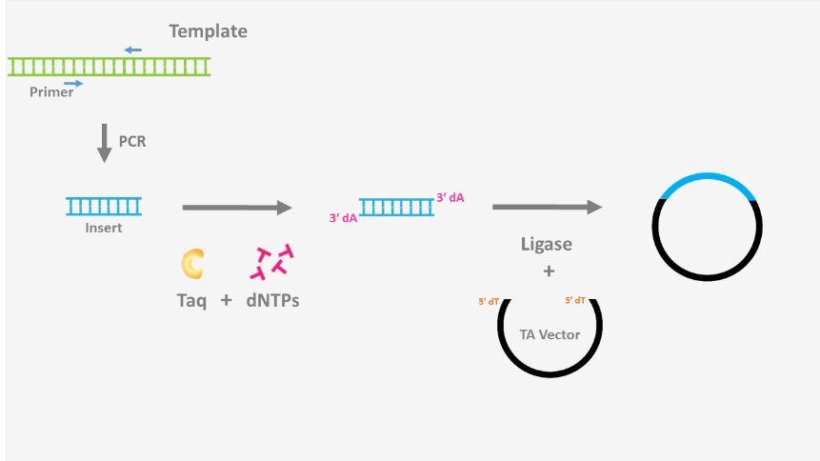
DNA Ligation
DNA ligation is an important technique in molecular cloning and in the generation of recombinant DNA. DNA ligation is the act of joining together DNA strands with covalent bonds with the aim of making new viable DNA or plasmids. The enzyme routinely used is the (T4 bacteriophage), T4 DNA ligase that creates a phosphodiester bond between the 3' hydroxyl of one nucleotide and the 5' phosphate of another (Below figure). This reaction requires adenosine triphosphate (ATP).
T4 DNA ligase is able to ligate overhanging, cohesive (sticky) ends and blunt ends, although a higher concentration of enzyme is required. The major reason being that the complementary ends aid in ligation by bringing matching DNA ends together, in the case of blunt ended DNA there is no initial attraction of the two strands to be joined.

Slide 3
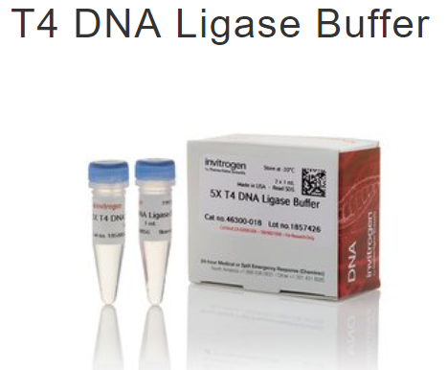
Components
Two or more fragments of DNA that have compatible ends.
A buffer that has 0.25-1mM ATP (adenosine triphosphate) to provide the necessary energy for the reaction.
The T4 DNA ligase itself.
The ideal temperature for the T4 DNA ligase reaction is 16°C, however it works over a range of temperatures, so 4°C or room temperature can also be used. The optimal temperature for a ligation is a balance between the optimal temperature for T4 DNA Ligase enzyme activity (16°C) and the temperature necessary to ensure annealing of the fragment ends (the melting temperature), which can vary with the length and base composition of the overhangs. For most sticky ends 90-100% ligation is achieved at 16ºC after a 16 hour ligation.

Slide 4
Components
Two or more fragments of DNA that have compatible ends.
A buffer that has 0.25-1mM ATP (adenosine triphosphate) to provide the necessary energy for the reaction.
The T4 DNA ligase itself.
The ideal temperature for the T4 DNA ligase reaction is 16°C, however it works over a range of temperatures, so 4°C or room temperature can also be used. The optimal temperature for a ligation is a balance between the optimal temperature for T4 DNA Ligase enzyme activity (16°C) and the temperature necessary to ensure annealing of the fragment ends (the melting temperature), which can vary with the length and base composition of the overhangs. For most sticky ends 90-100% ligation is achieved at 16ºC after a 16 hour ligation.
he ideal ratios for ligating insert to vector for sticky end ligations ranges between 1:1 and 3:1, where as for blunt ended ligations the insert/vector ration should be at least 10:1

Slide 5
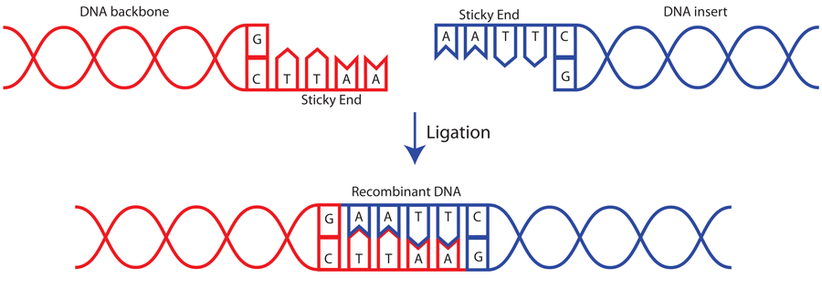
Ratios
he ideal ratios for ligating insert to vector for sticky end ligations ranges between 1:1 and 3:1, where as for blunt ended ligations the insert/vector ration should be at least 10:1

Slide 6
Procedure
Ligation of a DNA fragment with a plasmid vector Protocol
Mix linearized plasmid vector DNA and a DNA fragment in a total volume of 10 μl. We recommend TE buffer (10 mM Tris-HCI pH 8.0, 1 mM EDTA) for dissolving DNA.
Add 3 μl of treated vector (about 50 ng).
Add same volume of treated DNA and complete the reaction to (10 μl) with solution 1.
Mix thoroughly.
Incubate at 16℃ for 30 minutes
Note: the ligation reaction mixture can be used directly for transformation of E. coli competent cells. When performing transformation immediately after ligation, use 10 μl of the ligation mixture to transform 100 μl of competent cells.
As mentioned: the reaction should be carried out at 16℃. higher temperatures inhibit the enzyme. In case of negative result, the time should be extended to overnight.

Slide 7
Procedure
Ligation of a DNA fragment with a plasmid vector Protocol
Mix linearized plasmid vector DNA and a DNA fragment in a total volume of 10 μl. We recommend TE buffer (10 mM Tris-HCI pH 8.0, 1 mM EDTA) for dissolving DNA.
Add 3 μl of treated vector (about 50 ng).
Add same volume of treated DNA and complete the reaction to (10 μl) with solution 1.
Mix thoroughly.
Incubate at 16℃ for 30 minutes
Note: the ligation reaction mixture can be used directly for transformation of E. coli competent cells. When performing transformation immediately after ligation, use 10 μl of the ligation mixture to transform 100 μl of competent cells.
As mentioned: the reaction should be carried out at 16℃. higher temperatures inhibit the enzyme. In case of negative result, the time should be extended to overnight.

Slide 8
Procedure
A. Ligation of a DNA fragment with a plasmid vector Protocol
Mix linearized plasmid vector DNA and a DNA fragment in a total volume of 10 μl. We recommend TE buffer (10 mM Tris-HCI pH 8.0, 1 mM EDTA) for dissolving DNA.
Add 3 μl of treated vector (about 50 ng).
Add same volume of treated DNA and complete the reaction to (10 μl) with solution 1.
Mix thoroughly.
Incubate at 16℃ for 30 minutes
Note: the ligation reaction mixture can be used directly for transformation of E. coli competent cells. When performing transformation immediately after ligation, use 10 μl of the ligation mixture to transform 100 μl of competent cells.
As mentioned: the reaction should be carried out at 16℃. higher temperatures inhibit the enzyme. In case of negative result, the time should be extended to overnight.
B. Self-circularization of linear DNA (Intramolecular ligation)
The protocol for self-circularization of linear DNA is essentially the same as for "A. Ligation of a DNA fragment with a plasmid vector". However, it is important to use low concentrations of DNA in the ligation reaction to maximize intramolecular ligation as well as to keep the volume of the DNA solution low for higher transformation efficiency.

Slide 9
Competent Cells
Background
Bacterial transformation is a natural process in which cells take up foreign DNA from the environment at a low frequency. After transformation, the cells may express the acquired genetic information, which may serve as a source of genetic diversity and potentially provide benefits to the host (e.g., antibiotic resistance). With the advent of molecular cloning in the 1970s, the process of transformation was exploited and enhanced to introduce recombinant plasmid DNA into bacterial strains that were made “competent,” or more permeable, for DNA uptake.
Competent cells are microbial cells that can readily take up foreign DNA from their surroundings through a process called transformation. Commercial competent cells are generally bacteria or yeast that have been artificially induced for competence. One common type is a chemically competent cell, which uses heating and chemical treatment (generally with calcium chloride) to facilitate the uptake of exogenous DNA. Electrocompetent cells on the other hand rely on electric pulses to briefly create openings in the cell membrane for DNA entry. This is also known as electroporation. Competent cells are a staple component of molecular cloning, enabling investigations in gene expression, protein expression, and more. Visit the supplier page for more product information, including transformation method and cellular specifications.

Slide 10
There are two main methods for the preparation of competent cells.
Calcium chloride method.
Electroporation.
Calcium chloride transformation technique is the most efficient technique among the competent cell preparation protocols. It increases the bacterial cell’s ability to incorporate plasmid DNA, facilitating genetic transformation. Addition of calcium chloride to the cell suspension allows the binding of plasmid DNA to LPS. Thus, both the negatively charged DNA backbone and LPS come together and when heat shock is provided, plasmid DNA passes into the bacterial cell. Prepare 2000 ml of 50 mM Calcium.
chloride stock solution by adding 14.701 g of CaCl2.2H2O in 2 l of milli-Q water, autoclave, and store at 4 °C.

Slide 11
Calcium chloride method
1. Shake E. coli at 37 °C overnight in 3 ml of LB.
2. Add 0.5 ml of the overnight culture into 50 ml of LB in a 200-ml flask, at 37 °C.
3. Monitor OD600. When OD600 of 0.35-0.4 is reached, chill the culture on ice.
4. Transfer the culture to a sterile centrifuge tube, and collect cells by centrifugation at 6,000 rpm for 8 minutes at (4 °C). Discard the supernatant.
5. Resuspend the cells in 20 ml of ice-cold 50 mM CaCl2. Incubate on ice for 20 minutes. Collect cells by centrifugation as in step 4.
6. Resuspend the cells in 2.5 ml of ice-cold 50 mM CaCl2, or, if you store the competent cells for long period as frozen stock, resuspend the cells in 2.5 ml of ice-cold 50 mM CaCl2 containing 10% glycerol.
7. Use 100-200 microliters of the competent cells for transformation, or dispense the competent cells into aliquotes of 100-200 microliters and freeze in liquid nitrogen for later use.
Note: how to reuse? inoculate 0.05 ml of an overnight culture into 3 ml of LB, and, after shaking 100-120 min at 37 C, cells are washed with an ice-cold calcium solution. The cells resuspended in 100-150 microliters of the calcium solution are used for transformation.

