Slide 1
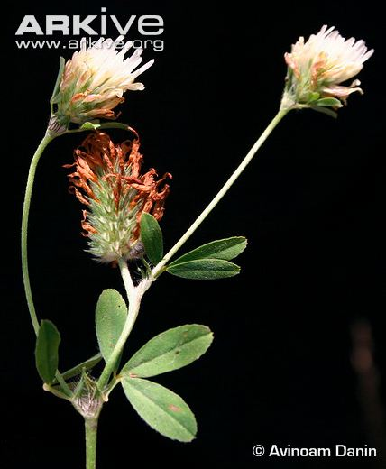
Berseem, berseem clover, Egyptian clover 3rd lecture Forage crops
Trifolium alexandrinum L
البرسيم المصري
BY Bnar Sardar Mustafa

Slide 2
Berseem (Trifolium alexandrinum L.) is one of the most important leguminous forages
Mediterranean region and in the Middle-East. Berseem is an annual, sparsely hairy, erect forage legume, 30 to 80 cm high. Berseem has a shallow taproot.
Its stems are hollow, branching at the base, with
alternate leaves bearing 4-5 cm long x 2-3 cm broad leaflets.
Flowers are yellowish-white and form dense, elliptical clustered heads about 2 cm in diameter. The flowers must be cross-pollinated by honey bees to produce seeds.
The fruit is a pod containing one single white to purplish-red seed.

Slide 3
Berseem is a variable species that can be classified into four cultivars groups according to their branching behavior and subsequent productivity. Highly branching and productive types are Miscawi and Kahdrawi
Berseem probably originated in Syria. It was introduced into Egypt in the 6th century

Slide 4
Berseem is mainly valued as a winter crop(mid of October) in the subtropics as it grows well in mid winter and recovers strongly after cutting. It does not grow well under hot summer conditions.
It is cultivated from 35°N to the Tropics.
Berseem has some frost tolerance, down to -6°C and as low as -15°C for some cultivars.
Berseem can grow in areas where annual rainfall ranges between 550 mm and 750 mm. Berseem has some frost tolerance, down to -6°C and as low as -15°C for some cultivar It can withstand some drought and short periods of water logging. It does better than alfalfa in high moisture soils and is very productive under irrigation.
It is moderately tolerant of salinity and can grow on a wide range of soils, though it prefers fertile, loamy to clay soils with mildly acidic to slightly alkaline pH (6.5-8)

Slide 5
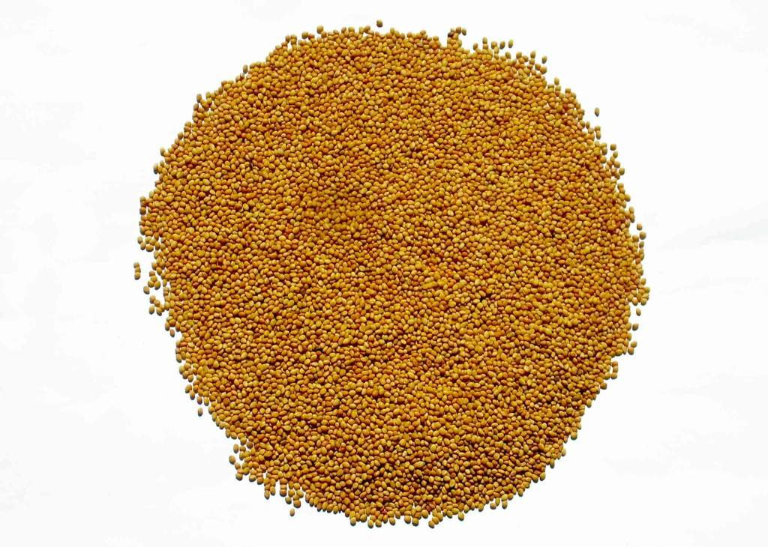

Slide 6
Berseem is only propagated by seeds and is usually sown in early autumn. It can be sown on a conventional seedbed or be direct drilled. Berseem can be sown alone or in combination with other species. It is mixed with grass (ryegrass) or with a winter cereal crop such as oats to make high quality silage.
Berseem can be integrated into a rice-wheat cropping system, as a winter and spring feed: it is then sown before or just after rice harvest.
In Australia, berseem is sown with other legumes such as arrow leaf clover (Trifolium vesiculosum), Persian clover (Trifolium resupinatum) or balansa clover (Trifolium michelianum). In some areas, berseem is sown with vegetables such as sarson (Brassica juncea) or turnips

Slide 7
Under irrigation, berseem must be sown earlier and irrigated on a weekly basis at the beginning. Ten to 15 irrigations are generally necessary for fodder production.
Highly branching and productive types such as Miscawi and Kahdrawi can yield 4-6 cuttings/season while Saidi can be cut only twice.
Fahl berseem is a low branching cultivar and is more adapted to dry areas.
Berseem should be cut when basal buds are short (about 2-4 cm high) so that they escape cutting, which would hamper regrowth and forage yield.

Slide 8
Berseem is a very palatable and fairly digestible forage. It is particularly valuable since it is a non-bloating forage legume.
Cultivated areas reached 1.3 million ha in 2007 in Egypt and 1.9 million ha in India

Slide 9
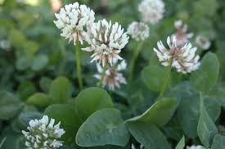

Slide 10
True clovers Trifolium spp البراسيم (النفل)
Clover or trefoil are common names for plants of the genus Trifolium (Latin, tres "three" + folium "leaf"), consisting of about 300 species of plants in the family Fabaceae. The genus has a cosmopolitan distribution;
The highest diversity is found in the temperate Northern Hemisphere, but many species also occur in South America and Africa, including at high altitudes on mountains in the tropics.
They are small annual, biennial or short lived perennial herbaceous plants.
Clover can be evergreen. The leaves are trifoliate(rarely quatrefoiled, cinquefoil, or septfoil), with stipules adnate to the leaf-stalk,
Heads or dense spikes of small red, purple, white, or yellow flowers; the small, few-seeded pods are enclosed in the clay

Slide 11
Clovers are important as livestock forage, green manure and cover crops, and also as honey plants.
Red clover (Trifolium pratense),
white clover (T. repens), and
alsike clover (T. hybridum) are the major species grown in Ontario, although numerous other species of Trifolium are cultivated in various parts of the world.

Slide 12
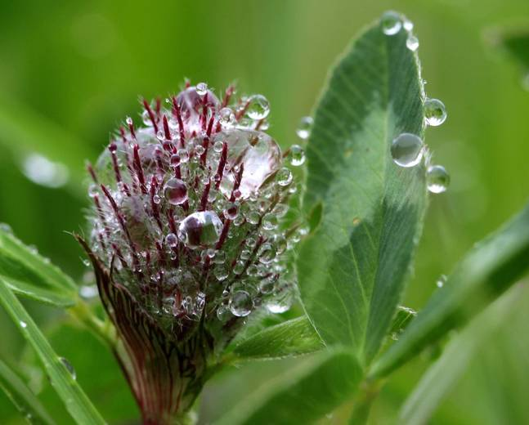
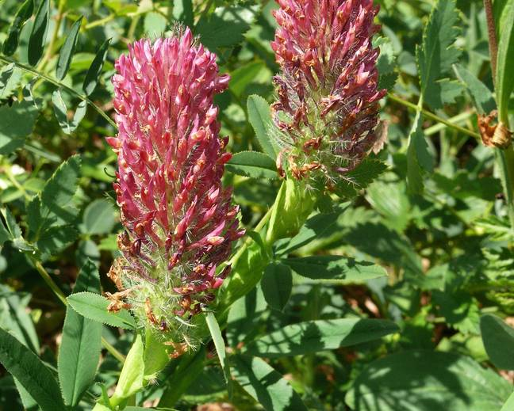
Red clover

Slide 13
The flowers of clover share a typical legume structure, although the tubular flowers are small and narrow, and grouped together in inflorescences.
The anthers release the pollen inside the bud prior to opening. When an insect visitor lands on the flower, its weight causes the anthers and stigma to extend forward and press against the head of the visitor.
Afterwards, the sexual structures return to their original position, allowing the same flower to deliver pollen repeatedly. In general, all three species of clover are self-sterile,
although some varieties (especially in white clover) are self-fertile. Insect pollinators are required for successful seed set

