Slide 1
Chapter (3) Fluid Dynamics Part (2)
3.2 Hydrodynamics:
Different forms of energy in a flowing liquid.
Bernoulli's equation and its application.
Energy line and Hydraulic Gradient Line.
Energy Equation.
Asst. Lect. Bruska S. Mamand

Slide 2
Forms of Energy
(1). Kinetic Energy: Energy due to motion of body. A body of mass, m, when moving with velocity, V, posses kinetic energy,
KE = ¹ mV ²
m and V are mass and velocity of body
2
(2). Potential Energy: Energy due to elevation of body above an arbitrary datum
Z is elevation of body from arbitrary datum
PE = mgZ
m is the mass of body
(3). Pressure Energy: Energy due to pressure above datum, most usually its pressure above atmospheric
PrE = γh
(4). Internal Energy: It is the energy that is associated with the molecular, or internal state of matter; it may be stored in many forms, including thermal, nuclear, chemical and electrostatic.

Slide 3
HEAD
Head: Energy per unit weight is called head
Kinetic head: Kinetic energy per unit weight
_{V} 2
KE ⎛ 1
₂ ⎞
(Weight = mg)
Kinetic head = = ⎜ mV ⎟ / mg =
Weight ⎝ 2 2g
⎠
Potential head: Potential energy per unit weigh
PE
= (mgZ )/ mg = Z
Potential head =
Weight
Pressure head: Pressure energy per unit weight
PrE ₌ P
Pressure head =
Weight γ

Slide 4
TOTAL HEAD
TOTAL HEAD
= Kinetic Head + Potential Head + Pressure Head
_{V} 2
Z
P
γ
2g
P
_{V} 2
Total Head = H = Z +
+
γ 2g

Slide 5
Bernoulli’s Equation
It states that the sum of kinetic, potential and pressure heads of a fluid particle is constant along a streamline during steady flow when compressibility and frictional effects are negligible.
i.e. , For an ideal fluid,Total head of fluid particle remains constant during a steady-incompressible flow.
Or total head along a streamline is constant during steady flow when compressibility and frictional effects are negligible.
_{V} 2
P
γ 2g
Total Head = Z +
= constt
P
_{V} 2
P
V ²2
2
₊ 1
γ 2g
Z
1
+ = Z +
2
+
1
2
γ 2g
1
H₁ = H ₂
Pipe

Slide 6
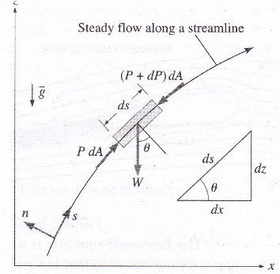
Derivation of Bernoulli’s Equation
Consider motion of flow fluid particle in steady flow field as shown in fig.
Applying Newton’s 2nd Law in s- direction on a particle moving along a streamline give
Assumption:
Fluid is ideal and incompressible Flow is steady
Flow is along streamline
Velocity is uniform across the section and is equal to mean velocity
Only gravity and pressure forces are acting
F_{s} = ma_{s}
Eq(1)
Where F is resultant force in s- direction, m is the mass and a_{s} is the acceleration along s-direction.
₌ dV ₌ dsdV ₌ dsdV _{= V} dV dt dsdt dtds ds
a
Eq(2)
s
Fig. Forces acting on particle along streamline

Slide 7
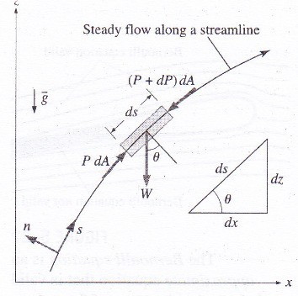
Derivation of Bernoulli’s Equation
F_{s} = PdA − (P + dp)dA −W sinθ
Substituting values from Eq(2) and Eq(3) to Eq(1)
Eq(3)
PdA − (P + dp)dA −W sin θ = mV
dV
sinθ = ^{dz}
ds
ds
dpdA − ρgdAds ^{dz} = ρdAdsV ^{dV}
ds ds
Cancelling dA and simplifying
dp − ρgdz = ρVdV
Note that VdV = ¹ dV ²
dp − ρgdz = ρ dV ²
2
Eq(4)
Fig. Forces acting on particle along streamline
2
1
W=weight of fluid W = mg = (ρdAds)g Wsin(θ)= component acting along s-direction dA= Area of flow
ds=length between sections along pipe
Eq(5)

Slide 8
Derivation of Bernoulli’s Equation
Dividing eq (5) by ρ
Hence Eq (9) for stead- incompressible fluid assuming no frictional losses can be written as
dp
1
2
gdz +
2
dV = 0
Eq (6)
ρ
P
_{V} 2
P V ²2
Integrating
Z
₊ 1
1
+ = Z + +
γ 2g
1
γ 2g
2
2
Eq (10)
∫
⎛ dp
1 ₂ ⎞
(Total Head) = (Total Head)
⎜ + gdz + dV ⎟ = contt
⎝ ² ⎠
Eq (7)
1 2
ρ
Assuming incompressible and steady flow
Above Eq(10) is general form of Bernoulli’s Equation
P 1
ρ
2
Eq (8)
gz + V = contt
2
Dividing each equation by g
P
_{V} 2
Eq (9)
z + = contt
ρg
2g

Slide 9
Energy Line and Hydraulic Grade line
P
γ
_{V} 2
z + = H
2g
Pressure head + Elevation head + Velocity head = Total Head
Multiplying with unit weight,γ,
_{V} 2
P + ρgz + ρ
= contt
2
Static Pressure :
P
Dynamic pressure :
ρV ² / 2
Hydrostatic Pressure: ρgZ
Stagnation Pressure: Static pressure + dynamic Pressure
_{V} 2
P + ρ
^{= P}stag
2

Slide 10
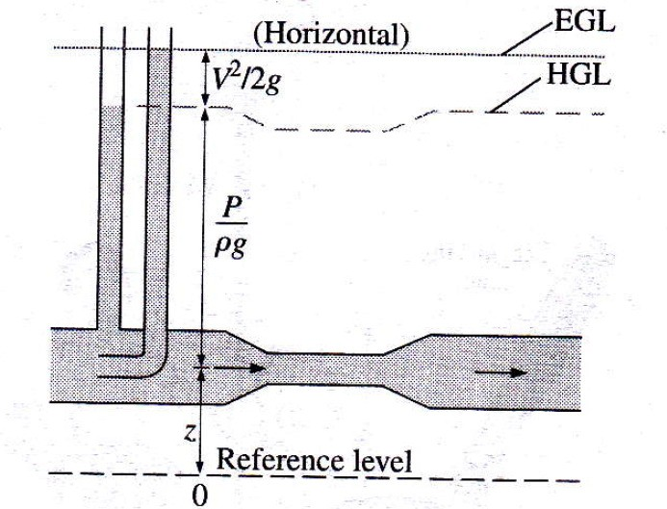
Energy Line and Hydraulic Grade line
Measurement of Heads
Piezometer: It measures pressure head ( P / γ ).
Pitot tube: It measures sum of pressure and velocity heads i.e.,
P
_{V} 2
+
γ 2g
What about measurement of elevation head !!

Slide 11
Energy Line and Hydraulic Grade line
Energy line: It is line joining the total heads along a pipe line.
HGL: It is line joining pressure head along a pipe line.

Slide 12
Cases of Energy equation:
Flow with out friction.
Flow with friction.
Pump between sections one and two.
Turbine between sections one and two.
Pump and Turbine are between sections one and two.

Slide 13
Equation of head loss due to friction:

Slide 14
Power
Rate of work done is termed as power
Power=Energy/time Power=(Energy/weight)(weight/time)
If H is total head=total energy/weight and γQ is the weight flow rate
then above equation can be written as
Power=(H)(γQ)= γQH
In BG:
1 horsepower=550ft.lb/s
Power in (horsepower)=(H)(γQ)/550
In SI:
Power in (Kilowatts)=(H)(γQ)/1000

Slide 15
Example 1
Water is flowing with a discharge of 0.5 m3/s in the following system. Find the power of the pump required assuming head loss due to friction is 3 m

Slide 16
Example 2
Determine the power of pump required to discharge water to a small town of 3000 houses (5 person average for each house). The small town is higher than the source of water by 60 m, the pipe available is 150 mm diameter, take:
Head loss due to friction is: $10 \frac{ V^{2}}{2g}$
Each person need 200 L/day water.

Slide 17
Momentum and Forces in Fluid Flow
We have all seen moving fluids exerting forces.The lift force on an aircraft is exerted by the air moving over the wing. A jet of water from a hose exerts a force on whatever it hits.
In fluid mechanics the analysis of motion is performed in the same way as in solid mechanics - by use of Newton’s laws of motion.
i.e., F = ma which is used in the analysis of solid mechanics to relate applied force to acceleration.
In fluid mechanics it is not clear what mass of moving fluid we should use so we use a different form of the equation.
∑ F = ma = ^{d (mV)s}
dt

Slide 18
Momentum and Forces in Fluid Flow
Newton’s 2nd Law can be written:
The Rate of change of momentum of a body is equal to the resultant force acting on the body, and takes place in the direction of the force.
_{∑ F =} d (mV)_{s}
dt
∑ F = Sum of all external forces on a body of fluid or system s
mV = Momentum of fluid body in direction s
The symbols F and V represent vectors and so the change in momentum must be in the same direction as force.
∑ Fdt = d (mV)_{s}
It is also termed as impulse momentum principle

Slide 19
The Jet:

