Slide 1
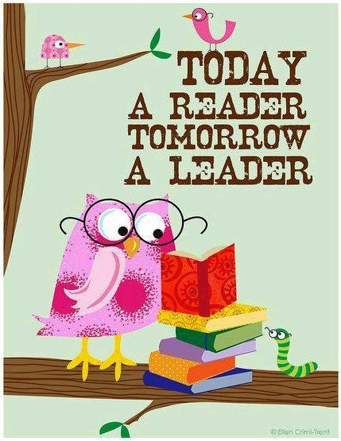
Salahaddin University- College of Basic Education
Advanced Speaking
Dr. Bukhari
"Readers of today, leaders of tomorrow"

Slide 2
Read in to-be-wasted times!
"Readers of today, leaders of tomorrow"

Slide 3
Does reading open our minds?
"Readers of today, leaders of tomorrow"

Slide 4
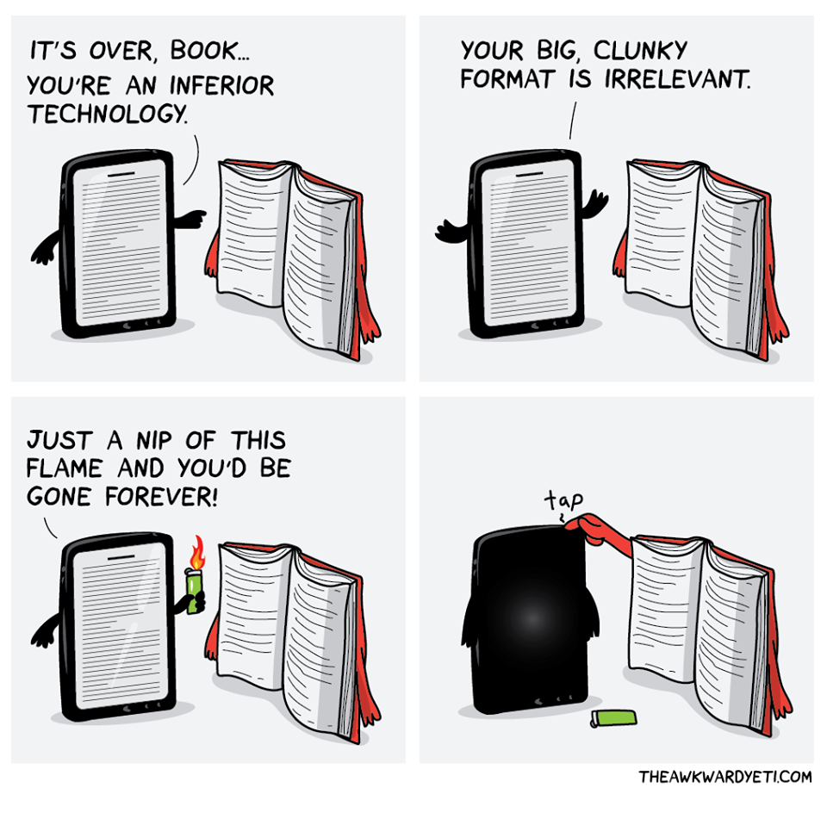
Facebook or paper book?

Slide 5
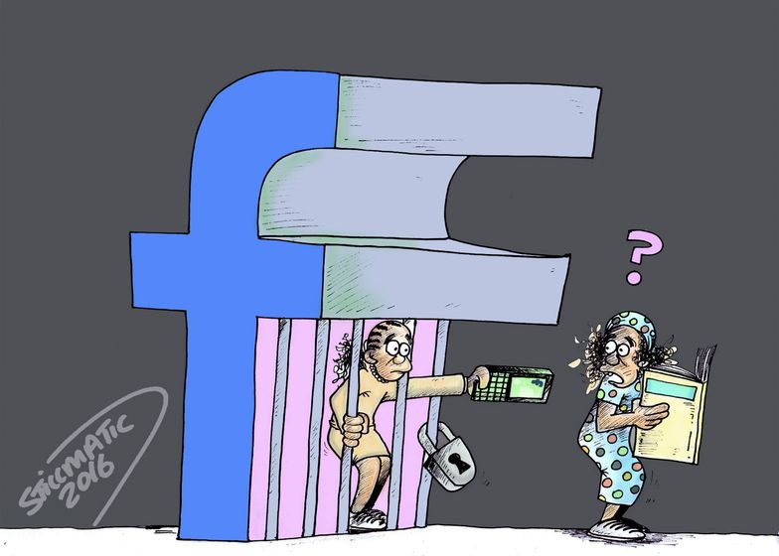
“I don't have time!”

Slide 6
What book you’ve read in your life you never forget?

Slide 7
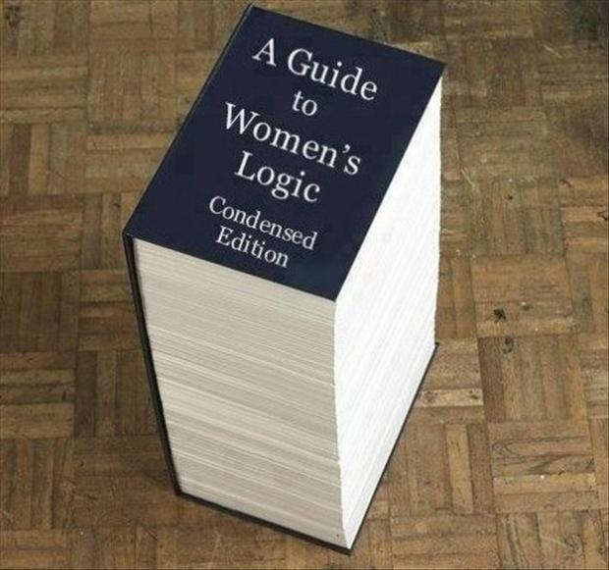
"Readers of today, leaders of tomorrow"

Slide 8
If your life is a book, what title do you compose for it?

Slide 9
Now, it is Time! ☺
book
Internet
Which one is more practical to learn English?

