Slide 1
The Beginnings of Molecular Biology

Slide 2
Molecular biology is a branch of science concerning biological activity at the molecular level.

Slide 3
The field of molecular biology overlaps with biology and chemistry and in particular, genetics and biochemistry. A key area of molecular biology concerns understanding how various cellular systems interact in terms of the way DNA, RNA and protein synthesis function

Slide 4
Cell- a discrete unit of life
Unicellular organism- organism of one cell
Multicellular organism- organism of many cells
Prokaryote- cells that lack specific nucleus
Eukaryote- cells with well-defined nucleus

Slide 5
Cells are building blocks:
Tissue- collection of cells with specific functions
Organs- collections of tissues with specific functions
Organ systems- collections of organs with specific functions

Slide 6
Molecular genetics- study of genes and how they are expressed
Chromosome- part of cell nucleus that contains heredity information and promotes protein synthesis
Gene- basic unit of heredity on a chromosome
DNA- molecule in a chromosome that codes genetic information

Slide 7
DNA-thread-like molecule which decodes DNA information

Slide 8
WHOLE ORGANISMS
ORGANS
TISSUES
CELLS
INTRACELLULAR ORGANELLES
CHEMICAL COMPONENTS

Slide 9
CHEMICAL COMPONENTS OF LIFE

Slide 10
PROTEINS
LIPIDS
NUCLEIC ACIDS:
DNA
RNA

Slide 12
DNA in cells
In eukaryotes, such as plants and animals, DNA is found in the nucleus, a specialized, membrane-bound vault in the cell, as well as in certain other types of organelles (such as mitochondria and the chloroplasts of plants). In prokaryotes, such as bacteria, the DNA is not enclosed in a membranous envelope, although it's located in a specialized cell region called the nucleoid.

Slide 13
In eukaryotes, DNA is typically broken up into a number of very long, linear pieces called chromosomes, while in prokaryotes such as bacteria, chromosomes are much smaller and often circular (ring-shaped). A chromosome may contain tens of thousands of genes, each providing instructions on how to make a particular product needed by the cell.

Slide 14
Nucleic acids, macromolecules made out of units called nucleotides, come in two naturally occurring varieties: deoxyribonucleic acid (DNA) and ribonucleic acid (RNA). DNA is the genetic material found in living organisms, all the way from single-celled bacteria to multicellular mammals like you and me. Some viruses use RNA, not DNA, as their genetic material, but aren’t technically considered to be alive (since they cannot reproduce without help from a host).

Slide 15
Deoxyribonucleic Acid (DNA); the genetic material of all cellular organisms and most viruses.
DNA; the gigantic molecule which is used to encode genetic information for all life on Earth.
A human cell contains about 2 meters of DNA. DNA in the body could stretch to the sun and back almost 100 times. So it is tightly packed.
DNA responsible for preserving, copying and transmitting information within cells and from generation to generation.

Slide 16
Nucleotides; ring shaped structures composed of:
Nitrogenous base; these bases are classified based on their chemical structures into two groups:
Purine; double ringed structure (Adenine and Guanine).
Pyrimidine; single ring structures (cytosine and thymine).
Sugar
Phosphate group

Slide 17
DNA: Four different types of nucleotides differ in nitrogenous base:
A is for adenine;
G is for guanine;
C is for cytosine and
T is for thymine.
RNA: thymine base replaced by uracil base.

Slide 18
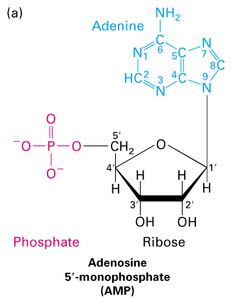
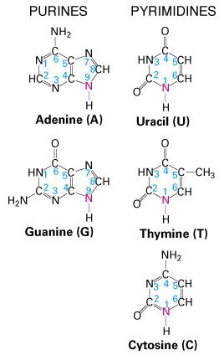
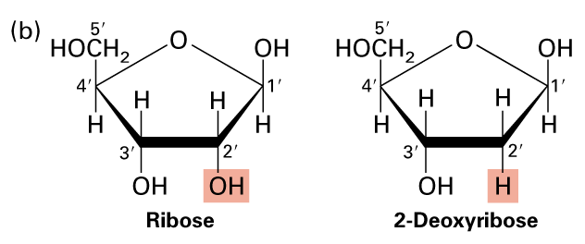

Slide 19
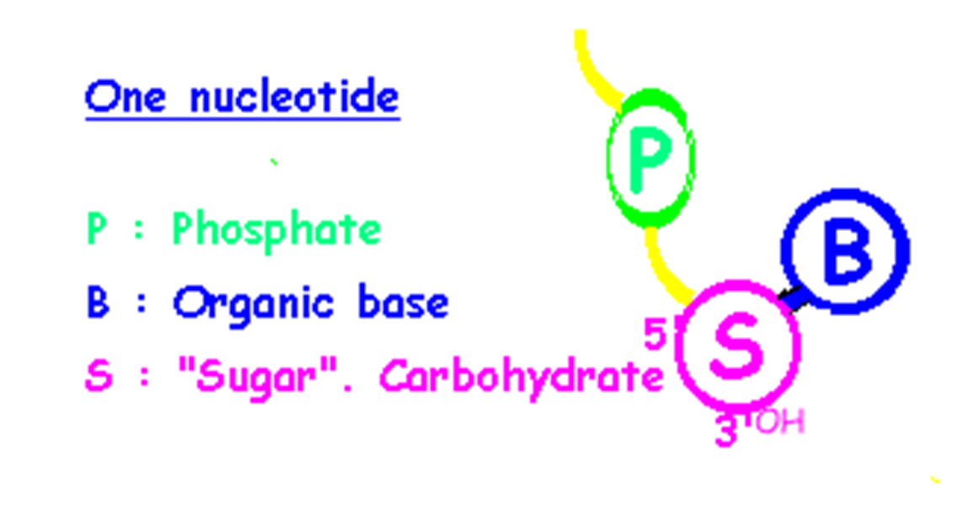

Slide 20
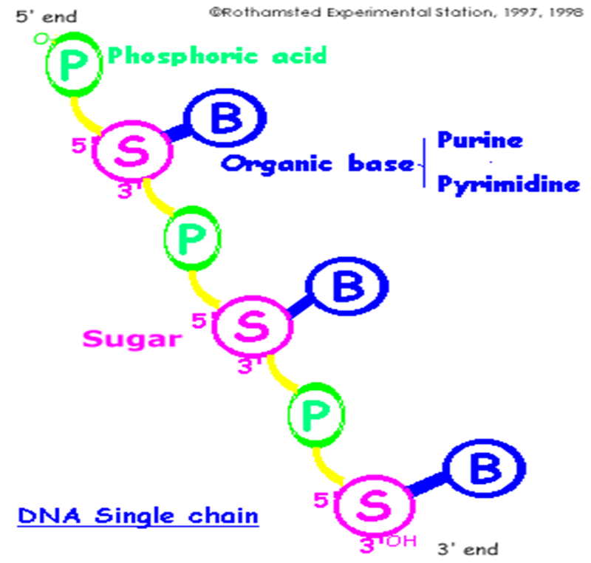

Slide 21
Three major classes of RNA: messenger (mRNA), transfer (tRNA) and ribosomal (rRNA). Minor classes of RNA include small nuclear RNA; small nucleolar RNA;……….
RNA is a single stranded; the pyrimidine base uracil (U) replaces thymine and ribose sugar replaces deoxyribose.

Slide 22
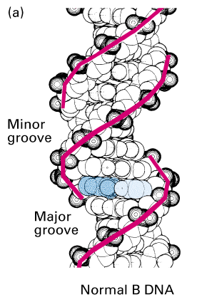
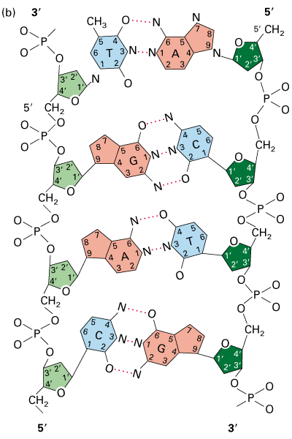

Slide 23
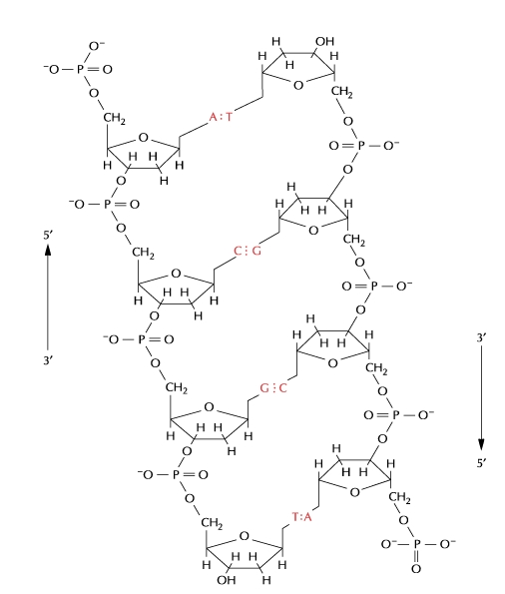

Slide 24
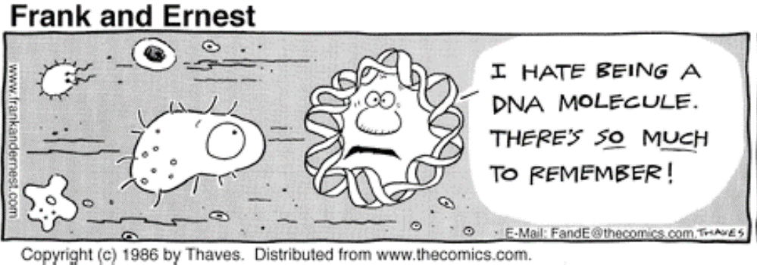

Slide 25
Nucleotides
DNA and RNA are polymers (in the case of DNA, often very long polymers), and are made up of monomers known as nucleotides. When these monomers combine, the resulting chain is called a polynucleotide (poly- = "many").

Slide 26
Each nucleotide is made up of three parts: a nitrogen-containing ring structure called a nitrogenous base, a five-carbon sugar, and at least one phosphate group. The sugar molecule has a central position in the nucleotide, with the base attached to one of its carbons and the phosphate group (or groups) attached to another.

Slide 27
Each nucleotide in DNA contains one of four possible nitrogenous bases: adenine (A), guanine (G) cytosine (C), and thymine (T). Adenine and guanine are purines, meaning that their structures contain two fused carbon-nitrogen rings. Cytosine and thymine, in contrast, are pyrimidines and have a single carbon-nitrogen ring. RNA nucleotides may also bear adenine, guanine and cytosine bases, but instead of thymine they have another pyrimidine base called uracil (U). As shown in the figure above, each base has a unique structure, with its own set of functional groups attached to the ring structure.

Slide 28
In molecular biology shorthand, the nitrogenous bases are often just referred to by their one-letter symbols, A, T, G, C, and U. DNA contains A, T, G, and C, while RNA contains A, U, G, and C (that is, U is swapped in for T).

Slide 29
Sugars
In addition to having slightly different sets of bases, DNA and RNA nucleotides also have slightly different sugars. The five-carbon sugar in DNA is called deoxyribose, while in RNA, the sugar is ribose. These two are very similar in structure, with just one difference: the second carbon of ribose bears a hydroxyl group, while the equivalent carbon of deoxyribose has a hydrogen instead. The carbon atoms of a nucleotide’s sugar molecule are numbered as 1′, 2′, 3′, 4′, and 5′ (1′ is read as “one prime”), as shown in the figure above. In a nucleotide, the sugar occupies a central position, with the base attached to its 1′ carbon and the phosphate group (or groups) attached to its 5′ carbon.

Slide 30
Phosphate
Nucleotides may have a single phosphate group, or a chain of up to three phosphate groups, attached to the 5’ carbon of the sugar. Some chemistry sources use the term “nucleotide” only for the single-phosphate case, but in molecular biology, the broader definition is generally accepted1^11
In a cell, a nucleotide about to be added to the end of a polynucleotide chain will bear a series of three phosphate groups. When the nucleotide joins the growing DNA or RNA chain, it loses two phosphate groups. So, in a chain of DNA or RNA, each nucleotide has just one phosphate group.

Slide 31
Polynucleotide chains
A consequence of the structure of nucleotides is that a polynucleotide chain has directionality – that is, it has two ends that are different from each other. At the 5’ end, or beginning, of the chain, the 5’ phosphate group of the first nucleotide in the chain sticks out. At the other end, called the 3’ end, the 3’ hydroxyl of the last nucleotide added to the chain is exposed. DNA sequences are usually written in the 5' to 3' direction, meaning that the nucleotide at the 5' end comes first and the nucleotide at the 3' end comes last.

Slide 32
As new nucleotides are added to a strand of DNA or RNA, the strand grows at its 3’ end, with the 5′ phosphate of an incoming nucleotide attaching to the hydroxyl group at the 3’ end of the chain. This makes a chain with each sugar joined to its neighbours by a set of bonds called a phosphodiester linkage.

Slide 33
Properties of DNA
Deoxyribonucleic acid, or DNA, chains are typically found in a double helix, a structure in which two matching (complementary) chains are stuck together, as shown in the diagram at left. The sugars and phosphates lie on the outside of the helix, forming the backbone of the DNA; this portion of the molecule is sometimes called the sugar-phosphate backbone. The nitrogenous bases extend into the interior, like the steps of a staircase, in pairs; the bases of a pair are bound to each other by hydrogen bonds.

Slide 34
The two strands of the helix run in opposite directions, meaning that the 5′ end of one strand is paired up with the 3′ end of its matching strand. (This is referred to as antiparallel orientation and is important for the copying of DNA.)

Slide 35
So, can any two bases decide to get together and form a pair in the double helix? The answer is a definite no. Because of the sizes and functional groups of the bases, base pairing is highly specific: A can only pair with T, and G can only pair with C, as shown below. This means that the two strands of a DNA double helix have a very predictable relationship to each other.

Slide 36
For instance, if you know that the sequence of one strand is 5’-AATTGGCC-3’, the complementary strand must have the sequence 3’-TTAACCGG-5’. This allows each base to match up with its partner:

Slide 37
When two DNA sequences match in this way, such that they can stick to each other in an antiparallel fashion and form a helix, they are said to be complementary.

Slide 38
Properties of RNA
Ribonucleic acid (RNA), unlike DNA, is usually single-stranded. A nucleotide in an RNA chain will contain ribose (the five-carbon sugar), one of the four nitrogenous bases (A, U, G, or C), and a phosphate group. Here, we'll take a look at four major types of RNA: messenger RNA (mRNA), ribosomal RNA (rRNA), transfer RNA (tRNA), and regulatory RNAs.

Slide 39
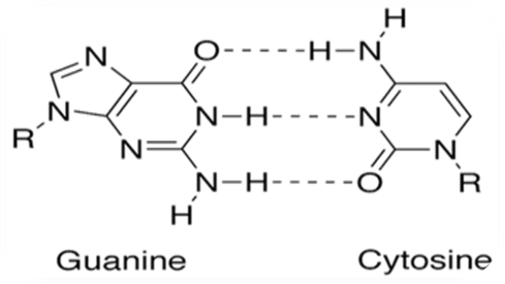
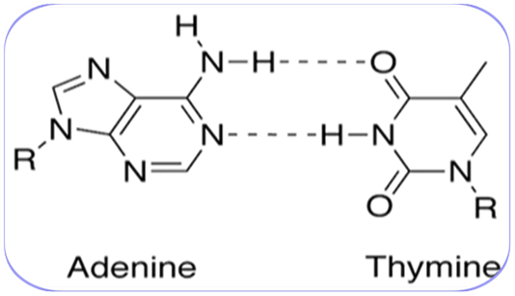

Slide 41
transcription
translation
DNA RNA Protein
$$$
reverse
transcription
Molecular
Biotechnology
DNA
replication

