Slide 1
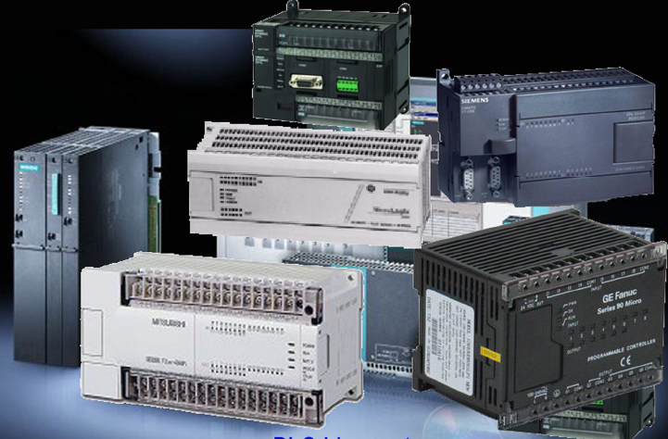

Slide 2
Programmable Logic Controllers
Senior Students – 7th Semesters
Academic Year (2023 - 2024) Fall Season
Lecture: Dr. Chalang H.R. Mohammed
Email: chalang.mohammed@su.edu.krd
Mobile: 07505568981
Lec.s available at http://www.engppt.com/2010/10/programmable-logic-controllers-lectures.html
Also, http://jjackson.eng.ua.edu/courses/ece485/lectures/
By: Electrical & Computer Engineering Dr. D. J. Jackson

Slide 3
Programmable Logic Controllers
Lecture 00
Introduction to Process

Slide 4
Grading
Attaining the requirements set to succeed in this study subject requires developing an engineering sense, related to this topic, based on emergent analytical and problem solving skills and memorizing topics cannot secure success.
In this system the maximum mark is (100%). The grading system is based on the summation of two categories of evaluations:
First, (40%) of the mark is based on the academic year effort of the student which includes but is not restricted to the following:
- At least one examination are held and the total mark of 15% will be collected.
- Quizzes(5%), activities and Seminars (5%), for which the study material is limited and assigned by the instructor
- Discussion for Reports practice (15%), also assigned by the instructor
Active participation of the student in the classroom attendance, activities and discussions may be rewarded by the instructor for up to a limit not exceeding (2%) as a general support margin, on the same basis for all of the students.
Second, (60%) of the mark is based on final examination that is comprehensive for the whole of the study material reviewed during this season and it usually occurs during the month of June. (50% theory and 10% practice)
At the end of the evaluation process, if the students could not secure a minimum of (50%), they are given a chance to repeat the final exam in September and they should be able by then to equal or exceed the (50%) limit otherwise they will have to repeat this subject during the next academic year if it did not contradict with the administrative regulations.

Slide 5
Course Material
Text books:
Hugh Jack, “Automating Manufacturing Systems with PLCs”. Version 4.7, April 14, 2005.
W. Bolton. 2006. “Programmable Logic Controllers”. Fourth Edition. ELSEVIER
Khaled Kamel and Eman Kamel.2014.” Programmable Logic Controllers” by McGraw-Hill Education.
Petruzella, and Frank D. 2011. “Programmable logic controllers”. 4th ed. Published by McGraw-Hill. Textbook
Siemens. “SIMATIC S7-1200 Programmable controller’. System Manual. And any other PLC book published.
The core materials of the course consists of the above, articles from journals and internet, and lecture's notes, make sure you read all materials and prepare well before going for the exams.

Slide 6
Forms of Teaching
Due to very equations and rules driving, the essence of teaching program is presented by data-show projector with explaining on white board. All explanations of details are prepared on MS power point. There are also assignments and seasonal projects appointed to individual students or groups that help the evaluation process and also support team work effort.
For the student to achieve a level of excellence in the subject, the following items should be given utmost consideration:
Class attendance on regular basis for the purpose of learning.
Active participation in class discussions.
Reviewing the lecture notes and topics on weekly basis, noting the ambiguous points, if any, and requesting clarification during instructor office hours.
Visiting the library on regular basis and checking the internet for other approaches or simplifications of topics and ideas.
Giving adequate and sufficient priority to preparing for weekly, monthly and final tests.

Slide 7
Week | Topic
Week 1 | Introduction to PLCs
Week 2 | PLC Basics
Week 3 | PLC Addressing and Basic Instructions
Week 4 | Basic Ladder Logic Programming
Week 5 | PLC Timer Functions
Week 6 | PLC Counter Functions
Week 7 | Comparison and Math Operations
Week 8 | Data Handling and Program Control Flow Instructions
Week 9 | Application Specific Instructions
Week 10 | File Instructions
Week 11 | I/O Module Types
Week 12 | Communications and Communications Instructions
Week 13 | Interrupts
Week 14 | Interrupt Function Files: Selectable Timed Interrupt (STI)
Week 15 | Ethernet-Based Communication Setup and MSG Instruction Use

Slide 9
Due to a number of unforeseen reasons that may lead to shifting of the academic year program, it may be subjected to modifications. Also extra curriculum hours may be needed to cover all the topics. The students shall be notified of the changes if and when they may occur.

Slide 10
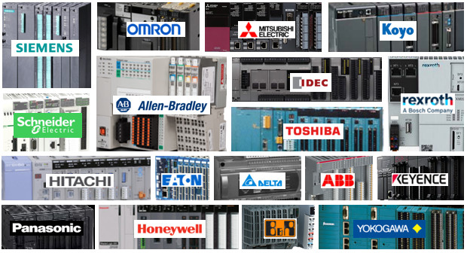
The most popular PLC, according to market share, was the Siemens Simatic PLC. The second most popular PLC was Rockwell Automation Allen Bradley PLC. Followed by Mitsubishi Melsec PLC, Schneider Modicon PLC and the Omron Sysmac PLC.

Slide 11
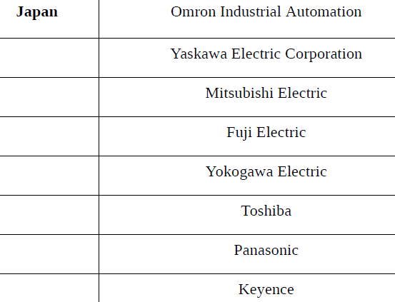

Slide 12
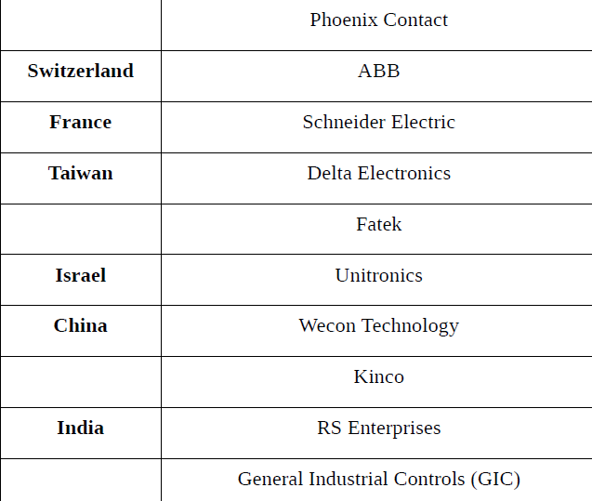

Slide 13
PLC Manufacturers: The Latest PLC Brands, Rankings & Revenues - Ladder Logic World
Market Share Ranking | PLC Manufacturers | PLC Brand Name/s
1 | Siemens | Simatic
2 | Rockwell Automation | Allen Bradley
3 | Mitsubishi Electric | Melsec
4 | Schneider Electric | Modicon
5 | Omron | Sysmac
6 | Emerson Electric (GE) | RX3i & VersaMax (GE Fanuc)
7 | Keyence | KV & V-8000
8 | ABB (B&R Automation) | AC500 X20 & X90
9 | Bosch | Rexroth ICL
10 | Hitachi | EH & H
11 | B&R Automation (part of ABB) | X20 & X90
12 | Phoenix Contact | AXC
13 | Panasonic | FP
14 | LS Electric (LSIS) | XG, Master-K & GM
15 | Eaton | XC & EasyE4 (Cutler-Hammer)
16 | Delta Electronic | DVP, AS & AH
17 | Fuji Electric | Micrex

