Slide 1
What is Analytical Chemistry?
The resolution of a chemical compound into its proximate or ultimate parts; the determination of its elements or of the foreign substances it may contain.

Slide 2
Introduction to Chemical Analysis
Chemical analysis includes any aspect of the chemical characterization of a sample material.
Analytical Chemistry?
“Science of Chemical Measurements”

Slide 3
Areas of Chemical Analysis and Questions They Answer
Quantitation:
How much of substance X is in the sample?
Detection:
Does the sample contain substance X?
Identification:
What is the identity of the substance in the sample?
Separation:
How can the species of interest be separated from the sample matrix for better quantitation and identification?

Slide 4
What is Analytical Chemistry?
Qualitative Analysis
Quantitative Analysis

Slide 5
What is Analytical Chemistry?
Qualitative analysis
The determination of the components of an unknown sample.
Organic spectroscopy

Slide 6
Quantitative analysis
The determination of the quantity of the components in a sample.
Classical methods

Slide 7
What is Analytical Chemistry?
Forensic Science
Medicine
Physics
Analytical
Science
Biochemistry
Materials Science
Physical Chemistry
Organic Chemistry

Slide 8
Titration
Titration is a procedure for determining the concentration of a solution by allowing a carefully measured volume to react with a standard solution of another substance, whose concentration is known. By finding the volume of the standard solution that reacts with the measured volume of the first solution, the cconcentration of the first solution can be calculated.

Slide 9
equivalent point
The point that all reactants are consumed, Stoichiometric mol numbers of both reactants are equal.
an indicator a compound that change its color around equivalent point. such as phenolphthalein, is colorless in acidic solution but turns pink in basic solution.

Slide 10
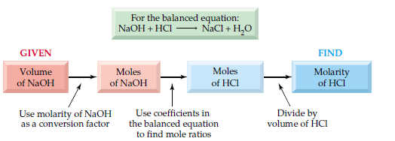

Slide 11
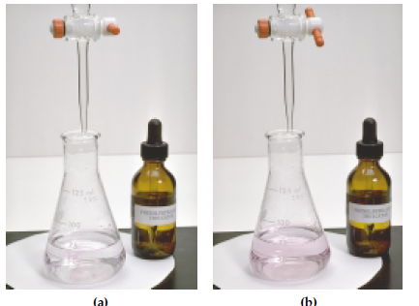

Slide 12
Calculations in the volumetric titrimetry
aA + bB ↔ cC + dD
a mol A react with b mol B
When A is a standard (titrant) the volume of A used in the titration and its molarity can be used to calculate the mol number of B

Slide 13
Example: A 25.0 mL sample of vinegar (dilute acetic acid, ) is titrated and found to react with 94.7 mL of 0.200 M NaOH. What is the molarity of the acetic acid solution?

Slide 14
The pH Scale
The pH is defined as the negative logarithm in base 10, of the hydronium ion concentration
pH = - log[H₃O+]
The pOH is defined as the negative logarithm in base 10, of the hydroxyl ion concentration
pOH = - log[OH-]

Slide 15
pH of an acidic solution < 7.00
pH of a neutral solution = 7.00
pH of a basic solution > 7.00

Slide 17
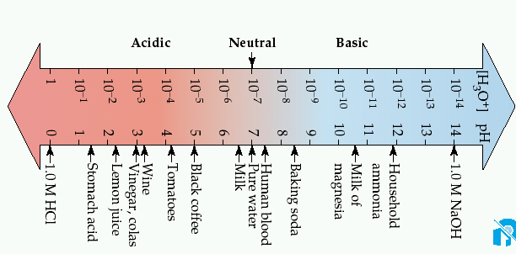

Slide 18
Buffer solution
is a solution whose pH changes only very slightly upon the addition of small of either an acid or a base.
Buffer solutions contain a weak acid and its conjugate base ( its salt) or a weak base and its conjugate acid ( its salt).

Slide 19
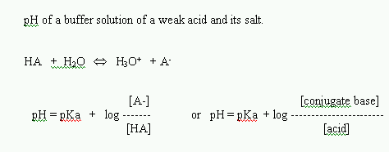

Slide 20
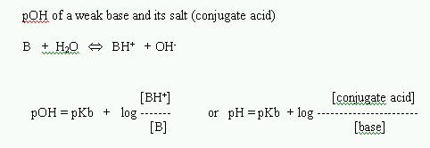

Slide 21
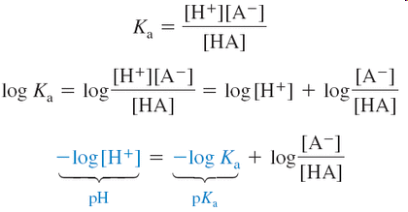
Buffers
A buffered solution resists changes in pH when acids or bases are added or when dilution occurs.

Slide 22
The buffer is a mixture of an acid and its conjugate base. There must be comparable amounts of the conjugate acid and base (say, within a factor of 10) to exert significant buffering.

Slide 24
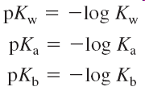
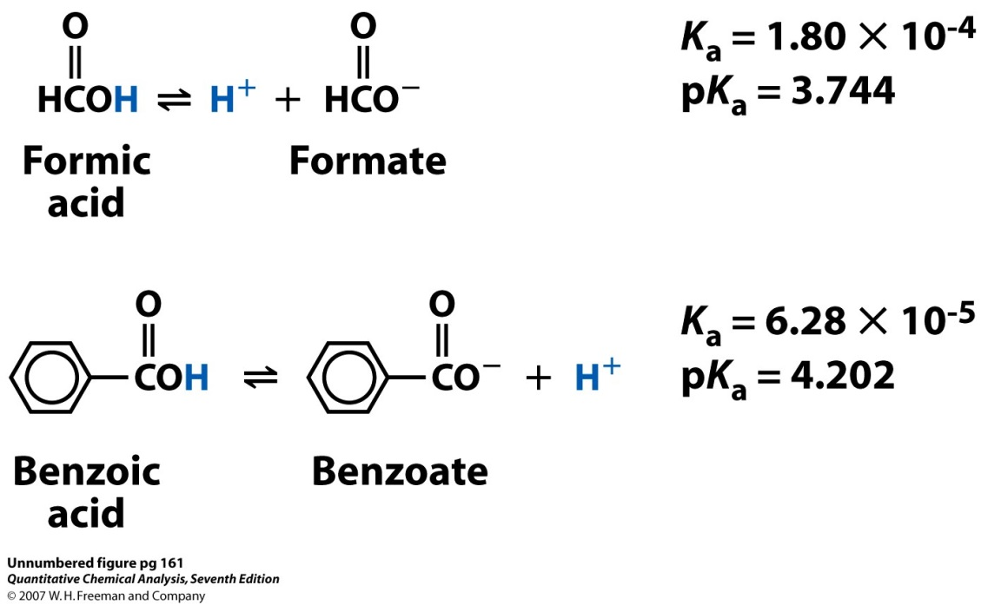
Weak acids and bases

Slide 25
The relationship between K_{a} and K_{b} for a conjugate acid-base pair: K_{a}*K_{b} = K_{w}.
Weak is conjugate to weak. The conjugate base of a weak acid is a weak base and vice verse.

Slide 26
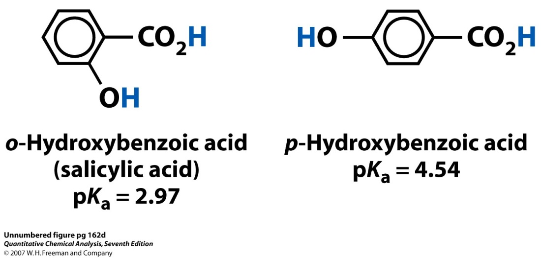
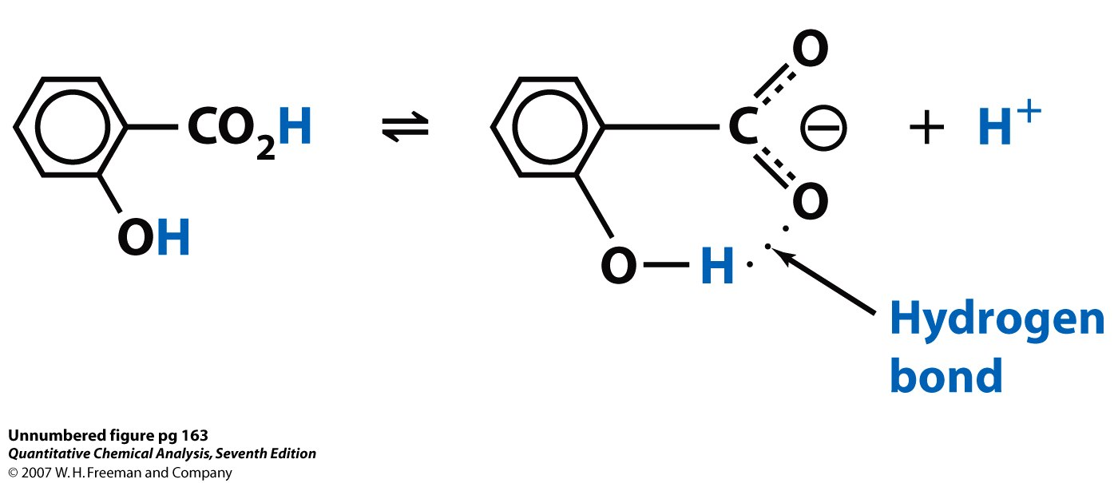
Weak acid equilibria
Why is the ortho isomer 30 times more acidic than the para isomer?
The product of the acid dissociation reaction forms a strong, internal hydrogen bond, that drives the reaction forward.

Slide 27
Calculate the pH of a weak acid
For any respectable weak acid, [H⁺] from HA will be much greater than [H⁺] from H₂O
If dissociation of HA is much greater than H₂O dissociation, [A⁻] >>[OH⁻]
Example: Calculation the pH of 0.0500 M o-hydroxybenzoic acid solution. The
K_{a} = 1.0 x 10⁻³.
Solution: plug into the above equation with F= 0.0500 and Ka = 1.0 x 10⁻³

Slide 28
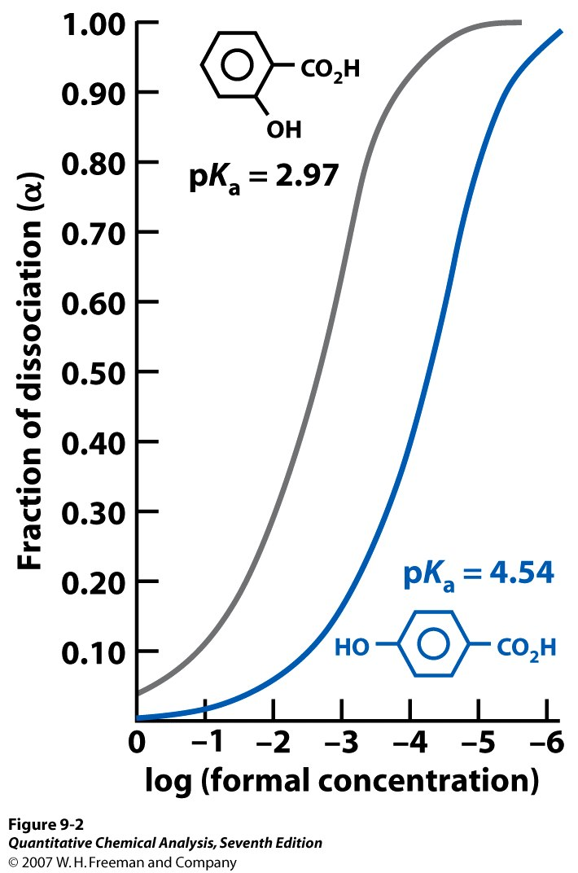
The fraction of dissociation, α, is defined as the fraction of the acid in the form A⁻
Fraction of dissociation of a weak electrolyte increases as electrolyte is diluted. The stronger acid is more dissociated than the weaker acid at all concentrations.
Weak electrolytes (compounds that are only partially dissociated) dissociate more as they are diluted.

Slide 29
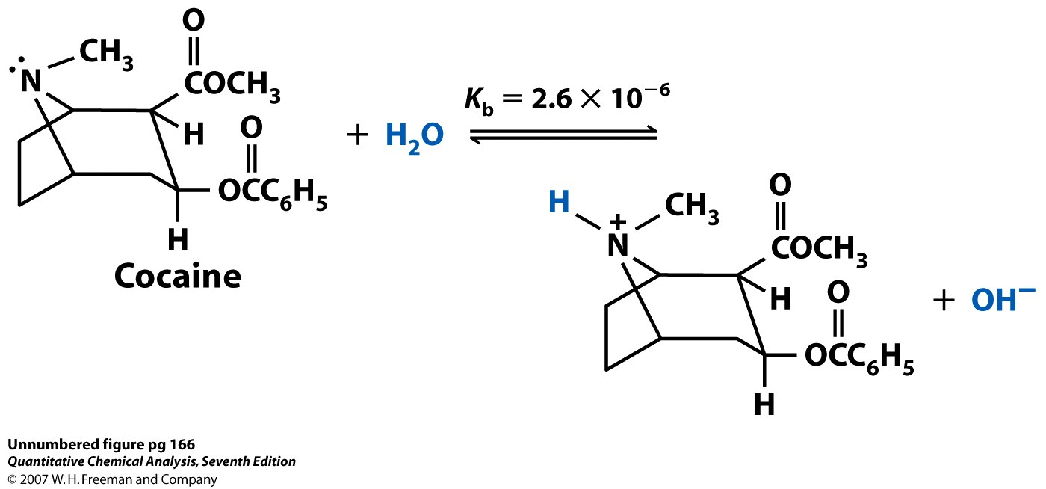
Weak base equilibria
Calling the formal concentration of base F (= [B] + [BH⁺]),
Notice that approximation in the last equation looks like a weak-acid problem, except that now x = [OH⁻].

