Slide 1
Practical (3) o f Dairy Microbiology
3rd Stage of Food Technology Dep.
Mrs. chnar
Milk borne Diseases

Slide 2
Milk borne Diseases
Group one :- Diseases transmitted from Lactating animals to Human
1- Brucellosis
2- Tuberculosis
3- Salmonellosis
4- Staphylococcal Enterotoxin Poisoning
5- Streptococcal infections
8- Anthrax
9- Leptospirosis

Slide 3
Group Tow :- Diseases transmitted from Human to Human Through Milk
1- Typhoid fever
2- Paratyphoid fever
3- Shigellosis
4- Cholera
5- Diphtheria
6- Tuberculosis
7- Viral hepatitis
8- Enteroviruses
9-Scarlet fever and Sore throat

Slide 4
Major Sources of Contamination of Milk
1- The Dairy Animal
2- Human Handler
3- The Environment

Slide 5
Prevention of Milk borne Diseases
1- Proper heating of milk before consuming or
. manufacturing
2- Milk must be saved against microbial . contamination
3- Wash hands before handling milk and milk . products
4- Utensils must be cleaned properly before . Using
.5- Keep Dairy Products refrigerated
6- Be attention for the Expiration date marked on the package
.7- Personal hygiene

Slide 7
Milk Testing and Quality Control
-- When milk arrives at the collection center , information on the milk is needed. -- This information could be quantity , quality , hygiene , composition, whether water has been added, etc.

Slide 8
What is Milk Quality Control ???
-Is the use of approved tests to ensure the application of approved Practices , Standards and Regulations concerning the milk and milk products.

Slide 9
Why have Milk Quality Control ????
1- The milk producer
-The milk producer expects a fair price is accordance with quality of milk she/he produces.
2- The milk processor
-The milk processor who pays the producer must assure that the milk received for processing is of normal composition and is suitable for processing into various dairy products .

Slide 10
3- The Consumer -- The consumer expects to pay a fair price for milk and milk products of acceptable to excellent quality .
4- The Public and Government Agencies
-- These have to ensure that the health and nutritional status of the people is protected from consumption of contaminated and sub- standard foodstuffs .

Slide 11
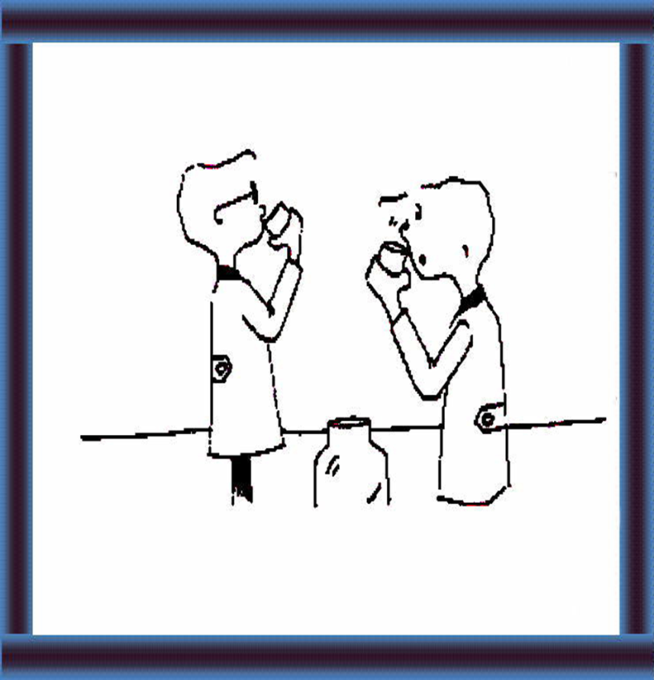
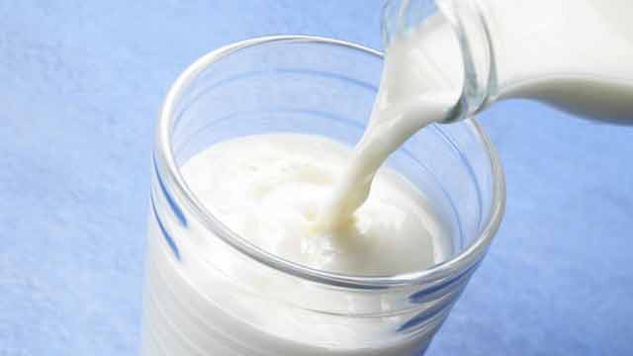
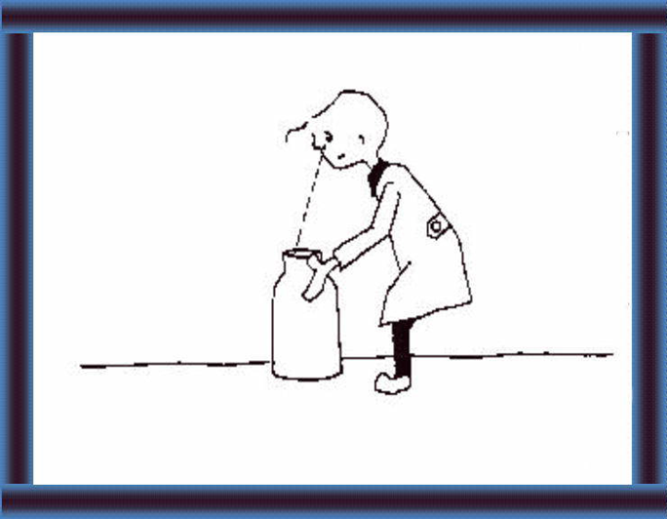
Quality Control Examinations of Milk
1- Taste , Smell
-- This should always be the first screening of the milk , since it is cheap , quick , and does not require any equipment .

Slide 12
Density ))2- Specific Gravity
Procedure
i. Adjust the temperature of milk sample at 15.5 C.
ii. Fill the clean, dry glass jar about 2/3 rd volume of it with milk, pour the milk down along the sides of the jar to avoid the incorporation of air.
iii. Lower the lactometer gently in the milk making sure that the lactometer floats freely without touching the sides of the jar.

Slide 13
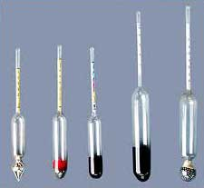
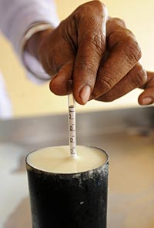
iv. Add milk to brim of the jar.
v. Read the lactometer reading at the top of the meniscus within one minute.
.vi. Record the temperature of milk

Slide 14
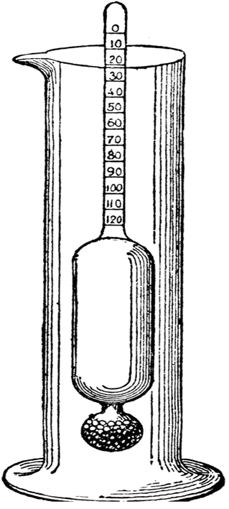

Slide 15
Calculation
Specific gravity of milk can be calculated by the following formula (for all type of lactometer).
Corrected lactometer reading
Sp. Gr. = ------------------------------------------- + 1
1000
Corrected lactometer reading = LR + CF.
Where CF for Quevennes lactometer
CF (+) = 0.1 x difference in temperature above 60 0 F
CF (-) = 0.1 x difference in temperature below 60 0 F

