Slide 1
Liquid Milk
Food Technology– 2st Stage
Lab2: Condensed Milk
Mrs.chnar

Slide 2
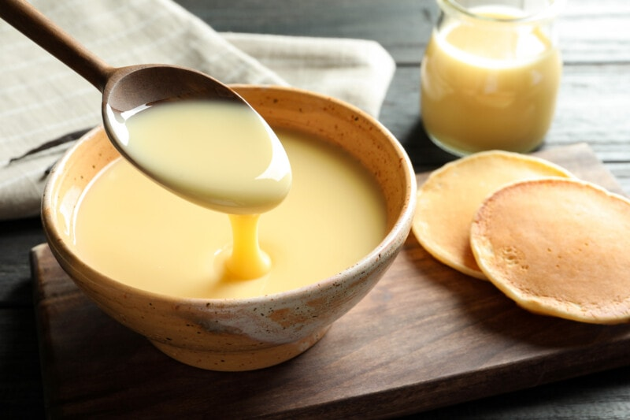
Condensed milk
The method of preserving milk by sterilizing evaporated water in milk in containers was developed at the beginning of the 1880s.The method of preserving evaporated milk by the addition of sugar had been perfected by an American

Slide 3
A distinction is made between two different types;
the difference between evaporated and condensed milk all boils down to condensed milk's added sugar. Here's another way to think of it: Condensed milk is evaporated milk with added sugar.
Sweetened evaporated milk exists in the form of condensed milk, but there's no such thing as unsweetened condensed milk — that's just evaporated milk.

Slide 4
unsweetened and sweetened condensed milk. Both products can be made from fresh milk or recombined milk (milk powder, fat and water)
Unsweetened condensed milk (also called double concentrated milk) is a sterilized product, light in colour and with the appearance of cream.

Slide 5
Sweetened condensed milk is basically concentrated milk, to which sugar has been added. The product is yellowish in colour and high viscous.
The high sugar concentration in sweetened condensed milk increases the osmotic pressure to such a level that most of the microorganisms are destroyed.

Slide 6
This product is not heat treated after packaging as its high sugar content preserves it for a long shelf-life.
The sugar concentration in the water phase must not be less than 62.5 % or more than 64.5 %. At the latter level

Slide 7
STANDARDIZATION
Condensed milk is marketed with a stipulated content of fat and dry solids. The figures vary with the applicable standard, but are normally 7.5 % fat and 17.5 % solids-non-fat. This product is often called “double concentrated milk” (25 % total solids). Another common standard is “triple concentrated milk “with 33 % total solids (often 4 – 10% fat content).

Slide 8
The heat treatment is intense: This results in a light brown colouration, because of chemical reactions between the protein and the lactose (Maillard reaction or browning reaction).
Stages in the manufacture of sweetened condensed
milk:
Addition of sugar and evaporation
Cooling to about 30 °C
subsequent cooling to 15 – 18 °C (sugar crystallization)
Canning (or packing)

