Slide 1
Q1Explain the relation between CEC and following soil properties? then give reason ?
1-Light soil texture
2-Soil organic matter
3-Soil pH
Q/2 What is the main different between CEC and ECEC?

Slide 2
Soil buffer capacity
Buffer solution
In the chemical sense the word of buffers are those systems that tend to maintain a constant pH level despite the addition within certain limits of an acid or base or despite dilution.

Slide 3
They usually consist of mixtures of either a weak acid and a salt formed from the acid and a strong base, or they consist of a weak base and a salt formed from the base and a strong acid.
Many chemical reactions and all biological processes take place only at specific pH levels. If there is no buffer action, hydrogen-ion concentration may alter and cause the reaction to slow down until it stops, or produce products different from those required.

Slide 4
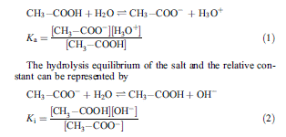
Using the case of an aqueous solution of acetic acid and sodium acetate i.e. a mixture of a weak acid and its salt formed from a strong base the dissociation equilibrium of the acid and the relative constant can be represented by

Slide 5
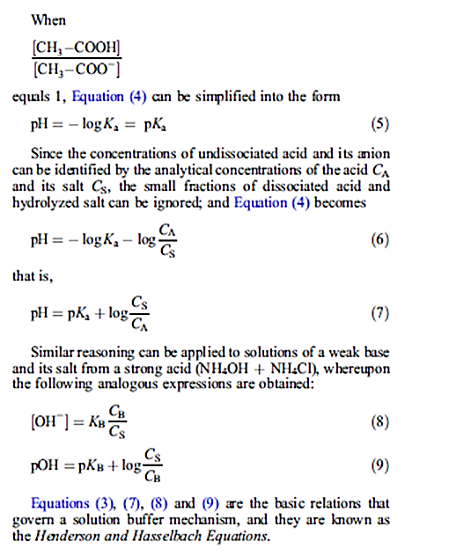

Slide 6
Mechanism and efficiency of buffer solutions
The buffer action produced by a system results from acid–base equilibrium. If a small amount of strong acid (HCl) is added to an equimolecular solution of acetic acid and sodium acetate, some of the acetate ion is converted into acetic acid; if a strong base (NaOH) is added, some of the acetic acid is converted into acetate ion. In other words, the strong acidity of the HCl is buffered by being converted into weak acidity, just as the strong base NaOH is buffered through the formation of its salt. Table B2 gives an idea of the effect obtained.

Slide 7
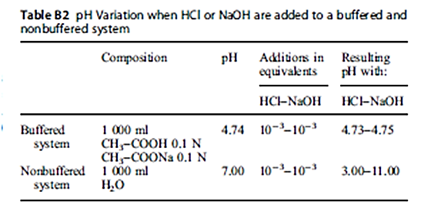
The Henderson and Hasselbach Equations show that the greatest buffering effect is obtained when the pH of the buffer equals pKa (or pKb). In fact, under these conditions, variations undergone by the ratioCS /CA (or CS/CB) are minimal when acid or base is added; and so must be variations in pH

Slide 8
The choice of buffer system components will be made according to the following criteria:
(1) Use a weak acid whose pK is as near as possible to the pH at which the reaction is to take place.
(2) Calculate the amount of conjugate base to mix with the acid from the opposite Henderson and Hasselbach Equation;
(3) The ratio CS /CA must be within 0.1 and 10 to guarantee good efficiency

Slide 9
Buffering in soil
Buffering in soil is defined as the resistance of the soil to variations in pH and is chiefly due to the colloidal humus and clay fractions. In soils containing appreciable amounts of phosphates and carbonates, buffering is also effected by these salts.
The soils with strong buffer effects were very fertile and advised organic fertilization to increase the buffer action. That a soil does not undergo marked fluctuations in pH following additions of acids or bases or as a result of dilution is of considerable practical importance if the organisms living in it, particularly microorganisms and the higher plants, are to continue their various activities under those particular pedological conditions

Slide 10
A large change in pH means a radical modification in soil environment, which severely affects the availability of plant nutrients and alters the pedogenetic processes. Compounds normally held in the soil solution may precipitate out, while others normally insoluble may to dissolve.
Factors causing alteration in soil pH
Factors tending to modify soil pH can be divided into two groups:
1. Those that bring about an increase in hydrogen-ion concentration tending to lower the pH.
2. Those that produce an increased adsorption of exchangeable bases tending to raise the pH.

Slide 11
Soil buffering system – mechanism
Most of the acid groups of the colloidal complex become deprotonated between the pH values of 4.0 and 8.5. In this pH range, the soil passes from a state of maximum non saturation to that of maximum saturation. This situation can be represented as follows:

Slide 12
Explain the role of the following on soil buffer:
1-Organic matter
2- Soil colloidal complex
3-Fertilization
4-Seasonally variation
5-The soil solution
6- Cation exchange capacity

