Slide 1
Introduction to MATLAB
Dalya Abdullah Anwar
Department of Computer science and information technology Salahaddin University
dalya.anwer@su.edu.krd
2022-2023

Slide 2
What Is MATLAB?
MATLAB® is a high-performance language for technical computing. It integrates computation, visualization, and programming in an easy-to-use environment where problems and solutions are expressed in familiar mathematical notation. Typical uses include:
•Math and computation
•Algorithm development
•Modeling, simulation, and prototyping
•Data analysis, exploration, and visualization
•Scientific and engineering graphics
•Application development, including graphical user interface building
The name MATLAB stands for matrix laboratory. MATLAB was originally written to provide easy access to matrix software .
https://www.mathworks.com/

Slide 3
Display Windows

Slide 4
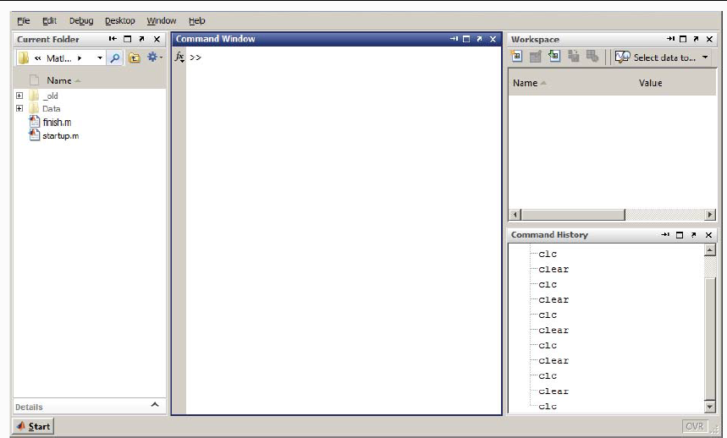
Display Windows (con’t…)

Slide 5
Display Windows (con’t…)
Graphic (Figure) Window
Displays plots and graphs
E.g: plot(x.^2,-2:2)
M-file editor/debugger window
Create and edit scripts of commands called M-files.

Slide 6
Matlab as a calculator
Commands in Matlab are executed by pressing Enter or Retun. The output will be displayed on screen immediately. Try the following:
>> 3 + 7.5
>> 18/4
>> 3 * 7
•The result of the last performed computation is ascribed to the variable ans, which is an example of a Matlab built-in variable. It can be used in the next command. For instance:
>> 14/4
ans =
3.5000

Slide 7
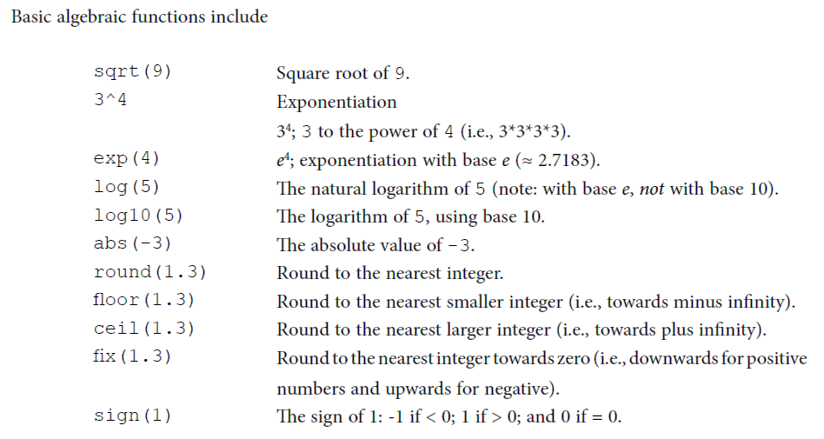

Slide 8
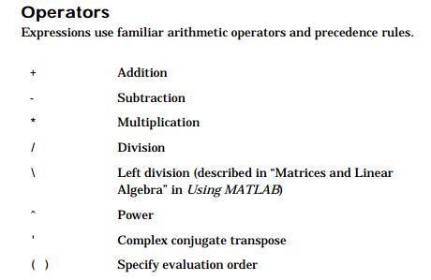

Slide 9
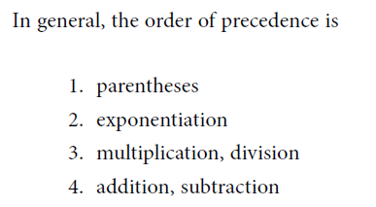
note
Matlab is case sensitive, for example, the following names represent five different variables: speed , Speed , SPEED , speed _1 , Speed_2.
help command – provides help for the specified command
>>help max

Slide 10
Control output display
format Short :Scaled fixed point format, with 4 digits after the decimal point. For example, 3.1416.
format long :Scaled fixed point format with 14 to 15 digits after the decimal point for double For example, 3.141592653589793.
format rat :Ratio of small integers. For example, 355/113
Example :When the format is set to short, both pi and single(pi) display as 5-digit values:
Format short
>>pi
>>ans =
3.1416

Slide 11
Variables
Special variables:
ans : default variable name for the result
pi: π = 3.1415926…………
inf : ∞, infinity
NaN or nan: not-a-number
Example:
>> tutorial = 1234;
>> tutorial = 1234
tutorial =
1234
NOTE: when a semi-colon ”;” is placed at the end of each command, the result is not displayed.

Slide 12
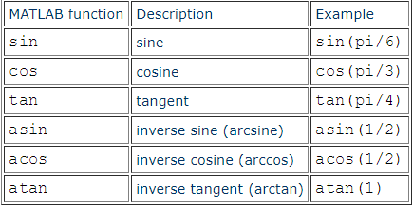
Trigonometric functions
Note that the arguments of sin, cos, tan are always in radians (not degrees) and that the results of the inverse trigonometric functions will also be in radians.sind ,cosd, evaluate in degree.

Slide 13
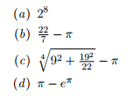
example
-Find the square roots of the integers 1,...,10.
>> sqrt(1:10)
-Evaluate the following mathematical expressions in Matlab

