Slide 1
Introduction to Matrix in Matlab Lecture 2
L.Dalya Abdullah Anwer
Computer science & IT
Second stage
2023-2024

Slide 2
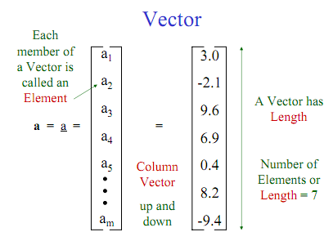
Scalar a = 5.4367
Just another name for a single number

Slide 3
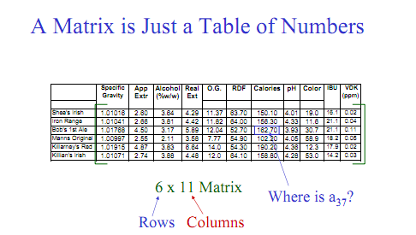

Slide 4
An Example
A = [1, 2, 3; 7, 8, 9]
Use ‘ ; ’ to indicate the end of each row
Use comma or space to separate elements of a row

Slide 5
Matrix in matlab
a vector x = [1 2 5 1] row vector
x =
1 2 5 1
y =[21;2;3;4] column vector
a matrix x = [1 2 3; 5 1 4; 3 2 -1]
x =
1 2 3
5 1 4
3 2 -1
Transpose y = x’ y =
1
2
5
1

Slide 6
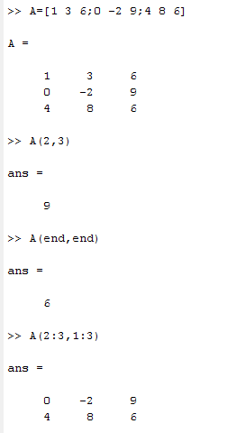
indexing

Slide 7
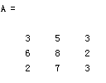
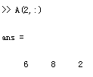
Matrix Index
The matrix indices begin from 1
The matrix indices must be positive integer
Given:
A(-2), A(0)
Error: ??? Subscript indices must either be real positive integers or logicals.
A(4,2)
Error: ??? Index exceeds matrix dimensions.

Slide 8
The use of “.” – “Element” Operation
A = [1 2 3; 5 1 4; 3 2 1]
A =
1 2 3
5 1 4
3 2 -1
b = x .* y
b=
3 4 -3
d = x .^2
d=
1 4 9
x = A(1,:)
x=
1 2 3
y = A(3 ,:)
y=
3 2 -1
K= x^2
Erorr:
??? Error using ==> mpower Matrix must be square.
B=x*y
Erorr:
??? Error using ==> mtimes Inner matrix dimensions must agree.

Slide 9
Example:

Slide 10
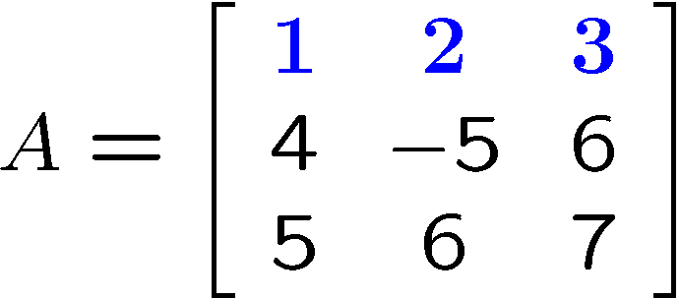
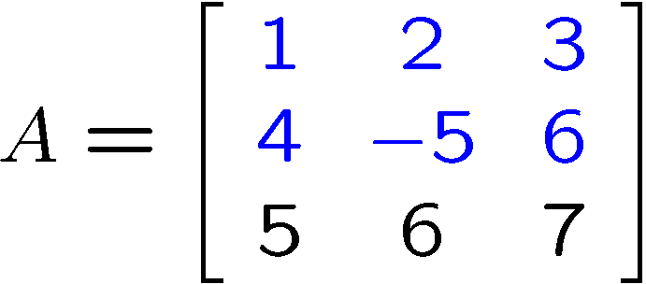
Indexing Matrices
Index complete row or column using the colon operator
>> A(1,:)
Can also add limit index range
>> A(1:2,:)
>> A([1 2],:)
General notation for colon operator
>> v=1:5
>> w=1:2:5

Slide 12
Matrix operations:
+ addition
- subtraction
* multiplication
^ power
‘ transpose
\ left division, / division
x = A \ b is the solution of A * x = b
x = b / A is the solution of x * A = b

Slide 13
Matrix Operations
Element-by-Element Array-Array Mathematics.
Operation | Algebraic Form | MATLAB
Addition | a + b | a + b
Subtraction | a – b | a – b
Multiplication | a x b | a .* b
Division | a ÷ b | a ./ b
Exponentiation | a^{b} | a .^ b
Example:
>> x = [ 1 2 3 ];
>> y = [ 4 5 6 ];
>> z = x .* y
z =
4 10 18
Each element in x is multiplied by the corresponding element in y.

Slide 14
Matrices functions
Some useful commands:
zeros(n)
zeros(m,n)
ones(n)
ones(m,n)
size (A)
length(A)
returns a n x n matrix of zeros
returns a m x n matrix of zeros
returns a n x n matrix of ones
returns a m x n matrix of ones
for a m x n matrix A, returns the row vector [m,n] containing the number of rows and columns in matrix.
returns the larger of the number of rows or columns in A.
eye(n) returns an n x n identity matrix

Slide 15
Important function:-
[m,n] = size(X) returns the size of matrix X in separate variables m and n.
n = length(X) returns the size of the longest dimension of X. If X is a vector, this is the same as its length.
B = sort(A) sorts the elements along different dimensions of an array, and arranges those elements in ascending order.
C = max(A) returns the largest elements along different dimensions of an array.
C = min(A) returns the smallest elements along different dimensions of an array.
B = sum(A) returns sums along different dimensions of an array.

