Slide 1
Numerical Method
Salahaddin-Hawler University | Academic Year | Course Name: Numerical Methods
Science College | 2022/2023 | Academic Stage: 2nd
Computer Science & IT Dep. | Second Semester | Binding: 3
Dalya Abdullah Anwar
Department of Computer science and information technology
Salahaddin University
dalya.anwer@su.edu.krd

Slide 3
An approximation to the root is given by
f (x₀ )
x₁ = x₀ −
f ′(x )
0

Slide 4
Better and successive approximations x₂, x₃, …, x_{n} to the root are obtained from
₋ f (x_{n} )
^{x}n+1 ^{= x}n
f ′(x )
n
N-R Formula

Slide 5
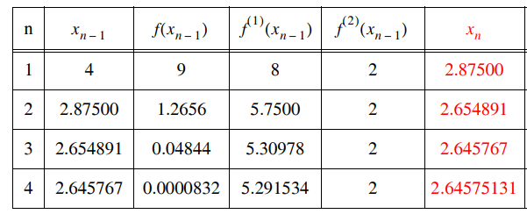
Example: Find the root of f(x)=x²-7 using an initial estimate x₀=4

Slide 6
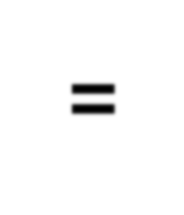

Slide 7
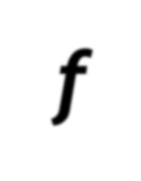
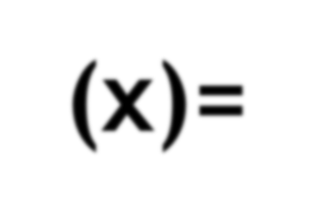

Slide 8
▶
▶
▶
x = x − ^{f (x0 )} = 2 − ⁵ = 1.54545
1 0
f ′(x ) 11
0
▶and
f (x₁ ) = 1.14573

Slide 9
The successive approximations are
x = 1.54545 − ^{1.14573} = 1.35961, f (x ) = 0.15369
2 2
6.16525
x = 1.35961− ^{0.15369} = 1.32579,
f (x ) = 4.60959×10⁻³
3
4.54562
3
4.60959×10⁻³
x₄ = 1.32579 −
= 1.32471,
f (x₄ ) = −3.39345×10
−5
4.27316
3.39345×10⁻⁵
x₅ = 1.32471+ = 1.324718, f (x₅ ) = 1.823×10
−7
4.26457
Hence, the required root is 1.3247.

Slide 10
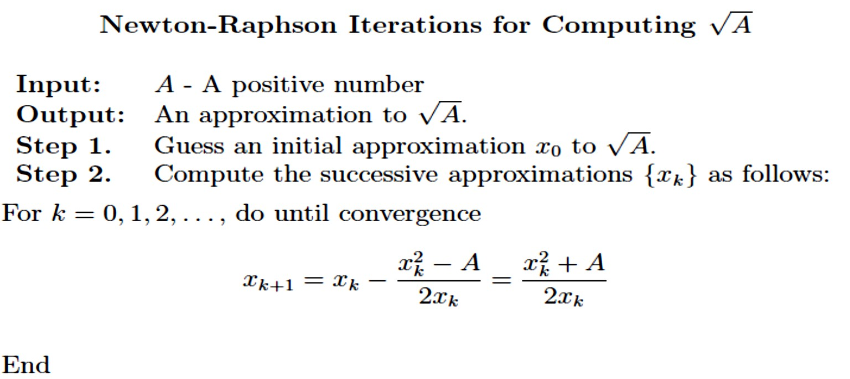
• Some Familiar Computations Using the Newton-Raphson Method

Slide 11
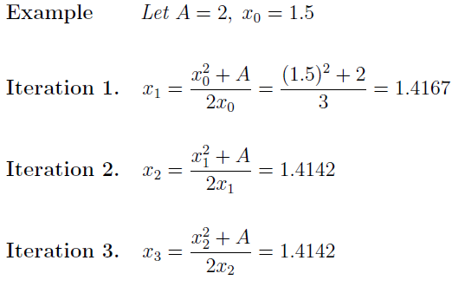

Slide 12
▶H.W
▶1- Evaluate 12 , by Newton’s formula for 3 iteration.
1
𝐴
▶2- Derive The Newton –Raphson Iteration for computing
3-The secant method

