Slide 1
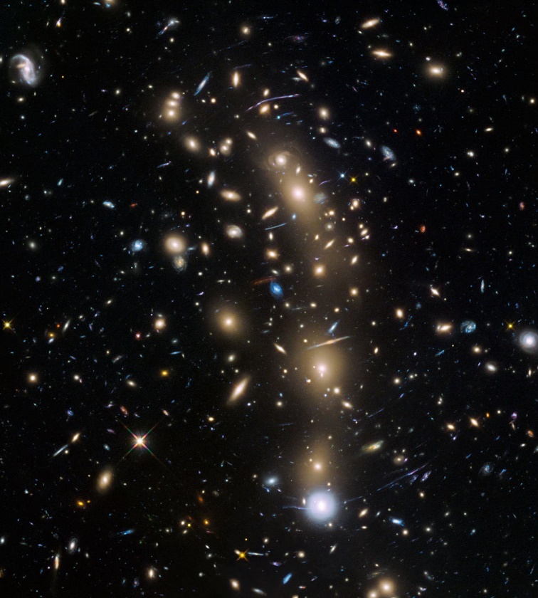
A Brief History of Earth
The main topics studied in Earth history are paleogeography, palaeontology, and paleoecology and paleoclimatology—respectively, past landscapes, past organisms, past ecosystems, and past environments.
1-Origin of the Universe
The universe appears to have an infinite number of galaxies and solar systems and our solar system occupies a small section of this vast entirety.
Every light on this image that does not have diffraction spikes is believed to be an entire galaxy, with hundreds of billions of stars.

Slide 2
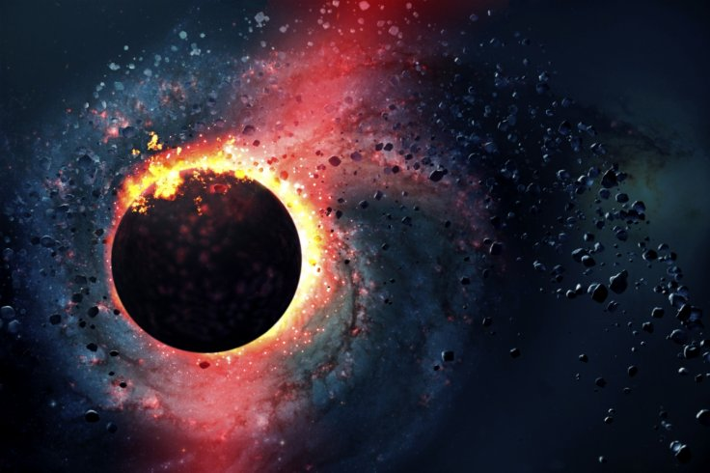
2-Big-Bang Theory
The prevailing idea about how the universe was created is called the big-bang theory. The big-bang theory proposes the universe was formed from an infinitely dense and hot core of material. The bang in the title suggests there was an explosive, outward expansion of all matter and space that created atoms.

Slide 3
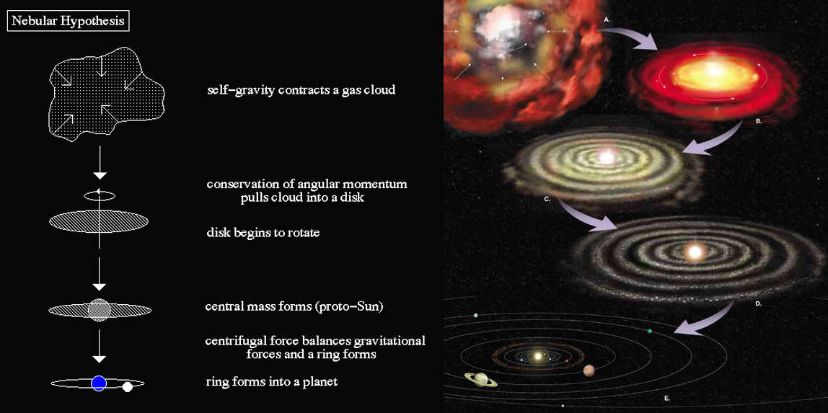
3-Origin of the Solar System: The Nebular Hypothesis
Our solar system formed as the same time as our Sun as described in the nebular hypothesis. The nebular hypothesis is the idea that a spinning cloud of dust made of mostly light elements, called a nebula, flattened into a protoplanetary disk, and became a solar system consisting of a star with orbiting planets.

