Slide 1
Vibrios, Campylobacters and Helicobacter

Slide 2
VIBRIO
Diseases
V. cholerae, the major pathogen in this genus, is the cause of cholera.
Vibrio parahaemolyticus causes diarrhea associated with eating raw or improperly cooked seafood.
Vibrio vulnificus causes cellulitis and sepsis.

Slide 3
Important Properties
Vibrios are curved, comma-shaped, gram-negative rods (Figure 1). V. cholera is divided into two groups according to the nature of its O cell wall antigen.
Members of the O1 group cause epidemic disease, whereas non-O1 organisms either cause sporadic disease or are nonpathogens.
The O1 organisms have two biotypes, called classic and El Tor, and three serotypes, called Ogawa, Inaba, and Hikojima. (Biotypes are based on differences in biochemical reactions, whereas serotypes are based on antigenic differences.)

Slide 4
These features are used to characterize isolates in epidemiologic investigations.
Serogroup O139 organisms, which caused a major epidemic in 1992, are identified by their reaction to antisera to the O139 polysaccharide antigens (O antigen).
V. parahaemolyticus and V. vulnificus are marine organisms; they live primarily in the ocean, especially in warm salt water.
They are halophilic (i.e., they require a high NaCl concentration to grow).

Slide 5
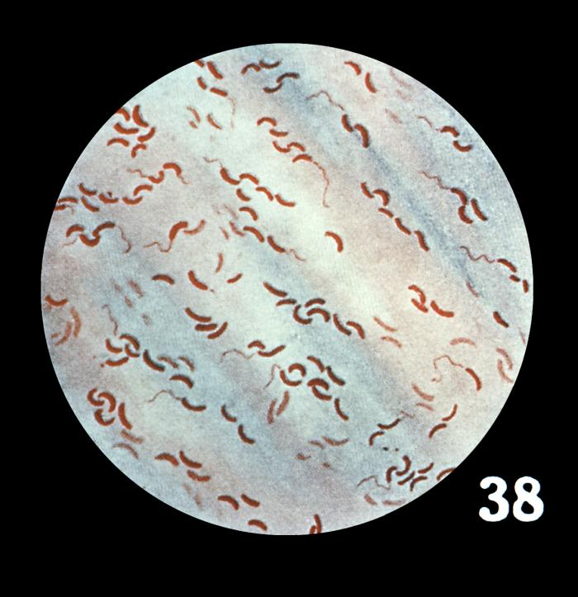
FIGURE-1-Vibrio cholera Gram stain. Long arrow points to a curved gram-negative rod. Arrowhead points to a flagellum at one end of a curved gram negative rod.

Slide 6
1. Vibrio cholerae
Pathogenesis & Epidemiology
V. cholerae is transmitted by fecal contamination of water and food, primarily from human sources.
Human carriers are frequently asymptomatic and include individuals who are either in the incubation period or convalescing.
The main animal reservoirs are marine shellfish, such as shrimp and oysters.
Ingestion of these without adequate cooking can transmit the disease.

Slide 7
The pathogenesis of cholera is dependent on colonization of the small intestine by the organism and secretion of enterotoxin.
For colonization to occur, large numbers of bacteria (10¹⁰) must be ingested because the organism is particularly sensitive to stomach acid.
Adherence to the cells of the brush border of the gut, which is a requirement for colonization, is related to secretion of the bacterial enzyme mucinase, which dissolves the protective glycoprotein coating over the intestinal cells.
After adhering, the organism multiplies and secretes an enterotoxin called choleragen (cholera toxin).

Slide 8
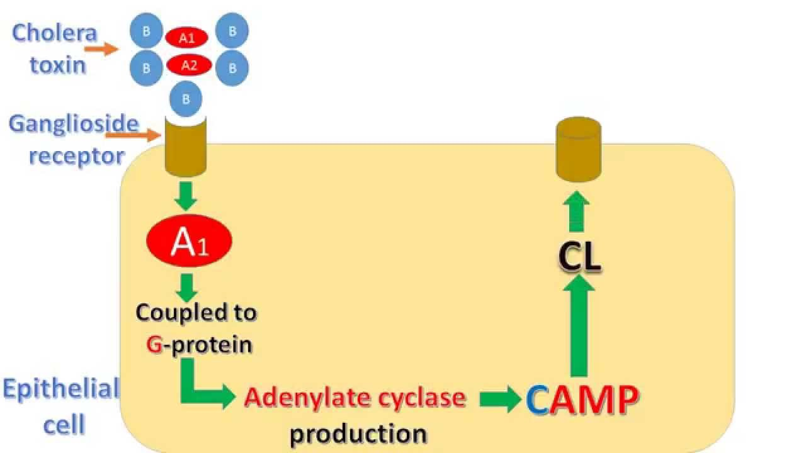
FIGURE 2- Mode of action of cholera toxin

Slide 9
Choleragen consists of an A (active) subunit and a B (binding) subunit.
The B subunit, which is a pentamer composed of five identical proteins, binds to a ganglioside receptor on the surface of the enterocyte.
The A subunit is inserted into the cytosol, where it catalyzes the addition of ADP-ribose to the Gs protein (Gs is the stimulatory G protein).
This locks the Gs protein in the “on” position, which causes the persistent stimulation of adenylate cyclase.

Slide 10
The watery efflux enters the lumen of the gut, resulting in a massive watery diarrhea that contains neither neutrophils nor red blood cells.
Morbidity and death are due to dehydration and electrolyte imbalance.
The resulting overproduction of cyclic AMP activates cyclic AMP–dependent protein kinase, an enzyme that phosphorylates ion transporters in the cell membrane, resulting in the loss of water and ions from the cell.

Slide 11
Clinical Findings
Watery diarrhea in large volumes is the hallmark of cholera. There are no red blood cells or white blood cells in the stool.
Rice-water stool is the term often applied to the nonbloody effluent.
There is no abdominal pain, and subsequent symptoms are referable to the marked dehydration.
The loss of fluid and electrolytes leads to cardiac and renal failure.
Acidosis and hypokalemia also occur as a result of loss of bicarbonate and potassium in the blood.
The mortality rate without treatment is 40%.

Slide 12
Laboratory Diagnosis
The approach to laboratory diagnosis depends on the situation.
During an epidemic, a clinical judgment is made and there is little need for the laboratory.
For diagnosis of sporadic cases, a culture of the diarrhea stool containing V. cholerae will show colorless colonies on MacConkey’s agar because lactose is fermented slowly.
The organism is oxidase-positive, which distinguishes it from members of the Enterobacteriaceae.
On TSI agar, an acid slant and an acid butt without gas or H₂S are seen.
On TCBS agar, typical colonies can be picked in 18 hours.

Slide 13
Treatment
Treatment consists of prompt, adequate replacement of water and electrolytes, either orally or intravenously.
Glucose is added to the solution to enhance the uptake of water and electrolytes.
Antibiotics such as tetracycline are not necessary, but they do shorten the duration of symptoms and reduce the time of excretion of the organisms.

Slide 14
2. Vibrio parahaemolyticus
V. parahaemolyticus is a marine organism transmitted by ingestion of raw or undercooked seafood, especially shellfish such as oysters.
It is a major cause of diarrhea in Japan, where raw fish is eaten in large quantities.
Little is known about its pathogenesis, except that an enterotoxin similar to choleragen is secreted and limited invasion sometimes occurs.
The clinical picture caused by V. parahaemolyticus varies from mild to quite severe watery diarrhea, nausea and vomiting, abdominal cramps, and fever.

Slide 15
The illness is self-limited, lasting about 3 days.
V. parahaemolyticus is distinguished from V. cholerae mainly on the basis of growth in NaCl: V. parahaemolyticus grows in 8% NaCl solution (as befits a marine organism), whereas V. cholerae does not.
No specific treatment is indicated, because the disease is relatively mild and self-limited.
Disease can be prevented by proper refrigeration and cooking of seafood.

Slide 16
CAMPYLOBACTER
Diseases
C. jejuni is a frequent cause of enterocolitis, especially in children.
Important Properties
Campylobacters are curved, gram-negative rods that appear either comma- or Sshaped.
They are microaerophilic, growing best in 5% oxygen rather than in
the 20% present in the atmosphere.
C. jejuni grows well at 42°C, whereas Campylobacter intestinalis does not an observation that is useful in microbiologic diagnosis.

Slide 17
Pathogenesis & Epidemiology
Domestic animals such as cattle, chickens, and dogs serve as a source of the organisms for humans.
Transmission is usually fecal–oral.
Food and water contaminated with animal feces are the major sources of human infection.
Foods, such as poultry, meat, and unpasteurized milk, are commonly involved.
Puppies with diarrhea are a common source for children.
Human-to-human transmission occurs but is less frequent than animal-to-human transmission.

Slide 18
Clinical Findings
Enterocolitis, caused primarily by C. jejuni, begins as watery, foul-smelling diarrhea followed by bloody stools accompanied by fever and severe abdominal pain.
Systemic infections, most commonly bacteremia, are caused more often by C. intestinalis.
The symptoms of bacteremia (e.g., fever and malaise) are associated with no specific physical findings.
Gastrointestinal infection with C. jejuni is associated with Guillain-Barré syndrome, the most common cause of acute neuromuscular paralysis.
Guillain-Barré syndrome is an autoimmune disease attributed to the formation of antibodies against C. jejuni that cross-react with antigens on neurons.

Slide 19
Laboratory Diagnosis
If the patient has diarrhea, a stool specimen is cultured on a blood agar plate containing antibiotics that inhibit most other fecal flora.
The plate is incubated at 42°C in a microaerophilic atmosphere containing 5% oxygen and 10% carbon dioxide, which favors the growth of C. jejuni.
It is identified by failure to grow at 25°C and oxidase positive.
Treatment
Erythromycin or ciprofloxacin is used successfully in C. jejuni enterocolitis.

Slide 20
HELICOBACTER
Diseases
Helicobacter pylori causes gastritis and peptic ulcers.
Infection with H. pylori is a risk factor for gastric carcinoma and is linked to mucosal-associated lymphoid tissue (MALT) lymphomas.

Slide 21
Important Properties
Helicobacters are curved gram-negative rods similar in appearance to campylobacters, but because they differ sufficiently in certain biochemical and flagellar characteristics, they are classified as a separate genus.
In particular, helicobacters are strongly urease-positive, whereas campylobacters are urease negative.

Slide 22
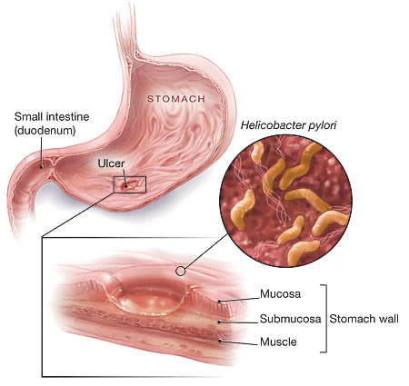
Figer-3-Helicobacter pylori

Slide 23
Pathogenesis
H. pylori attaches to the mucus-secreting cells of the gastric mucosa.
The production of large amounts of ammonia from urea by the organism’s urease, coupled with an inflammatory response, leads to damage to the mucosa.
Loss of the protective mucus coating predisposes to gastritis and peptic ulcer.
The ammonia also neutralizes stomach acid, allowing the organism to survive.
.

Slide 24
The natural habitat of H. pylori is the human stomach, and it is probably acquired by ingestion.
However, it has not been isolated from stool, food, water, or animals.
Person-to-person transmission probably occurs because there is clustering of infection within families.
The rate of infection with H. pylori in developing countries is very high—a finding that is in accord with the high rate of gastric carcinoma in those countries.

Slide 25
MALT lymphomas are B-cell tumors located typically in the stomach, but they occur elsewhere in the gastrointestinal tract as well.
H. pylori is often found in the MALT lesion, and the chronic inflammation induced by the organism is thought to stimulate B-cell proliferation and eventually a B-cell lymphoma.
Antibiotic treatment directed against the organism often causes the tumor to regress.

Slide 26
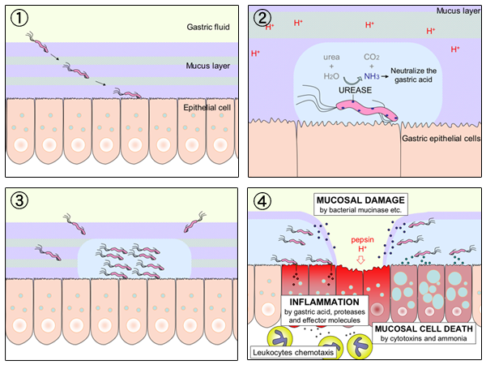
FIGURE-4-Mechanism of ulceration by Helicobacter pylori

Slide 27
Clinical Findings
Gastritis and peptic ulcer are characterized by recurrent pain in the upper abdomen, frequently accompanied by bleeding into the gastrointestinal tract.
No bacteremia or disseminated disease occurs.

Slide 28
Laboratory Diagnosis
The organism can be seen on Gram-stained smears of biopsy specimens of the gastric mucosa.
It can be cultured on the same media as campylobacters. In contrast to C. jejuni, H. pylori is urease-positive.
Urease production is the basis for a non invasive diagnostic test called the “urea breath” test.
In this test, radiolabeled urea is ingested.
If the organism is present, urease will cleave the ingested urea, radiolabeled CO2 is evolved, and the radioactivity is detected in the breath.

Slide 29
A test for Helicobacter antigen in the stool can be used for diagnosis and for confirmation that treatment has eliminated the organism.
The presence of IgG antibodies in the patient’s serum can also be used as evidence of infection.

Slide 30
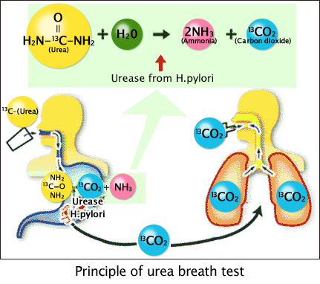
FIGURE-5- Principle of urea breath test

Slide 31
Treatment
The concept that underlies the choice of drugs is to use antibiotics to eliminate Helicobacter plus a drug to reduce gastric acidity.
A combination of two antibiotics is used because resistance, especially to metronidazole, has emerged.
Treatment of duodenal ulcers with antimicrobials (e.g., amoxicillin and metronidazole) and bismuth salts (Pepto-Bismol) results in a greatly decreased recurrence rate.
Tetracycline can be used instead of amoxicillin.
There is no vaccine or other specific preventive measure.

