Slide 1
Mycobacteria

Slide 2
Introduction
Mycobacteria are aerobic, acid-fast bacilli (rods). They are neither gram-positive nor gram-negative (i.e., they are stained poorly by the dyes used in Gram stain).
The term acid-fast refers to an organism’s ability to retain the carbolfuchsin stain despite subsequent treatment with an ethanol–hydrochloric acid mixture.
The high lipid content (approximately 60%) of their cell wall makes mycobacteria acid-fast.
The major pathogens are Mycobacterium tuberculosis, the cause of tuberculosis, and Mycobacterium leprae, the cause of leprosy.

Slide 3
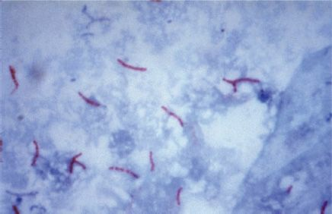
Mycobacterium tuberculosis—acid-fast stain. Long red rods of M. tuberculosis are seen on a blue background.

Slide 4
MYCOBACTERIUM TUBERCULOSIS
Disease
This organism causes tuberculosis. Worldwide, M. tuberculosis causes more deaths than any other single microbial agent.
Approximately one-third of the world’s population is infected with this organism.
Each year, it is estimated that 1.7 million people die of tuberculosis and that 9 million new cases occur. An estimated 500,000 people are infected with a multidrug-resistant strain of M. tuberculosis.

Slide 5
Important Properties
M. tuberculosis grows slowly (i.e., it has a doubling time of 18 hours, in contrast to most bacteria, which can double in number in 1 hour or less).
Because growth is so slow, cultures of clinical specimens must be held for 6 to 8 weeks before being recorded as negative.
M. tuberculosis can be cultured on bacteriologic media, whereas M. leprae cannot.
Media used for its growth (e.g., Löwenstein-Jensen medium) contain complex nutrients (e.g., egg yolk) and dyes (e.g., malachite green).

Slide 6
M. tuberculosis is an obligate aerobe; this explains its predilection for causing disease in highly oxygenated tissues such as the upper lobe of the lung and the kidney.
Cord factor (trehalose dimycolate) is correlated with virulence of the organism. Virulent strains grow in a characteristic “serpentine” cordlike pattern, whereas avirulent strains do not.
The organism also contains several proteins, which, when combined with waxes, elicit delayed hypersensitivity. These proteins are the antigens in the purified protein derivative (PPD) skin test (also known as the tuberculin skin test).

Slide 7
Transmission
M. tuberculosis is transmitted from person to person by respiratory aerosol, and its initial site of infection is the lung.
In the body, it resides chiefly within reticuloendothelial cells (e.g., macrophages).
Humans are the natural reservoir of M. tuberculosis. Although some animals, such as cattle,can be Infected,they are not the main reservoir for human infection.

Slide 8
Pathogenesis
M. tuberculosis produces no exotoxins and does not contain endotoxin in its cell wall. In fact, no mycobacteria produce toxins.
The organism preferentially infects macrophages and other reticuloendothelial cells. M. tuberculosis survives and multiplies within a cellular vacuole called a phagosome. The organism produces a protein called “exported repetitive protein” that prevents the phagosome from fusing with the lysosome, thereby allowing the organism to escape the degradative enzymes in the lysosome.

Slide 9
Lesions are dependent on the presence of the organism and the host response. There are two types of lesions:
(1) Exudative lesions, which consist of an acute inflammatory response and occur chiefly in the lungs at the initial site of infection.
(2) Granulomatous lesions, which consist of a central area of giant cells containing tubercle bacilli surrounded by a zone of epithelioid cells. These giant cells, called Langhans’ giant cells, are an important pathologic finding in tuberculous lesions.
A tubercle is a granuloma surrounded by fibrous tissue that has undergone central caseation necrosis. Tubercles heal by fibrosis and calcification.

Slide 10
The primary lesion of tuberculosis usually occurs in the lungs. The parenchymal exudative lesion and the draining lymph nodes together are called a Ghon complex.
Primary lesions usually occur in the lower lobes, whereas reactivation lesions usually occur in the apices.
Reactivation lesions also occur in other well-oxygenated sites such as the kidneys, brain, and bone.
Reactivation is seen primarily in immunocompromised or debilitated patients.

Slide 12
Spread of the organism within the body occurs by two mechanisms:
(1) A tubercle can erode into a bronchus, empty its caseous contents, and thereby spread the organism to other parts of the lungs, to the gastrointestinal tract if swallowed, and to other persons if expectorated.
(2) It can disseminate via the bloodstream to many internal organs. Dissemination can occur at an early stage if cell-mediated immunity fails to contain the initial infection or at a late stage if a person becomes immunocompromised.

Slide 13
Tuberculin Skin Test
Prior infection can be detected by a positive tuberculin skin test result, which is due to a delayed hypersensitivity reaction. PPD is used as the antigen in the tuberculin skin test.
The intermediate-strength preparation of PPD, which contains five tuberculin units, is usually used.
The skin test is evaluated by measuring the diameter of the induration surrounding the skin test site. Induration (thickening), not simply erythema (reddening), must be observed.

Slide 14
The diameter required to judge the test as positive varies depending on the status of the individual being tested.
Induration of 15 mm or more is positive in a person who has no known risk factors.
Induration of 10 mm or more is positive in a person with high-risk factors, such as a homeless person, intravenous drug users, or nursing home residents.
Induration of 5 mm or more is positive in a person who has deficient cell-mediated immunity (e.g., AIDS patients) or has been in close contact with a person with active tuberculosis.

Slide 15
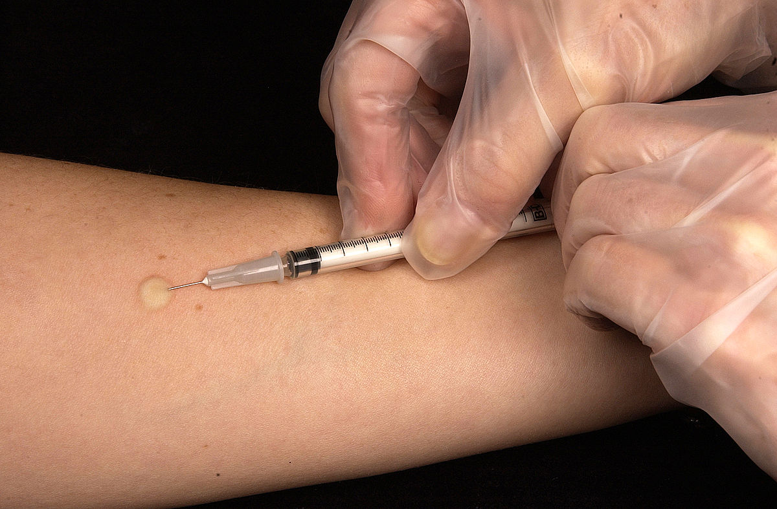
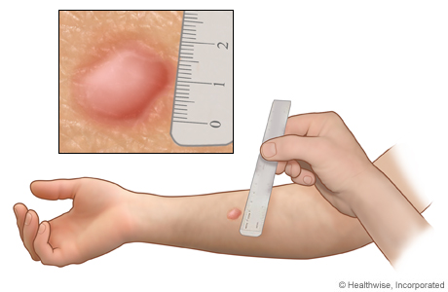
Mantoux Test

Slide 16
Clinical Findings
Fever, fatigue, night sweats, and weight loss are common. Pulmonary tuberculosis causes cough and hemoptysis.
Scrofula is mycobacterial cervical lymphadenitis that presents as swollen, nontender lymph nodes, usually unilaterally.
Lymphadenitis is the most common extrapulmonary manifestation of tuberculosis. Patients infected with human immunodeficiency virus (HIV) are more likely to have multifocal lymphadenitis than those not infected with HIV.

Slide 17
Laboratory Diagnosis
Acid-fast staining of sputum or other specimens is the usual initial test.
After digestion of the specimen by treatment with NaOH and concentration by centrifugation, the material is cultured on special media, such as Löwenstein-Jensen agar, for up to 8 weeks.

Slide 18
Treatment & Resistance
Multidrug therapy is used to prevent the emergence of drug-resistant mutants during the long (6- to 9-month) duration of treatment. (Organisms that become resistant to one drug will be inhibited by the other).
Isoniazid (INH), a bactericidal drug, is the mainstay of treatment.
Treatment for most patients with pulmonary tuberculosis is with three drugs: INH, rifampin, and pyrazinamide. INH and rifampin are given for 6 months, but pyrazinamide treatment is stopped after 2 months.

Slide 19
Prevention
An important component of prevention is the use of the PPD skin test to detect recent converters and to institute treatment for latent infections as described earlier.
BCG vaccine can be used to induce partial resistance to tuberculosis. The vaccine contains a strain of live, attenuated M. bovis called bacillus Calmette- Guérin. The vaccine is effective in preventing the appearance of tuberculosis as a clinical disease, especially in children.

Slide 20
MYCOBACTERIUM LEPRAE
Disease
This organism causes leprosy (Hansen’s disease).
Important Properties
M. leprae has not been grown in the laboratory, either on artificial media or in cell culture. It can be grown in experimental animals, such as mice and armadillos. Humans are the natural hosts.
The optimal temperature for growth (30°C) is lower than body temperature; therefore, M. leprae grows preferentially in the skin and superficial nerves. It grows very slowly, with a doubling time of 14 days. This makes it the slowest-growing human bacterial pathogen. One consequence of this is that antibiotic therapy must be continued for a long time, usually several years.

Slide 21
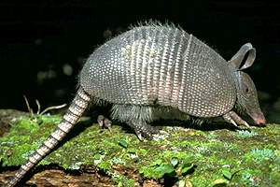
Armadillo

Slide 22
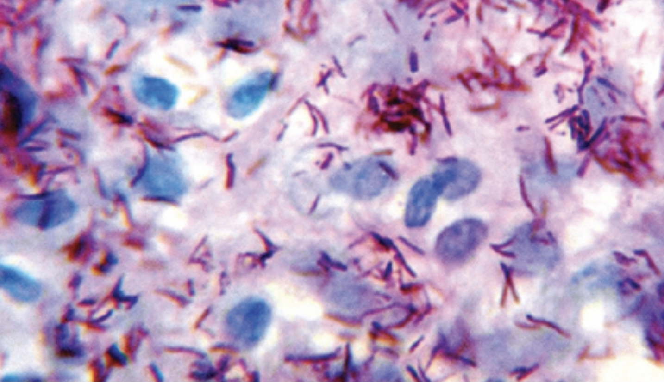
Mycobacterium leprae

Slide 23
Transmission
Infection is acquired by prolonged contact with patients with lepromatous leprosy, who discharge M. leprae in large numbers in nasal secretions and from skin lesions.
Pathogenesis
There are two distinct forms of leprosy—tuberculoid and lepromatous—with several intermediate forms between the two extremes
(1) In tuberculoid (also known as paucibacillary) leprosy, the CMI response to the organism limits its growth, very few acid-fast bacilli are seen, and granulomas containing giant cells form. The nerve damage seems likely to be caused by cell- mediated immunity as there are few organisms and the CMI response is strong.

Slide 24
(2) In lepromatous (also known as multibacillary) leprosy, the cell-mediated response to the organism is poor, the skin and mucous membrane lesions contain large numbers of organisms, foamy histiocytes rather than granulomas are found, and the lepromin skin test result is negative.
The nerve damage seems likely to be caused by direct contact as there are many organisms and the CMI response is poor.

Slide 25
Clinical Findings
The incubation period averages several years, and the onset of the disease is gradual.
In tuberculoid leprosy, hypopigmented macular or plaque-like skin lesions, thickened superficial nerves, and significant anesthesia of the skin lesions occur.
In lepromatous leprosy, multiple nodular skin lesions occur, resulting in the typical leonine (lion-like) facies.
After the onset of therapy, patients with lepromatous leprosy often develop erythema nodosum leprosum (ENL), which is interpreted as a sign that cell-mediated immunity is being restored.
ENL is characterized by painful nodules, especially along the extensor surfaces of the tibia and ulna, neuritis, and uveitis.

Slide 26
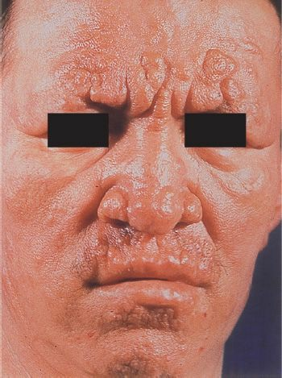
Lepromatous leprosy. The lepromatous form is characterized by multiple, raised lesions, often with the appearance of leonine facies (the face resembles a lion with a prominent brow)

Slide 27
Laboratory Diagnosis
In lepromatous leprosy, the bacilli are easily demonstrated by performing an acid- fast stain of skin lesions or nasal scrapings. Lipid-laden macrophages called “foam cells” containing many acid-fast bacilli are seen in the skin.
In the tuberculoid form, very few organisms are seen, and the appearance of typical granulomas is sufficient for diagnosis.
Cultures are negative because the organism does not grow on artificial media.

Slide 28
Treatment
The mainstay of therapy is dapsone (diaminodiphenylsulfone), but because sufficient resistance to the drug has emerged, combination therapy is now recommended (e.g., dapsone, rifampin, and clofazimine for lepromatous leprosy and dapsone and rifampin for the tuberculoid form).
Treatment is given for at least 2 years or until the lesions are free of organisms.

