Slide 1
Pancreas
Lab 3

Slide 2
Pancreas: is a triangular gland that has both exocrine and endocrine cells.
The pancreas has two main functions:
Exocrine Function: Acinar cells produce digestive enzymes necessary for breaking down food in the intestine.
Endocrine Function: Pancreatic islets (islets of Langerhans) secrete hormones that regulate blood sugar levels and metabolism.

Slide 3
Beta (β) Cells: Produce insulin, which lowers blood sugar levels by promoting the uptake of glucose into cells.
Alpha (α) Cells: Produce glucagon, which raises blood sugar levels by stimulating the release of glucose from the liver.
Delta (δ) Cells: Produce somatostatin, which regulates hormone secretion and inhibits the release of insulin and glucagon.
F cells/PP Cells: Produce pancreatic polypeptide, involved in regulating pancreatic secretions and appetite.

Slide 4
Insulin
Insulin is a vital hormone that tells the body when nutrients are plentiful. It helps cells use and store glucose, fats, and proteins for energy. Structurally, Insulin is a protein hormone composed of two peptide chains, A and B, connected by disulfide bonds. Initially synthesized as proinsulin, it consists of 86 amino acids. Enzymatic cleavage then produces functional insulin (51 amino acids) and C peptide (29 amino acids). Insulin has a short lifespan in the blood, about 6 minutes, showing how quickly it responds to changes in metabolism.

Slide 5
Insulin synthesis
Insulin synthesis is tightly regulated to maintain metabolic balance. Here's a summary of its synthesis process:
Stimulation and Inhibition: Insulin synthesis is stimulated by glucose or feeding, indicating nutrient availability. Conversely, fasting or low glucose levels decrease insulin synthesis.
Glucose Threshold: There's a threshold for glucose-stimulated insulin secretion, typically around 100 mg/dL. When blood glucose levels exceed this threshold, insulin synthesis and secretion increase.

Slide 6
Insulin release
The main pathway for insulin secretion involves the glucose receptor GLUT2, found in beta cells, kidney, liver, and intestine. Glucose entering the cell is phosphorylated and undergoes glycolysis to produce ATP, providing energy. Simultaneously, an ATP-sensitive potassium channel on the cell membrane allows potassium to exit the cell, but high ATP levels block this channel, leading to cell depolarization. Depolarization opens voltage-gated calcium channels, allowing calcium to enter the cell. Calcium triggers the exocytosis of insulin storage granules, facilitating insulin release. This process ensures insulin secretion is tightly regulated in response to glucose levels, maintaining metabolic balance.

Slide 7
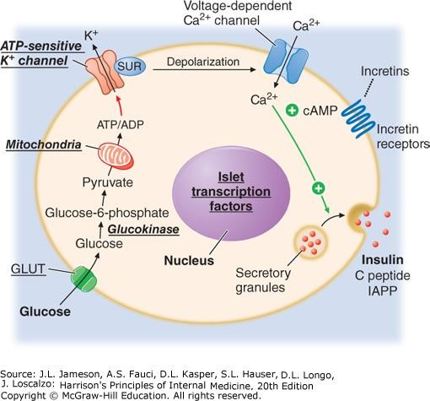

Slide 8
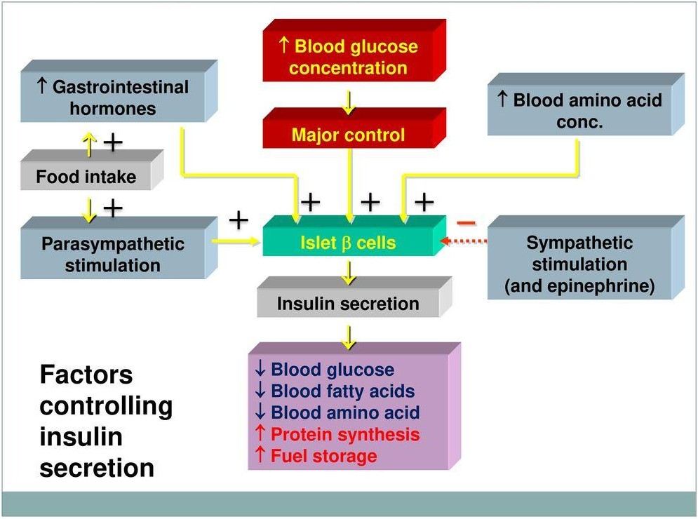
Factors controlling insulin release

Slide 9
Incretins, including glucagon-like peptide-1 (GLP-1) and glucose-dependent insulinotropic polypeptide (GIP), are hormones released in response to food intake. They boost insulin secretion from pancreatic beta cells in response to high blood glucose levels, aiding in glucose regulation. Importantly, incretins stimulate insulin release only when blood glucose levels are elevated, ensuring a glucose-dependent response. This mechanism supports postprandial glucose control, contributing to metabolic balance after meals.

Slide 10
Insulin action
1) Carbohydrate metabolism: Insulin enhances glucose utilization by promoting cellular uptake, glycolysis, and glycogen synthesis while inhibiting glycogen breakdown, ultimately lowering blood glucose levels.
(2) Lipid metabolism: Insulin suppresses the breakdown of fats (lipolysis), promotes the synthesis of fatty acids and triglycerides, and decreases fatty acid oxidation, collectively favoring fat storage.
3) Protein metabolism: Insulin facilitates tissue growth and repair by promoting amino acid uptake and protein synthesis, while also regulating electrolyte balance through potassium uptake.

Slide 11
Procedure:
Effect of glibenclamide and sitagliptin on the blood glucose level.
Nine male albino rats aged 12-14 weeks are acclimatized to the animal room conditions for at least a week before the experiment, maintained at 25±2°C with a 12-hour light/12-hour dark cycle. They are supplied with commercial pellet food and water. The rats are randomly divided into three groups, each comprising three rats. Before drug administration, blood glucose levels are checked. Each group receives one of the following treatments: Group 1: control
Group 1: control
Group 2: glibenclamide (5 mg/kg body weight)
Group 3: sitagliptin (20mg/kg).
After three hours, blood glucose levels will be measured.

Slide 12
2-Sitagliptin increasing insulin secretion through inhibition of dipeptidyl peptidase (DPP)-4, an enzyme that degrades incretin, and by suppressing excess glucagon secretion.
1-Glibenclamide exhibited a significant reduction in blood glucose levels when compared to normal control, works by increasing the amount of insulin that pancreas produces. This helps to reduce the amount of sugar in your blood.

Slide 13
Thank you

