Slide 1
How to obtain free scientific ebooks in Telegram application
Assist. Lecturer : Delman D. Maulod

Slide 2
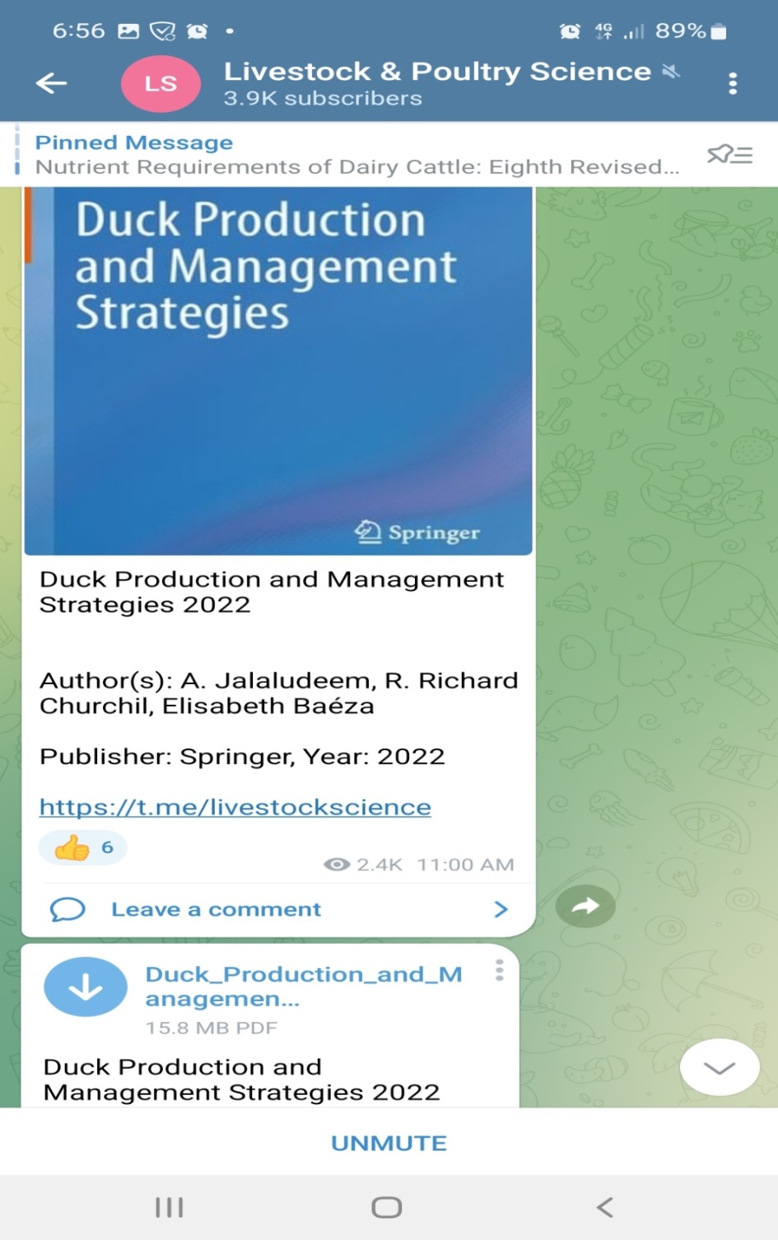

Slide 3
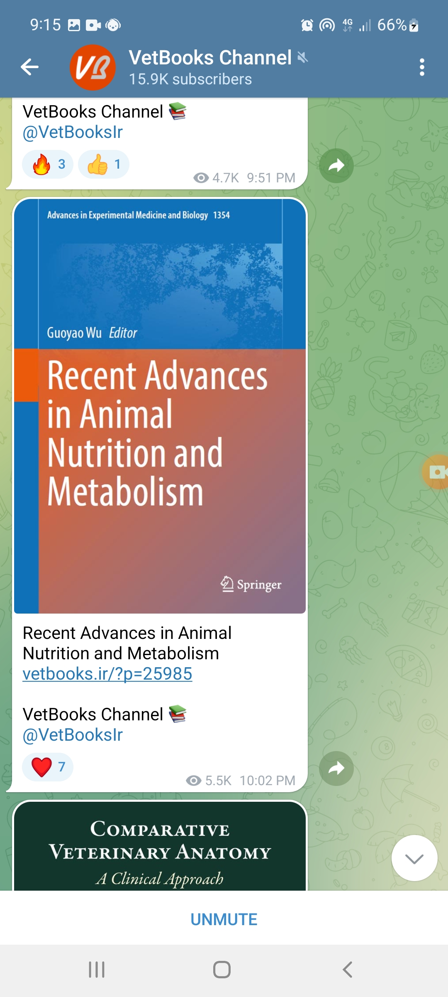

Slide 4
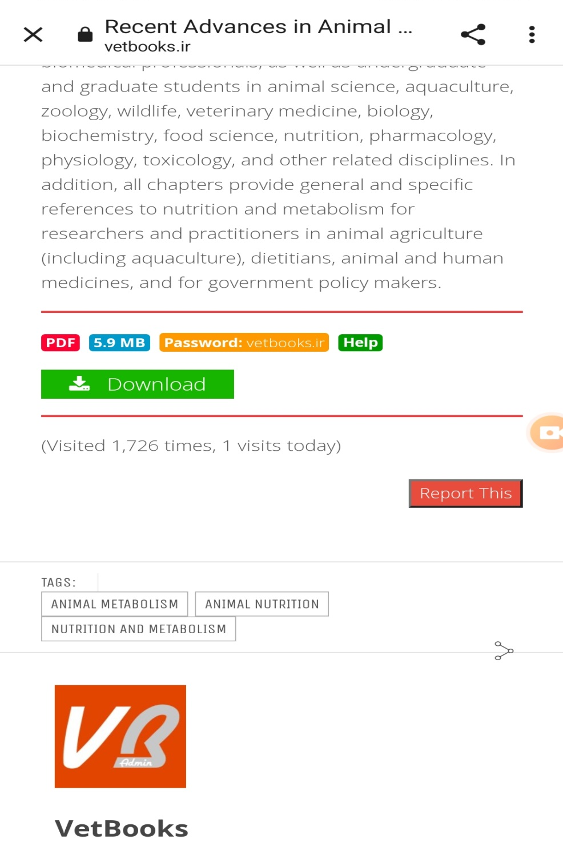
Vetbooks.ir

Slide 5
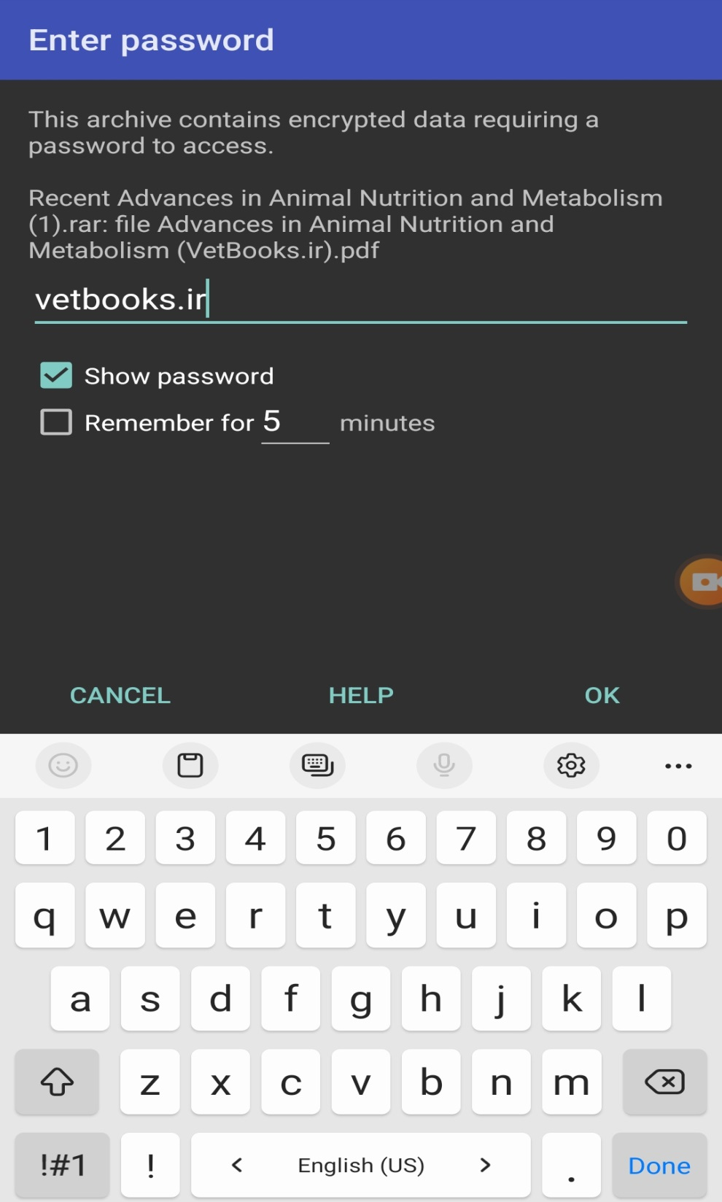

Slide 6
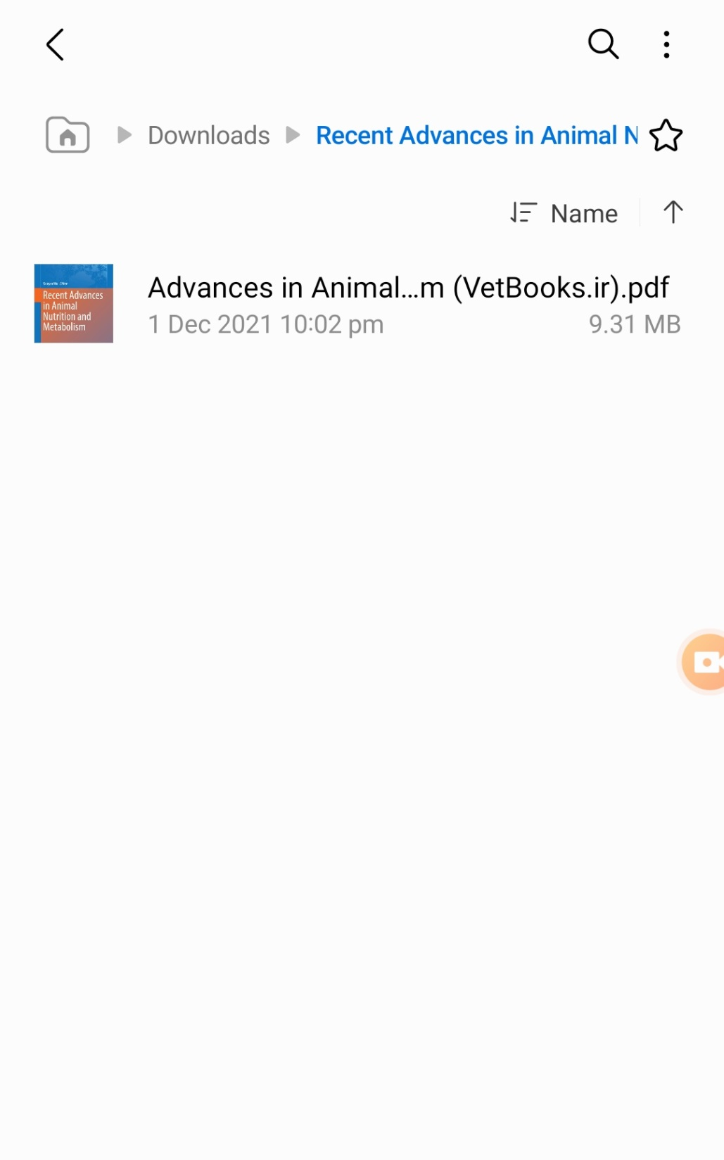

Slide 7
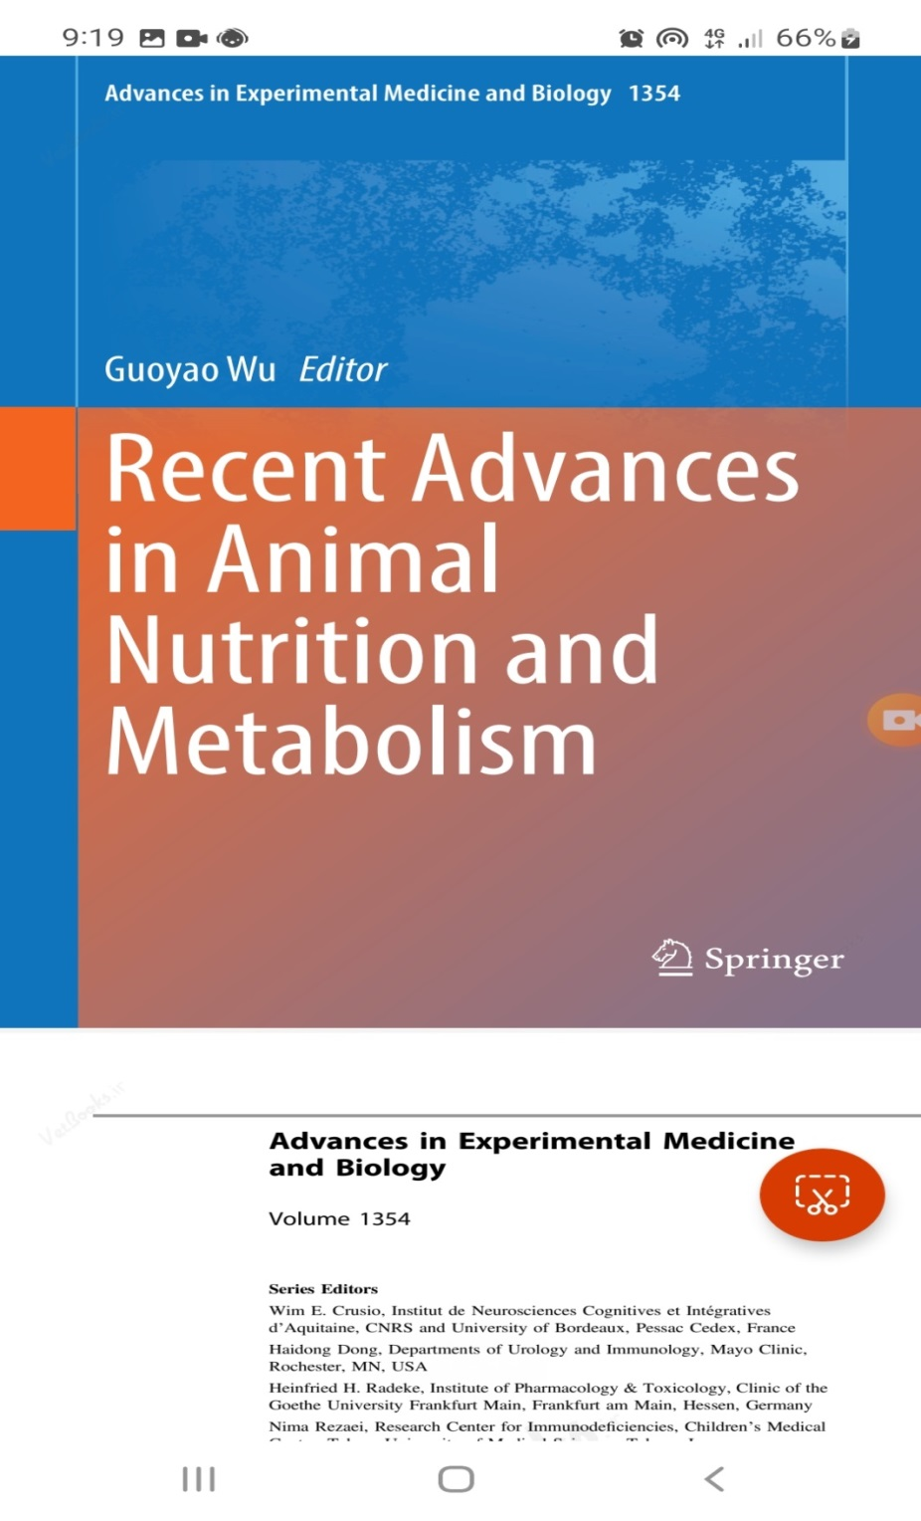

Slide 8
Thanks

