Slide 1
Salahaddin University
College of Agriculture Engineering Science
Field Crops and Medicinal Plants Department
Welcome to Chemistry Class
Prof. (A) Dr./Dheyaa Jirjees Yaqoob
First year students 2022 – 2023
Autumn Semester

Slide 2
Analytical Chemistry’s lecture comprises Theoretical session Practical session

Slide 3
-Analytical chemistry
Branches of chemistry
-Organic chemistry
-Inorganic chemistry
-Biochemistry
-Physical chemistry
-Industrial chemistry
-Food chemistry
-Medicinal chemistry
-Nuclear chemistry,
-and more….

Slide 4
What is chemistry?

Slide 5
The Study of Chemistry
What is Chemistry?
Chemistry is the study of the properties and behavior of matter.
Matter – anything that occupies space and has mass.

Slide 6
Classification of Matter:
The basic difference between these states is the distance between the “bodies.”
Gas – bodies are far apart and in rapid motion.
Liquid – bodies closer together, but still able to move past each other.
Solid – bodies are closer still and are now held in place in a definite arrangement.

Slide 7
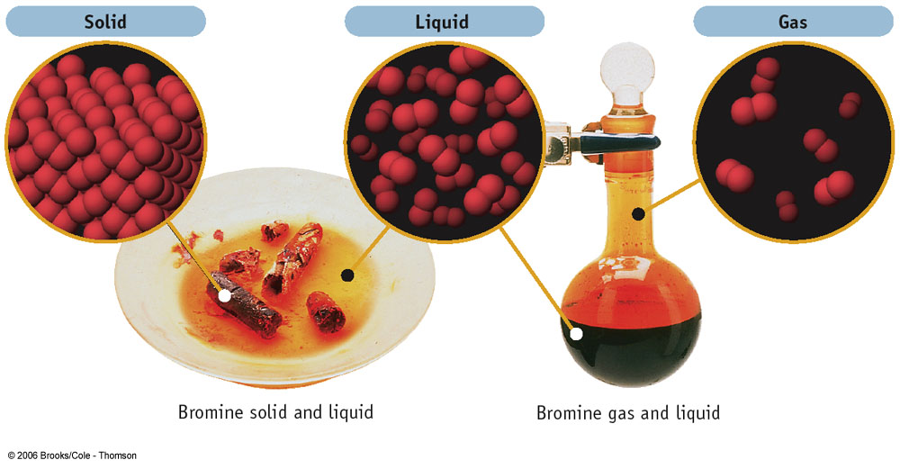

Slide 8
Classification of Matter
Matter
Substances
Mixtures
Homogeneous
(Solutions)
Elements Compounds
Heterogeneous
Memorize
http://owl.thomsonlearning.com

Slide 9
Pure Substances and Mixtures:
Mixture – combination of two or more substances in which each substance retains its own chemical identity.
Homogeneous mixture – composition of this mixture is consistent throughout.
Solution (Air, gasoline)
Heterogeneous mixture – composition of this mixture varies throughout the mixture.

Slide 10
Separation of Mixtures
Mixtures can be separated by physical means.
Filtration.
Chromatography.
Distillation.

Slide 11
Pure Substances and Mixtures
It is also possible for a homogeneous substance to be composed of a single substance – pure substance.
Element – A substance that can not be separated into simpler substances by chemical means.
Compound - A substance composed of two or more elements chemically combined in fixed ratios by mass.
Water - H₂O Carbon dioxide - CO₂
Sodium Chloride – NaCl Iron(II) sulfide - FeS
Atom – the smallest unit of an element that retains a substances chemical activity.

Slide 12
Classification of Analytical Methods
Analytical Chemistry deals with methods for determining the chemical composition of samples.
Qualitative analysis establishes the chemical identity of the species in the sample or reveals the identity of the elements and compounds in a sample.
Quantitative analysis determine the relative amounts of these species , or analytes Or indicates the amount of each substance in a sample.
Analytes are the components of a sample to be determined.

Slide 13
Analytical Methods
Classical Methods: Wet chemical methods such as precipitation, extraction, distillation, boiling or melting points, gravimetric and titrimetric measurements.
Instrumental Methods: Analytical measurements (conductivity, electrode potential, light absorption or emission, mass-to-charge ratio, fluorescence etc.) are made using instrumentation.

Slide 14
Types of Instrumental Methods
1. Spectroscopic methods:
Atomic spectroscopy
Molecular spectroscopy
2. Chromatographic methods (separations):
3. Electrochemistry:

Slide 15
The chemical Composition of Solutions
Strong and Week electrolyte:
Most of the compounds with which we shall be concerned are electrolytes, that is in aqueous solution they dissociate to a great or lesser extent into ions.
Strong electrolyte: are completely or nearly completely dissociated.
Week electrolyte: are only partially ionized.

Slide 16
It is important to know whether the solute acts as a strong or week electrolyte. The following table illustrates what is mentioned above:
Table of Classification of electrolytes:
Strong electrolyte Week electrolyte
HNO3, HClO4, H2SO4. H2CO3, H3PO4, H2SO4, H3BO3.
Alkaly and Alkaline earth hydroxides Most of the Organic acids.
as well as some of the heavy metal
hydroxides NaOH, Ca(OH)2, Cd(OH)2.
Most Salts. Ammonia and most Organic Bases.
Hydroxides, Cynides, and ThioCynides
of Hg, Zn, Cd

Slide 17
Example/ H2SO4 is completely dissociated is classified as strong electrolyte. However it should be noted that the (HSO4)⁻ ions is week electrolyte, being only partially dissociated.
H Ӧ: ℮ H⁺
H
H₃O⁺

Slide 18
Acids & Bases
Acids &Bases: were named according to their properties in aqueous solutions.
Acids: Causes litmus paper to turn red, give sharp taste to water, and react with base to form salt.
Base: turn litmus paper to blue, produce a salt with an acid, and impart a bitter taste and slippery feel to water.

Slide 19
Definitions of Acids & Bases
Arrhenius: Acids were defined as a hydrogen containing substances that dissociate into H⁺ and anions where dissociate in H₂O:
HCl H⁺ + CL⁻
Bases were defined as compounds containing hydroxyl groups (OH⁻) that give OH⁻ ions and cations upon the same treatment.
NaOH Na⁺ + OH⁻
Ba(OH)₂ Ba⁺ + 2OH⁻

Slide 20
Bronshted &Lowry (1923):
Acids are any substances capable of donating a proton; a base is any substances that can accept a proton. The relation can be represented as:
Acid Base + Proton
Conjugate base
When an acid losses a proton, the entity that remains clearly becomes a potential proton acceptor and thus a base, its called the conjugate base of the parent acid.

Slide 21
It is important to recognize that a substance can exhibit acidic behavior only in the presence of proton acceptor, similarly, basic behavior requires the presence of a proton donar.
The neutralization in Bronsheted & Lowry theory can be write as follows:
Acid₁ + Base₂ Acid₂ + Base₁
this process will be spontaneous the direction that favors production of the weaker conjugate acid & base.

Slide 22
Examples: Base
HCl + H₂O H₃O⁺ + Cl⁻
CH₃COOH + H₂O H₃O⁺ + CH₃COO⁻
AL(H₂O)₆ ⁺⁺⁺ + H₂O H₃O⁺ + Al(H₂O)₅OH ⁺⁺
H₂PO₄ ⁻ + H₂O H₃O⁺ + HPO₄ ⁻⁻
NH₄⁺ +H₂O H₃O⁺ + NH₃
H₂O + ˸NH₃ NH₄ ⁺+ OH⁻
acid

Slide 23
Above equations illustrates that acids and bases can be anionic, cationic or electrically neutral in character.
In the first five examples, water acts as proton acceptor (Base) and proton donar (Acid). Solvent that posses dual capacity are called Amphiprotic.
The extent to which an acid or base react with a given solvent varies greatly.
Example: The reaction between HCl and H₂O is essentially complete, thus, this substance is classified as strong acid in H₂O.

Slide 24
Example: Acetic acid (CH₃COOH)and Ammonium ion (NH₄ ⁺) react to produce H₂O and salt.
The relations are mentioned previously.
Example:
{HCl, HClO₄, and HBr} in H₂O are strong acids.
HClO₄ in CH₃COOH is strong acid.
{HCl and HBr} in CH₃COOH are weak acids.
CH₃COOH + HClO4 CH₃COOH2⁺ + ClO4⁻
acid1 base2 acid2 base1

Slide 25
Another important consequence of Bronshted theory is that the most effective proton donar (strong acid) give rise to poorest proton acceptor (weakest conjugate base).
Example: Referring a gain to the reaction of:
{HCl, CH₃COOH and NH₄⁺} with H₂O
The order of decrease in basicity of conjugated base.
˸NH₃ ˃ CH₃COO⁻ ˃ Cl⁻
Strongest weakest

