Slide 1
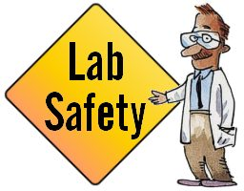
Kurdistan Regional Government-Iraq
Ministry Of Higher Education & Scientific Research
Salahaddin University-Hawler
Agriculture College, Animal resources Department
Class2th year/2nd sem./Practical of Molecular Genetic
2018-2019
First Practical; Safety in the Laboratory

Slide 2
Basic operations in the laboratory
The purpose of this discussion is to help the student understand proper laboratory safety, to increase his awareness of the possible risks or hazards involved with laboratory work and to realize the laboratory is generally a safe place to work if safety guidelines are properly followed.
Instruments and Equipment
An important part of working in any laboratory is the proper use and calibration of instruments and equipment. Students will become familiar with general information about the use of lab equipment, as well as more detailed information about the step-by-step procedures for the specific instruments that they use.

Slide 3
Objectives:
Upon completion of this lecture, the student will be able to describe:
Personal safety
Eye safety
Radiation Safety.
Handling of needles and sharps.
List of some equipment / apparatus used in biotechnology laboratory

Slide 4
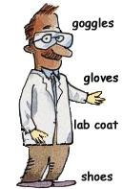
Personal safety
Lab coats or disposable aprons should be worn in the lab
to protect you and your clothing from contamination.
Do not eat food, drink beverages, or
chew gum in the laboratory, do not use
laboratory glassware as containers for food.
Dress properly during a laboratory activity. Long hair,
dangling jewelry, and loose or baggy clothing are a hazard in the laboratory. Long hair must be tied back, and dangling
jewelry and baggy clothing must be secured. Shoes must completely cover the foot. No sandals allowed on lab days
Report any accident (spill, breakage, etc.) or injury
(cut, burn, etc.) to the teacher immediately,
no matter how trivial it seems. Do not panic.

Slide 5
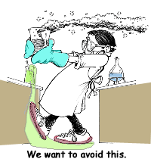
Keep hands away from face, eyes, mouth, and body while using chemicals or lab equipment. Wash your hands with soap and water after performing all experiments.
Be alert and proceed with caution at all times in the laboratory. Notify the teacher immediately of any unsafe conditions you observe
Know what to do if there is a fire drill during a laboratory period; containers must be closed, and any electrical equipment turned off.

Slide 6
Eye Safety; Eye goggles should be worn:
When performing procedures that are likely to generate droplets/aerosols of blood.
When working with reagents under pressure.
When working in close proximity to ultra-violet radiation (light).

Slide 7
Handling of needles and sharps.
Never handle broken glass with your bare hands. Use a brush clean up broken glass. Place broken glass in the designated glass disposal container.
Examine glassware before each use.
Never use chipped, cracked, or dirty glassware.
Do not immerse hot glassware in cold water. The glassware may shatter.

Slide 8
Radiation Safety
Remember: the amount of radiation exposure decreases with distance.
Eye goggles should be worn when working in close proximity to ultra-violet radiation (light).
If you do not understand how to use a piece of equipment, ASK THE TEACHER FOR HELP!

Slide 9
List of some equipment / apparatus used in molecular genetics laboratory
Pipette
Digital Balance
pH meter
Autoclave
Thermometer
Water bath
Centrifuge
Refrigerator
Gel Electrophoresis
UV Light
Nano drop
ELISA

Slide 10
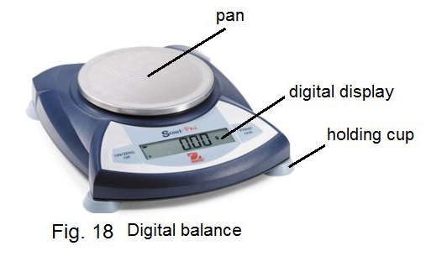
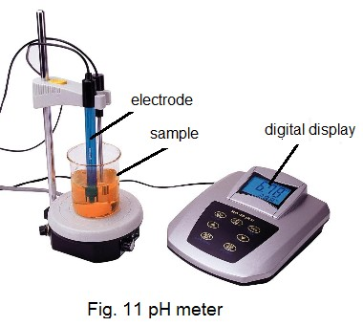
Digital Balance
Balance is needed in molecular genetic lab forbweighing
chemicals, powders, samples (e.g., tissue), etc. Digital balances
are fast to work
pH meter
pH meter is an electrical instrument used for measuring hydrogen ion concentration solutions and mixtures The pH meter must be standardized with buffer solutions before operation. It must not be dipped in hot or very cold solutions. The electrodes must always be kept immersed in suitable solutions.
Thermometer
Thermometers are required to ensure the heating equipment is running at the correct temperature. The temperature of the water bath, incubator, etc., need to be frequently checked. (e.g., Mercury Thermometer)

Slide 11
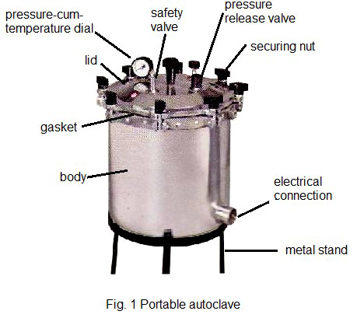
Autoclave
Autoclave is a robust, electrically heated steam vessel meant for sterilizing glassware, culture media, and other materials that are not spoiled by moist heat. Microorganisms / cells are killed as a result of denaturation of cellular constituents (protein and nucleic acids). In this process, sterilization can be achieved by operating the autoclave at 121°C for 15 min.
UV (Ultraviolet) light
Exposure to ultraviolet light can cause acute eye irritation. Since the retina cannot detect UV light, you can have serious eye damage and not realize it until 30 min to 24 hours after exposure. Therefore, always wear appropriate eye protection when using UV lamps.

