Slide 1
Standard practice for selecting proportions for
Heavyweight concrete

Slide 2
Heavyweight Concrete :
Concrete of normal placeability can be proportioned for densities as high as 350 lb per cu ft ( 5607 kg/m3 ) by using heavy aggregates such as iron ore, iron or steel shot, barite, and iron or steel punchings. Although each of the materials has its own special characteristics, they can be processed to meet the standard requirements for grading, soundness cleanliness, etc. The selection of the aggregate should depend on its intended use.
In the case of radiation shielding, determination should be made of trace elements within the material which may become reactive when subjected to radiation. In the selection of materials and proportioning of heavyweight concrete, the data needed and procedures used are similar to those required for normal weight concrete.
Aggregate density and composition for heavyweight concrete should meet requirements of ASTM C 637 and C 638.

Slide 3
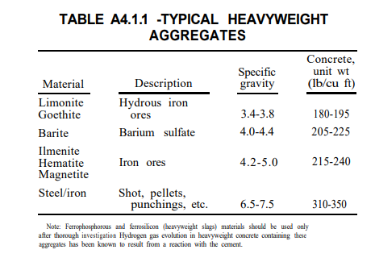
Typical materials used as heavy aggregates are listed in Table A4.1.1.

Slide 4
Example -- Concrete is required for counterweights on a lift bridge that will not be subjected to freezing and thawing conditions. An average 28 day compressive strength of 4500 psi ( 31.0 MPa) will be required. Placement conditions permit a slump of 2 to 3 in ( 50 – 75 mm ). at point of placement and a nominal maximum size aggregate of 1 in ( 25 mm ). The design of the counterweight requires* an oven dry unit weight of 225 lb/ft³ ( 3604 kg/m3) . An investigation of economically available materials has indicated the following:
Cement ASTM C type I ( Non-air entraining )
Fine aggregate specular hematite
Coarse aggregate ilmenite
Fineness modulus ( fine = 2.30 )
Specific gravity ( Bulk SSD ) fine = 4.95 , coarse = 4.61
Absorption % fine = 0.05 , coarse = 0.08
Dry rodded weight coarse = 165 Ib/ft³ ( 2643.3 kg/m3)

Slide 5
Solution :
Step 1 – Slump :
As indicated, the desired slump is 2 to 3 in ( 50 -75 mm ). at point of placement.
Step 2 – Nominal maximum size :
The available aggregate sources have been indicated as suitable, and the course aggregate will be a well-graded and well-shaped crushed ilmenite with a nominal maximum size of 25 mm.The fine aggregate will be hematite.
Step 3 -- water content :
By interpolation in Table 6.3.3, non-air-entrained concrete with a 50 to 75 mm. slump and a 25 mm. nominal maximum size aggregate requires a water content of approximately 310 lb per cu yd ( 183.92 kg/m3). The estimated entrapped air is 1.5 percent.
Note; Non-air-entrained concrete will be used because ;
(1) the concrete is not to be exposed to severe weather.
(2) a high air content could reduce the dry unit weight of the concrete.

Slide 6
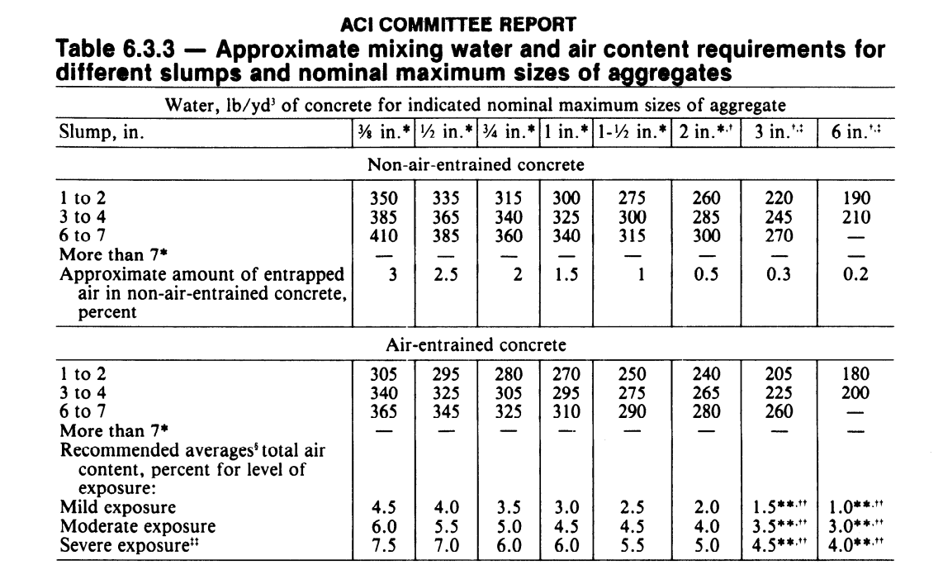

Slide 7
Step 4 – water/ cement ratio :
From Table 6.3.4(a) the water-cement ratio needed to produce a strength of 4500 psi ( 31.0 MPa ) in non-air-entrained concrete is found to be approximately 0.52.
Step 5 – Cement content :
From the information derived in Steps 3 and 4, the required cement content is calculated to be 310/0.52 = 596 lb per cu yd ( 353.6 kg/m3).
Step 6 – coarse aggregate content :
The quantity of coarse aggregate is estimated by extrapolation from Table 6.3.6.
27 x 0.72 = 19.44 cu ft (0.55 m3)
19.44 x 165 = 3208 lb ( 1455.14 kg)

Slide 8
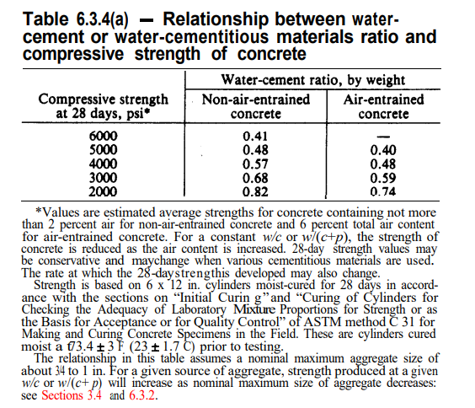
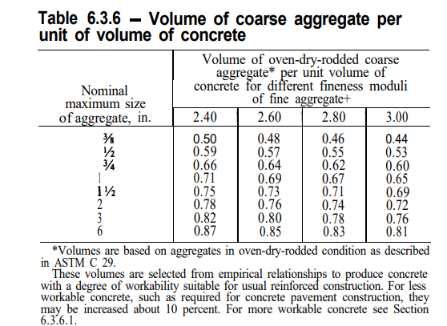

Slide 9
Step 7 -- Fine aggregate content :
For heavyweight concrete, the required fine aggregate should be determined on the absolute volume basis. With the quantities of cement, water, air, and coarse aggregate established, the fine aggregate content can be calculated as follows:
Volume of water = 310/ 62.4 = 4.97 ft³ ( 0.14 m3 )
Volume of air = 0.015 * 27 = 0.40 ft³ ( 0.015 m3 )
Solid volume of cement = 596 / ( 3.15 * 62.4 ) = 3.03 ft³ ( 0.0858 m3 )
Solid volume of coarse aggregate = 3208 / ( 4.61 * 62.4 ) = 11.15 ft³ ( 0.31576 m3 )
Total volume of all ingredients except fine aggregate = 19.55 ft³ ( 0.553 m3 )
Solid volume of coarse aggregate = 27 ft³ – 19.55 = 7.45 ft³ ( 0.7646 – 0.553 = 0.2116 m3 )
Required weight of fine aggregate = 7.45 * 62.4 * 4.95 = 2301 Ib ( 0.2116 * 4.95 *1000 = 1047 kg ).
1 yard = 27 ft³ = 0.7646 m³

Slide 10
Materials | Weight kg | Volume m³
Cement | 354 | 0.0858
Water | 184 | 0.14
Coarse aggregate | 1455 | 0.31576
Fine aggregate | 1047 | 0.2116
air |  | 0.0114
total | 3040 | 0.76456

