Slide 1
The stages of plant growth according to nutrient concentration in plant tissue : - 1- Sever deficiency 2- Mild deficiency 3- Luxury 4- Toxic Critical level Ideal growth by using least quantity ( concentration ) of nutrient there is no further increase in the yield as a result of the increased content of plant nutrient component . The indicators for inference on the plant content : - 1- The part of the plant

Slide 2
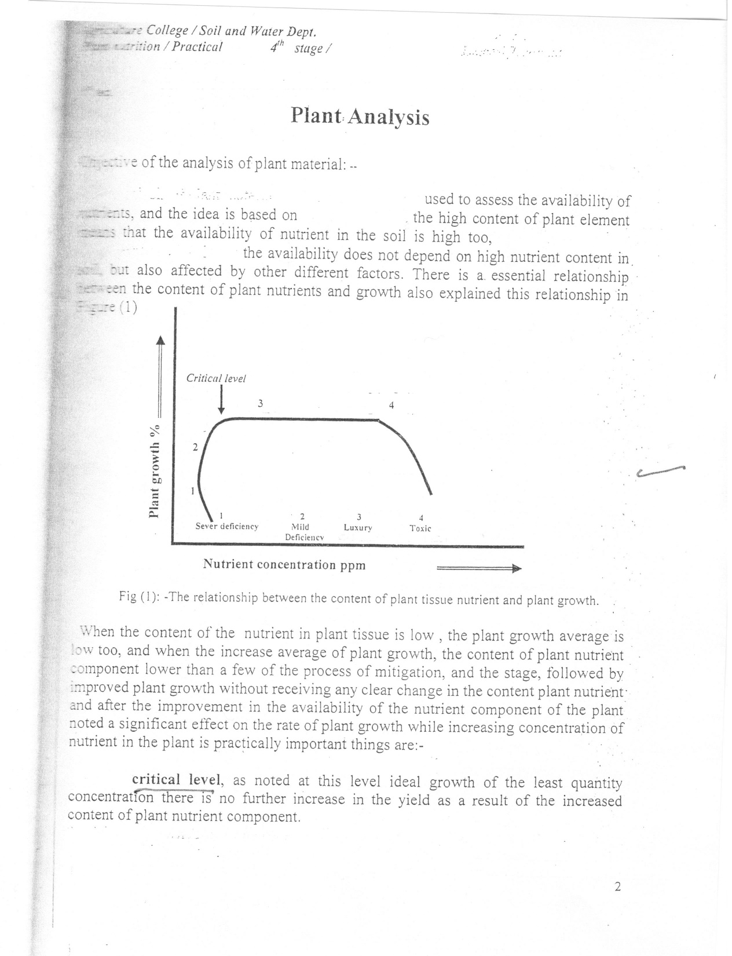

Slide 3
2- Plant age (N, P , K) concentration in plant decreases with increasing Plant age , while increasing their content of( Ca, Mg , Mn,B) with plant age . 3- Supplying nutrient to the plant Nutrient absorption depend on : - A – deep of the root . B – aeration of the soil . C – water level . Note : - before supplying nutrient to the soil for treating its deficiency in the plant we have to be soil and plant analysis because its results related to gather , if the symptoms deficiency not related to plant diseases .

Slide 4
The types of vegetative tests : - 1 – Glass houses 2 – Plastic house 3 – Wooden canopy 4 – Tunnels 5 – Field trials The source of difference between the tests A – The size of experiments ( tests ) . B – The time of investigation . C – Yield quantity from the experiment unit . D – Controlling of growth factors and plant experience .

Slide 5
The important point at plant sampling 1 – Collecting plants consisting of one sample in different parts Of basin , pots or field . 2 – The number of the plants taken from different places . 3 – No distinction at plant sampling . The purpose of drying plant sample ? To kill the enzymes in the plant material in a short time because these enzymes continue its works even after cutting the plant sample .

Slide 6
The stages of plant sample preparations for analysis 1- Receipt of samples and registering in laboratory files and give the numbers . 2 – Estimate wet weight then cut it into small pieces by knife or scissors . 3 - Oven drying the samples at a temperature of 70 c for 24 – 48 hours . 4 – Grinding samples ( electrical mills ) . 5 – Storage samples in plastic cans and registering necessary information about the samples .

