Slide 1
Lec-6- The structure of a typical prokaryotic cell The Cell Wall

Slide 2
Learning objectives:
The function of the cell wall
Characteristic and composition of cell wall Gram-Positive and Gram-Negative Cell Walls
Atypical Cell Walls
Acid-Fast Cell Wall
Damage to the Cell Walls

Slide 3
The function of the cell wall:
Cell wall prevents bacterial cells from rupturing when the water pressure inside the cell is greater than that outside the cell.
It also helps maintain the shape of a bacterium.
It serves as a point of anchorage for flagella.

Slide 4
Characteristic and composition and of cell wall:
The cell wall of the bacterial cell is a complex, semirigid structure.
The bacterial cell wall is composed of a macromolecular network called peptidoglycan (murein).
Peptidoglycan composed of two portions:
The glycan portion of peptidoglycan.
The peptide portion of peptidoglycan.

Slide 5
Peptidoglycan consists of a repeating disaccharide connected by polypeptides.
The disaccharide portion is made up of N-acetylglucosamine (NAG) and N-acetylmuramic acid (NAM), which are related to glucose.
Alternating NAM and NAG molecules are linked in rows to form a carbohydrate backbone (the glycan portion of peptidoglycan).
Adjacent rows are linked by polypeptides (the peptide portion of peptidoglycan).

Slide 6
The polypeptide link includes tetrapeptide side chains, which consist of four amino acids attached to NAMs in the backbone. The amino acids occur in an alternating pattern of d and l forms.
Parallel tetrapeptide side chains may be directly bonded to each other or linked by a peptide cross-bridge, consisting of a short chain of amino acids.

Slide 7
Figure: N-acetylglucosamine (NAG) and N-acetylmuramic acid (NAM) joined as in a peptidoglycan. The gold areas show the differences between the two molecules. The linkage between them is called a β-1,4 linkage.

Slide 8
Structure of Peptidoglycan in Gram-Positive Bacteria

Slide 9
Gram-Positive Cell Walls:
In most gram-positive bacteria, the cell wall consists of many layers of peptidoglycan, forming a thick, rigid structure, and teichoic acids, which consist of alcohol and phosphate.
There are two classes of teichoic acids:
Lipoteichoic acid, which spans the peptidoglycan layer and is linked to the plasma membrane.
Wall teichoic acid, which is linked to the peptidoglycan layer.

Slide 10
The space between the cell wall and plasma membrane of gram-positive bacteria is the periplasmic space. It contains the granular layer, which is composed of lipoteichoic acid.
Importance of teichoic acids:
Because of their negative charge (from the phosphate groups), teichoic acids may bind and regulate the movement of cations (positive ions) into and out of the cell.

Slide 12
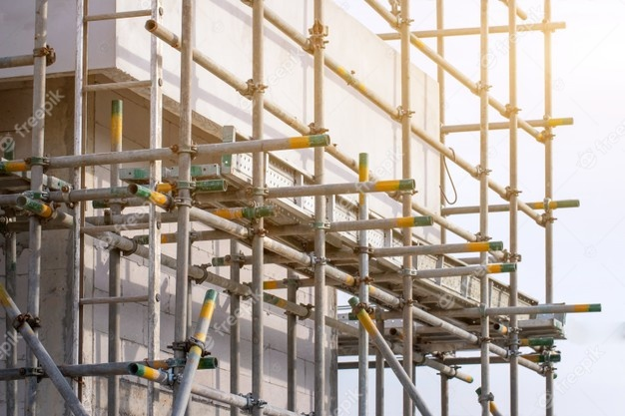
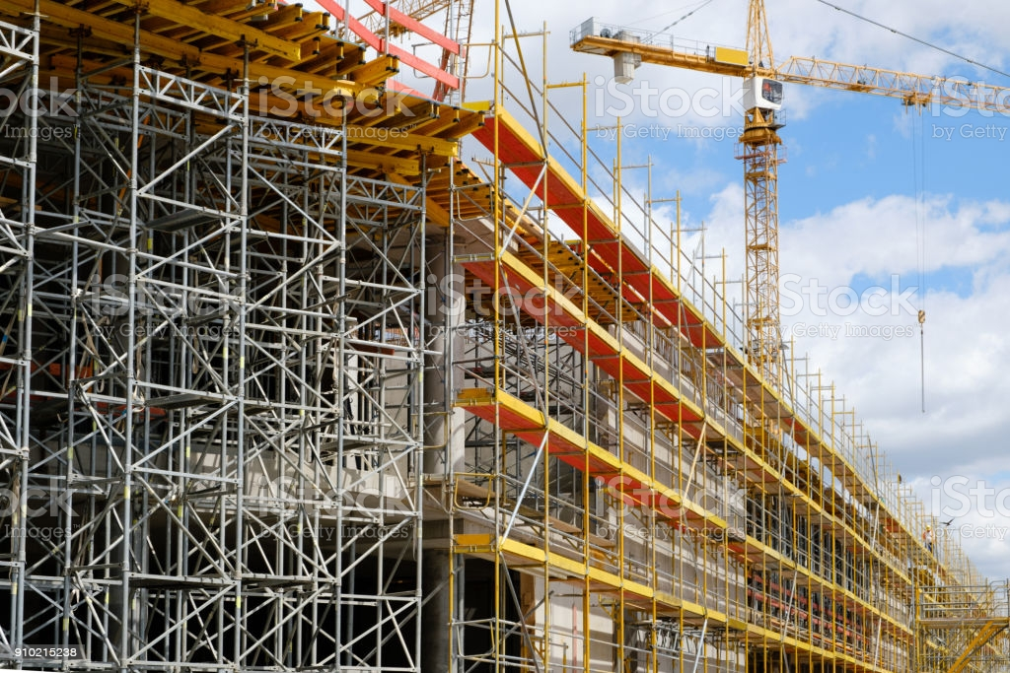

Slide 13
Gram-Negative Cell Walls:
The cell walls of gram-negative bacteria consist of one or a very few layers of peptidoglycan and an outer membrane. The peptidoglycan is bonded to lipoproteins in the outer membrane.
Periplasmic space is the region between the outer membrane and the plasma membrane. The periplasm contains a high concentration of degradative enzymes and transport proteins.

Slide 14
The outer membrane consists of: lipopolysaccharides (LPS), lipoproteins, and phospholipids.
The lipopolysaccharide (LPS) of the outer membrane consists of three components: lipid A, a core polysaccharide, and O polysaccharide.
Lipid A is the lipid portion of the LPS and is embedded in the top layer of the outer membrane. When gram-negative bacteria die, they release lipid A which functions as an endotoxin and responsible for the symptoms such as fever, dilation of blood vessels, shock, and blood clotting.

Slide 15
The outer membrane has several specialized functions:
Its strong negative charge is an important factor in evading phagocytosis.
The outer membrane is barrier to detergents, heavy metals, bile salts, certain dyes, antibiotics (for example, penicillin), and lysozyme.
Part of the permeability of the outer membrane is due to proteins called porins, that form channels. Porins permit the passage of molecules such as nucleotides, disaccharides, peptides, amino acids, vitamin B12, and iron.

Slide 17
Toxin produced Exotoxins Exotoxin and endotoxins

Slide 18
Atypical Cell Walls:
Among prokaryotes, the genus Mycoplasma cells have no walls. Mycoplasmas are the smallest known bacteria that can grow and reproduce outside living host cells. Their plasma membranes are unique among bacteria in having lipids called sterols, which are thought to help protect them from lysis (rupture).
Archaea have unusual walls composed of polysaccharides and proteins called pseudomurein.

Slide 19
Acid-Fast Cell Walls:
These bacteria contain high concentrations (60%) of a hydrophobic waxy lipid (mycolic acid) in their cell wall that prevents the uptake of dyes.
The mycolic acid forms a layer outside of a thin layer of peptidoglycan. The mycolic acid and peptidoglycan are held together by a polysaccharide.
The acid-fast bacteria such as Mycobacterium and Nocardia.

Slide 20
Acid Fact Bacteria

Slide 21
Damage to the Cell Wall:
Chemicals that damage bacterial cell walls, often do not harm the cells of an animal host because the bacterial cell wall is made of chemicals unlike those in eukaryotic cells. Thus, cell wall is the target for some antimicrobial drugs.
The cell wall can be damaged by enzyme lysozyme. This enzyme occurs naturally in perspiration, tears, mucus, and saliva. Lysozyme hydrolyze the bonds between the sugars in the disaccharide of peptidoglycan (a β-1,4 linkage).

Slide 22
Penicillin, destroy bacteria by interfering with the formation of the peptide cross-bridges of peptidoglycan, thus preventing the formation of a functional cell wall.
Most gram-negative bacteria are not as susceptible to penicillin because the outer membrane of gram-negative bacteria forms a barrier that inhibits the entry of this substance, and gram-negative bacteria have fewer peptide cross-bridges.

Slide 23
L forms:
Some bacteria can lose their cell walls and swell into irregularly shaped cells called L forms. They may form spontaneously or develop in response to penicillin (which inhibits cell wall formation) or lysozyme. L forms can live and divide repeatedly or return to the walled state.

Slide 24
The gram-positive cell wall is almost completely destroyed by lysozyme. The cellular contents surrounded by the plasma membrane may remain intact if lysis does not occur; this wall-less cell is termed a protoplast.
When lysozyme is applied to gram-negative cells, some of the outer membrane also remains. In this case, the cellular contents, plasma membrane, and remaining outer wall layer are called a spheroplast.

Slide 25
Wishing you good health and happiness in life

