Slide 1
Programming Fundamentals II
Lecture 5: Arrays

Slide 2
Outline
Types of Arrays
2-Dimensional Array
2-D Array Declarations
2-D Array Initialization
Reading and Writing 2-D Arrays
Examples

Slide 3
Arrays
Types of Array
🗸(Vector)
One Dimentional
Multidimentional
2-Dimensional …

Slide 4
Two Dimensional Arrays
The arrays we have used previously have all been one-dimensional, which means that they are linear or sequential.
An array of arrays is called multidimensional array.
A one-dimensional array of one-dimensional array is called two- dimensional array
Example:- double a[5][6]
A one-dimensional array of two-dimensional arrays is called three- dimensional array, …etc.
Example:- double a[5][6][3]

Slide 5
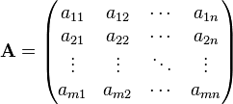
Two Dimensional Arrays
(Matrix)

Slide 6
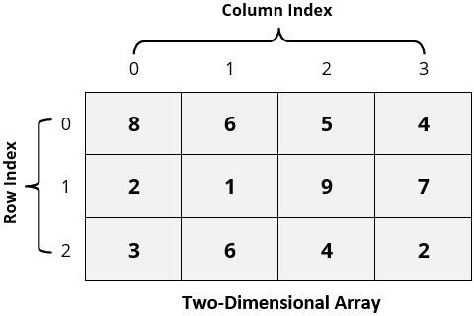
Two Dimensional Arrays

Slide 7
Two Dimensional Arrays
Square Matrix (A_{3x3})
Above Main diagonal i < j
 | Column 0 | Column 1 | Column 2
Row 0 | ª0,0 | ª0,1 | ª0,2
Row 1 | ª1,0 | ª1,1 | ª1,2
Row 2 | ª2,0 | ª2,1 | ª2,2
 | 0 | 1 | 2
0 | a[0][0] | a[0][1] | a[0][2]
1 | a[1][0] | a[1][1] | a[1][2]
2 | a[2][0] | a[2][1] | a[2][2]
Below Main diagonal i > j
Main diagonal i = j

Slide 8
Two Dimensional Arrays 2-D ARRAY STORAGE
Conception of 2-D Array
ª0,0 | ª0,1 | ª0,2
ª1,0 | ª1,1 | ª1,2
ª2,0 | ª2,1 | ª2,2
Actual Storage
ª0,0 | ª0,1 | ª0,2 | ª1,0 | ª1,1 | ª1,2 | ª2,0 | ª2,1 | ª2,2

Slide 9
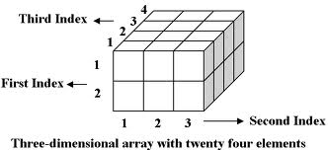
Three Dimensional Arrays

Slide 10
2-D Array Declaration
An array must be declared before use.
Syntax
DataType identifier[integerConstant][integerConstant];
DataType is the type of each element
Can be simple or complex type, doesn't matter
identifier is the name used to access the array
integerConstant is a literal or named constant
Defines the number of elements in the array.

Slide 11
2-D Array Initialization
Using two loops to initialize 2-D arrays, like following:
const int ROWS = 3; const int COLUMNS = 2;
int array[ROWS][COLUMNS];
// Number of rows
// Number of columns
for (int i = 0; i < ROWS; i++) {
for (int j = 0; j < COLUMNS; j++){
// set initial value to 0
array[i][j] = 0;
}
}
Initializing arrays at declaration with same size and number of elements of the
array:
int array[ROWS][COLUMNS] = {{3,5},{7,4},{1,6}};

Slide 12
2-D Array Initialization
Unassigned elements are initialized to 0:
int array[ROWS][COLUMNS] = {{3,5},{7,4}};
// array[0][0] = 3 , array[0][1] = 5
// array[1][0] = 7 , array[1][1] = 4
// array[2][0] = 0 , array[2][1] = 0
Providing too many initial values is compile-time error:
// ERROR!
int array[ROWS][COLUMNS] = {{3,5},{7,4},{1,6},{8,9}};

Slide 13
Reading & Writing 2-D Arrays
Example 1:- Write a C++ program that reads and prints out matrix (A_{nxm}).
//Declaration of the Matrix and its size
const int ROW_SIZE = 3; const int COL_SIZE = 3;
int array[ROW_SIZE][COL_SIZE];
cout<<"Enter the Matrix elements\n";
//Reading the Matrix
for(int i = 0; i<ROW_SIZE; i++){ for(int j = 0; j<COL_SIZE; j++){
cin>>array[i][j];
}
}
…
//Printing the Matrix
for(int i = 0; i<ROW_SIZE; i++){ for(int j = 0; j<COL_SIZE; j++){
cout<<array[i][j];
}
cout<<endl;
}

Slide 14
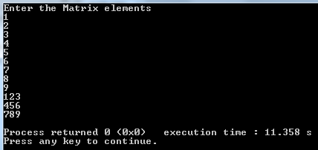
Reading & Writing 2-D Arrays
Example 1:- Write a C++ program that reads and prints out matrix (A_{nxm}).
Output

Slide 15
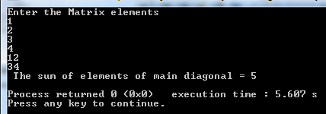
Example 2
Write a C++ program that reads matrix (A_{nxm}), then find and print the sum of the elements of main diagonal.
…
…
//Find sum of elements of main diagonal
int sum = 0;
for(int i = 0; i<ROW_SIZE; i++){
for(int j = 0; j<COL_SIZE; j++){
if(i == j){
sum = sum + array[i][j];
}
}
}
cout << " The sum of elements of main diagonal = " << sum << endl;
…
15

Slide 16
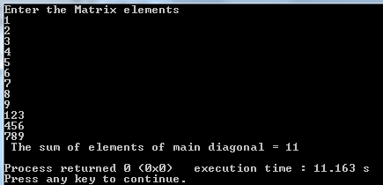
Example 3
Write a C++ program that reads matrix (A_{nxm}), then find and print the sum of the elements above main diagonal.
…
…
//Find sum of elements of main diagonal
int sum = 0;
for(int i = 0; i<ROW_SIZE; i++){
for(int j = 0; j<COL_SIZE; j++){
if(i < j){
sum = sum + array[i][j];
}
}
}
cout << " The sum of elements of main diagonal = " << sum << endl;
…
16

Slide 17
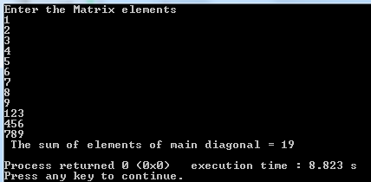
Example 4
Write a C++ program that reads matrix (A_{nxm}), then find and print the sum of the elements below main diagonal.
…
…
//Find sum of elements of main diagonal
int sum = 0;
for(int i = 0; i<ROW_SIZE; i++){
for(int j = 0; j<COL_SIZE; j++){
if(i > j){
sum = sum + array[i][j];
}
}
}
cout << " The sum of elements of main diagonal = " << sum << endl;
…
17

Slide 18
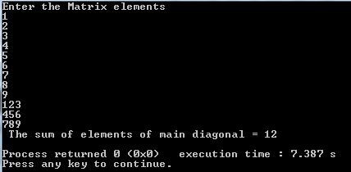
Example 5
Write a C++ program that reads matrix (A_{nxm}), then find and print the sum of the elements of the first column.
…
…
//Find sum of elements of main diagonal
int sum = 0;
for(int i = 0; i<ROW_SIZE; i++){ sum = sum + array[i][0];
}
cout << " The sum of elements of main diagonal = " << sum << endl;
…

Slide 19
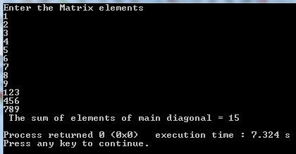
Example 6
Write a C++ program that reads matrix (A_{nxm}), then find and print the sum of the elements of the second row.
…
…
//Find sum of elements of main diagonal
int sum = 0;
for(int j = 0; j<COL_SIZE; j++){ sum = sum + array[1][j];
}
cout << " The sum of elements of main diagonal = " << sum << endl;
…

Slide 20
Questions?

