Slide 1
Q1 –
A-How we can differentiate between plant parasitic and
free living nematodes.
B-Classify plant parasitic nematodes according to their
feeding habitats?

Slide 2
Q2 –
A- Which of the following extraction methods not suitable
for the extraction of dead nematodes?
1- Blending and Sieving method
2- Bucket and sieving
B- Why?

Slide 3
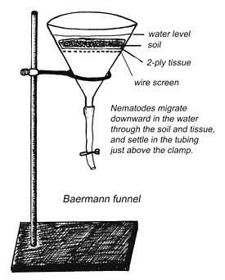
Q 3 - A This method is not used for the extraction of which of the following:
1- Nematode eggs.
2- Nematode from soil.
3- Nematodes from plant root.
B- write the name of this extraction method

Slide 4
Q4/ Write types of sampling patterns can be used

Slide 5
Q5/ write the Symptoms caused by aerial nematodes attacking the foliage (only 5)

Slide 6
Q-6
A- write the name of this extraction method?
B- On what principle the nematodes are extracted in this method?
C-Write the Advantages and Limitations of this method

Slide 7
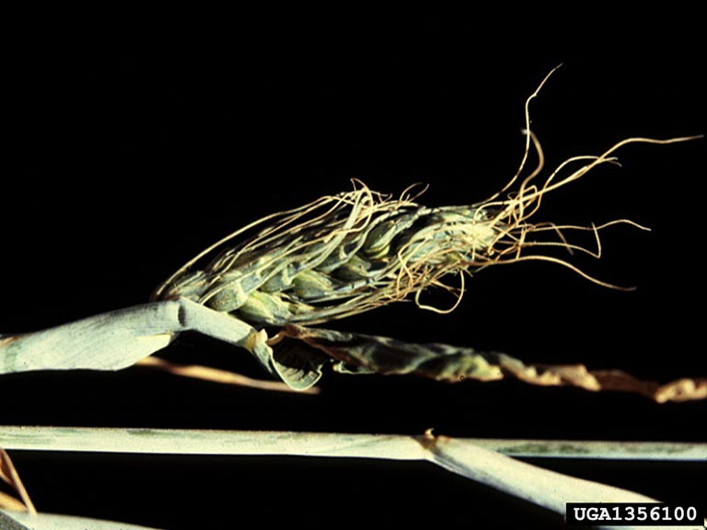
Q7/write the name of this disease and describe the symptoms

Slide 8
Q8/ When sampling for routine nematode management, how we take samples ?

Slide 9
Q9)
A- Which depths is better to collect soil sample used for the detection nematode?
B- Why?

Slide 10
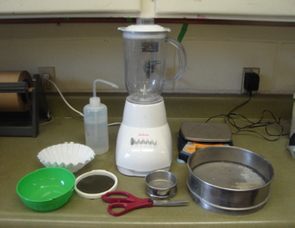
Q10 -
What is the name of this extraction method?
Why we use this plastic ring?

