Slide 1
Chapter One
Introduction to todays Technology
First Year students
Dept. of Computer Science & IT

Slide 2
Objectives Overview
Differentiate among laptops, tablets, desktops, and servers
Describe the purpose and uses of smartphones, digital cameras, portable and digital media players, e-book readers, wearable devices, and game devices
Explain the purpose of a browser, a search engine, and an online social network
Differentiate the web from the Internet, and describe the relationship among the web, webpages, websites, and web servers
Briefly explain various input options
Describe the relationship between data and information

Slide 3
Objectives Overview
Briefly describe digital security risks associated with viruses and other malware, privacy, your health, and the environment
Differentiate between an operating system and applications
Differentiate between wired and wireless technologies, and identify reasons individuals and businesses use networks
Discuss how society uses technology in education, government, finance, retail, entertainment, health care, science, travel, publishing, and manufacturing
Identify technology used by home users, small/home office users, mobile users, power users, and enterprise users

Slide 4
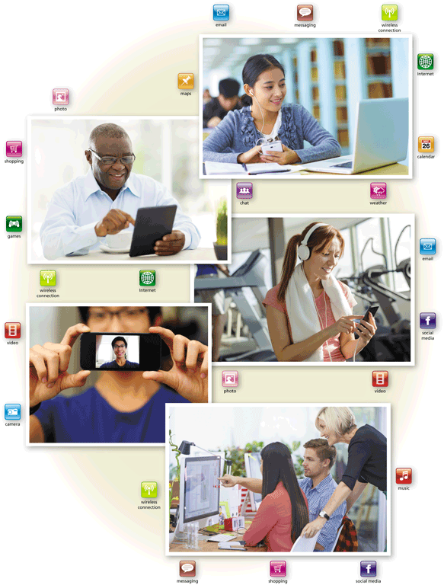
Today’s Technology
Because technology changes, you must keep up with the changes to remain digitally literate
Digital literacy involves having a current knowledge and understanding of computers, mobile devices, the web, and related technologies

Slide 5
Computers
A computer is an electronic device, operating under the control of instructions stored in its own memory
Accepts data (input)
Processing
Produces information (output)

Slide 6
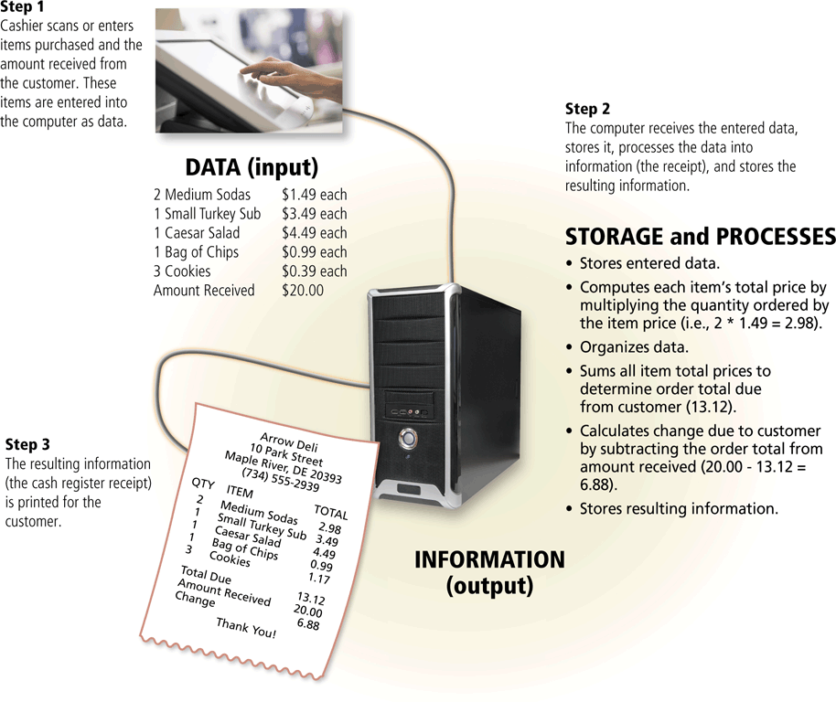
Data and Information

