Slide 1
Statistics
Chapter 3
Symbolization Review Example
Dr Dler M. Khidhr
Email
dler.khidhr@su.edu.krd

Slide 2
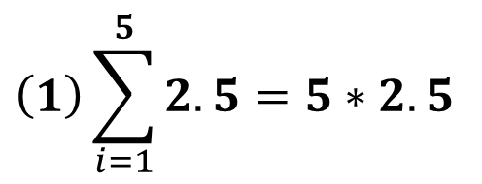
Example for Important Symbolization in Statistics
Summation Notation ∑
Example: Let a= 2.5 and b= 5. The random variables are
Let a & b are constant, where both X & Y are variable.
X: $X_{1}$ $X_{2}$ $X_{3}$ $X_{4}$ $X_{5}$
x: 3 5 4 3 8
Y: $Y_{1}$ $Y_{2}$ $Y_{3}$ $Y_{4}$ $Y_{5}$
y: 6 5 5 4 7
*// Calculate all Symbolization for Summation and Multiplication.
$$n a$$
Solution
$$(1)\sum_{i=1}^{n}{a}=a+a+...+a=na$$
$$\left(1\right)\sum_{i=1}^{5}{2.5}=5∗2.5$$
$$=12.5$$
$$(2)\sum_{i=1}^{n}{x_{i}}=x_{1}+x_{2}+...+x_{n}$$
$$(2)\sum_{i=1}^{n}{x_{i}}=\text{3}\text{+} \text{5}\text{+} \text{4} \text{+}\text{3} \text{+}\text{8}$$
$$=23$$

Slide 3
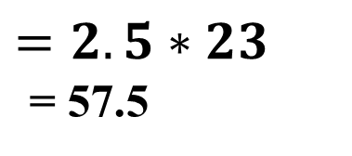
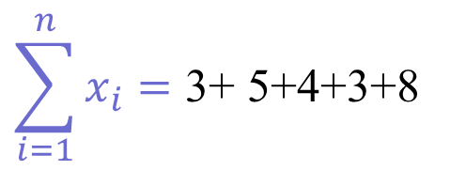
$$\sum_{i=1}^{n}{x_{i}}=\text{3}\text{+} \text{5}\text{+} \text{4} \text{+}\text{3} \text{+}\text{8}$$
$$(3)\sum_{i=1}^{n}{ax_{i}}=a\sum_{i=1}^{n}{x_{i}}$$
2.5 * $\sum_{i=1}^{n}{x_{i}}=\text{2.5}\text{∗}\text{(}\text{3}\text{+} \text{5}\text{+} \text{4} \text{+}\text{3} \text{+}\text{8}\text{)}$
$$=2.5∗23$$
= 57.5
$$(4)(\sum_{i=1}^{n}{x_{i}})^{2}=(\text{3}\text{+} \text{5}\text{+} \text{4} \text{+}\text{3} \text{+}\text{8})^{2}$$
$$={(23) }^{2}=529$$
$$(5)\sum_{i=1}^{n}{x_{i}^{2}}=x_{1}^{2}+x_{2}^{2}+...+x_{n}^{2}$$
$$(5)\sum_{i=1}^{n}{x_{i}^{2}}=3^{2}\text{+}5^{2} \text{+}4^{2} \text{+}3^{2} \text{+}8^{2}$$
$$9\text{+}25 \text{+}16 \text{+}9 \text{+}64= 123$$

Slide 4
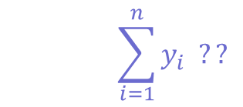
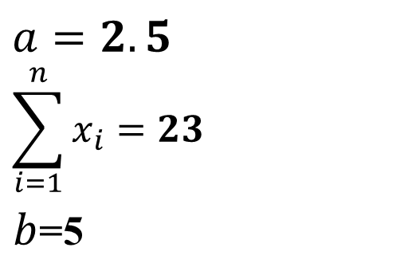
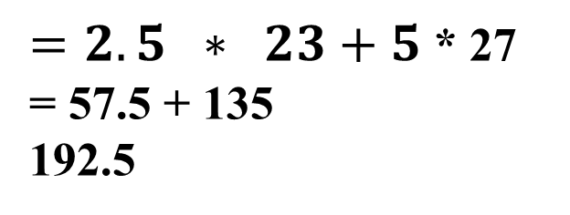
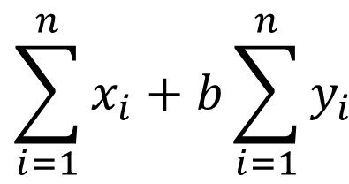
$$\left(6\right)\sum_{i=1}^{n}{x_{i}^{2}}≠ (\sum_{i=1}^{n}{x_{i}})^{2}$$
$123≠$ ${(23) }^{2}$
$$123≠529$$
$$a=2.5 \\ \sum_{i=1}^{n}{x_{i}}=23$$ $b$=5
$$(7)\sum_{i=1}^{n}{(ax_{i}+by_{i})}=a\sum_{i=1}^{n}{x_{i}}+b\sum_{i=1}^{n}{y_{i}}$$
$$\sum_{i=1}^{n}{y_{i}=y_{1}+y_{2}+y_{3}+y_{4}+y_{5}}$$
$$\sum_{i=1}^{n}{y_{i} ??}$$
= 6 +5 + 5+ 4+ 7
= 27
$$\sum_{i=1}^{n}{x_{i}}+b\sum_{i=1}^{n}{y_{i}}$$
$=2.5 ∗ 23+5$ * 27
= 57.5 + 135
192.5

Slide 5
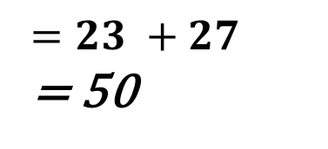
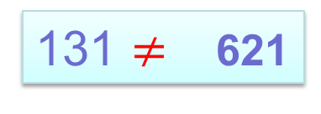
$$(8)\sum_{i=1}^{n}{(x_{i}+y_{i})}=\sum_{i=1}^{n}{x_{i}+}\sum_{i=1}^{n}{y_{i}}$$
$$=23 +27$$
= 50
$$(9)\sum_{i=1}^{n}{x_{i}y_{i}}=x_{1}y_{1}+x_{2}y_{2}+...+x_{n}y_{n}$$
= 3* 6 + 5*6 + 4*5 + 3*4+ 8*7
= 18+ 30 + 20 + 12 + 56
$$(10)\sum_{i=1}^{n}{x_{i}y_{i}}≠\sum_{i=1}^{n}{x_{i}}.\sum_{i=1}^{n}{y_{i}}$$
131 $≠$ 23 * 27
131 $≠$ 621

Slide 6
$$\left(11\right) \sum_{i=1}^{n}{\frac{x_{i}}{y_{i}}}=\frac{x_{1}}{y_{1}}+\frac{x_{2}}{y_{2}}+...+\frac{x_{n}}{y_{n}}$$
$$=\frac{3}{6}+\frac{5}{5}+\frac{4}{5}+\frac{3}{4}+\frac{8}{7}$$
$$=3.88$$
$=0.5+1+0.2+0.75+1.$43
$$\left(12\right) \frac{\sum_{i=1}^{n}{x_{i}}}{\sum_{i=1}^{n}{y_{i}}}=\frac{x_{1}+x_{2}+...+x_{n}}{y_{1}+y_{2}+...+y_{n}}$$
$$\frac{\text{3}\text{+} \text{5}\text{+} \text{4} \text{+}\text{3} \text{+}\text{8}}{\text{6}\text{+}\text{5}\text{+}\text{5}\text{+}\text{4}\text{+}\text{7 }}=\frac{\text{23}}{\text{27} }=0.85$$

Slide 7
$$\left(13\right) \frac{\sum_{i=1}^{n}{x_{i}}}{\sum_{i=1}^{n}{y_{i}}} ≠\sum_{i=1}^{n}{\frac{x_{i}}{y_{i}}}$$
Where
$$\frac{\sum_{i=1}^{n}{x_{i}}}{\sum_{i=1}^{n}{y_{i}}}=\frac{\text{3}\text{+} \text{5}\text{+} \text{4} \text{+}\text{3} \text{+}\text{8}}{\text{6}\text{+}\text{5}\text{+}\text{5}\text{+}\text{4}\text{+}\text{7 }}=\frac{\text{23}}{\text{27} }=0.85$$
$$0.85 ≠3.88$$
$$\sum_{i=1}^{n}{\frac{x_{i}}{y_{i}}}$$
$$=3.88$$
Then:

Slide 8

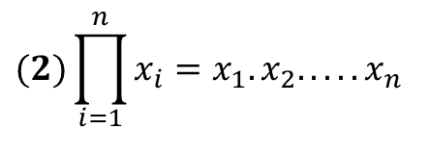
Multiplication Notation
$$\prod_{i=1}^{n}{}$$
$$\left(1\right)\prod_{i=1}^{n}{c}=c∗c ∗c∗c∗c=c^{n}$$
$$\prod_{i=1}^{5}{2.5}=2.5∗2.5∗2.5∗2.5∗2.5= {(2.5)}^{5}$$
=97.66
$$(2)\prod_{i=1}^{n}{x_{i}}=x_{1}.x_{2}.....x_{n}$$
=3 *5 *4*3*8
=1440
$$(3)\prod_{i=1}^{n}{x_{i}^{2}}=x_{1}^{2}.x_{2}^{2}.....x_{n}^{2}$$
=$3^{2}$*$5^{2}$ *$4^{2}$*$3^{2}$*$8^{2}$
=$9$*$25$ *$16$*$9$*$64$
=2073600

