Slide 1
How do you rate plastic in mechanics
Prepared by: Mrs. Dlven Kareem

Slide 2
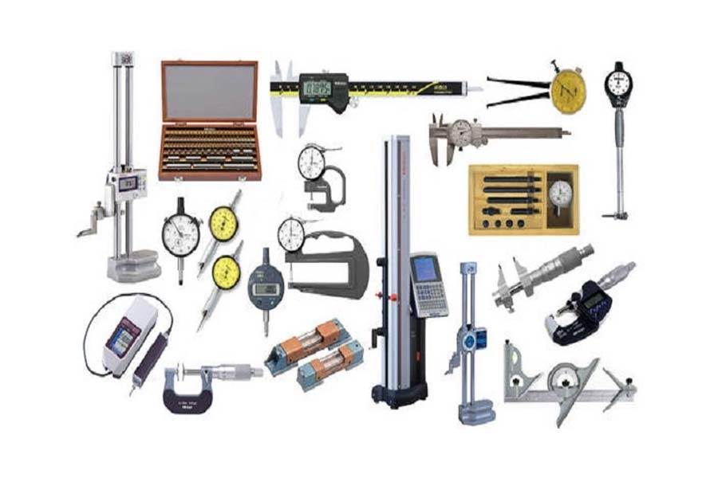

Slide 3
Introduction:
Plastics play a significant role in the field of mechanics, offering a range of properties that make them valuable in various applications. These materials are lightweight, durable, and often cost-effective compared to metals. They exhibit good resistance to corrosion and chemicals, and can be engineered to provide specific mechanical properties such as flexibility, toughness, and thermal stability.

Slide 4
Introduction:
In mechanics, plastics are commonly used in components like gears, bearings, and housings, contributing to improved performance and efficiency. However, their suitability depends on the specific requirements of the application, including load-bearing capacity, environmental conditions, and durability.

Slide 5
Mechanical tests for plastic:
Tensile Test: Measures the strength and elongation of plastic by pulling a sample until it breaks. This test provides data on tensile strength, elongation at break, and Young's modulus.
Compression Test: Determines how a plastic material behaves under crushing loads. This test assesses the compressive strength and deformation characteristics.
Flexural Test: Evaluates the plastic's ability to resist bending. The test measures flexural strength, flexural modulus, and the material's behavior under bending stress.

Slide 6
Mechanical tests for plastic:
Impact Test: Assesses the material's toughness and ability to absorb energy during sudden impacts. Common methods include Charpy and Izod impact tests.
Hardness Test: Measures the resistance of plastic to indentation. Common scales used are Rockwell, Shore, and Barcol hardness tests.
Creep Test: Analyzes the deformation of plastic under a constant load over an extended period. This test helps understand the long-term performance and stability of the material under stress.

Slide 7
Mechanical tests for plastic:
Fatigue Test: Determines the plastic's ability to withstand repeated loading and unloading cycles. This test helps predict the material's lifespan under cyclic stresses.
Thermal Analysis: Techniques like Differential Scanning Calorimetry (DSC) and Thermogravimetric Analysis (TGA) assess the plastic's thermal properties, such as melting temperature, glass transition temperature, and thermal stability.
Dynamic Mechanical Analysis (DMA): Measures the material's viscoelastic properties as a function of temperature, frequency, or time, providing insights into its stiffness and damping behavior.

Slide 8
Mechanical tests for plastic:
Fracture Toughness Test: Evaluates the material's resistance to crack propagation. This test is crucial for applications where plastics are subjected to high-stress conditions.

Slide 9
References:
"Journal of Mechanical Design" - Published by the American Society of Mechanical Engineers (ASME), this journal features articles on the design, analysis, and application of mechanical systems and instruments.
"Measurement Science and Technology" - This journal publishes research on new measurement techniques, instrument development, and applications in science and engineering.
"Instrumentation and Measurement Magazine" - Published by the IEEE, this magazine covers advancements in instrumentation and measurement technologies and their applications.

