Slide 1
Inorganic Chemistry Part 1
First year
Chemistry students
Dr Dotsha Jaleel

Slide 2
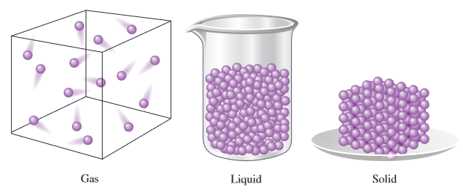
States of Matter and Physical Properties
In a gas, the molecules are in constant random motion through largely empty space. In a liquid, the molecules are also in constant random motion, but they are more closely packed than in a gas. In a solid, the basic units (atoms, ions, or molecules) are closely packed and vibrate about fixed sites.

Slide 3
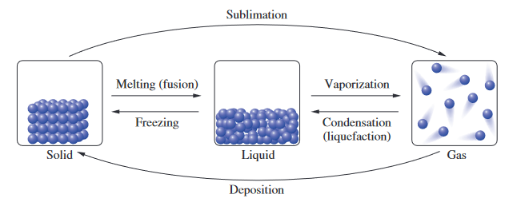

Slide 4
General Definitions (lack chemistry)
Melting Point: The temperature at which a solid substance changes into a liquid state is called its melting point.
Boiling Point: The temperature at which a liquid substance changes into a gaseous state is called its boiling point.
For example, the melting point of water at 1 atmosphere of pressure is 0 ºC and the boiling point of water is 100 ºC.

Slide 5
Sublimation: The process of transition of a substance from a solid state directly into a gaseous state without passing through the intermediate liquid state is called sublimation.
Deposition: The process of transition of a substance from a gaseous state directly into a solid state without passing through the intermediate liquid state is called deposition.
Sublimation: An example of a substance that undergoes sublimation is dry ice (solid carbon dioxide), which sublimates at -78.5°C and turns directly into gas.
Deposition: An example of deposition is the formation of frost on a cold surface, which occurs when water vapor in the air turns directly into ice crystals without first becoming liquid.

Slide 6
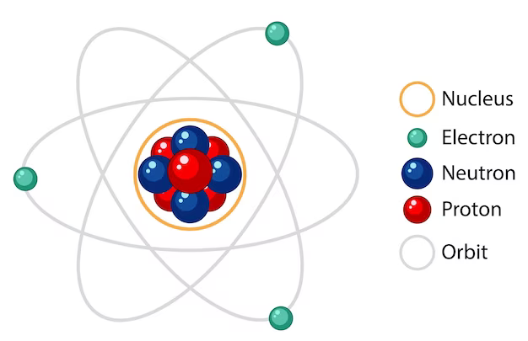
Atomic Structure and Bonding
Atoms
Atoms are a collection of various subatomic particles containing negatively charged electrons, positively charged protons and neutral particles called neutrons.
Neutrons and protons are located in the atomic nucleus
The negatively charged electrons orbit around the nucleus and are distributed on a rather large cloud of electrons

Slide 7
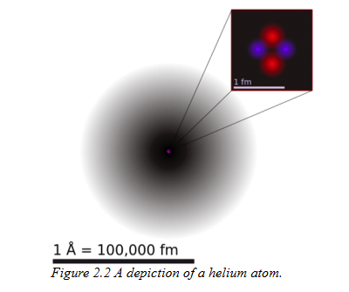
Each element has its own unique number of protons, neutrons and electrons.
Both protons and neutrons have mass, whereas the mass of electrons is negligible.
Protons and neutrons exist at the center of the atom in the nucleus.
Notes:
To put it in perspective (if the nucleus was a 1 cm ball, electrons will be 1Km away)
The dot in the middle is the nucleus, and the surrounding cloud represents where the two electrons might be at any time. The darker the shade, the more likely that an electron will be there. An angstrom (Å) is 10⁻¹⁰m . A femtometre (fm) is 10⁻¹⁵m. In other words, a helium atom’s electron cloud is about 100,000 times bigger than its nucleus.

Slide 8
Particle | Charge | Mass (g) | Mass (amu)
Proton | +1 | 1.6727 x 10 ⁻²⁴ | 1.007316
Neutron | 0 | 1.6750 x 10 ⁻²⁴ | 1.008701
Electron | -1 | 9.110 x 10 ⁻²⁸ | 0.000549
Amu: Atomic Mass Unit

Slide 9
Elements
An element is a basic chemical substance that consists of only one type of atom and cannot be broken down or converted into simpler substances by chemical means. Some well-known elements include hydrogen (H), oxygen (O), carbon (C), and iron (Fe).
Each element has a unique atomic number that determines the number of protons in its nucleus and the number of electrons around its nucleus. This, in turn, determines the chemical and physical properties of an element.
Notes:
An element is a basic chemical substance that consists of only one type of atom and cannot be broken down or converted into simpler substances by chemical means. The elements are the building blocks of matter and are the simplest forms of matter. There are 118 elements recognized by the International Union of Pure and Applied Chemistry (IUPAC) that have been discovered or created so far. Each element has a unique atomic number that determines the number of protons in its nucleus, and therefore, the number of electrons around its nucleus. This, in turn, determines the chemical and physical properties of an element. Some well-known elements include hydrogen, oxygen, carbon, and iron.

Slide 10
Molecules
A molecule is a group of two or more atoms held together by chemical bonds.
Compounds
A compound is a substance which is formed by two or more different types of elements joined together in a fixed proportion, e.g. NaCl, H₂O and HCl.
All compounds are molecules.
All molecules are not compounds.

Slide 11
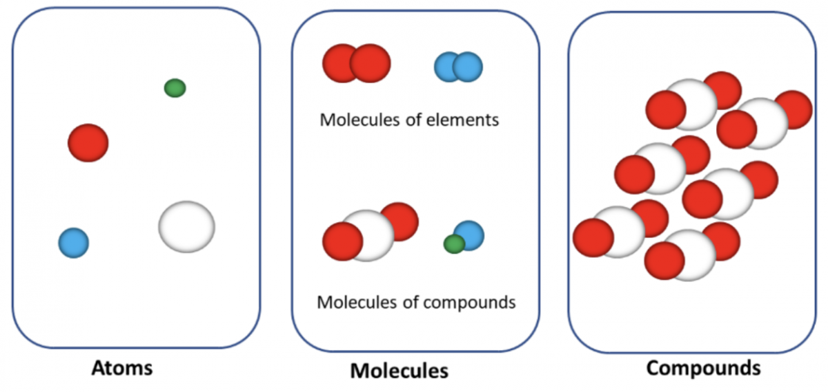

Slide 12
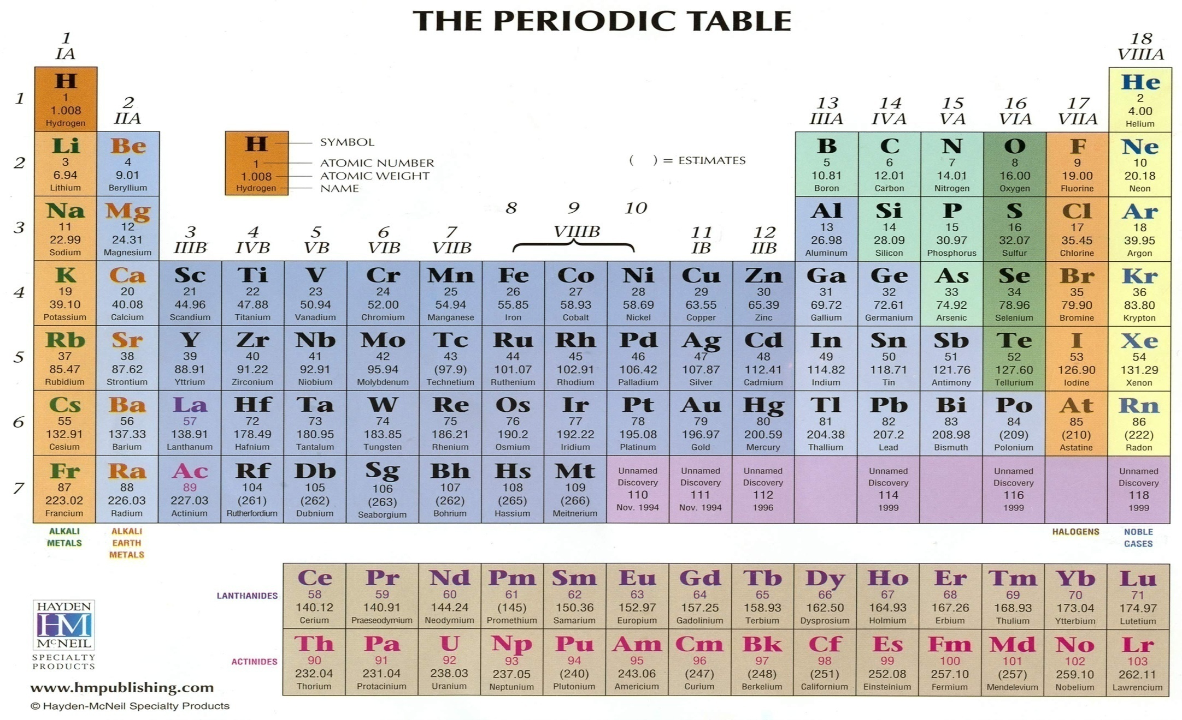
The Periodic Table

Slide 13
Groups in the Periodic Table
Main Group Elements (Vertical Groups)
Group IA (1) nS¹ - Alkali Metals
Group IIA (2) nS²- Alkaline Earth Metals
Group IIIA(13) nP¹ - Boron Family
Group IVA (14) nP² - Carbon Family
Group VA(15) nP³ - Nitrogen Family
Group VIA (16) nP⁴ - Oxygen Family (Calcogens)
Group VIIA(17) nP⁵ - Halogens
Group VIIIA(18) nP⁶ - Noble Gases
Other Groups ( Vertical and Horizontal Groups)
Group (IB - 8B) - Transition Metals
Period 6 Group – Lanthanides
Period 7 Group – Actinides

Slide 14
Elements are arranged in rows according to increasing atomic numbers and in columns based on having similar properties
Groups of elements can be classified into:
S and p-block (main group elements)
d-block (transition elements)
f-block (actinides and lanthanides) sometimes called the Inner transition elements. would extend the table to a width of 32 members, if incorporated in the main body of the table. The table would generally be too wide to fit on a printed page, and so the f-block elements are extracted from the table and placed at the bottom.
Groups can also be classified according to metallic character

Slide 15
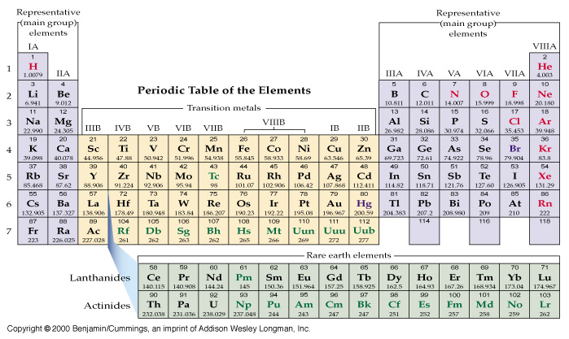
Classification: The three broad Classes Main, Transition, Actinides and lanthanides

Slide 16
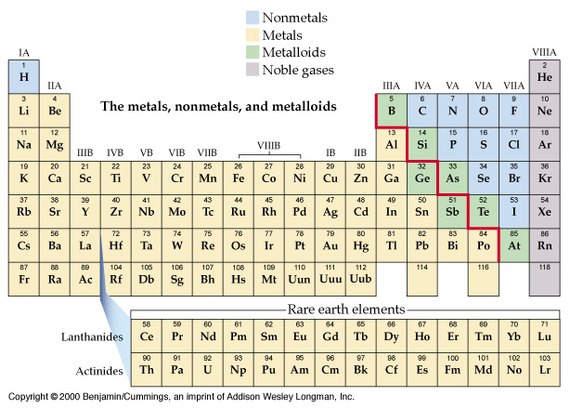
Classification According to Metallic Character

Slide 17
The Extended Periodic Table
Source: By User:DePiep - File:Periodic_Table_2.svg, CC BY-SA 3.0, https://commons.wikimedia.org/w/index.php?curid=33928254

Slide 18
General Characteristics of Groups (Columns)
Number of valence electrons: on moving down a given group, the number of valence electrons does not change (atoms have the same valency. e.g., H, Li)
Properties of elements: All elements of a given group possess similar physical and chemical properties. The reactivity of halogens decreases as we pass from F to I.
Size of atoms: increases on descending a group. Li<Na<K<Rb<Cs
Metallic character: increases in moving from top to bottom in group.
Number of electron shells: increases on descending a group and ultimately becomes equal to number of the period
Notes:
Metallic character refers to the set of properties associated with metals. These properties include metallic luster, formation of cations, high electrical and thermal conductivity, and malleability. Metallic character is a measure of how readily an atom loses its electrons. A metallic element easily loses electrons and forms cations, while a nonmetallic element does not easily lose electrons (usually gaining them) and forms anions.
Metallic character is a periodic table trend. The elements with the most metallic character are on the left side of the periodic table (except hydrogen). Metallic character increases moving down a periodic table group and decreases moving across a period. This is because moving down a group, atoms add electron shells so the atomic radius increases and it takes less energy to remove electrons. Moving across a period (not including the noble gases), the number of protons increases but the number of electron shells remains the same. This increases the effective nuclear force on electrons and makes it more difficult to remove them.

Slide 19
General Characteristics of Periods (Rows)
Number of valence electrons: increases when we proceed from left to right in a period.
Size of atoms: decreases from left to right in a period.
Metallic character: decreases on moving from left to right in a period.
Number of shells: remains the same as the number of a period

Slide 20
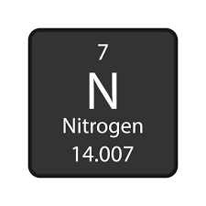
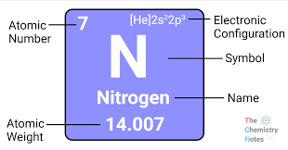
The Nuclear Symbol
A notation that identifies the element (by symbol or atomic number) and the mass number of the element.
The mass number is the sum of the number of nucleons (protons and neutrons) in the atomic nucleus.
or

Slide 21
Atomic Orbitals
Atomic orbitals are the places surrounding the nucleus of an atom where the electrons are most likely to be at any given time. Electrons are not simply floating within the atom; instead, they are fixed within these electronic orbitals. Each orbital can hold two electrons.

Slide 22
Orbital shapes
representations of 1s and 2s orbitals
representations of 2p orbitals

