Slide 1
Respiratory events (four respiration processes)
1. Pulmonary ventilation = exchange of gases between lungs and atmosphere.
2. External respiration = exchange of gases between alveoli and pulmonary capillaries.
3. Internal respiration = exchange of gases between systemic capillaries and tissue cells.
4. Cellular respiration: oxygen used to produce ATP, carbon dioxide as a waste.

Slide 2
Respiration processes
At the organism level, respiration is the process of gas exchange - the release of carbon dioxide and the uptake of oxygen that occurs between RBCs and alveoli.

Slide 3
Breathing is the actual mechanical intake of air:
Lungs are sealed in pleural membranes inside the chest cavity. At the bottom of the cavity is a large, flat muscle known as the diaphragm.
During inspiration, the diaphragm contracts, and the rib cage rises. This expands the volume of the chest cavity. The chest cavity is sealed, so this creates a partial vacuum inside the cavity. Atmospheric pressure fills the lungs as air rushes into the breathing passages.
Often expiration is a passive event. When the rib cage lowers and the diaphragm relaxes, pressure in the chest cavity is greater than atmospheric pressure. Air is pushed out of the lungs.

Slide 4
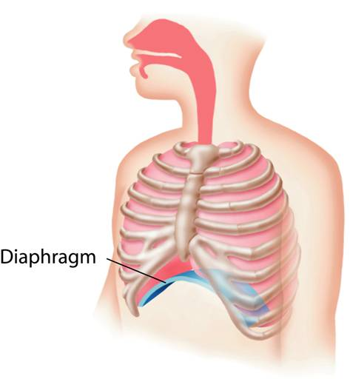
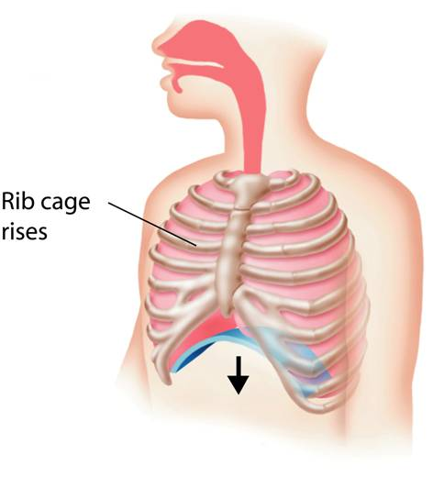
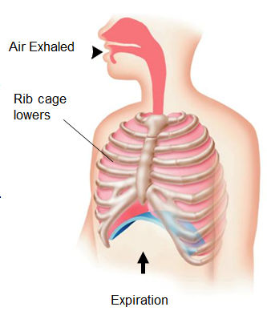

Slide 5
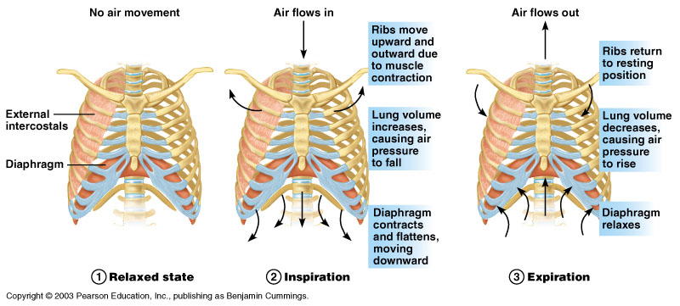
Respiratory cycle

Slide 6
Ventilation control by respiratory centers of the brain
The trachea, bronchial tree, and lungs are innervated by the autonomic nervous system.
The autonomic nerve fibers that innervate the heart also send branches to the respiratory structures.
The involuntary, rhythmic activities that deliver and remove respiratory gases are regulated in the brainstem within the reticular formation through both the medulla oblongata and pons.

Slide 7
How breathing is controlled
Breathing is controlled by the medulla oblongata.
The medulla oblongata monitors carbon dioxide in the blood.
As carbon dioxide increases, nerve impulses make the diaphragm contract, bringing air into the lungs.
The higher the carbon dioxide level, the stronger the impulses.

Slide 8
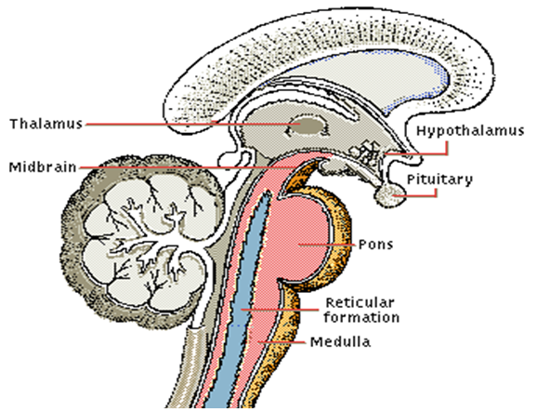

Slide 9
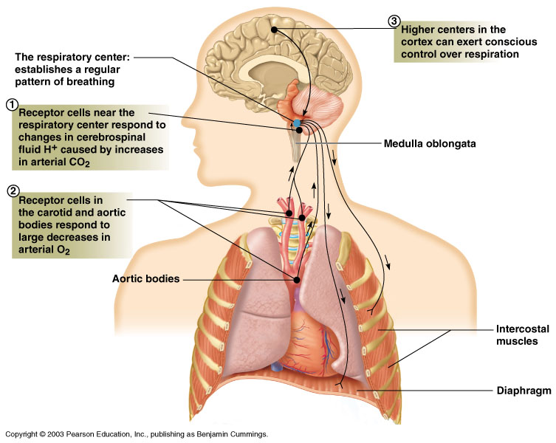
Regulation of breathing

Slide 10
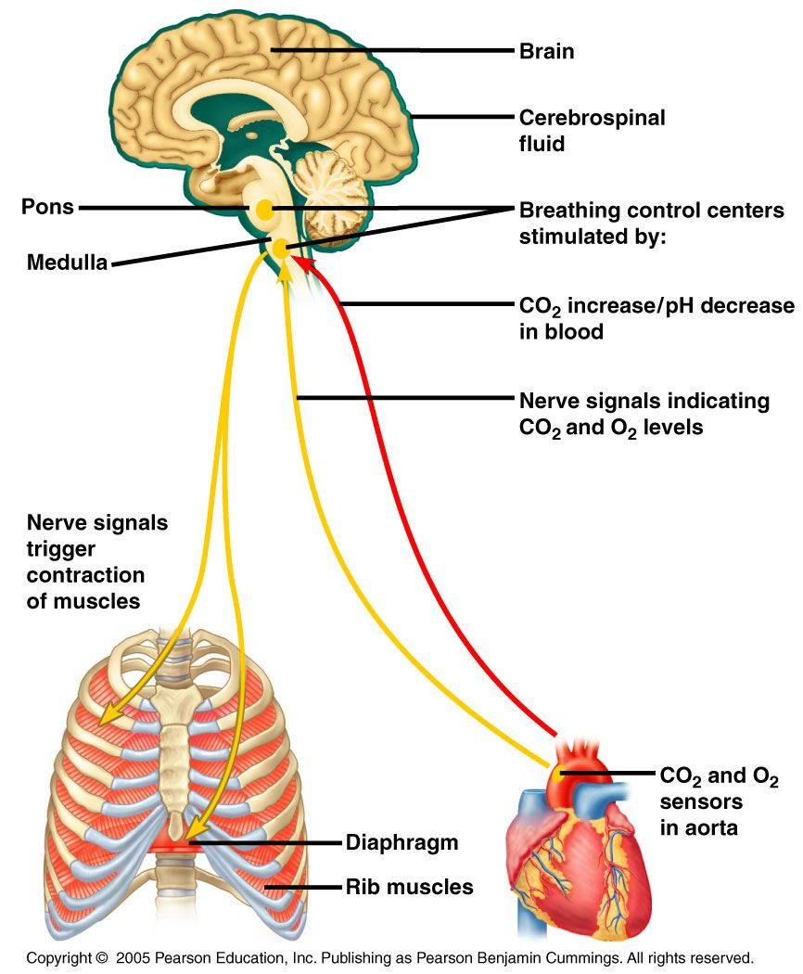
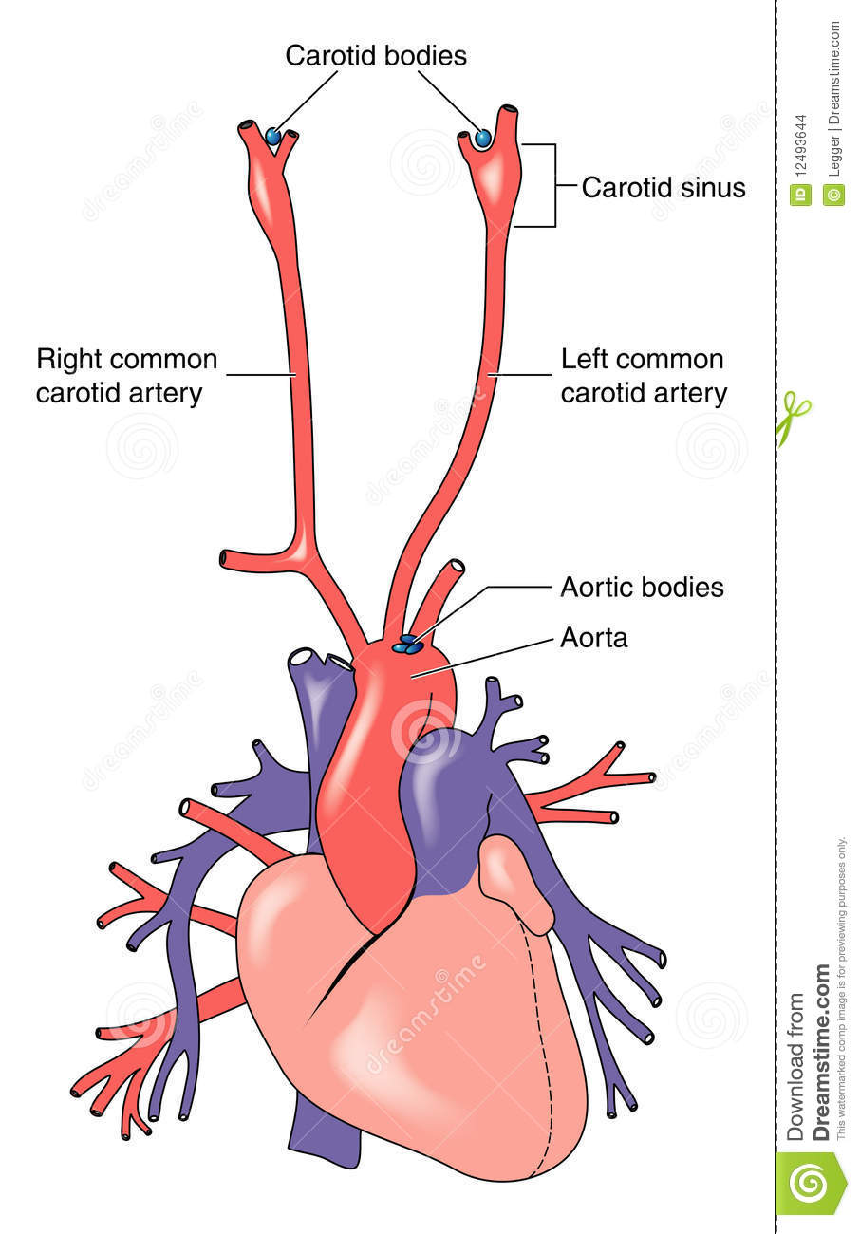

Slide 11
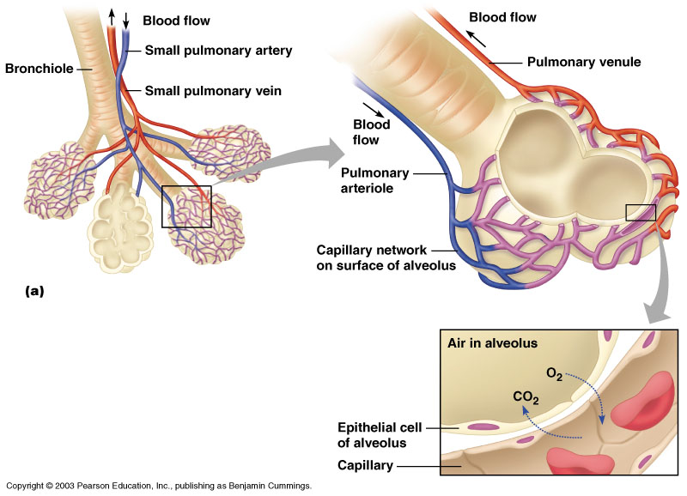
Gas exchange between the blood and alveoli

Slide 12
This “air-blood barrier” (the respiratory membrane) is where gas exchange occurs:
Oxygen diffuses from the air in the alveolus to blood in the capillary.
Carbon dioxide diffuses from the blood in the capillary into the air in the alveolus.

Slide 13
Microscopic detail of alveoli
Alveoli are surrounded by fine elastic fibers.
Alveoli interconnect via alveolar pores.
Alveolar macrophages – free-floating “dust cells”.
Note type I and type II cells and joint membrane.

Slide 14
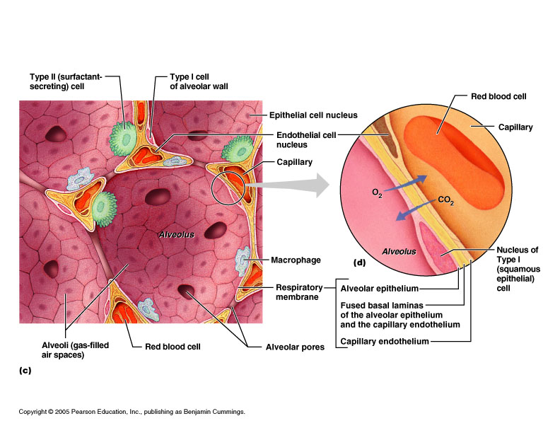

Slide 15
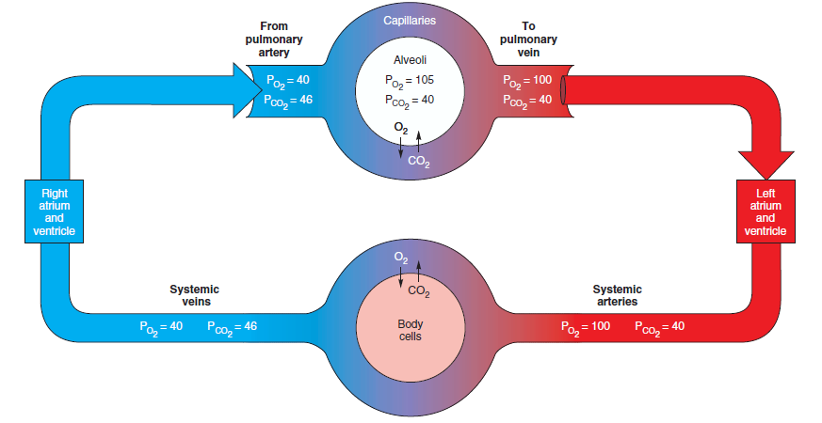
Figure: partial pressure of gases in blood: the Po₂ andPco₂ values of blood are a result of gas exchange in the lung alveoli and gas exchange between systemic capillaries and body cells.

Slide 16
Respiratory values
A normal adult averages 12 breathes per minute = respiratory rate (RR).
Respiratory volumes – determined by using a spirometer.

Slide 17
Measurement of lung function
Lung volumes and vital capacity
Tidal volume: volume of air inspired and expired in a single breath.
Dead space volume: the air that remains in the airways and does not participate in gas exchange.
Vital capacity: the maximal volume that can be expired after maximal inspiration.
Inspiratory reserve volume: the amount of air that can be inspired beyond the tidal volume.
Expiratory reserve volume: the amount of air that can be forcibly expired beyond the tidal volume.
Residual volume: the amount of air remaining in the lungs, even after a forceful maximal expiration.

Slide 18
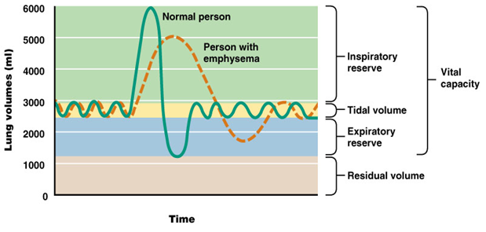
Measurement of lung capacity

Slide 19
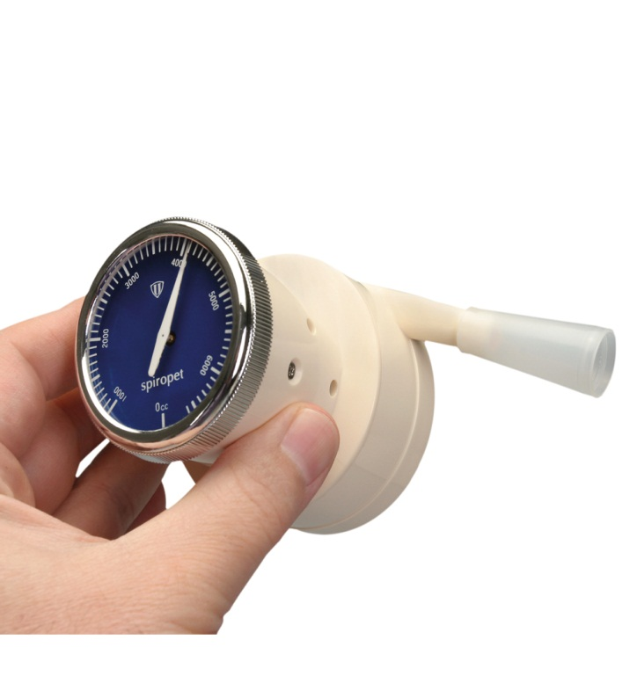
Measurement: Spirometer

