Slide 1
Urinary system
The organ system that produces, stores, and carries urine.
Includes two kidneys, two ureters, the urinary bladder, two sphincter muscles, and the urethra.
Humans produce about 1.5 liters of urine over 24 hours, although this amount may vary according to the circumstances.
Increased fluid intake generally increases urine production.
Increased perspiration (sweating) and respiration may decrease the amount of fluid excreted through the kidneys.
Some medications interfere directly or indirectly with urine production, such as diuretics.

Slide 2
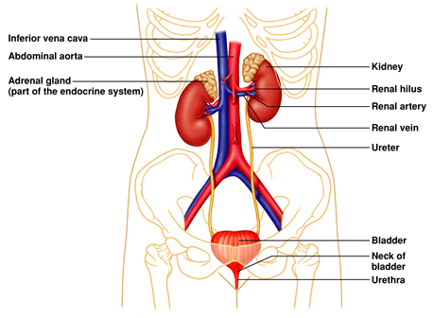

Slide 3
Kidneys
Morphology:
It is paired organ (weight about 300g)
The compound from two parts: cortex (isotonic urine) and medulla (hypertonic urine)
Cortex: Glomerular apparatus
Medulla: Divided: Outer and Inner.
Consists of about 1 million filtering units termed nephrons (basic structural and functional units)
The kidney plays a crucial role in regulating electrolytes in the human blood (e.g. Na⁺, K⁺, and Ca2⁺).
It clears urea, a nitrogenous waste product from the metabolism of amino acids.

Slide 4
Kidney function
Filters blood plasma, eliminates waste, returns useful chemicals to blood.
Regulates blood volume and pressure.
Regulates osmolarity of body fluids.
Secretes renin, activates angiotensin, aldosterone.
controls blood pressure, electrolyte balance
Secretes erythropoietin red blood cell production in the bone marrow.
Regulates PCO₂ and acid-base balance.
Detoxifies free radicals and drugs.

Slide 7
Nephron
A nephron (1-1.2 million) is the basic structural and functional unit of the kidney.
Its chief function is to regulate water and soluble substances by filtering the blood, reabsorbing what is needed, and excreting the rest as urine.
Each nephron is composed of an initial filtering component (the renal corpuscle) and a tubule specialized for reabsorption and excretion (the renal tubule).
The renal corpuscle filters out large solutes from the blood, delivering water and small solutes to the renal tubule for modification.

Slide 9
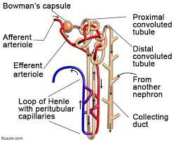

Slide 10
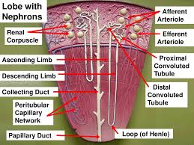

Slide 11
Types of nephrons:
Cortical nephrons (glomerular apparatus belong to the surface and Loop of Henle only to the outer part of the medulla).
Juxtamedullary nephrons (glomerular apparatus deep in the cortex near the medulla and Loop of Henle is going deep to the inner part of the medulla).

Slide 12
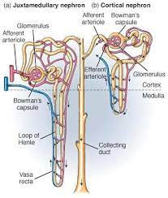

Slide 13
Renal (Malpighian) corpuscle
Malpighian capsule refers to the blood filtering component of the kidney. It is also called the renal corpuscle. The main function of the Malpighian capsule is the filtration of blood. The two components of the Malpighian capsule are the Bowman's capsule and the glomerulus.
Glomerulus - is a capillary tuft that receives its blood supply from an afferent arteriole and passes into the efferent arteriole of the renal circulation.
Efferent arterioles of juxtamedullary nephrons (ie, the 15% of nephrons closest to the medulla) send straight capillary branches that deliver isotonic blood to the renal medulla.
Along with the loop of Henle, these vasa recta play a crucial role in the establishment of the nephron's countercurrent exchange system.
Bowman's capsule - surrounds the glomerulus and is composed of visceral (inner) and parietal (outer) layers.

Slide 14
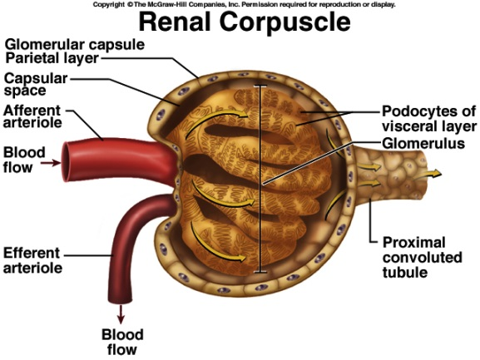
Figure: Glomerular filtrate collects in capsular space, flows into the renal tubule
Figure: Glomerular filtrate collects in capsular space, flows into the renal tubule

Slide 15
