Slide 1
Urinary system
Juxtaglomerular apparatus
The juxtaglomerular cells are cells that synthesize, store, and secrete the enzyme renin.
Specialized smooth muscle cells in the wall of the afferent arteriole that are in contact with the distal tubule.
Have mechano-receptors for blood pressure.
The macula densa is an area of closely packed specialized cells lining the distal convoluted tubule where it lies next to the juxtaglomerular apparatus.
Cells of macula densa are taller and have more prominent nuclei than surrounding cells.
Sensitive to the concentration of sodium ions in the fluid.

Slide 2
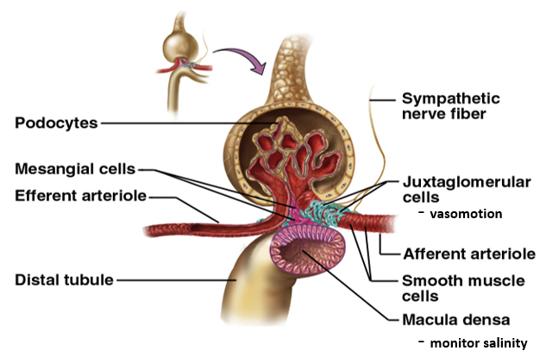

Slide 3
Proximal tubule
Morphology: 15mm long and 55μm in diameter; epithelium cells have a striate brush border (projections), which enlarge the surface for reabsorption.
Function: Reabsorption of the largest volume of solution filtered in the glomerular apparatus.
75 - 80 % water
Na⁺, Cl⁻, HCO3⁻, K⁺, Ca²⁺, Mg²⁺, HPO₄²⁻
Glucose
Fluid in the filtrate entering the proximal convoluted tubule is reabsorbed into the vasa recta, including approximately 2/3 of the filtered salt and water and all filtered organic solutes (primarily glucose and amino acids).
This is driven by sodium transport from the lumen into the blood by the Na⁺/K⁺ ATPase in the basolateral membrane of the epithelial cells.
Much of the mass movement of water and solutes occurs in between the cells through the tight junctions.

Slide 4
The solutes are absorbed isotonically: the osmotic potential of the fluid leaving the proximal tubule is the same as that of the initial glomerular filtrate.
Glucose and amino acids are absorbed actively via cotransport channels driven by the sodium gradient out of the nephron.
Loop of Henle
A U-shaped tube consists of a descending limb (thin part) and ascending limb (thin and thick part).
Begins in the cortex, receiving urine from the proximal convoluted tubule, extends into the medulla, and then returns to the cortex to empty into the distal convoluted tubule.
Its primary role is to concentrate the salt in the interstitium, the tissue surrounding the loop.

Slide 5
Loop of Henle - descending limb
Permeable to water and salt, and thus only indirectly contributes to the concentration of the interstitium.
As the filtrate descends deeper into the hypertonic interstitium of the renal medulla, water flows freely out of the descending limb by osmosis until the tonicity of the filtrate and interstitium equilibrate.
Longer descending limbs allow more time for water to flow out of the filtrate, so longer limbs make the filtrate more hypertonic than shorter limbs.

Slide 6
Loop of Henle - ascending limb
Impermeable to water, permeable for salts.
Actively pumps sodium out of the filtrate, generating the hypertonic interstitium that drives countercurrent exchange.
This hypotonic filtrate is passed to the distal convoluted tubule in the renal cortex.

Slide 7
Distal tubule
Morphology:
Continuation of the thick ascending limb of the loop of Henle in the cortex of kidneys – direct part.
Convolute part – Juxtaglomerular apparatus (the part of distal tubule near the glomerular apparatus) = special cells = macula densa (thin cells very tight next to each other). Large nucleus, secretion of renin.
Reabsorption: Water and Na⁺
After traveling the length of the distal convoluted tubule, only 3% of water remains.
97.9% of the water in the glomerular filtrate enters the convoluted tubules and collects ducts by osmosis.

Slide 8
The distal convoluted tubule is similar to the proximal convoluted tubule in structure and function. Cells lining the tubule have numerous mitochondria, enabling active transport to take place by the energy supplied by ATP.
Much of the ion transport taking place in the distal convoluted tubule is regulated by the endocrine system.
In the presence of parathyroid hormone, the distal convoluted tubule reabsorbs more Ca²⁺ and excretes more phosphate.
When aldosterone is present, more Na⁺ is reabsorbed and more K⁺ excreted.
Atrial natriuretic peptide causes the distal convoluted tubule to excrete more Na⁺.
In addition, the tubule also secretes hydrogen and ammonium to regulate pH.

Slide 9
Collecting duct
Collects about 10 distal tubules, continues as medullary pyramids.
Each distal convoluted tubule delivers its filtrate to a collecting duct, most of which begin in the renal cortex and extend deep into the medulla.
As the urine travels down the collecting duct, it passes by the medullary interstitium which has a high sodium concentration as a result of the loops of Henle.
The collecting duct is normally impermeable to water; it becomes permeable under the actions of antidiuretic hormone (ADH).
As much as 3/4 of the water from urine can be reabsorbed as it leaves the collecting duct by osmosis.
The levels of ADH determine whether urine will be concentrated or dilute.
Dehydration increases ADH, while water sufficiency results in low ADH allowing for diluted urine.
Lower portions of the collecting duct are also permeable to urea, allowing some of it to enter the medulla of the kidney, thus maintaining its high ion concentration (which is very important for the nephron).
Urine leaves the collecting duct through the renal papilla, emptying into the renal calyces, the renal pelvis, and finally into the bladder via the ureter.

Slide 10
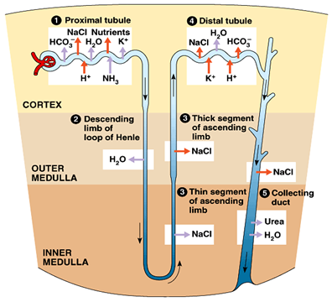

Slide 11
Nephron-tubular system
Proximal convoluted tubule
Descending loop of Henle
Ascending loop of Henle
Distal convoluted tubule
Collecting duct

Slide 12
Filtration: Fluid is squeezed out of the glomerular capillary bed.
Resorption: Most nutrients, water, and essential ions are returned to the blood of the peritubular capillaries.
Secretion: Moves additional undesirable molecules into tubules from the blood of peritubular capillaries.

Slide 13
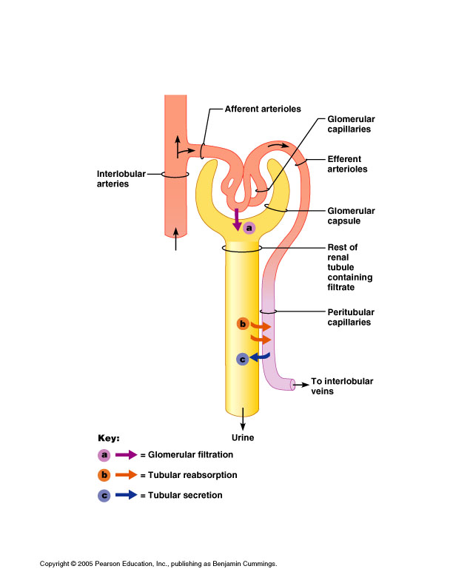

Slide 14
The formation of urine
There are three processes involved in the formation of urine.
Simple filtration
Selective reabsorption
Hormonal control
Parathyroid hormone, calcitonin.
Anti-diuretic hormone.
Aldosterone.
Renin-angiotensin.

Slide 15
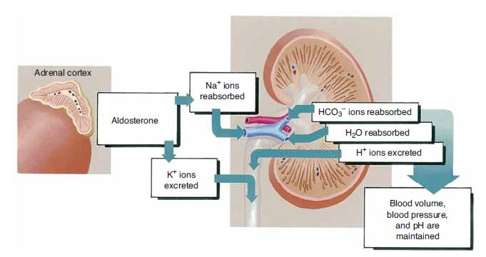

Slide 16
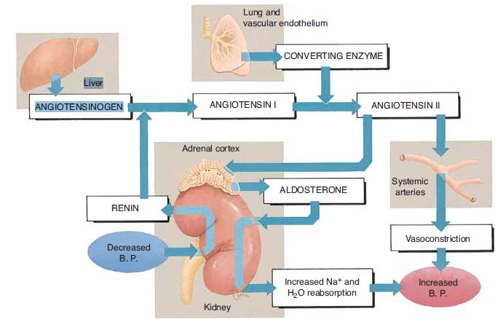

Slide 17
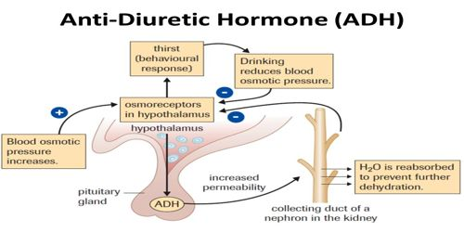

Slide 18
Secretion
Urine
Water: 95%
Nitrogenous waste: (urea, uric acid, creatinine).
Ions: (sodium, potassium, sulfate, phosphate).
From the original 1800 g NaCl, only 10 g appears in the urine.
Ureters
Urine is collected in the renal pelvis (or pyelum), which connects to the ureters, which carry urine to the bladder.
The ureters are about 200 to 250 mm long.
Smooth muscular tissue in the walls of the ureters peristaltically forces the urine downward.

Slide 19
Urine flow through ureters
Urine is not flowing through the ureter but goes to the bladder as a urinary spindle.
Starts with the sucking up of the urine during the diastolic phase → closing of collecting ductus → peristaltic movements.
Small amounts of urine are emptied into the bladder from the ureters about every 10 to 15 seconds.
Urinary bladder
The urinary bladder is a hollow muscular organ shaped like a balloon.
It is located in the pelvic fossa and held in place by ligaments attached to the pelvic bones.
The bladder stores urine - up to 500 ml of urine comfortably for 2 to 5 hours.
Sphincters (circular muscles) regulate the flow of urine from the bladder.

Slide 20
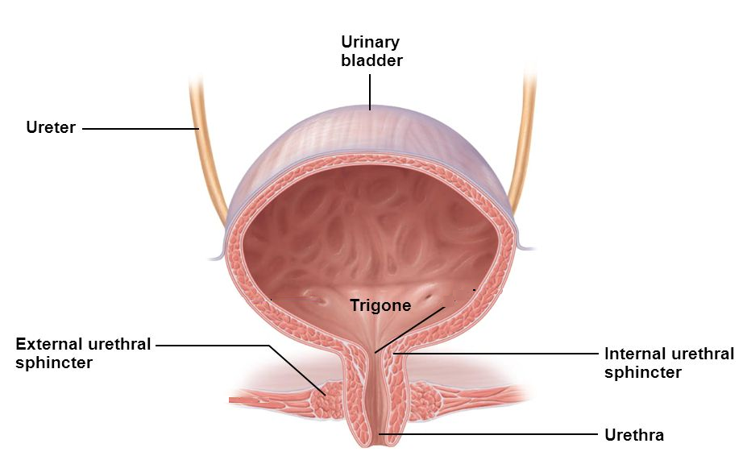
Internal urethral sphincter = at the beginning of urethra smooth muscle – not under our voluntary control
External urethral sphincter = skeletal muscle – we can control it

Slide 21
Urethra
The urethra has an excretory function in both sexes, to pass urine to the outside, and also a reproductive function in the male, as a passage for sperm.
In males, the internal and external urethral sphincters are more powerful, able to retain urine for twice as long as females.
The process of disposing urine from the urinary bladder through the urethra to the outside of the body is called urination. The process of urination is usually under voluntary control.

Slide 22
Glomerular filter
The filtration surface is 1.5 square meters.
The amount of the solution, which is filtered in the glomerular apparatus is around 180-200 liters.
The rest (97%) has to be reabsorbed in the tubules back to the body, so the final volume of urine is around (1.5 - 2 liters per day).
Glomerular filter:
The capillary endothelium.
Basal membrane.
Epithelium of the bowman’s capsule (podocytes).
Podocytes: special cells which have numerous pseudopodia (pedicles) that interdigitate to form filtration slits along the capillary wall.

Slide 23
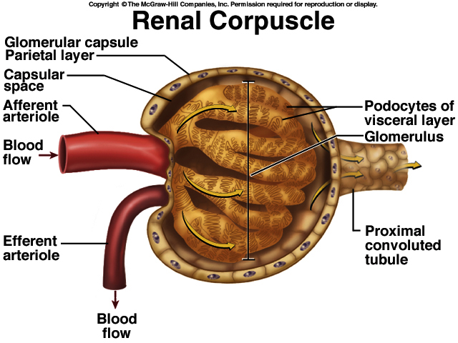

Slide 24
Depends on:
The pressure gradient across the filtration slit (endothelium, basal membrane, epithelium = podocytes).
Blood circulation throughout the kidneys.
Permeability of the filtration barrier.
Filtration surface.
The solution after filtration is very similar to plasma but should be without protein.

Slide 25
Glomerular filtration rate (GFR): The amount of renal filtrate formed by the kidneys in 1 minute, and averages 100 to 125 mL per minute. GFR may be altered if the rate of blood flows through the kidney changes. If blood flow increases, the GFR increases, and more filtrate are formed. If blood flow decreases (as may happen following a severe hemorrhage), the GFR decreases, less filtrate is formed, and urinary output decreases.
GFR=NFP × Kf =10 × 12.5 =125 ml/min. NFP= Net filtration pressure. Kf= filtration coefficient
Normal GFR is around 125 ml/min (7.5 liters/h)
Clearance: The ability of kidneys to clear plasma from different products.

Slide 26
Glomerular filtration rate (GFR)
can be measured by measuring the excretion and plasma level of a substance that freely filtered through the glomeruli and is neither secreted nor reabsorbed by the tubules, such as inulin (polymer of fructose).
GFR = U x V/P=C
U = concentration of inulin in urine.
V = volume of the urine.
P = concentration of inulin in plasma.
C = clearance of inulin.
A GFR of 60 or higher is in the normal range. A GFR below 60 may mean kidney disease. A GFR of 15 or lower may mean kidney failure.

