Slide 1
Introduction to human physiology
The study of how living organisms function including such processes as nutrition, movement, and reproduction.
The word "function" is important to the definition of physiology because physiology traditionally had to do with the function of living things while anatomy had to do with morphology, the shape, and form, of things.
Some physiological studies are concerned with processes that go on within cells such as phagocytosis, the process by which cells engulf and usually digest particles, bacteria and other microorganisms, and even harmful cells.

Slide 2
Other physiological studies deal with how tissues and organs work, how they are controlled and interact with other tissues and organs, and how they are integrated within the individual.
Yet other physiological studies deal with how we respond to our environment.
Human physiological processes are the functions of living persons and their parts, and the physical and chemical factors and processes involved.

Slide 3
Is the study of biological function—of how the body works, from cell to tissue, tissue to organ, organ to the system, and of how the organism as a whole accomplishes particular tasks essential for life?
Cell physiology: Study the processes occurring in cells
Systemic physiology: considers the functions of organ systems.
Neurophysiology: focuses on the nervous system and Cardiovascular physiology deals with the heart and blood vessels.
Pathophysiology: is the medical science dealing with all aspects of the disease, with an emphasis on the cause and development of abnormal conditions as well as the structural and functional changes resulting from disease.
Exercise physiology: focuses on changes in function, but also structure, caused by exercise.

Slide 4
Physiology: This is the study of the functions of living organisms (whole organisms…organ systems…organs…tissues…cells)
Groups of cells with similar characteristics or specializations form tissues.
Different tissues combine to form organs (Discrete structures with specific functions).
Organs that function together form organ systems.

Slide 5
Tissues occur in four basic types
Epithelial tissues: form linings or coverings perform functions appropriate to organ.

Slide 6
2- Connective tissues: exist in matrix support and reinforce other tissues.
Connective Tissue: Most abundant tissue in the body.
Binds, supports, and strengthens body tissues.
Consists of three basic elements (cells, fibers, and ground substance).
Connective cells include: (fibroblast, macrophages, plasma cells, and mast cells).
Three kinds of fibers are embedded in the matrix: (collagen fibers, elastic fibers, and reticular fibers)
Cartilage: There are three kinds of cartilage (hyaline, fibrocartilage, and elastic).
Bone: consists of compact bone and spongy bone.
Blood.

Slide 7
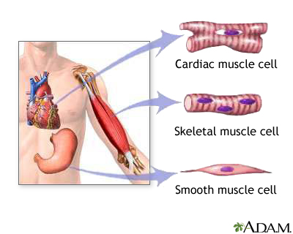
3- Muscle tissues contract provide movement or propulsion and include Skeletal muscles, cardiac muscles, and smooth muscles.

Slide 8
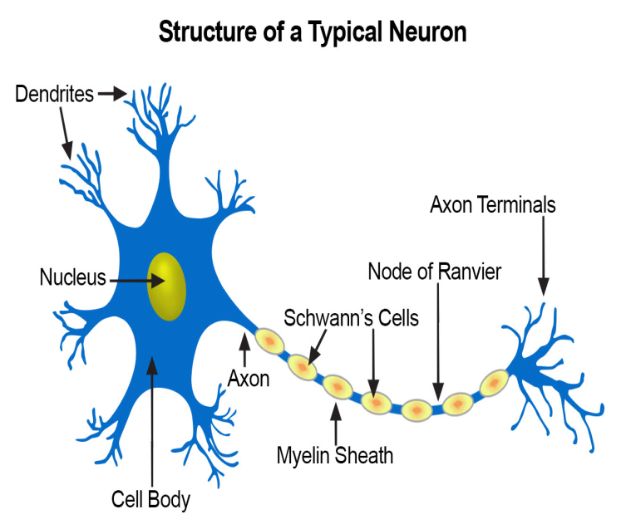
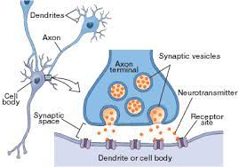
4- Nervous tissues transmit and process information, consist of two types of cells: Neurons (nerve cells) and neuroglia.

Slide 9
Levels of organization of the human body
The chemical level: The chemical level is the basic structure of which all substances are composed. Includes:
Atoms: Atoms are the smallest parts of an element that have the characteristics of that element. An atom consists of three major subunits or particles: protons, neutrons, and electrons. A proton has a positive electrical charge and is found in the nucleus (or center) of the atom. A neutron is electrically neutral (has no charge) and is also found in the nucleus. An electron has a negative electrical charge and is found outside the nucleus orbiting in what may be called an electron cloud or shell around the nucleus.

Slide 10
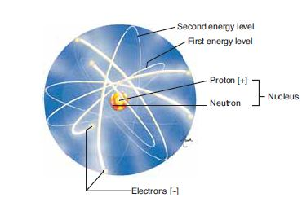

Slide 11
The number of protons in an atom gives it its atomic number. Protons and neutrons have mass and weight; they give an atom its atomic weight. In an atom, the number of protons (+) equals the number of electrons (−); therefore, an atom is electrically neutral. The electrons, however, are important in that they may enable an atom to connect, or bond, to other atoms to form molecules. Each atom is capable of bonding in only very specific ways. This capability depends on the number and the arrangement of the electrons of the atom. Electrons orbit the nucleus of an atom in shells or energy levels. The first, or innermost, energy level can contain a maximum of two electrons and is then considered stable. The second energy level is stable when it contains a maximum of eight electrons. The remaining energy levels, more distant from the nucleus, are also most stable when they contain eight electrons or a multiple of eight.

Slide 12
Molecules: A molecule is a combination of atoms (usually of more than one element) that are so tightly bound together that the molecule behaves as a single unit.
Ionic bonds:
An ionic bond involves the loss of one or more electrons by one atom and the gain of the electron(s) by another atom or atoms. An atom of sodium (Na) has one electron in its outermost shell, and to become stable, it tends to lose that electron. When it does so, the sodium atom has one more proton than it has electrons. Therefore, it now has an electrical charge (or valence) of ⁺1 and is called a sodium ion (Na⁺). An atom of chlorine has seven electrons in its outermost shell, and to become stable tends to gain one electron. When it does so, the chlorine atom has one more electron than it has protons, and now has a charge (valence) of ⁻1. It is called a chloride ion (Cl⁻).

Slide 13
When an atom of sodium loses an electron to an atom of chlorine, their ions have unlike charges (positive and negative) and are thus attracted to one another. The result is the formation of a molecule of sodium chloride: NaCl, or common table salt. The bond that holds these ions together is called an ionic bond.
Ions with positive charges are called cations. These include Na⁺, Ca⁺2, K⁺, Fe⁺2, and Mg⁺2. Ions with negative charges are called anions, which include Cl⁻, SO4⁻2 (sulfate), and HCO3⁻ (bicarbonate). The types of compounds formed by ionic bonding are salts, acids, and bases.

Slide 14
Formation of an ionic bond. An atom of sodium loses an electron to an atom of chlorine. The two ions formed have unlike charges, are attracted to one another, and form a molecule of sodium chloride.

Slide 15
2- The cell:
The most basic structural and functional unit of an organism is the cell.
It is the smallest living unit of the human body.
There are many different types of cells in the body including: (nerve cells, blood cells, muscle cells, and fat cells).
3- The tissue: Tissues are groups of cells, and the surrounding environment, which work together to produce a specific function. There are only four types of tissues in the body: Epithelial tissue, connective tissue, muscle tissue, and nervous tissue.

Slide 16
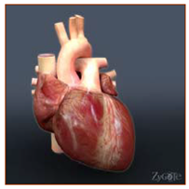
4- The organ: organs are structures that are made of two or more different types of tissues. They have specific functions and a defined shape.
The heart is an example of an organ.
It is made of muscle, as well as connective and nervous tissue.
The tissues work in concert to move blood through the body.

Slide 17
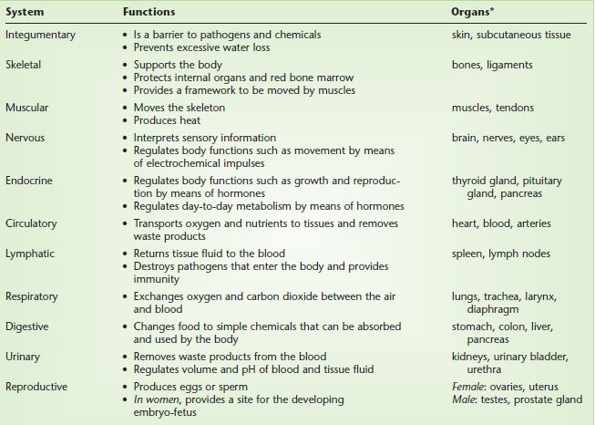
5- The system: A system consists of related organs that have a common function. There are eleven organ systems in the body:

Slide 18
6. The organism: an organism is the highest level of organization.

