Slide 1
Synapse
A synapse is a junction between two neurons. There is a very narrow gap of about 20nm between neurons called the synaptic cleft.
An action potential cannot cross the synaptic cleft, so nerve impulses are carried by chemicals called neurotransmitters.

Slide 2
Synapse
A junction that mediates information transfer from one neuron:
To another neuron: Called neuro-synapses or just synapses.
To an effector cell
Neuromuscular synapse if muscle involved
Neuroglandular synapse if gland involves
Presynaptic neuron: conducts impulses toward the synapse
Postsynaptic neuron: transmits impulses away from the synapse.
Pre-synaptic neuron = neuron sending impulse
Post-synaptic neuron = neuron receiving impulse

Slide 3
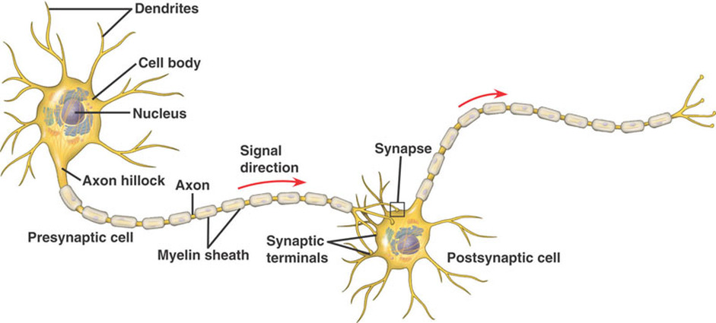
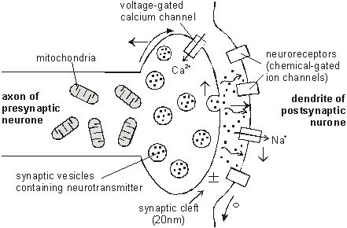

Slide 4
Two neurons communicating at a synapse

Slide 5
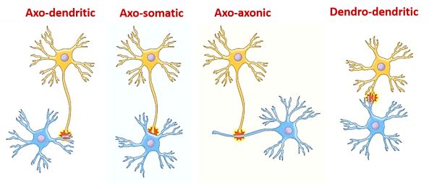
Anatomical (structurally) types of synapse
Axodendritic: synapses between the axon of one neuron and the dendrite of another.
Axosomatic: synapses between the axon of one neuron and the soma of another.
Axoaxonic: (axon to axon).
Dendrodendritic: (dendrite to dendrite).

Slide 6
What happens at the synapse?
Information is transmitted in the central nervous system (CNS) mainly in the form of nerve impulses, which pass from one neuron to another.
Each impulse from its way from one neuron to another may:
Be blocked in its transmission from one neuron to another.
Be changed from the single impulse to repetitive impulses.
Synaptic transmission is a complex process that permits grading and adjustment of neural activity necessary for normal function.

Slide 7
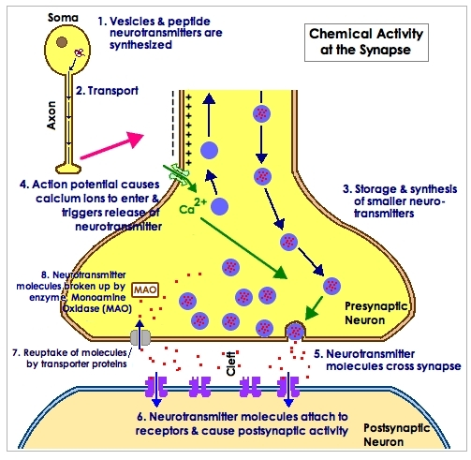
Functional classification of synapse
Chemical synapse: Almost all synapses used for signal transmission in the CNS of human beings are chemical synapses, i.e. first neuron secretes a chemical substance called a neurotransmitter at the synapse to act on a receptor on the next neuron to excite it, inhibit, or modify its sensitivity.

Slide 8
Electrical Synapse: Membranes of the pre-and post-synaptic neurons come close together and gap junctions form low membrane borders which allow passage of ions.
Conjoint synapse (mixed ): Where there are both types of transmission (chemical and electrical synapse).

Slide 9
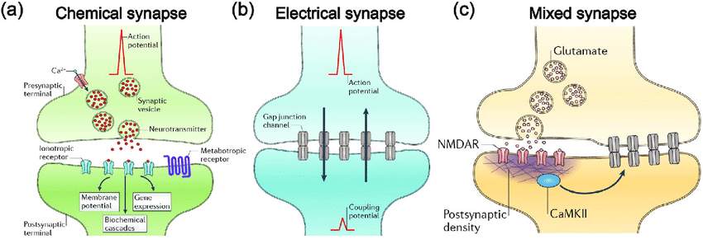

Slide 10
Synaptic properties
One-way conduction: Synapses generally permit conduction of impulses in one-way i.e. from pre-synaptic to post-synaptic neuron.
Synaptic delay: This is the minimum time required for transmission across the synapse.
a. Get released from synaptic vesicles when action potential has reached the presynaptic region.
b. Pass-through synaptic cleft.
c. Act on the postsynaptic region to bring about the production of action potential in the postsynaptic region.
For all the above events to be brought about, some time is required. This is known as synaptic delay, which is normally about 0.5 msec at every synapse.

Slide 11
3- Excitation or inhibition
The impulse conduction across a synapse may either stimulate or inhibit the activity of the postsynaptic region. If there is stimulatory influence, then there will be the production of action potential in postsynaptic neurons and if it has an inhibitory influence, then there is no action potential generation in the postsynaptic region.

Slide 12
4- Convergence and divergence:
Impulses from one pre­synaptic nerve fiber may end on the postsynaptic region of a large number of neurons and this is called divergence. When nerve fibers of different pre­synaptic neurons end on a common postsynaptic neuron, this is known as convergence. In CNS, on average, about 10000 synapses are found on one neuron.

Slide 13
5- Summation
When a stimulus of subthreshold strength is applied, there will not be the development of action potential in the postsynaptic region. But if many subthreshold stimuli are applied at the pre­synaptic region, effects of these stimuli can get added up and lead to action potential development in the postsynaptic region. This is known as summation.
There are two types of summation namely spatial and temporal. In temporal summation, pre­synaptic neuron stimulated will be same, but many stimuli are applied in rapid succession (timing of stimuli will be different, but the place of stimulation will be same).
In spatial summation, presynaptic neurons stimulated will be different but stimuli will be applied simultaneously (time of stimulation shall be same, but places of stimulation will be different). This is possible because of the property of convergence.

Slide 14
6- Occlusion
It means that when there is simultaneous stimulation of two presynaptic neurons, the response is less than the total of the response obtained when they are stimulated separately.
7- Synaptic fatigue
When synapses are continuously stimulated, after some time, due to exhaustion of neurotransmitters at presynaptic terminals, impulses fail to get conducted. This results in fatigue occurring at the level of the synapse. Fatigue is a temporary phenomenon. If some rest is given to neurons, resting facilitates the resynthesis of neurotransmitters for further conduction of impulse across the synapse.
8- Synaptic plasticity
In neuroscience, synaptic plasticity is the ability of synapses to strengthen or weaken over time, in response to increases or decreases in their activity.

Slide 15
Neurotransmitters
“Substance that is released at a synapse by one neuron and that affects a postsynaptic cell…in a specific manner”
Types of neurotransmitters
Amino Acids … Synaptic vesicles
Amines … Synaptic vesicles
Peptides (a short chain of amino acids)… Secretory granules
Peptides may exist in the same axon terminals as amino acids and amines.
The fast transmission uses amino acids or acetylcholine (ACh).
Slow transmission may use any of the three types of neurotransmitters.

Slide 16
Properties of neurotransmitters
Synthesized in the presynaptic neuron.
Localized to vesicles in the presynaptic neuron.
Released from the presynaptic neuron under physiological conditions.
Rapidly removed from the synaptic cleft by uptake or degradation.
Presence of receptor on the post-synaptic neuron.
Binding to the receptor elicits a biological response.

Slide 17
Neurotransmitters found in the nervous system
Excitatory: (Acetylcholine, Aspartate, Dopamine, Histamine, Norepinephrine, Epinephrine, Glutamate, and Serotonin).
Inhibitory: Glycine, Gamma-aminobutyric acid (GABA) is a chemical that is made in the brain and also found in some foods. In the brain, GABA has anti-seizure and anti-anxiety effects and works by blocking brain signals (neurotransmissions).)

Slide 18
Neurotransmitter Molecule | Derived From | Site of Synthesis
Acetylcholine | Choline | CNS, parasympathetic nerves
Serotonin 5-Hydroxytryptamine (5-HT) | Tryptophan | CNS, chromaffin cells of the gut, enteric cells
GABA | Glutamate | CNS
Histamine | Histidine | hypothalamus
Epinephrine (synthesis pathway) | Tyrosine | the adrenal medulla, some CNS cells
Norepinephrine (synthesis pathway) | Tyrosine | CNS, sympathetic nerves
Dopamine (synthesis pathway) | Tyrosine | CNS
Nitric oxide, NO | Arginine | CNS, gastrointestinal tract

Slide 19
Neuromuscular junctions
The neuromuscular junction is a synapse.
The motor endplate is the terminal button of a motor neuron that makes contract with a muscle cell.
The motor endplate releases the neurotransmitter acetylcholine that ultimately causes the muscle cell to contract.
Same stages as cholinergic synapses, but in this case, the postsynaptic membrane is the muscle fiber membrane (Sarcolemma).
Depolarisation of the sarcolemma leads to the contraction of muscle fiber.

Slide 20
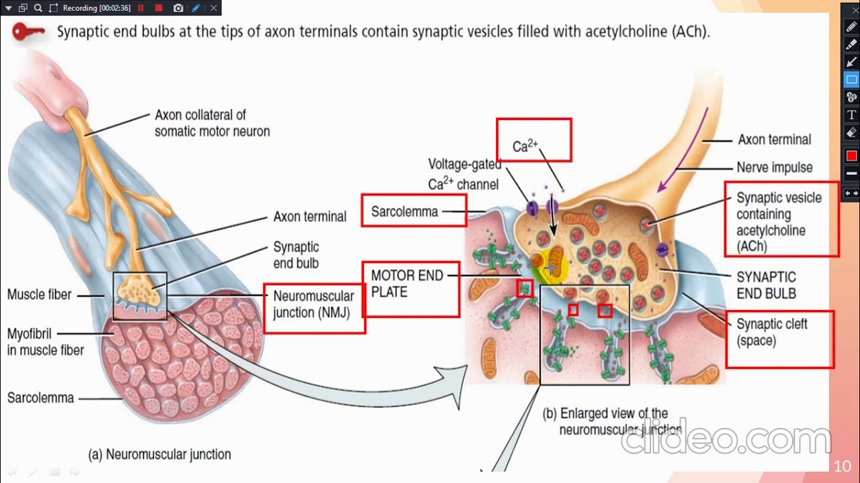

Slide 21
