Slide 1
The Muscular system
Properties of muscle
Contractility: Ability of a muscle to shorten with force.
Excitability: Capacity of muscle to respond to a stimulus.
Elasticity: Ability of muscle to recoil to original resting length after stretching.

Slide 2
Muscle tissue types
Skeletal
Attached to bones.
Nuclei are ovoid, multiple, and peripherally located.
Striated, voluntary.
Smooth
Walls of hollow organs, blood vessels, eye, glands, skin.
Single nucleus centrally located.
Not striated, involuntary.
Cardiac
Heart.
Single nucleus centrally located.
Striations, involuntary.

Slide 3
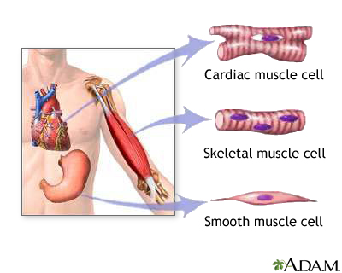

Slide 4
The function of skeletal muscles
Attach to bones to provide voluntary movement.
Produce heat and energy for the body.
Help maintain posture.
Protect internal organs.
Called striated (striped) because they have striations of alternating light and dark bands.
Provide movements to the limbs, but contract quickly, fatigue easily, and cannot maintain the contraction for long periods.

Slide 5
Connective tissue wrappings of skeletal muscle
Endomysium – around single muscle fiber.
Perimysium – around a fascicle (bundle) of fibers.
Epimysium – covers the entire skeletal muscle.
Fascia – on the outside of the epimysium.

Slide 6
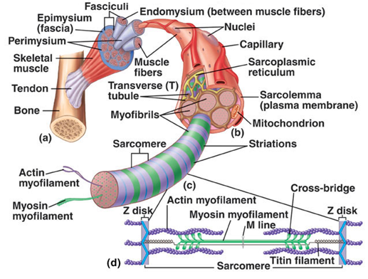
Parts of a muscle
Microscopic anatomy of skeletal muscle

Slide 7
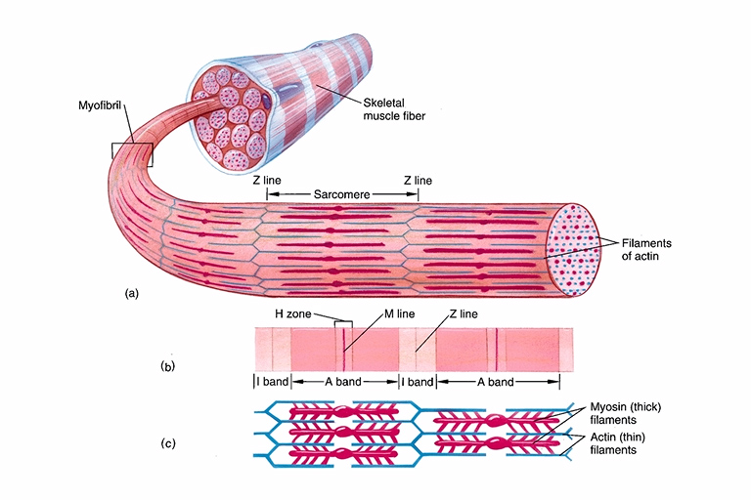
Myofibril
Bundles of myofilaments
Myofibrils are aligned to give distinct bands
I band = light band
A band = dark band

Slide 8
Sarcomere
Sarcomere - The basic functional unit of the muscle fiber consists of the array of thick and thin filaments between two Z disks.
Thick filaments - with myosin (protein) molecules
Thin filaments - with actin (protein) molecules plus smaller amounts of troponin and tropomyosin.
Striations - of dark A bands and light I bands.
A band - is bisected by the H zone with the M line or band running through the center of this H zone.
I bands - are bisected by the Z disk or line.

Slide 9
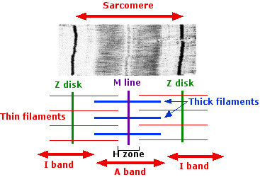

Slide 10
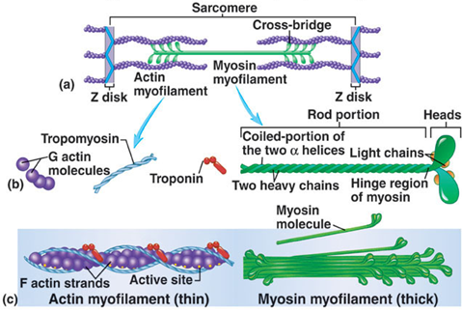
Structure of actin and myosin

Slide 11
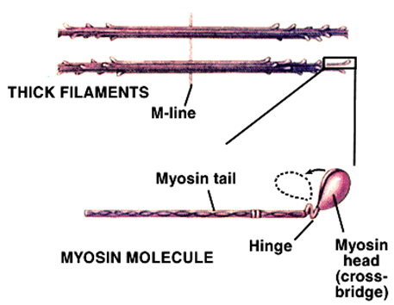
Thick filaments (Myosin)
Bundle of myosin proteins shaped like double-headed golf clubs.
Myosin heads have two binding sites:
Actin binding site forms cross bridge.
The nucleotide-binding site binds ATP (Myosin ATPase).
Hydrolysis of ATP provides energy to generate power stroke.

Slide 12
Thin filaments (Actin)
Backbone: two strands of polymerized globular actin – fibrous actin.
Each actin has a myosin binding site.
Troponin
Binds Ca²⁺; regulates muscle contraction.
Tropomyosin
Lies in the groove of the actin helix.
Blocks myosin binding.
Sites in absence of Ca²⁺.

Slide 13
Thick filament: Myosin (head and tail)
Thin filament: Actin, Tropomyosin, Troponin (calcium-binding site)

Slide 14
Sliding Filament Model
Actin myofilaments slide over myosin to shorten sarcomeres.
Actin and myosin do not change length.
Shortening sarcomeres are responsible for skeletal muscle contraction.
During relaxation, sarcomeres lengthen.

Slide 15
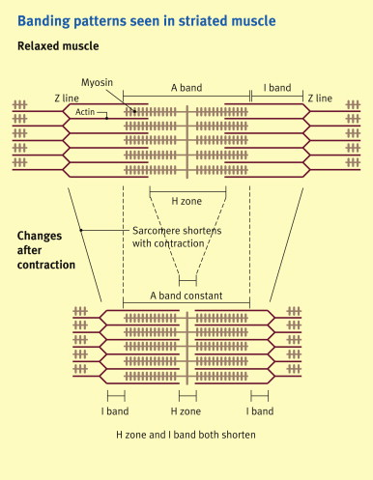

Slide 16
Excitation-Contraction coupling
Depolarization of motor endplate (excitation) is coupled to muscular contraction.
The nerve impulse travels along the sarcolemma and down T-tubules to cause a release of Ca²⁺ from the Sarcoplasmic reticulum.
Ca²⁺ binds to troponin and causes position change in tropomyosin, exposing active sites on actin.
Permits a strong binding state between actin and myosin and contraction occurs.
ATP is hydrolyzed and energy goes to the myosin head which releases from actin.

Slide 17
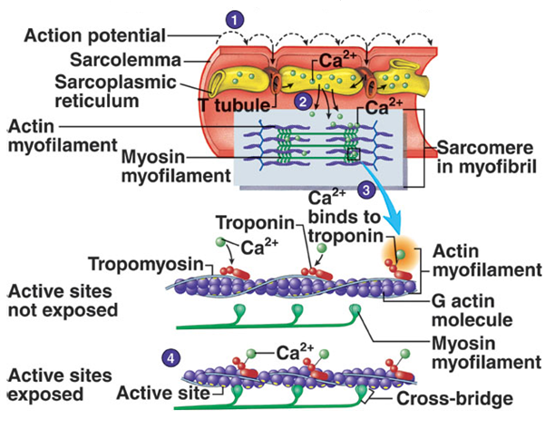
Action potentials and muscle contraction

Slide 18
