Slide 3
Components of the cardiovascular system
Blood.
Heart.
Blood vessels.
Blood
The blood: Blood cells and plasma
Blood cells (Erythrocytes, Leucocytes, and Thrombocytes).
Plasma is the fluid portion.

Slide 4
Heart
The heart is a four-chambered, hollow muscular organ approximately the size of your fist.
Location:
The superior surface of the diaphragm.
Left of the midline.
Anterior to the vertebral column, posterior to the sternum.
About the size of a clenched fist.

Slide 5
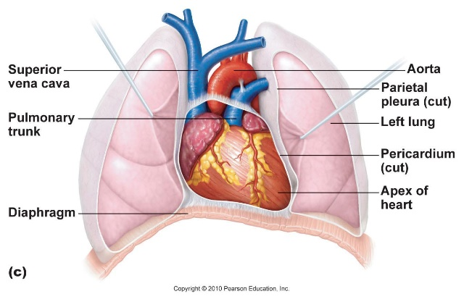
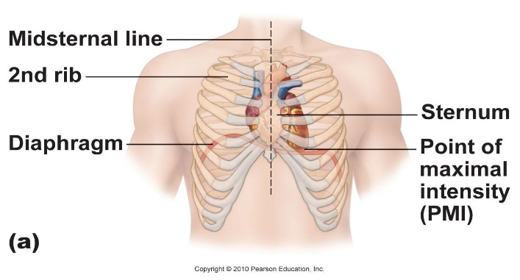

Slide 6
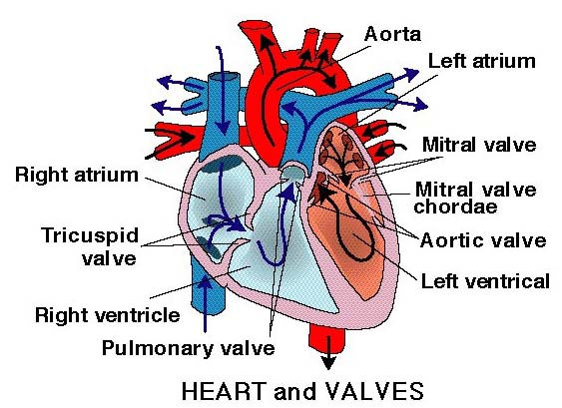
Heart chambers and valves

Slide 7
Functions of the heart
Generating blood pressure.
Routing blood.
Heart separates pulmonary and systemic circulations.
Ensuring one-way blood flow
Heart valves ensure one-way flow.
Regulating blood supply
Changes in contraction rate and force match.
Blood delivery to changing metabolic needs.

Slide 8
Blood vessels
Blood Vessels -A closed network of tubes.
These includes:
Arteries.
Capillaries.
Veins.

Slide 9
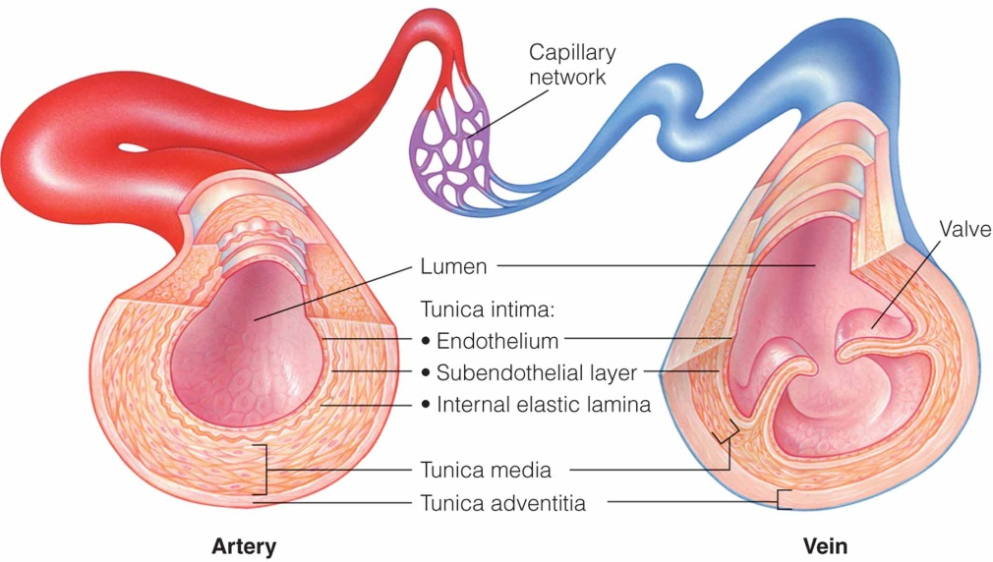
The capillary network between arterial and venous blood.

Slide 10
The heart wall: 3 layers
Epicardium
Outside layer.
This layer is the parietal pericardium.
Connective tissue layer.
Myocardium
Middle layer
Mostly cardiac muscle.
Endocardium
Inner layer.
Endothelium.

Slide 11
Blood vessels
Arteries (Distributing channel)
Thick-walled tubes.
Capillaries (microscopic vessels)
One cell thick.
Veins (draining channel)

Slide 12
The general structure of blood vessels
Tunica intima.
Tunica media.
Tunica adventitia.

Slide 13
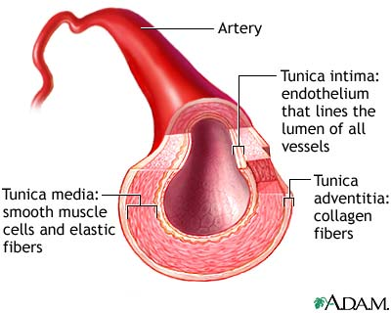
Arteries
Blood vessels that carry blood away from the heart are called arteries.
They are the thickest blood vessels and they carry blood high in oxygen known as oxygenated blood (oxygen-rich blood).
Accompanied by vein and nerves.
Lumen is small.
No valves.
Repeated branching.

Slide 14
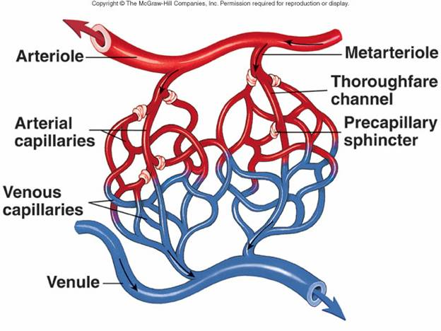

Slide 15
Capillaries (5-8 micron)
The smallest blood vessels are capillaries and they connect the arteries and veins.
This is where the exchange of nutrients and gases occurs.

Slide 17
Veins without valves:
Superior and inferior vena cava.
Hepatic, renal.
Uterine, ovarian.
Facial.
Pulmonary.
Umbilical.
Portal Veins.

Slide 19
Circulation
Coronary circulation – the circulation of blood within the heart.
Pulmonary circulation – the flow of blood between the heart and lungs.
Systemic circulation – the flow of blood between the heart and the cells of the body.
Fetal circulation.

Slide 20
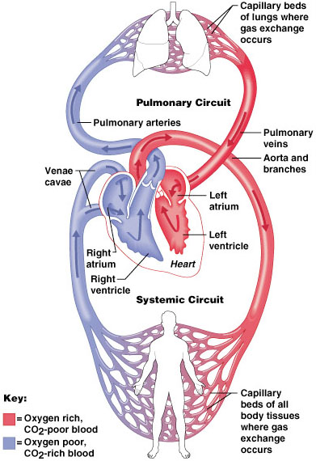
Systemic and pulmonary circulation

