Slide 1
Digestive system
The organs that are involved in the breaking down of food into molecules can pass through the wall of the digestive tract and can be taken up by the cells.
Digestive processes
Five basic activities are involved in the digestive process:
Ingestion: The taking of food into the mouth.
Mixing and movement of food: Involves the muscular contractions (peristalsis) that mix the food and move it along the digestive tract.
Digestion: The breakdown of food by mechanical and chemical means.
Absorption: The passage of food from the digestive tract into the cardiovascular and lymphatic systems.
Defecation: The elimination of indigestible waste.

Slide 2
Digestion: Two stages
Mechanical digestion
Physical breakdown of food into smaller particles by the cutting and grinding action of the teeth and the churning contractions of the stomach and small intestines.
Serves to expose more food surface to the actions of the digestive enzymes.

Slide 3
Chemical digestion
A series of hydrolysis reactions that break macromolecules into their monomers.
Polysaccharides into monosaccharides.
Proteins into amino acids.
Nucleic acids into nucleotides.
Fats into glycerol and fatty acids.
Hydrolysis carried out by digestive enzymes from the
Salivary glands, stomach, pancreas, small intestine.
Some foods are absorbed without enzymatic action.
Vitamins, free amino acids, minerals, cholesterol, and water.

Slide 4
The processes of digestion
Motility: The muscular contractions that break up food, mix, and propel food.
Secretion: The release of enzymes and hormones that carry out and regulate digestion.
Membrane transport: All the mechanisms that absorb nutrients and transfer them into the blood and lymph (active transport, facilitated diffusion, etc.).

Slide 5
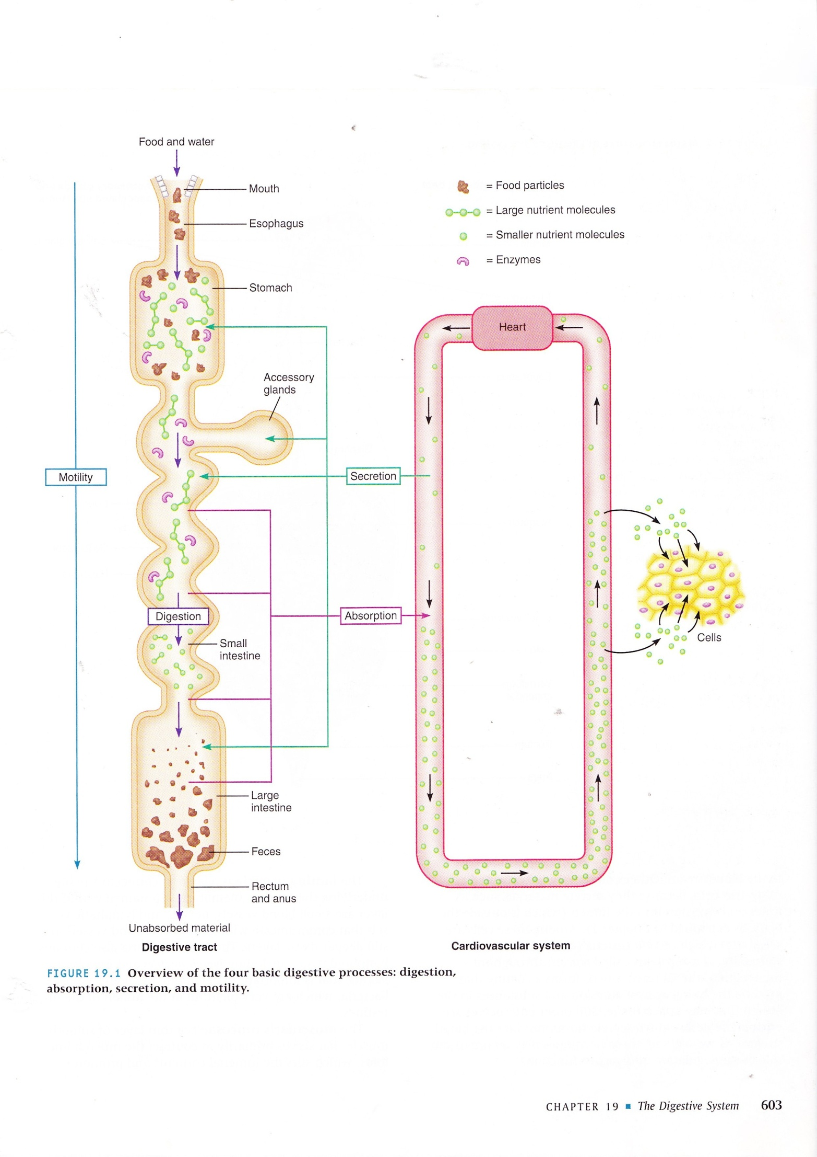

Slide 6
Organization
Gastrointestinal (GI) tract or alimentary canal: The continuous tube that begins at the mouth and ends at the anus.
Mouth, pharynx, esophagus, stomach, small intestine, and large intestine.
Accessory organs: Aid in the digestive process by mechanical manipulation and secreting various substances (enzymes, mucus).
Teeth, tongue, salivary glands, liver, gallbladder, and pancreas.

Slide 7
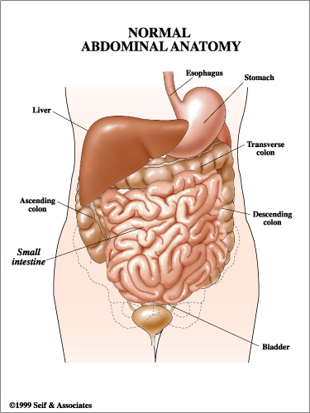

Slide 8
Four layers of the GI tract
Mucosa: (Epithelium, lamina propria, muscularis mucosa).
Submucosa
Muscularis: (Internal oblique (only in the stomach), inner circular layer, outer longitudinal layer).
Serosa: (Areolar tissue, mesothelium).

Slide 9
Salivary glands
There are two kinds of salivary glands:
Intrinsic: an indefinite number of small glands dispersed amid the oral tissue.
Contains lingual lipase and lysozyme.
Serves to moisten the mouth and inhibit bacterial growth.
Extrinsic glands
Three pairs of larger more discrete organs are located outside of the oral mucosa.
They communicate with the oral cavity by way of ducts.

Slide 10
Saliva
Moistens the mouth.
Digest a little starch and fat.
Cleanses the teeth.
Inhibits bacterial growth.
Dissolves molecules so they can stimulate taste buds.
Dilute and buffer foods.
Moistens food and binds particles together to aid in swallowing.
Is a hypotonic solution of 99% water and other solutes.
The pH of 6.8 to 7.0.

Slide 11
Solutes in saliva
Salivary amylase- an enzyme that begins starch digestion.
Lingual lipase- activated by stomach acid and digest fat after the food is swallowed.
Mucus- binds and lubricates the food mass and aids in swallowing.
Lysozyme- kills bacteria.
Immunoglobulin A (IgA)- inhibits bacterial growth.
Electrolytes- including sodium, potassium, chloride, phosphate, and bicarbonate ions.

Slide 12
Secretion of saliva
Controlled by the parasympathetic system through the facial and glossopharyngeal nerves which promote continuous secretion to maintain a moist oral cavity.
The sympathetic system is in control when under stress and prevents secretion, resulting in dry mouth.

Slide 13
Three accessory glands that secrete saliva into the oral cavity:
Parotid gland
Is the largest of the three glands and is located below and in front of the ears.
Secretes a fluid rich in amylase
Submandibular gland
Located on the floor of the mouth on the inside surface of the lower jaw.
Secretes are mostly a serious fluid.
Sublingual gland
Are the smallest of the salivary glands and is located on the floor of the mouth under the tongue.
Secretes mostly mucous.

Slide 14
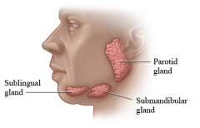

Slide 15
Digestion in the mouth
Mastication (chewing): The tearing, grinding, and mixing of food with saliva to form a bolus that is easily swallowed.
The chemical breakdown of starches begins in the mouth with the secretion of amylase from the parotid gland. The salivary amylase breaks the bonds between the polysaccharides, converting them to monosaccharides that can then be absorbed through the walls of the GI tract.

Slide 16
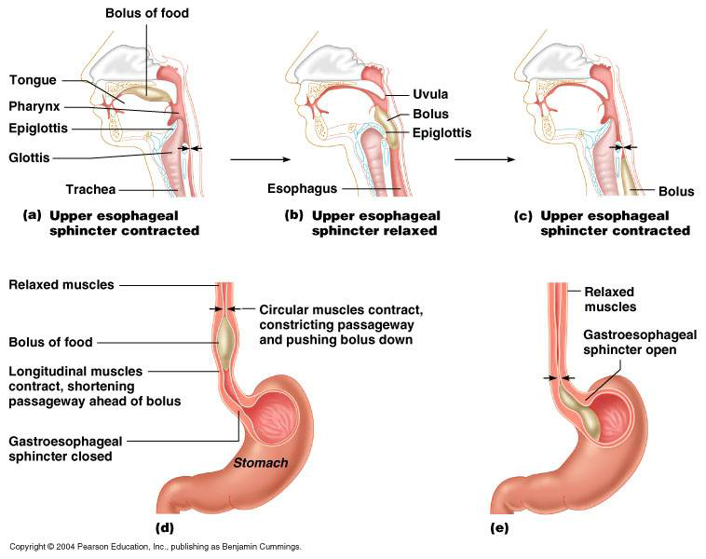

Slide 17
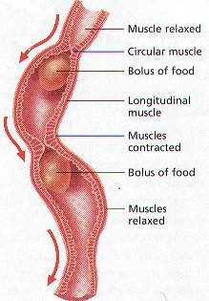
Peristalsis
Series of involuntary wave-like muscle contractions move food along the digestive tract.

