Slide 1
If the same experiment is performed with a conducting wire connected from the sphere to the Earth (Fig. 1.4c), some of the electrons in the conductor are so strongly repelled by the presence of the negative charge in the rod that they move out of the sphere through the wire and into the Earth.
Figure 1.4 c . (c) When the sphere is grounded, some of its electrons leave through the ground wire
If the wire to ground is then removed (Fig. 1 .4d), the conducting sphere contains an excess of induced positive charge because it has fewer electrons than it needs to cancel out the positive charge of the protons.
Figure 1.4 e. (e) When the rod is removed, the remaining electrons redistribute uniformly and there is a net uniform distribution of positive charge on the sphere. +
Figure 1.4 d. (d) When the ground connection is removed, the sphere has excess positive charge that is no uniformly distributed

Slide 2
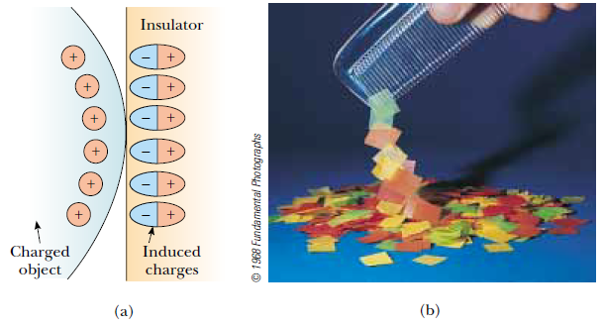
Figure 1.5 (a) The charged object on the left induces a charge distribution on the surface of an insulator due to realignment of charges in the molecules. (b) A charged comb attracts bits of paper because charges in molecules in the paper are realigned.
Quick Quiz 1.3 Three objects are brought close to each other, two at a time. When objects A and B are brought together, they attract. When objects B and C are brought together, they repel. From this, we conclude that (a) objects A and C possess charges of the same sign. (b) objects A and C possess charges of opposite sign. (c) all three of the objects possess charges of the same sign. (d) one of the objects is neutral. (e) we need to perform additional experiments to determine information about the charges on the objects.

Slide 3
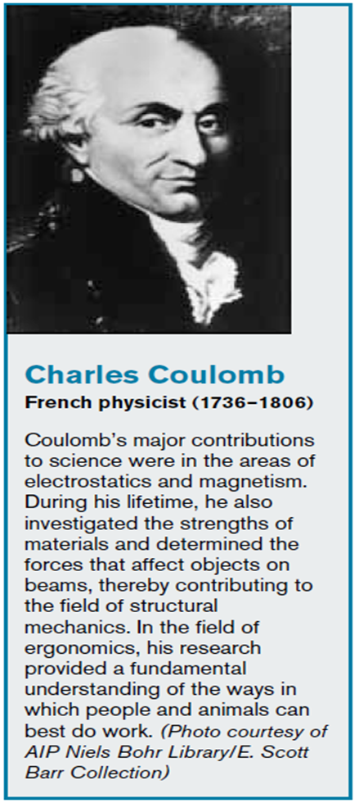
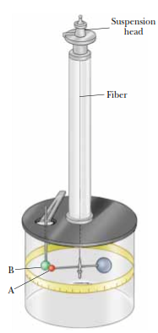
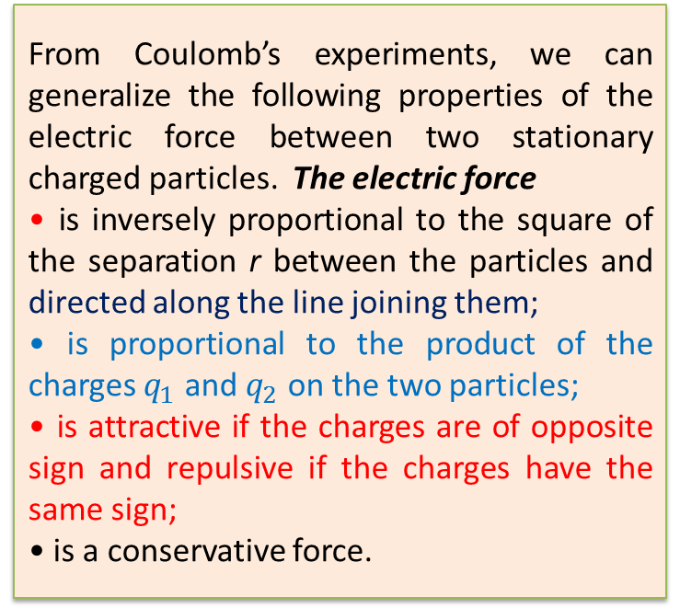
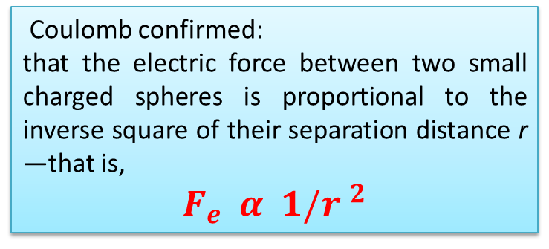
1.3 Coulomb’s Law
Charles Coulomb (1736–1806) measured the magnitudes of the electric forces
Coulomb confirmed:
that the electric force between two small charged spheres is proportional to the inverse square of their separation distance r —that is,
$F_{e} α 1/{r }^{2}$
From Coulomb’s experiments, we can generalize the following properties of the electric force between two stationary charged particles. The electric force
• is inversely proportional to the square of the separation r between the particles and directed along the line joining them;
• is proportional to the product of the charges $q_{1}$ and $q_{2}$ on the two particles;
• is attractive if the charges are of opposite sign and repulsive if the charges have the same sign;
• is a conservative force.
Figure 1.6 Coulomb’s
torsion balance, used to establish the inverse-square law for the electric force between two charges.

Slide 4
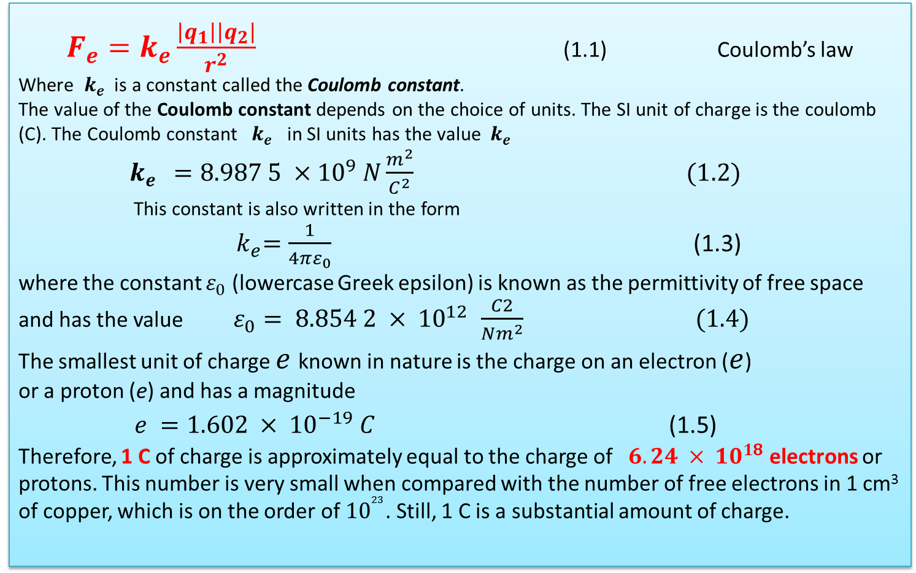
We will use the term point charge to mean a particle of zero size that carries an electric charge. The electrical behavior of electrons and protons is very well described by modeling them as point charges. From experimental observations on the electric force
$F_{e}=k_{e}\frac{\left|q_{1}\right|\left|q_{2}\right|}{r^{2}}$ (1.1) Coulomb’s law
Where $k_{e}$ is a constant called the Coulomb constant.
The value of the Coulomb constant depends on the choice of units. The SI unit of charge is the coulomb (C). The Coulomb constant $k_{e}$ in SI units has the value $k_{e}$
$k_{e}$ $=8.987 5 ×{10}^{9} N\frac{m^{2}}{C^{2}} (1.2)$
This constant is also written in the form
${ k}_{e}=\frac{1}{4πε_{0}}$ (1.3)
where the constant $ε_{0}$ (lowercase Greek epsilon) is known as the permittivity of free space and has the value $ε_{0}= 8.854 2 × {10}^{12 }\frac{C2}{Nm^{2}} (1.4)$
The smallest unit of charge $e$ known in nature is the charge on an electron ($e$)
or a proton (e) and has a magnitude
$e =1.602 × {10}^{−19} C$ (1.5)
Therefore, 1 C of charge is approximately equal to the charge of $6.24 × {10}^{18}$ electrons or protons. This number is very small when compared with the number of free electrons in 1 cm³ of copper, which is on the order of ${10}^{23}$. Still, 1 C is a substantial amount of charge.

Slide 5
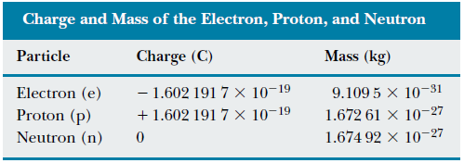
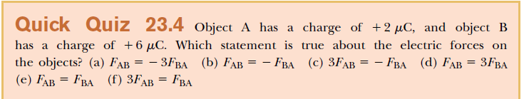
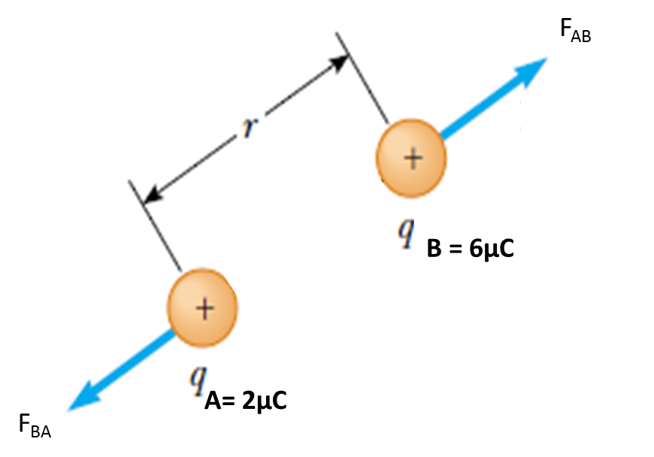

Slide 6
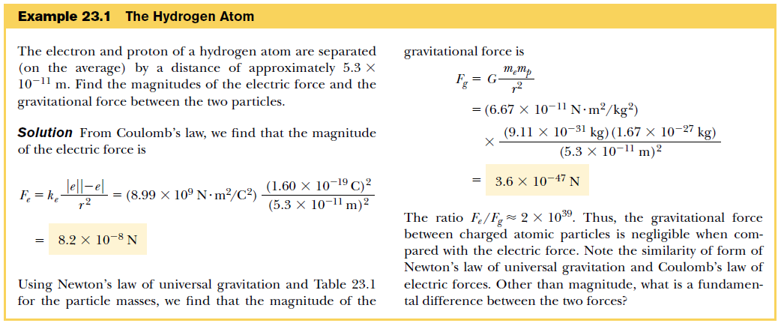

Slide 7
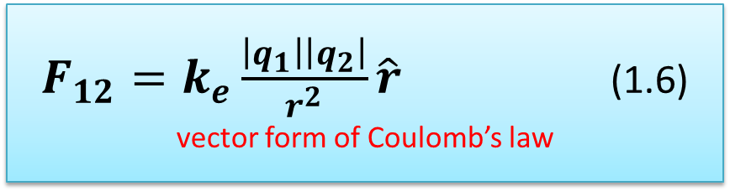
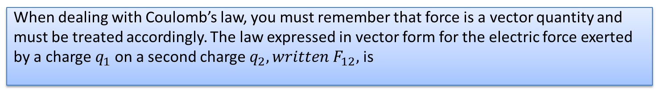
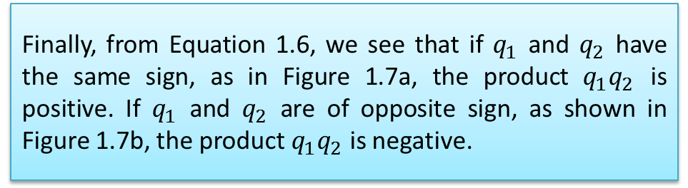
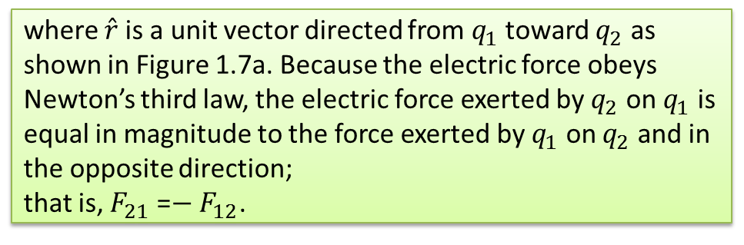
When dealing with Coulomb’s law, you must remember that force is a vector quantity and must be treated accordingly. The law expressed in vector form for the electric force exerted by a charge $q_{1}$on a second charge $q_{2}, written F_{12},$ is
$F_{12}=k_{e}\frac{\left|q_{1}\right|\left|q_{2}\right|}{r^{2}}\hat{r}$ (1.6) vector form of Coulomb’s law
where ${\hat{r}}^{ }$is a unit vector directed from $q_{1}$ toward $q_{2}$ as shown in Figure 1.7a. Because the electric force obeys Newton’s third law, the electric force exerted by $q_{2}$ on $q_{1}$ is equal in magnitude to the force exerted by $q_{1}$ on $q_{2}$ and in the opposite direction;
that is, $F_{21}$ =$− F_{12}$.
Figure 1.7a
Finally, from Equation 1.6, we see that if $q_{1}$ and $q_{2}$ have the same sign, as in Figure 1.7a, the product $q_{1}q_{2}$ is positive. If $q_{1}$ and $q_{2}$ are of opposite sign, as shown in Figure 1.7b, the product $q_{1}q_{2}$ is negative.
Figure 1.7b

Slide 8
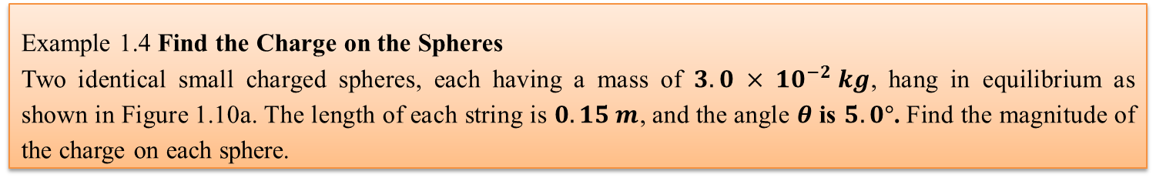
Example 1.4 Find the Charge on the Spheres
Two identical small charged spheres, each having a mass of $3.0 × {10}^{−2} kg$, hang in equilibrium as shown in Figure 1.10a. The length of each string is $0.15 m$, and the angle $θ$ is $5.0°$. Find the magnitude of the charge on each sphere.
Figure 1.10 (Example 1.4) (a) Two identical spheres, each carrying the same charge q, suspended in equilibrium. (b) The free-body diagram for the sphere on the left.
We analyze this problem by drawing the free-body diagram for the left-hand sphere in Figure 1.10b. The sphere is in equilibrium under the application of the forces T from the string, the electric force F_{e} from the other sphere, and the gravitational force mg. Because the sphere is in equilibrium, the forces in the horizontal and vertical directions must separately add up to zero:
From Equation (2), we see that
thus, T can be eliminated from Equation (1) if we
make this substitution. This gives a value for the
magnitude of the electric force F_{e} :

Slide 9
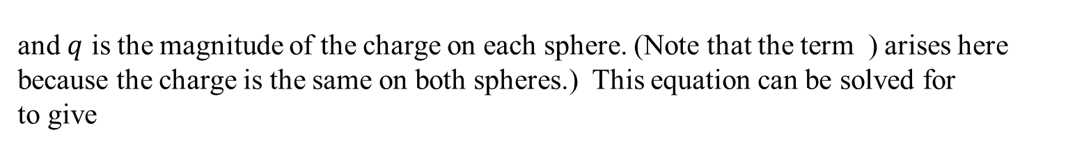

Considering the geometry of the right triangle in Figure 1.10a,
we see that $sinθ=\frac{a}{L}$ Therefore,
The separation of the spheres is 2a = 0.026 m. From Coulomb’s law (Eq. 1.1), the magnitude of the electric force is
and $q$ is the magnitude of the charge on each sphere. (Note that the term ) arises here because the charge is the same on both spheres.) This equation can be solved for to give
$$=1.96×{10}^{−15}C$$

Slide 10
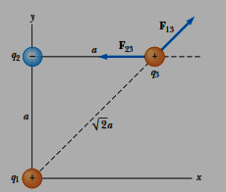
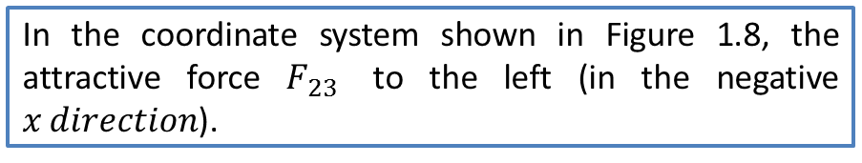
When more than two charges are present, the force between any pair of them is given by Equation 1.6. Therefore, the resultant force on any one of them equals the vector sum of the forces exerted by the various individual charges. For example, if four charges are present, then the resultant force exerted by particles 2, 3, and 4 on particle 1 is
Example 1.2 Find the Resultant Force
Consider three point charges located at the corners of a right triangle as shown in Figure 1.8, where
In the coordinate system shown in Figure 1.8, the attractive force $F_{23}$ to the left (in the negative $x direction$).
Figure 1.8

