Slide 1
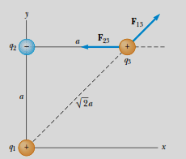
The magnitude of the force $F13$ exerted by q₁ on q₃ is
The repulsive force $F_{13}$ makes an angle of 45° with the $x axis$. Therefore, the$x$ and y components of $F_{13}$ are equal, with magnitude given by $F_{13} cos 45°= 7.9 N.$
Combining $F_{13} with F_{23}$ by the rules of vector addition, we arrive at the $x and y$components of the resultant force acting on $q_{3}$:

Slide 2
Example 1.3 Where Is the Resultant Force Zero?
Three point charges lie along the $x$ axis as shown in Figure 1.9. The positive charge $q_{1}=15.0 μC$ is at$x= 2.00 m$, the positive charge $q_{2}=6.00 μC$ is at the origin, and the resultant force acting on $q_{3}$ is zero. What is the $x −$ coordinate of $q_{3}$?
Solution Because q₃ is negative and q₁ and q₂ are positive, the
forces F₁₃ and F₂₃ are both attractive, as indicated in Figure 1.9.
From Coulomb’s law, F₁₃ and F₂₃ have magnitudes
For the resultant force on q₃ to be zero, F₂₃ must be equal in magnitude and opposite in direction to F₁₃. Setting the magnitudes of the two forces equal, we have
Figure 1.9 (Example 1.3) Three point charges are placed along the x axis. If the resultant force acting on q₃ is zero, then the force F₁₃ exerted by q₁ on q₃ must be equal in magnitude and opposite in direction to the force F₂₃ exerted by q₂ on q₃.
This can be reduced to the following quadratic equation: Solving this quadratic equation for $x$, we find that the positive
root is $x=0.77$ There is also a second root, $x=3.44 m$ This is another location at which the

Slide 3
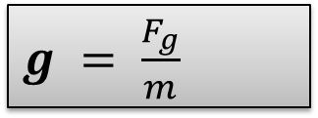
1.4 The Electric Field
field forces can act through space, producing an effect even when no physical contact occurs between interacting objects.
The gravitational field $g$ at a point in space equal to the gravitational force $F_{g}$ acting on a test particle of mass ( m ) divided by that mass:
$g = \frac{F_{g}}{m}$
An electric field is said to exist in the region of space around a charged object—the source
charge.
When another charged object—the test charge—enters this electric field, an electric force acts on it. As an example, consider Figure 1.11, which shows a small positive test charge $q_{0}$ placed near a second object carrying a much greater positive charge Q.
Figure 1.11, which shows a small positive test charge $q_{0}$ placed near a second object carrying a much greater positive charge Q.

Slide 4
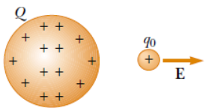
Definition of electric field
The electric field vector $E$ at a point in space is defined as the electric force $F_{e}$ acting on a positive test charge $qo$ placed at that point divided by the test charge: $E=\frac{F_{e}}{q_{0}}$ (1-7)
Note that E is the field produced by some charge or charge distribution separate from the test charge—it is not the field produced by the test charge itself.
Also, note that the existence of an electric field is a property of its source—the presence of the test charge is not necessary for the field to exist.
The test charge serves as a detector of the electric field. Equation 1.7 can be rearranged as
$$F_{e}=qE$$
where we have used the general symbol q for a charge. This equation gives us the force on a charged particle placed in an electric field. If q is positive, the force is in the same If $q_{ }$is negative, the force and the field are in opposite directions.

Slide 5
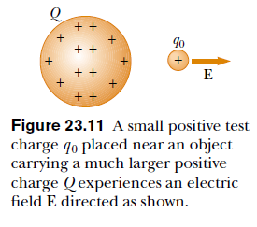
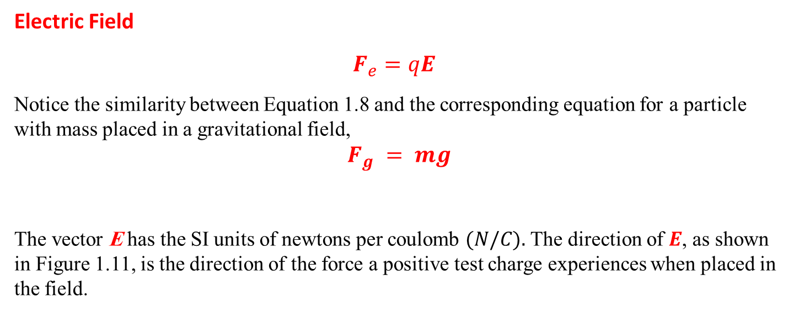
Electric Field
$$F_{e}=qE$$
Notice the similarity between Equation 1.8 and the corresponding equation for a particle with mass placed in a gravitational field,
$F_{g} = mg$
The vector E has the SI units of newtons per coulomb $(N/C).$ The direction of $E$, as shown in Figure 1.11, is the direction of the force a positive test charge experiences when placed in the field.
1

Slide 6
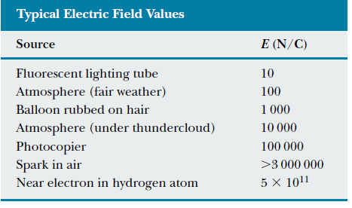
We say that an electric field exists at a point if a test charge at that point experiences an electric force. Once the magnitude and direction of the electric field are known at some point, the electric force exerted on any charged particle placed at that point can be calculated from Equation
$$F_{e}=qE$$
The electric field magnitudes for various field sources are given in Table 1.2.

Slide 7
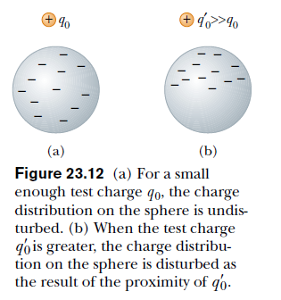
When using Equation $E=\frac{F_{e}}{q_{0}}$
we must assume that the test charge $q_{0}$ is small enough that it does not disturb the charge distribution responsible for the electric field. If a vanishingly small test charge $q_{0}$is placed near a uniformly charged metallic sphere, as in Figure 1.12a. the charge on the metallic sphere, which produces the electric field, remains uniformly distributed. If the test charge is great enough (${q´}_{0}≫q_{0}$), as in Figure 1.12b, the charge on the metallic sphere is redistributed and the ratio of the force to the test charge is different: (${\acute{F}}_{e}/{\acute{q}}_{0}≠ F_{e} /q_{0}$).
That is, because of this redistribution of charge on the metallic sphere, the electric field it sets up is different from the field it sets up in the presence of the much smaller test charge $q_{0}$.

Slide 8
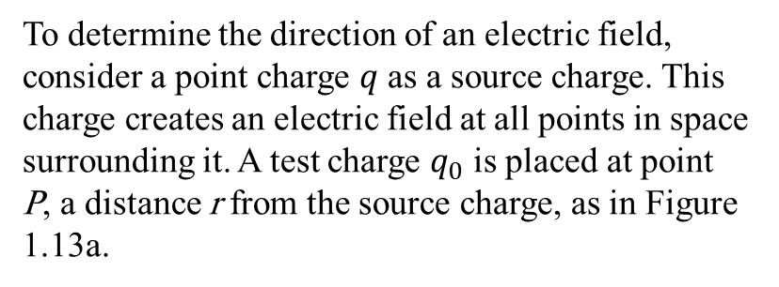
To determine the direction of an electric field, consider a point charge $q$ as a source charge. This charge creates an electric field at all points in space surrounding it. A test charge $q_{0}$ is placed at point P, a distance r from the source charge, as in Figure 1.13a.
Active Figure 1.13 A test charge q₀ at point P is a distance r from a point charge q.
(a) If q is positive, then the force on the test charge is directed away from q.
(b) For the positive source charge, the electric field at P points radially outward from q.
(c) If q is negative, then the force on the test charge is directed toward q.
(d) For the negative source charge, the electric field at P points radially inward toward q.

Slide 9
According to Coulomb’s law, the force exerted by $q$ on the test charge is:-
$$F=k_{e}\frac{qq_{0}}{r^{2}}\hat{r}$$
Where $\hat{r}$ is a unit vector directed from $q$ toward $q_{0}$. This force in Figure 1.13a is directed away from the source charge q
Because the electric field at $P$, the position of the test charge, is defined by $E=\frac{F_{e}}{q_{0}}$
$$\text{we} \text{find} \text{that} \text{at} P\text{, }\text{the} \text{electric} \text{field} \text{created} \text{by} q \text{is}$$
$E=k_{e}\frac{q}{r^{2}}\hat{r}$ ( 1.9)

Slide 10
at any point $P$, the total electric field due to a group of source charges equals the vector sum of the electric fields of all the charges.
This superposition principle applied to fields follows directly from the superposition property of electric forces.
Thus, the electric field at point $P$ due to a group of source charges can be expressed as the vector sum
Electric field due to a finite number of point charges
$E=k_{e}\sum_{i }{\frac{q_{i}}{r_{i}^{2}}}{\hat{r}}_{i}$
Where $\acute{r_{\dot{i}}}$is the distance from the $i^{th}$ source charge q_{i} to the point P and $\acute{r_{\dot{i}}}$is a unit vector directed from $q_{i}$toward P.

