Slide 1
Chapter 1
Electric Fields

Slide 2
CHAPTER OUTLINE
1.1 Properties of Electric Charges
1.2 Charging Objects By Induction
1.3 Coulomb’s Law
1.4 The Electric Field
1.5 Electric Field of a Continuous Charge Distribution
1.6 Electric Field Lines
1.7 Motion of Charged Particles in a Uniform Electric Field

Slide 3
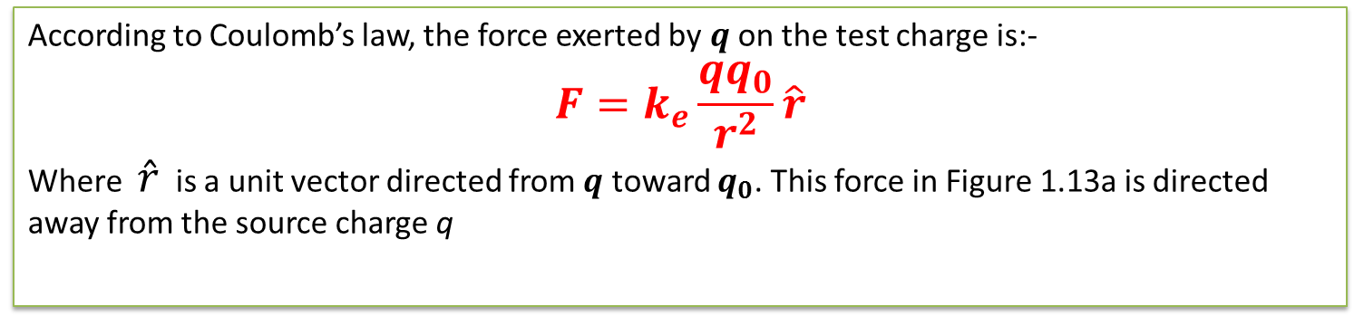

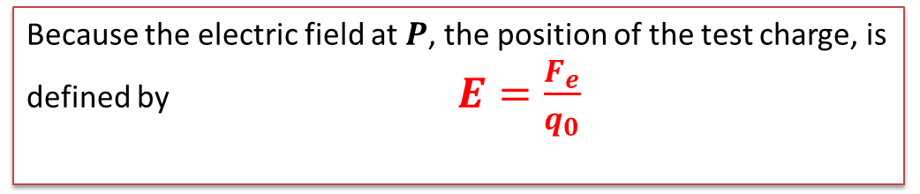
According to Coulomb’s law, the force exerted by $q$ on the test charge is:-
$$F=k_{e}\frac{qq_{0}}{r^{2}}\hat{r}$$
Where $\hat{r}$ is a unit vector directed from $q$ toward $q_{0}$. This force in Figure 1.13a is directed away from the source charge q
Because the electric field at $P$, the position of the test charge, is defined by $E=\frac{F_{e}}{q_{0}}$
$$\text{we} \text{find} \text{that} \text{at} P\text{, }\text{the} \text{electric} \text{field} \text{created} \text{by} q \text{is}$$
$E=k_{e}\frac{q}{r^{2}}\hat{r}$ ( 1.9)

Slide 4
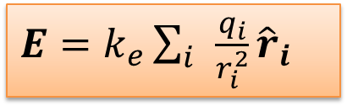
at any point $P$, the total electric field due to a group of source charges equals the vector sum of the electric fields of all the charges.
This superposition principle applied to fields follows directly from the superposition property of electric forces.
Thus, the electric field at point $P$ due to a group of source charges can be expressed as the vector sum
Electric field due to a finite number of point charges
$E=k_{e}\sum_{i }{\frac{q_{i}}{r_{i}^{2}}}{\hat{r}}_{i}$
Where $\acute{r_{\dot{i}}}$is the distance from the $i^{th}$ source charge q_{i} to the point P and $\acute{r_{\dot{i}}}$is a unit vector directed from $q_{i}$toward P.

Slide 5
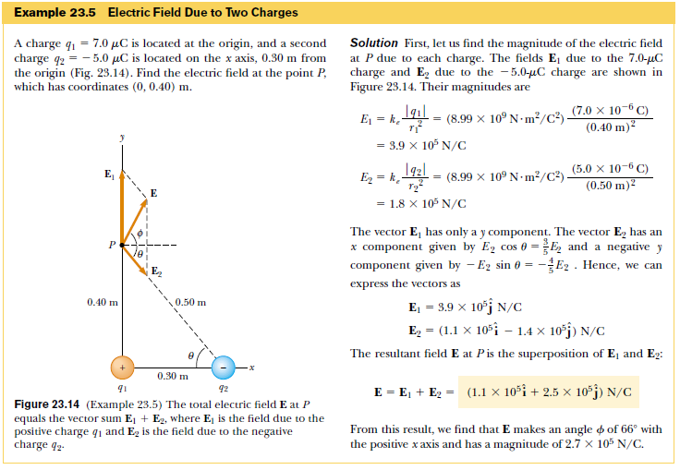

Slide 6
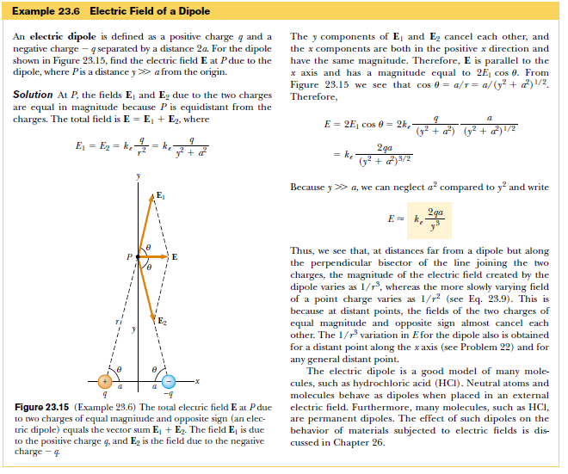

Slide 7
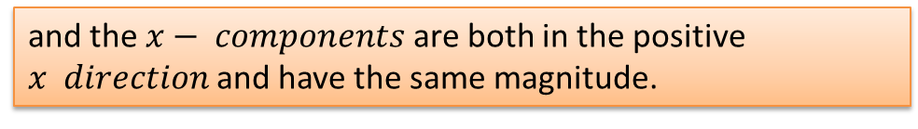
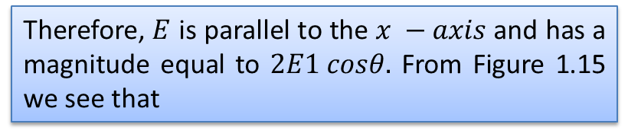

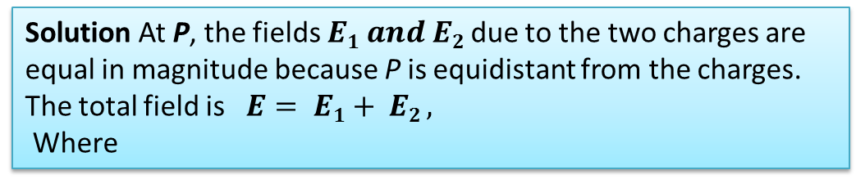
Example 1.6 Electric Field of a Dipole
a positive charge $+q$ and a negative charge $−q$ separated by a distance 2a. For the dipole shown in Figure 1.15.
An electric dipole is defined as
, find the electric field E at P due to the dipole,
where P is a distance $y ≫a$ from the origin.
Solution At P, the fields $E1 and E2$due to the two charges are equal in magnitude because P is equidistant from the charges. The total field is $E= E1+ E2 ,$
Where
The y components of $E_{1} and E_{2}$ cancel each other,
and the $x− components$are both in the positive $x direction$and have the same magnitude.
Therefore, $E$ is parallel to the $x −axis$and has a magnitude equal to $2E1 cosθ.$ From Figure 1.15 we see that
Figure 1.15 (Example 1.6) The total electric field E at P due to two charges of equal magnitude and opposite sign (an electric dipole) equals the vector sum E1 +E2. The field E1 is due to the positive charge q, and E2 is the field due to the negative charge -q.
$$cosθ=\frac{a}{r}=\frac{a}{{(y^{2}+x^{2})}^{1/2}}$$
Because $y ≫ a$, we can neglect $a^{2}$ compared to $y^{2}$ and write$E=k_{e}\frac{2qa}{y^{3}}$

Slide 8
H.W/ What is the magnitude of a point charge that would create an electric field of 1.00 N/C at points 1.00 m away?
H.W/ Two particles with equal charge magnitudes 2.0 x 10⁻⁷ C but opposite signs are held 15 cm apart. What are the magnitude and direction of the Electric Field E at the point midway between the charges?

Slide 9
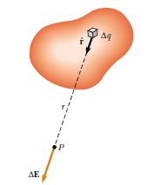
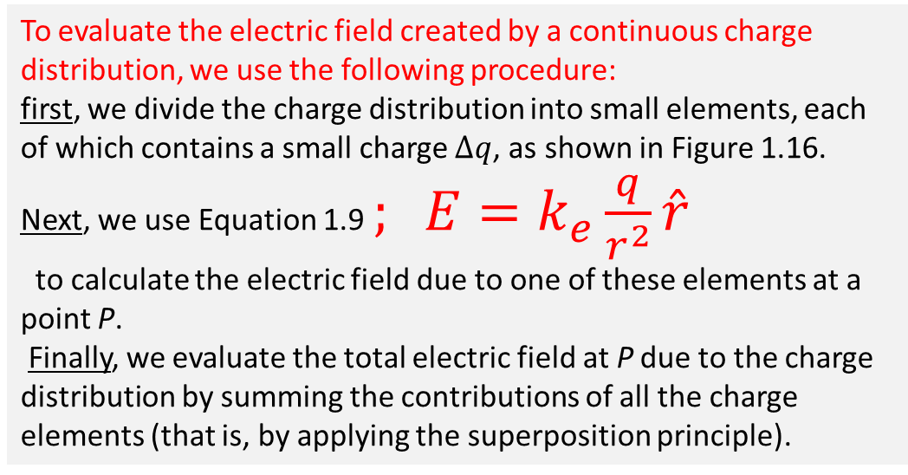
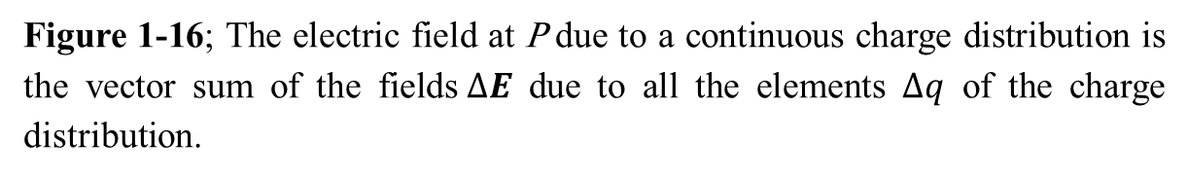
1.5 Electric Field of a Continuous Charge Distribution
Very often the distances between charges in a group of charges are much smaller than the distance from the group to some point of interest (for example, a point where the electric field is to be calculated). In such situations, the system of charges can be modeled as continuous.
That is, the system of closely spaced charges is equivalent to a total charge that is continuously distributed along some line, over some surface, or throughout some volume.
To evaluate the electric field created by a continuous charge distribution, we use the following procedure:
first, we divide the charge distribution into small elements, each of which contains a small charge $∆q$, as shown in Figure 1.16.
Next, we use Equation 1.9 $; E=k_{e}\frac{q}{r^{2}}\hat{r}$
to calculate the electric field due to one of these elements at a point P.
Finally, we evaluate the total electric field at P due to the charge distribution by summing the contributions of all the charge elements (that is, by applying the superposition principle).
Figure 1-16; The electric field at P due to a continuous charge distribution is the vector sum of the fields$∆E$ due to all the elements $∆q$ of the charge distribution.

Slide 10
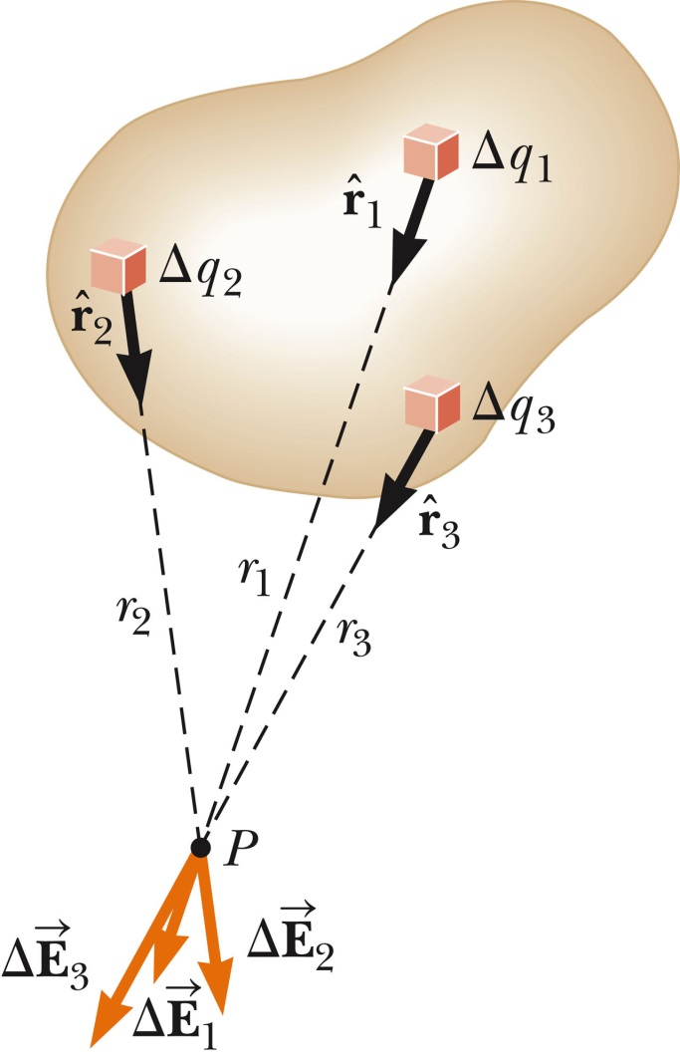
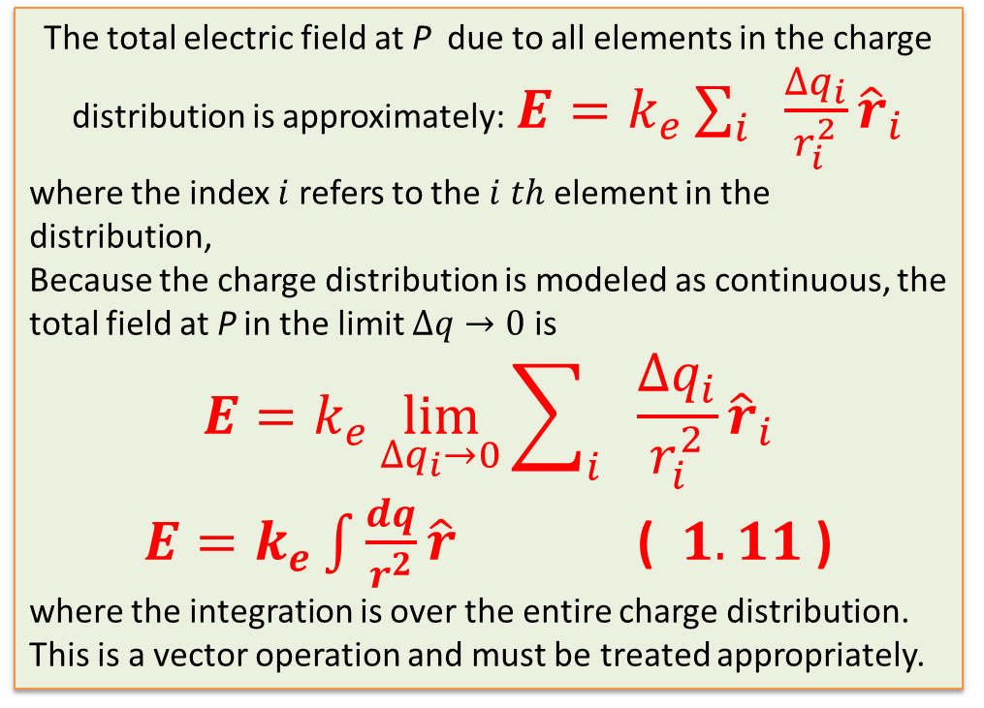
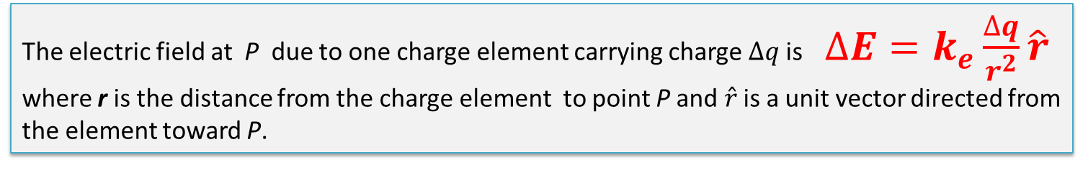
The electric field at P due to one charge element carrying charge $∆q$is $∆E=k_{e}\frac{∆q}{r^{2}}\hat{r}$
where r is the distance from the charge element to point P and$\hat{r}$ is a unit vector directed from the element toward P.
The total electric field at P due to all elements in the charge distribution is approximately: $E=k_{e}\sum_{i}{ \frac{∆q_{i}}{r_{i}^{2}}{\hat{r}}_{i}}$
where the index $i$refers to the $i th$ element in the distribution,
Because the charge distribution is modeled as continuous, the total field at P in the limit $∆q→0$ is
$$E=k_{e}\lim_{∆q_{i}→0}{\sum_{i}{ \frac{∆q_{i}}{r_{i}^{2}}{\hat{r}}_{i}}}$$
$E=k_{e}\int{\frac{dq}{r^{2}}\hat{r}}$ ( $1.11$ )
where the integration is over the entire charge distribution. This is a vector operation and must be treated appropriately.

Slide 11
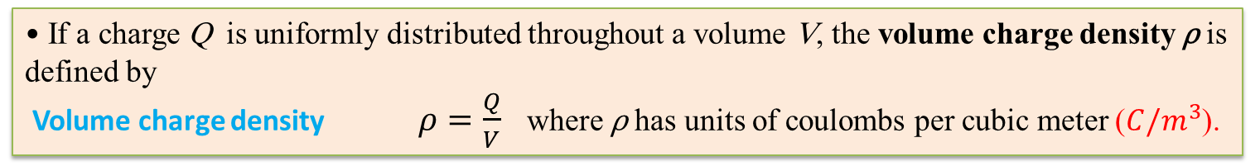
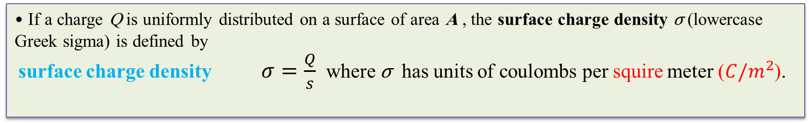
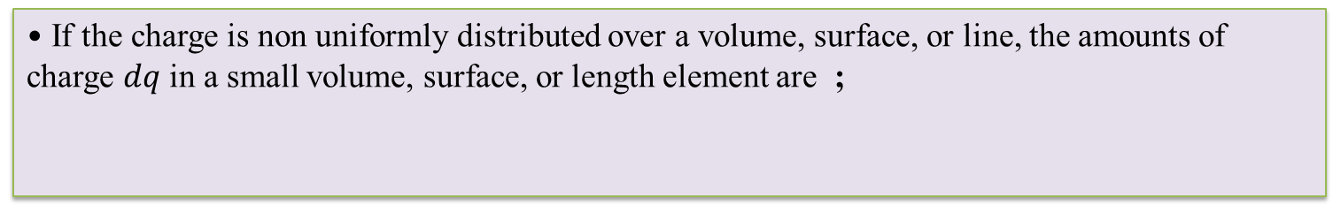
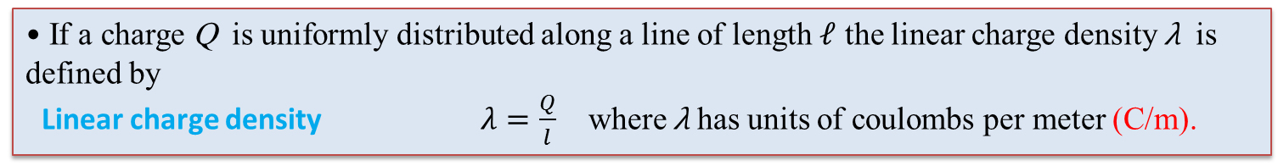
We illustrate this type of calculation with several examples, in which we assume the charge is uniformly distributed on a line, on a surface, or throughout a volume.
When performing such calculations, it is convenient to use the concept of a charge density along with the following notations:
• If a charge Q is uniformly distributed throughout a volume V, the volume charge density ρ is defined by
Volume charge density $ρ=\frac{Q}{V}$ where ρ has units of coulombs per cubic meter ($C/m^{3}$).
• If a charge Q is uniformly distributed on a surface of area A , the surface charge density σ (lowercase Greek sigma) is defined by
surface charge density $σ=\frac{Q}{s}$ where σ has units of coulombs per squire meter ($C/m^{2}$).
• If a charge Q is uniformly distributed along a line of length $𝓁$ the linear charge density λ is defined by
Linear charge density $λ=\frac{Q}{l}$ where λ has units of coulombs per meter (C/m).
• If the charge is non uniformly distributed over a volume, surface, or line, the amounts of charge $dq$ in a small volume, surface, or length element are ;

Slide 12
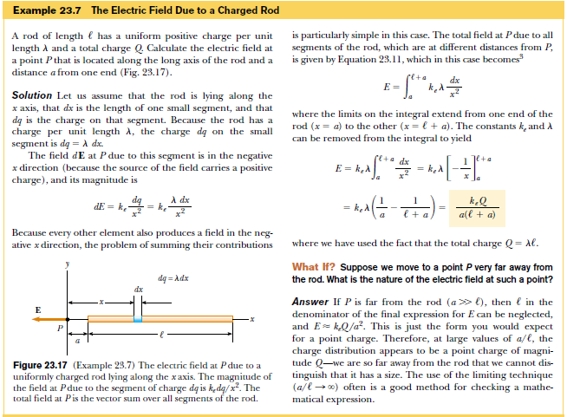
https://www.youtube.com/watch?v=xszkaIJAwy4

